Slide 1
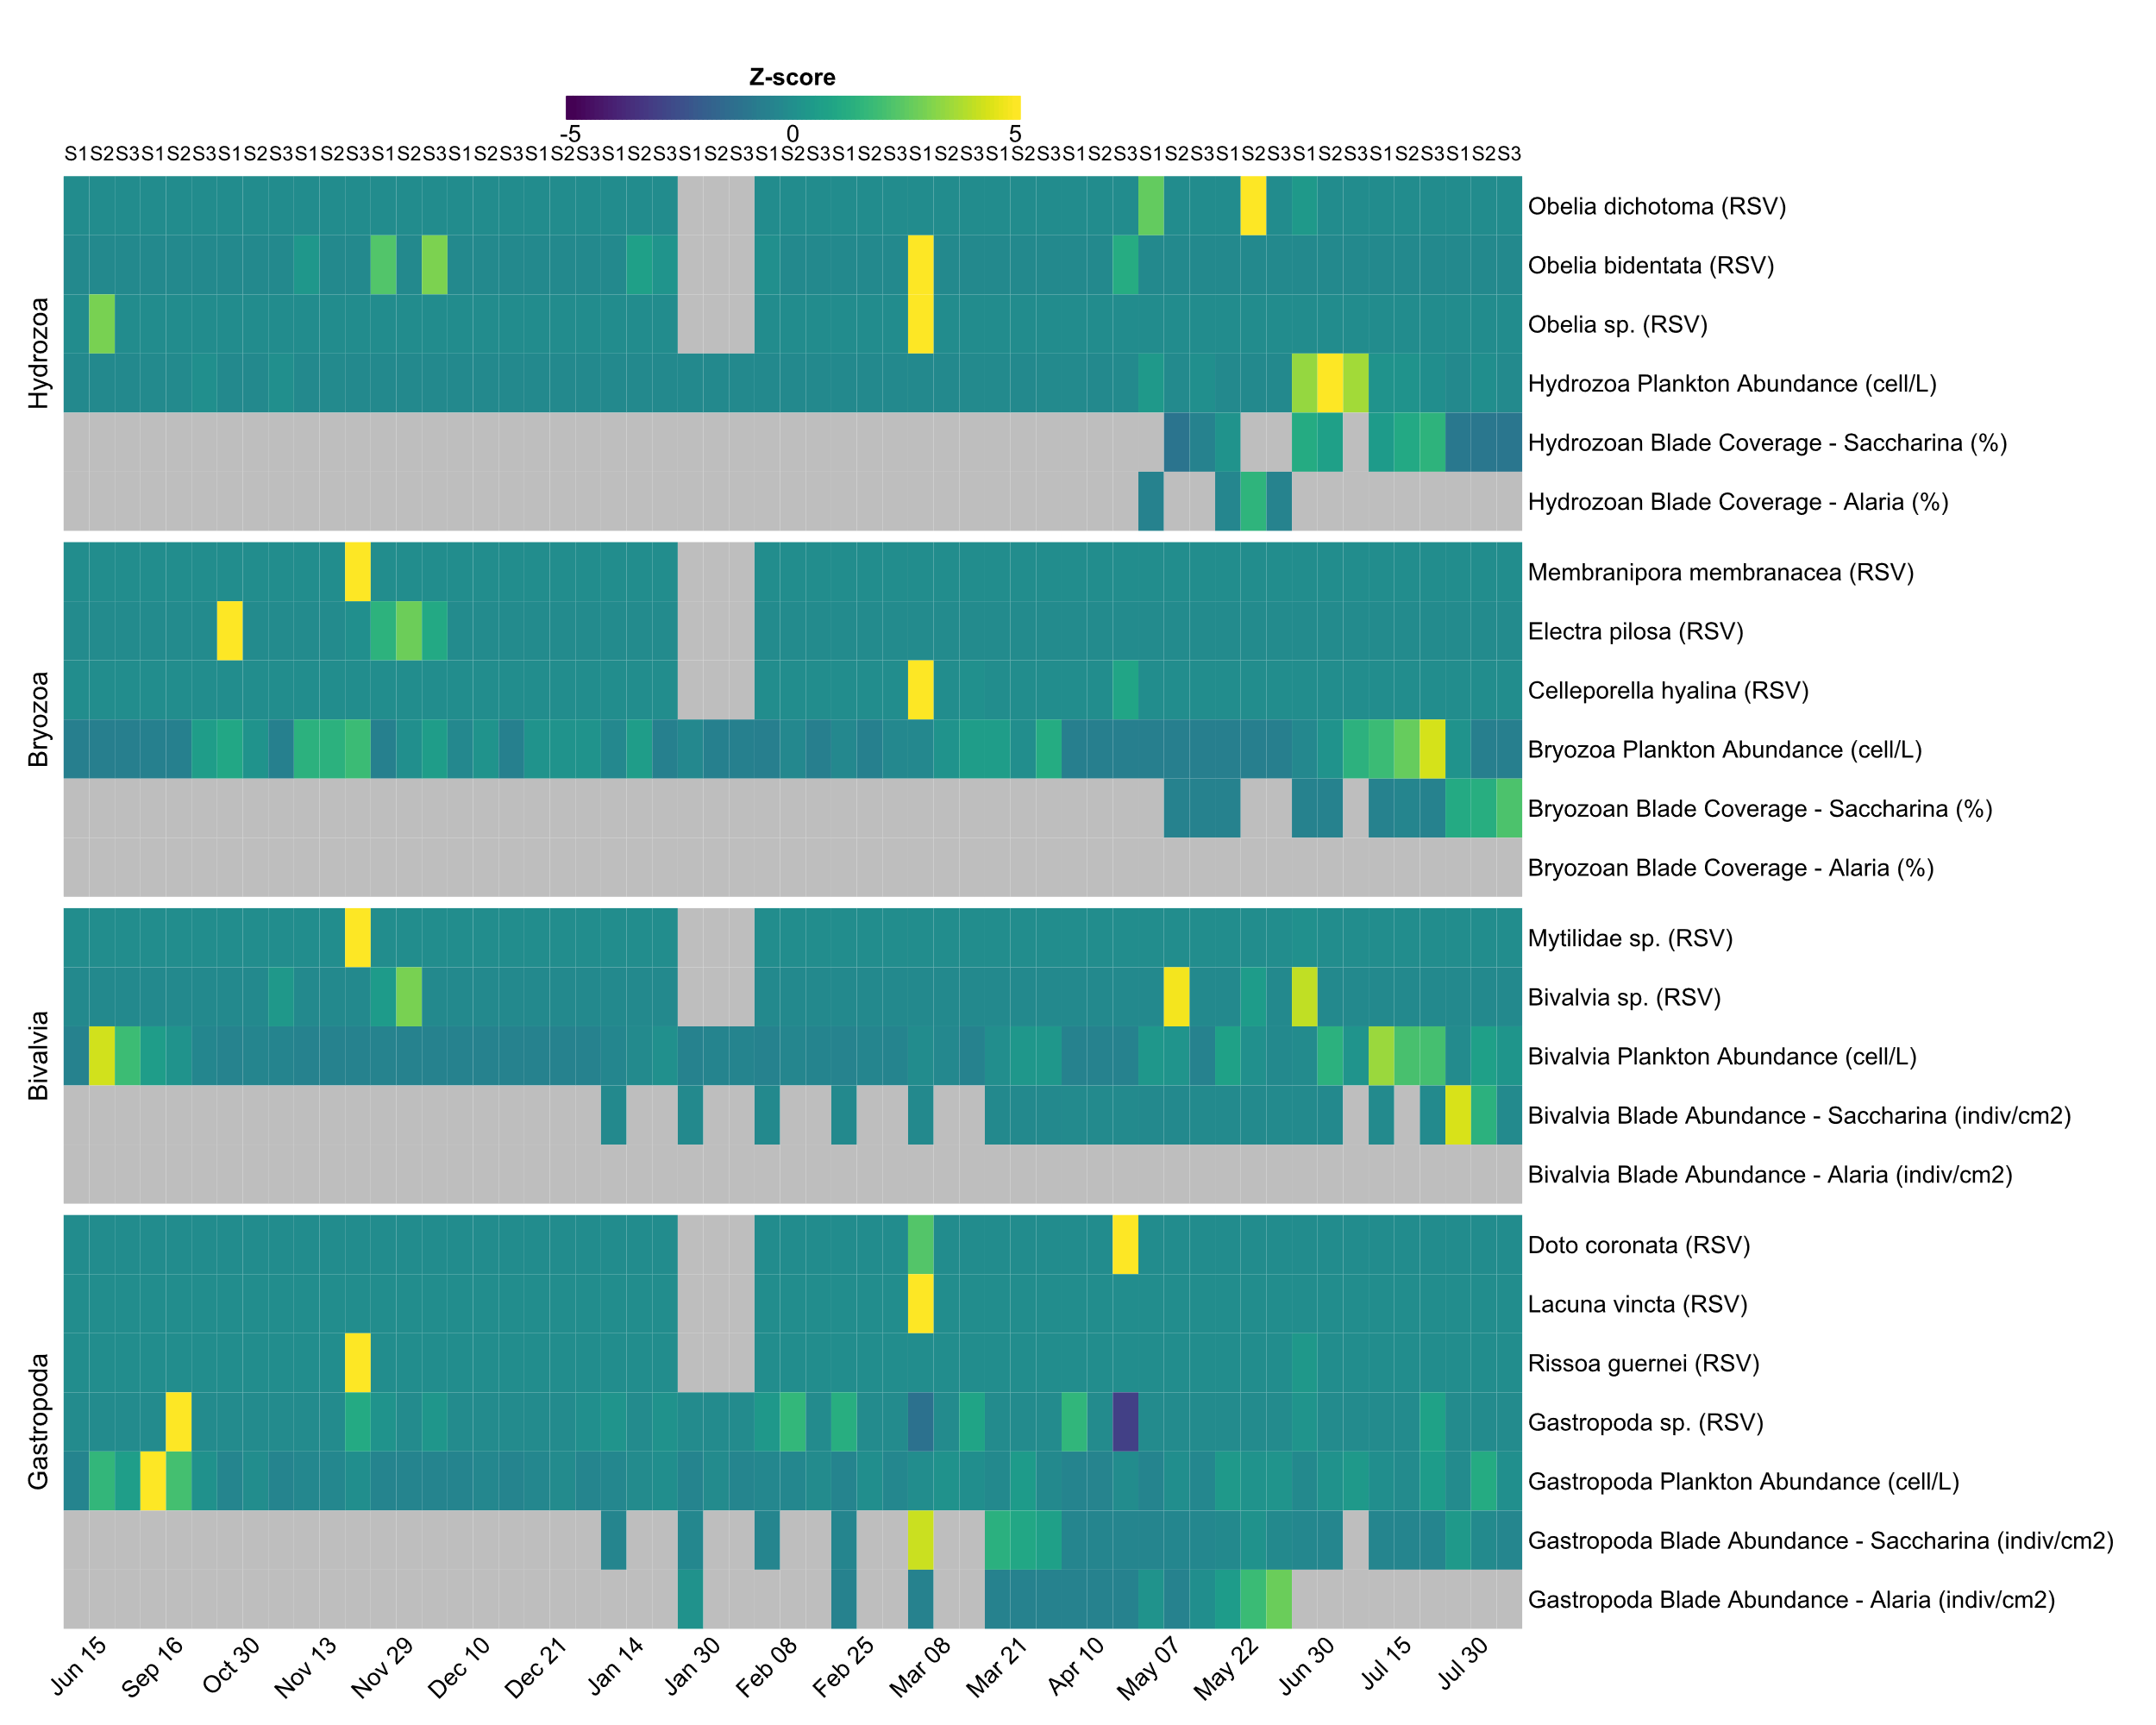
Epibiont eDNA, plankton counts, and blade attachment show some congruence between methods. Taxa like Hydrozoa and Bivalvia show agreement across methods. eDNA signals often precede or coincide with peaks in plankton and later blade abundance, supporting a link from detection in the water column through to settlement. In some cases (e.g., Gastropoda), this pattern is less consistent, possibly due to life history traits or detection limits.
2021
2022
Notes:
Objective Q – does Otu agree with plankton counts with respect to species ID but also temporal dynamics of the abundances –
Whether, what we see, either in the eDNA and/or plankton does it translate into epibionts on the blade later in time
We just want to see that these things are being identified – congruence amongst methods –
Rope scrub – rope samples of specific farm – pabay – is species identified – rope was source of infestation – presence / absence rope
Plankton eDNA (RSV) = unit
Fix NAs fron zeroes
Bivlavles, mussels, scallops, oysters: combine coverage with out taxa table
Check RSV values are true as some appear more than once in table – more resolution
Instead bryozoan coverage it was electra Pilosa or m. memraranaceea
Combine pecten
Have sepearates for each method – not normalised -

Slide 2
Dominant Plankton Taxa by Month - Pabay
Top taxa per month (April–July)
15
Taxon
balanoida
bivalvia
10
brachiopoda
Abundance (log10)
copepoda
gastropoda
hydrozoa
malacostraca
5
polychaeta
0
June 21
April 22
May 22
June 22
July 22
Date (month-year)
Notes:
Remove gridlines
Add bryozoan – add mean and error bars – stacked columns -

Slide 3
Blade Coverage by Taxon with Standard Error - Pabay
Mean ± SE % cover (April–July)
Alaria
Saccharina
50
40
30
Taxon
Blade Coverage (%)
Bryozoans
Ectocarpus
20
Hydrozoans
10
0
May 22
May 22
Jun 22
Jul 22
Month
Notes:
Add in gatro/amphipods/bivlaves

Slide 4
Blade Abundance by Taxon with Standard Error - Pabay
Mean ± SE (ind/cm², April–July)
Alaria
Saccharina
2.0
1.5
Taxon
Amphipoda
Blade Abundance (ind/cm²)
Bivalvia
1.0
Copepoda
Polychaete
0.5
0.0
Apr 22
May 22
Apr 22
May 22
Jun 22
Jul 22
Month

