Slide 1


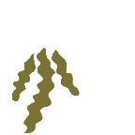

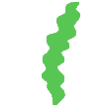

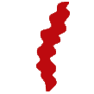
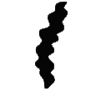
Enrichment phase
NO₃
+ seawater
PO₄
+ seawater
Control
= seawater
Young sugar kelp
Old sugar kelp
Experimental phase
High turbulence
Low turbulence

