Slide 1
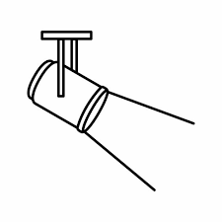


Light source
Seawater inlet
Seawater output
x 5
x 5
x 5
x 5
x 5
x 5
No water agitation
Replicate seaweed unit within coloured / labelled tray to be identifiable during tank rotations
Agitated water
with turbulence generators
Responses:
after 1 week exposure measure biofilm within variable nutrient treatments
Biofouling coverage / diversity / location
Kelp growth
+NO₃
+PO₄
+PO₄
+NO₃
Control
Nutrient Spiking: Seaweed + stones dipped for x# hours

