Slide 1
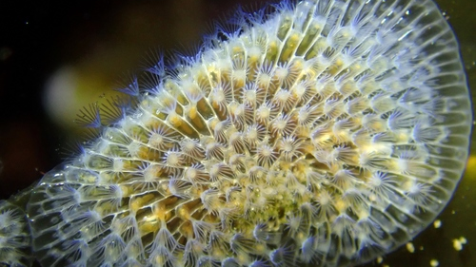
Membranipora membranacea; repeated repeats, repeatedly.

Slide 2
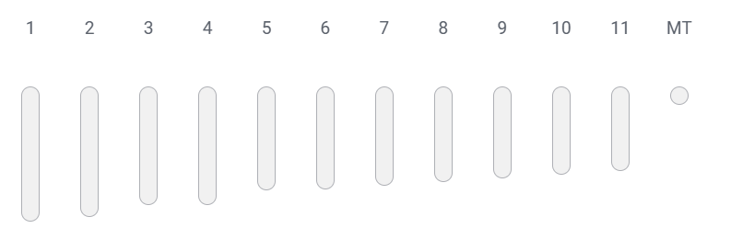
Published M. membranacea genome assembly
Assembly : GCA_914767715.1
Size : 339.4 Mb
Level : Chromosome
Repeats : ?
Ref: : Bishop et al. (2024)
Chromosomes
https://pmc.ncbi.nlm.nih.gov/articles/PMC10290214/

Slide 3
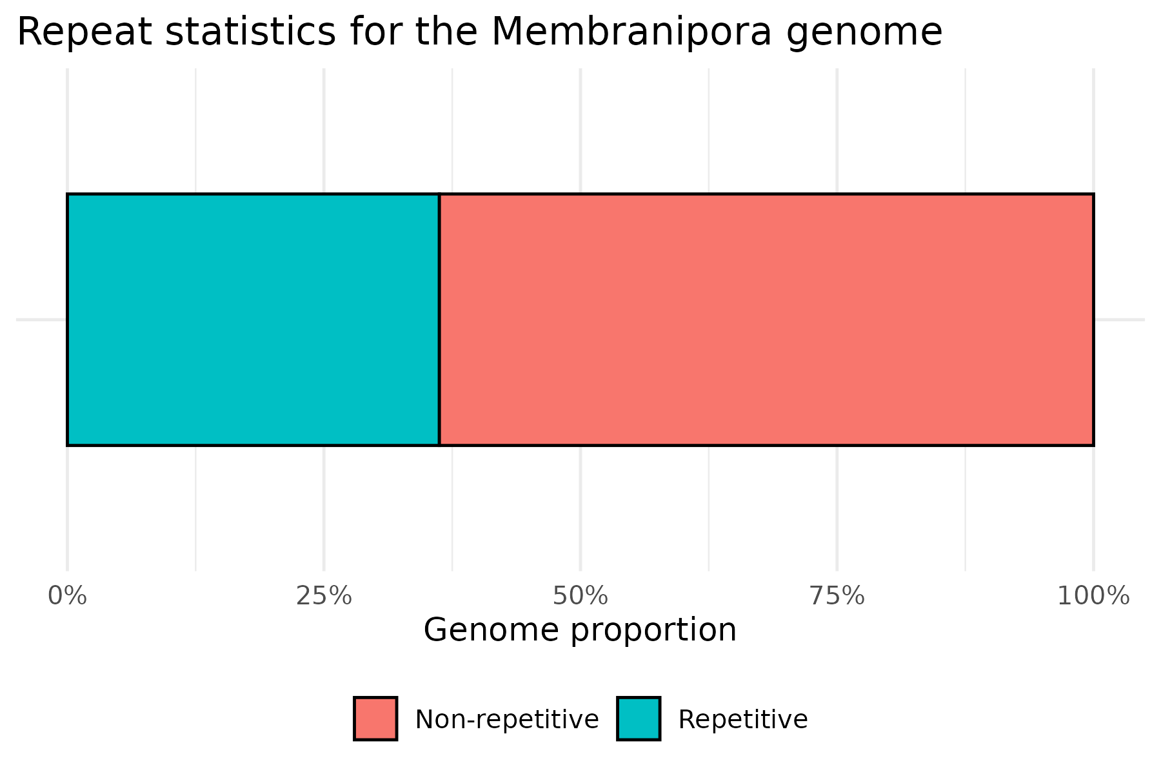
Repeat statistics for M. membranacea
Packages used (Obelix) :
De novo repeats search: RepeatModeler (Flynn et al.(2020) PNAS, 117(17), 9451-9457) .
Repeats annotation: RepeatMasker (Chen (2004) Cur Protoc. Bioinf., 5(1), 4-10.) + Pfam database (Finn et al. (2014) NAR, 42(D1), D222-D230) + RECON (Bao, Eddy (2002) Genome Res, 12(8), 1269-1276), RepeatScout (Price et al. (2005) Bioinf., 21(suppl_1), i351-i358.)
Search: RMBlast
Total number of repeats : 423,110. 38.13% of genome.

Slide 4
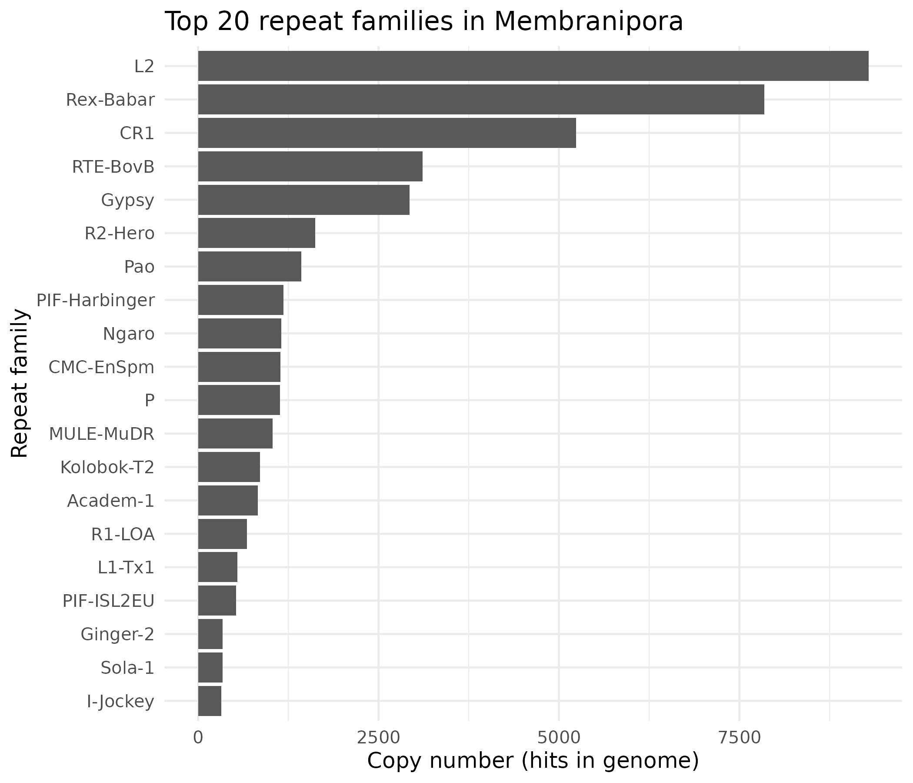
rank | family_id | copies
1 | L2 | 9291
2 | Rex-Babar | 7845
3 | CR1 | 5235
4 | RTE-BovB | 3110
5 | Gypsy | 2931
6 | R2-Hero | 1624
7 | Pao | 1427
8 | PIF-Harbinger | 1180
9 | Ngaro | 1151
10 | CMC-EnSpm | 1142
11 | P | 1132
12 | MULE-MuDR | 1031
13 | Kolobok-T2 | 857
14 | Academ-1 | 826
15 | R1-LOA | 679
16 | L1-Tx1 | 542
17 | PIF-ISL2EU | 529
18 | Ginger-2 | 342
19 | Sola-1 | 337
20 | I-Jockey | 324
Top 20 repeat families in Membranipora
Bars show the 20 most abundant repeat families ranked by copy number in the genome.
LINE/L2 and Rex-Babar families dominate, each with >7,000–9,000 copies, followed by CR1 and RTE-BovB.
Several other LINE and DNA transposon families (e.g. Gypsy, R2-Hero, PIF-Harbinger, MULE-MuDR) also reach high copy numbers.
These highly amplified families provide prime candidates for qPCR marker design, as primers targeting them should encounter many genomic copies per cell, boosting assay sensitivity.
Notes:
Copy number: is the repeated regions

Slide 5
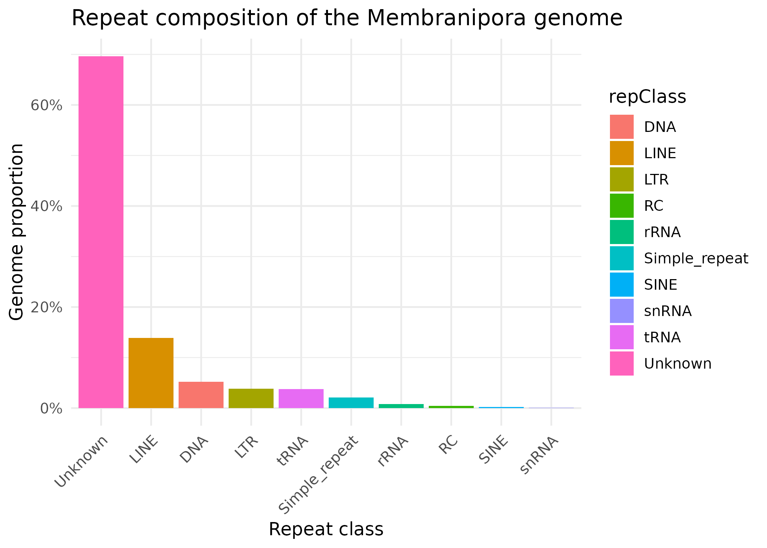
Breakdown of repetitive sequence in the Membranipora membranacea genome by repeat class. DNA transposons / LINEs / LTRs (etc.) make up the bulk of the masked sequence, with additional contributions from simple and low-complexity repeats. These classes form the primary search space for high-copy, species-specific marker candidates
Notes:
LINE : transposons
Functionality of repeat is dependant on their class: Class types will have very specific repeat characterstic

Slide 6
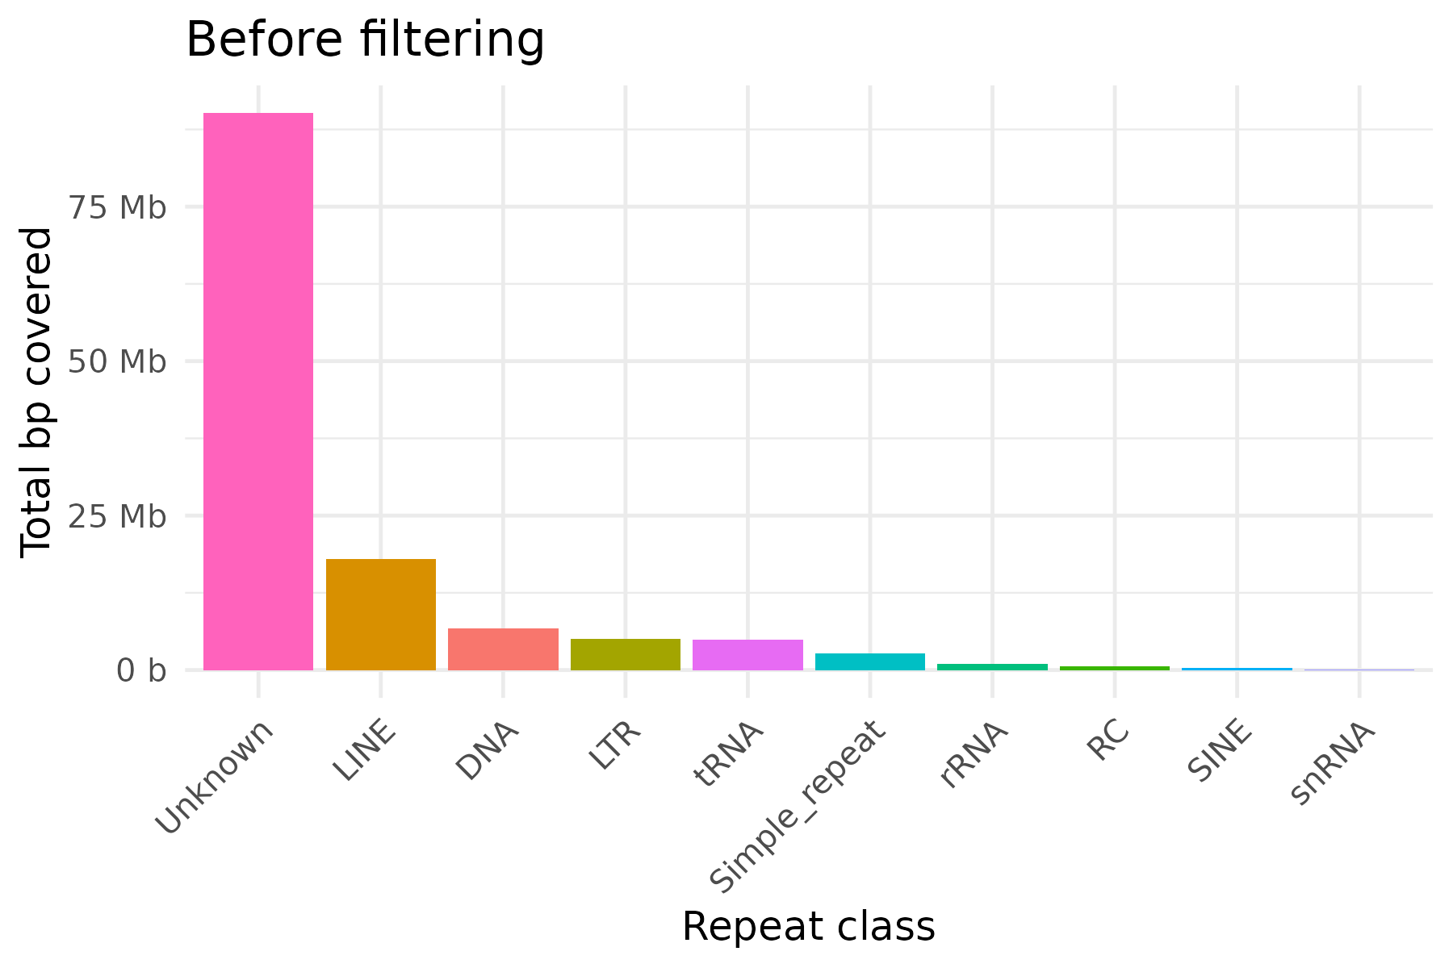
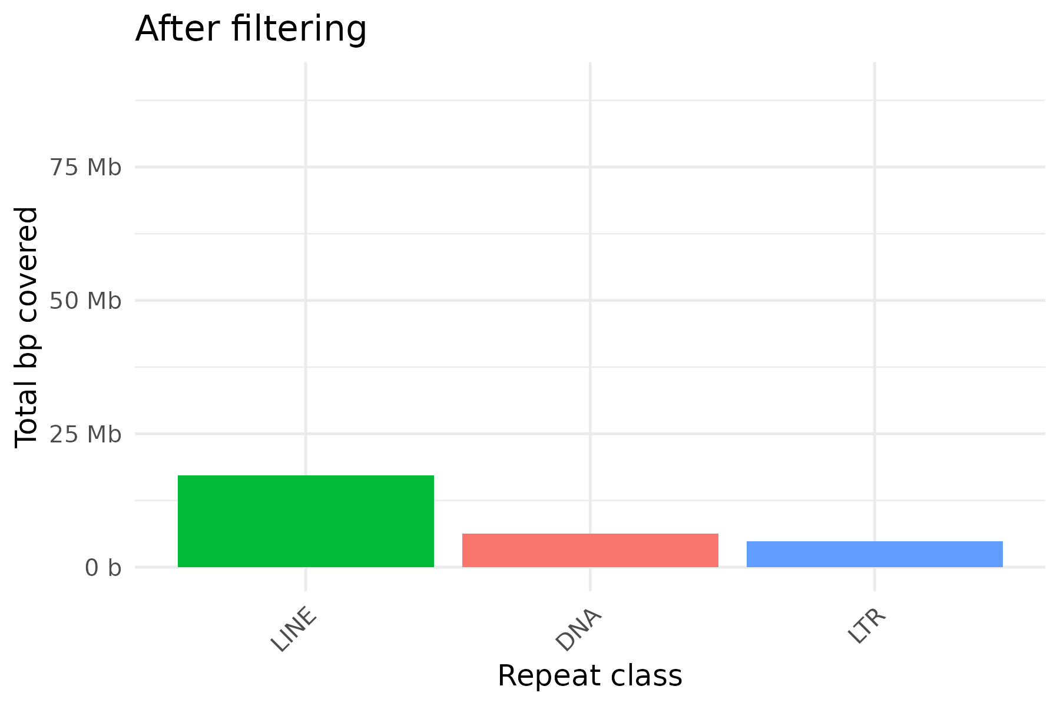
Barplots show repeat abundance by class before and after filtering.
Before filtering, unclassified and simple/low-complexity repeats dominate the masked portion of the genome.
After removing these and retaining only DNA transposons, LINEs and LTR elements ≥100 bp obtains a cleaner set of ‘good’ repeats suitable as candidates for high-copy qPCR marker development.

Slide 7
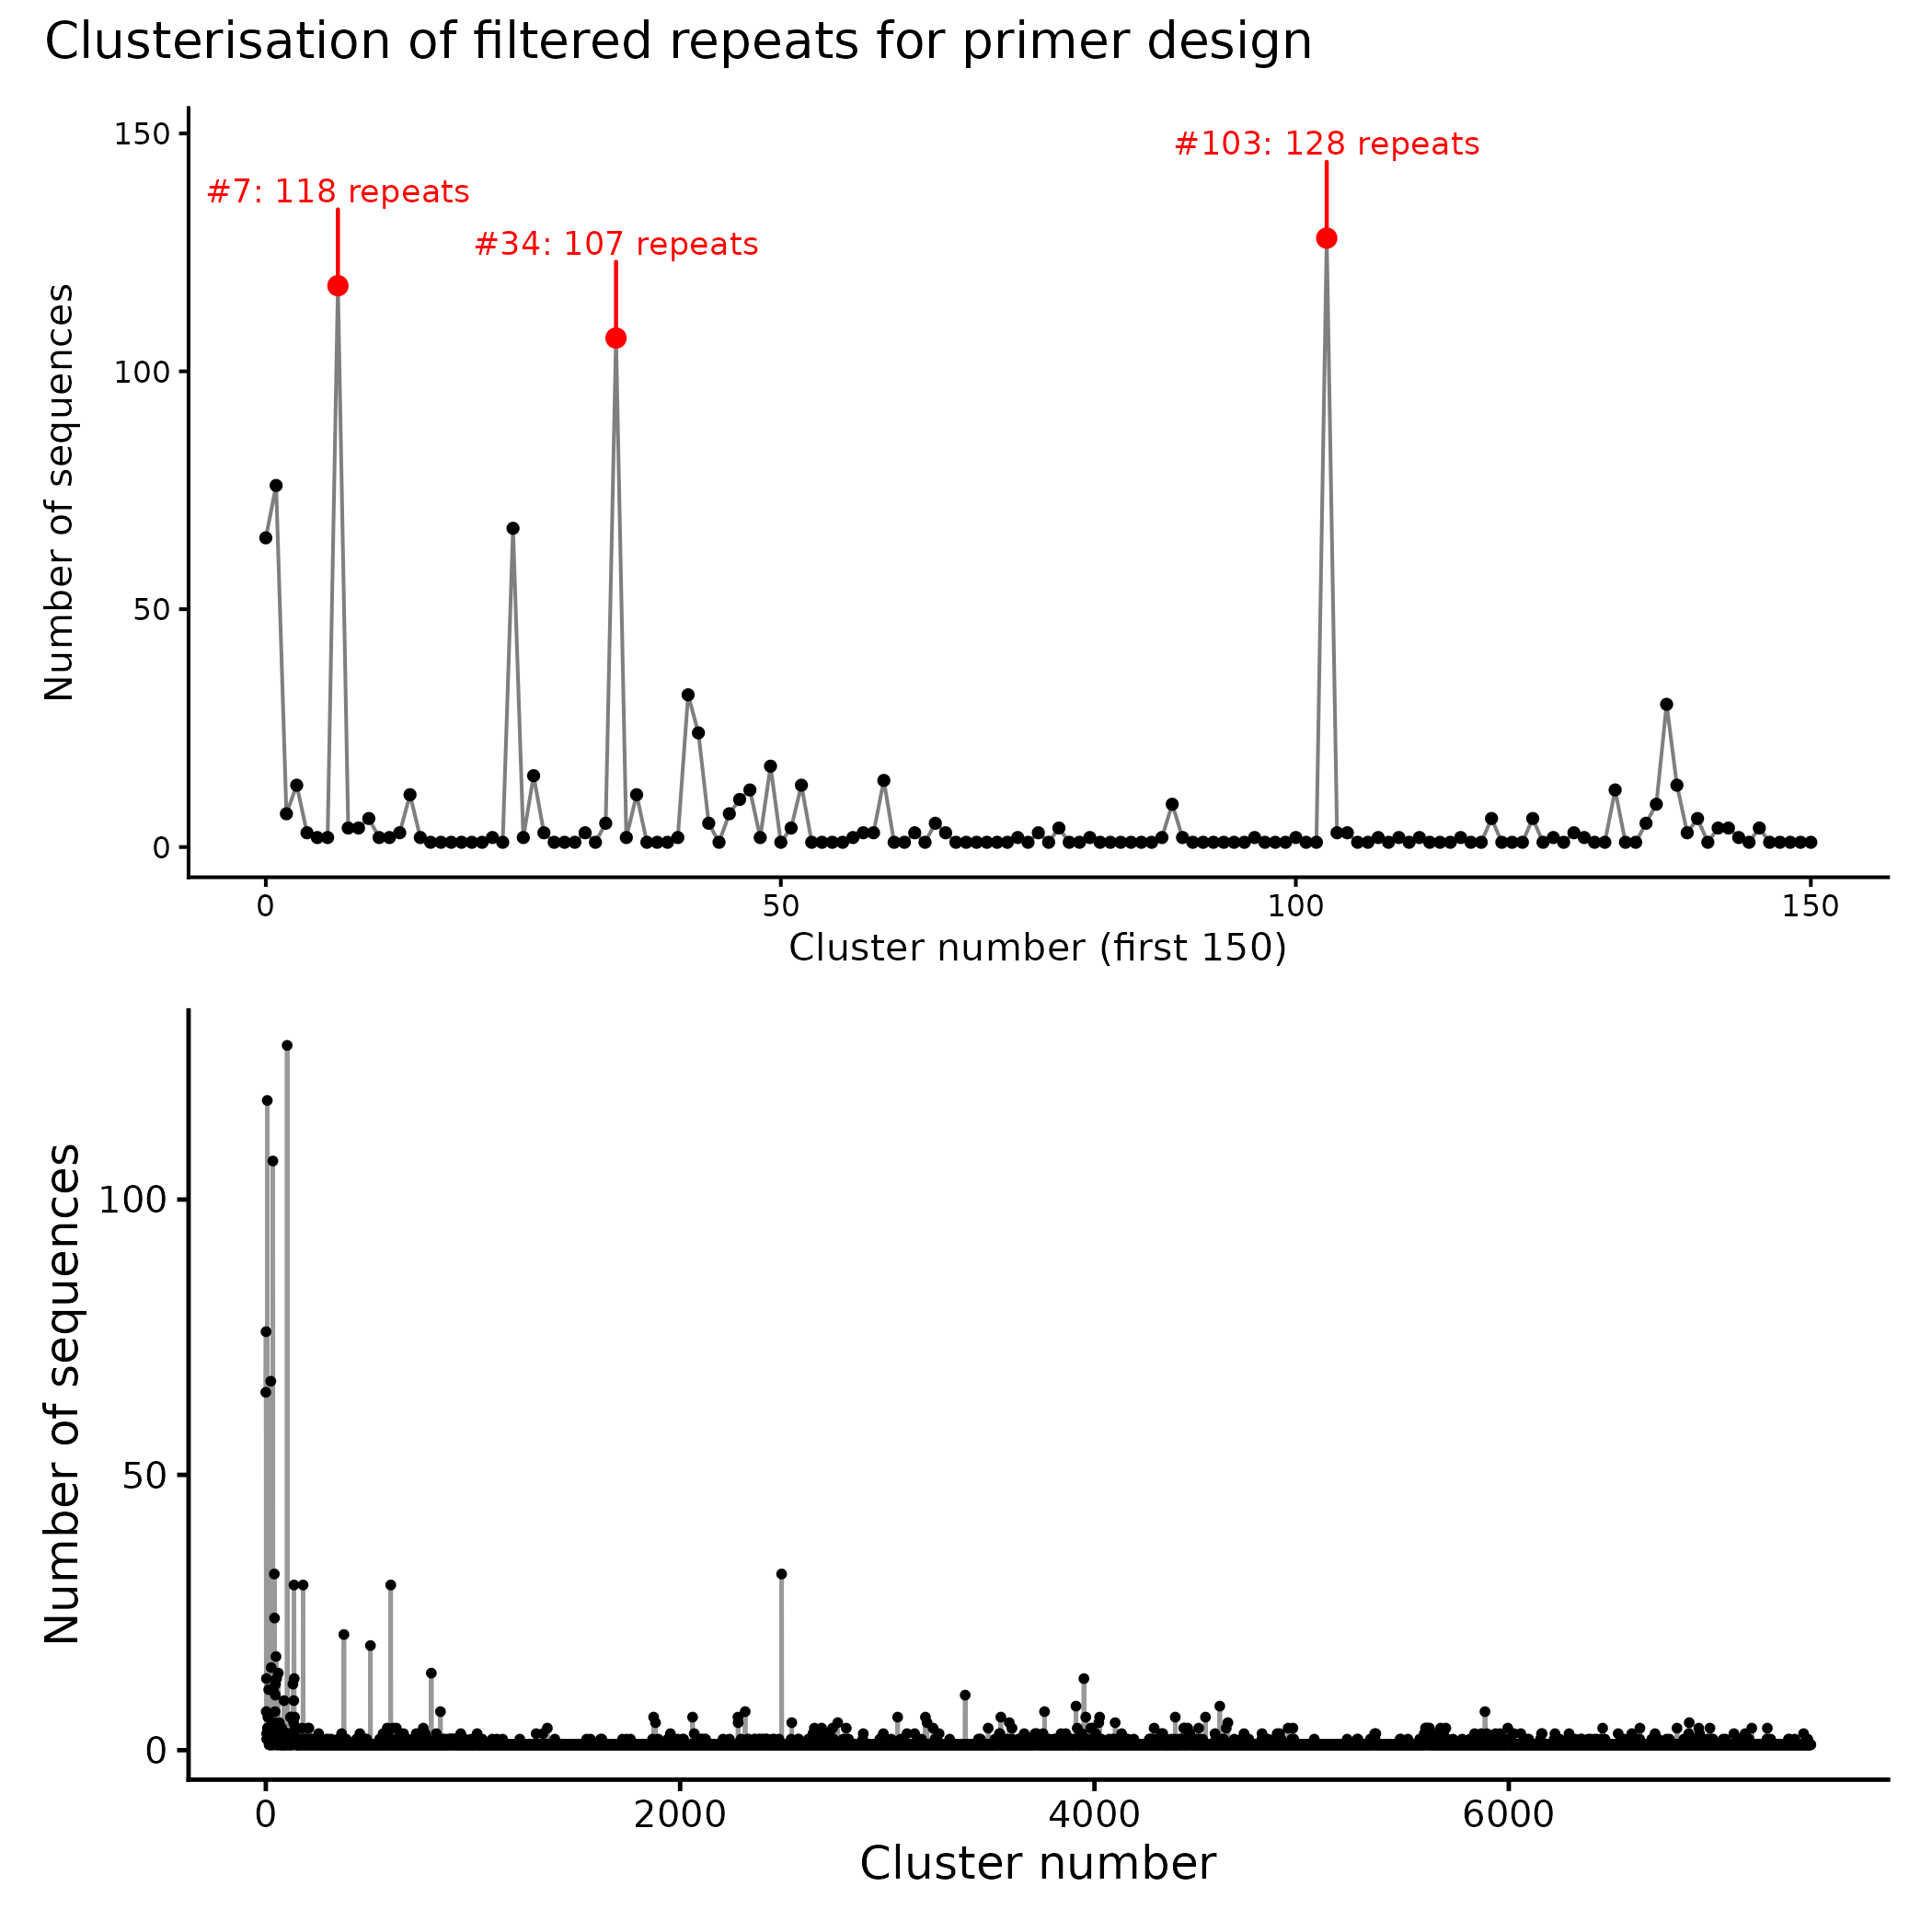
CD-HIT takes messy, redundant repeat sequences and groups them into non-overlapping clusters of highly similar sequences (>85%), giving compact set of representative repeat families with copy numbers from which to pick high-copy families for primer design.
CD-HIT clustering of filtered repeats reveals thousands of small clusters and only a few very large ones.
Three clusters (#103, 7#, #34) each contain >100 similar repeats, indicating highly expanded families that are promising (but not automatically safe) targets for repeat-based qPCR marker development.
Notes:
Clusterisation of filtered repeats of Membranipora membranacea for primer design
Filtered RepeatMasker hits (low divergence, non-simple repeats) were clustered by sequence similarity using CD-HIT-EST.
The bottom panel shows the size of each cluster (number of repeats) across all clusters:
– Most clusters are small, containing only a few sequences.
– A few clusters are very large, with >100 repeat copies.
The top panel zooms into clusters 1–100 and labels the largest clusters, highlighting highly expanded repeat families.
The table lists the top repeat families by copy number; these large, low-divergence families are prime candidates for repeat-based qPCR assay development (subject to specificity checks).
Make a schematic of how CD HIT works

Slide 8
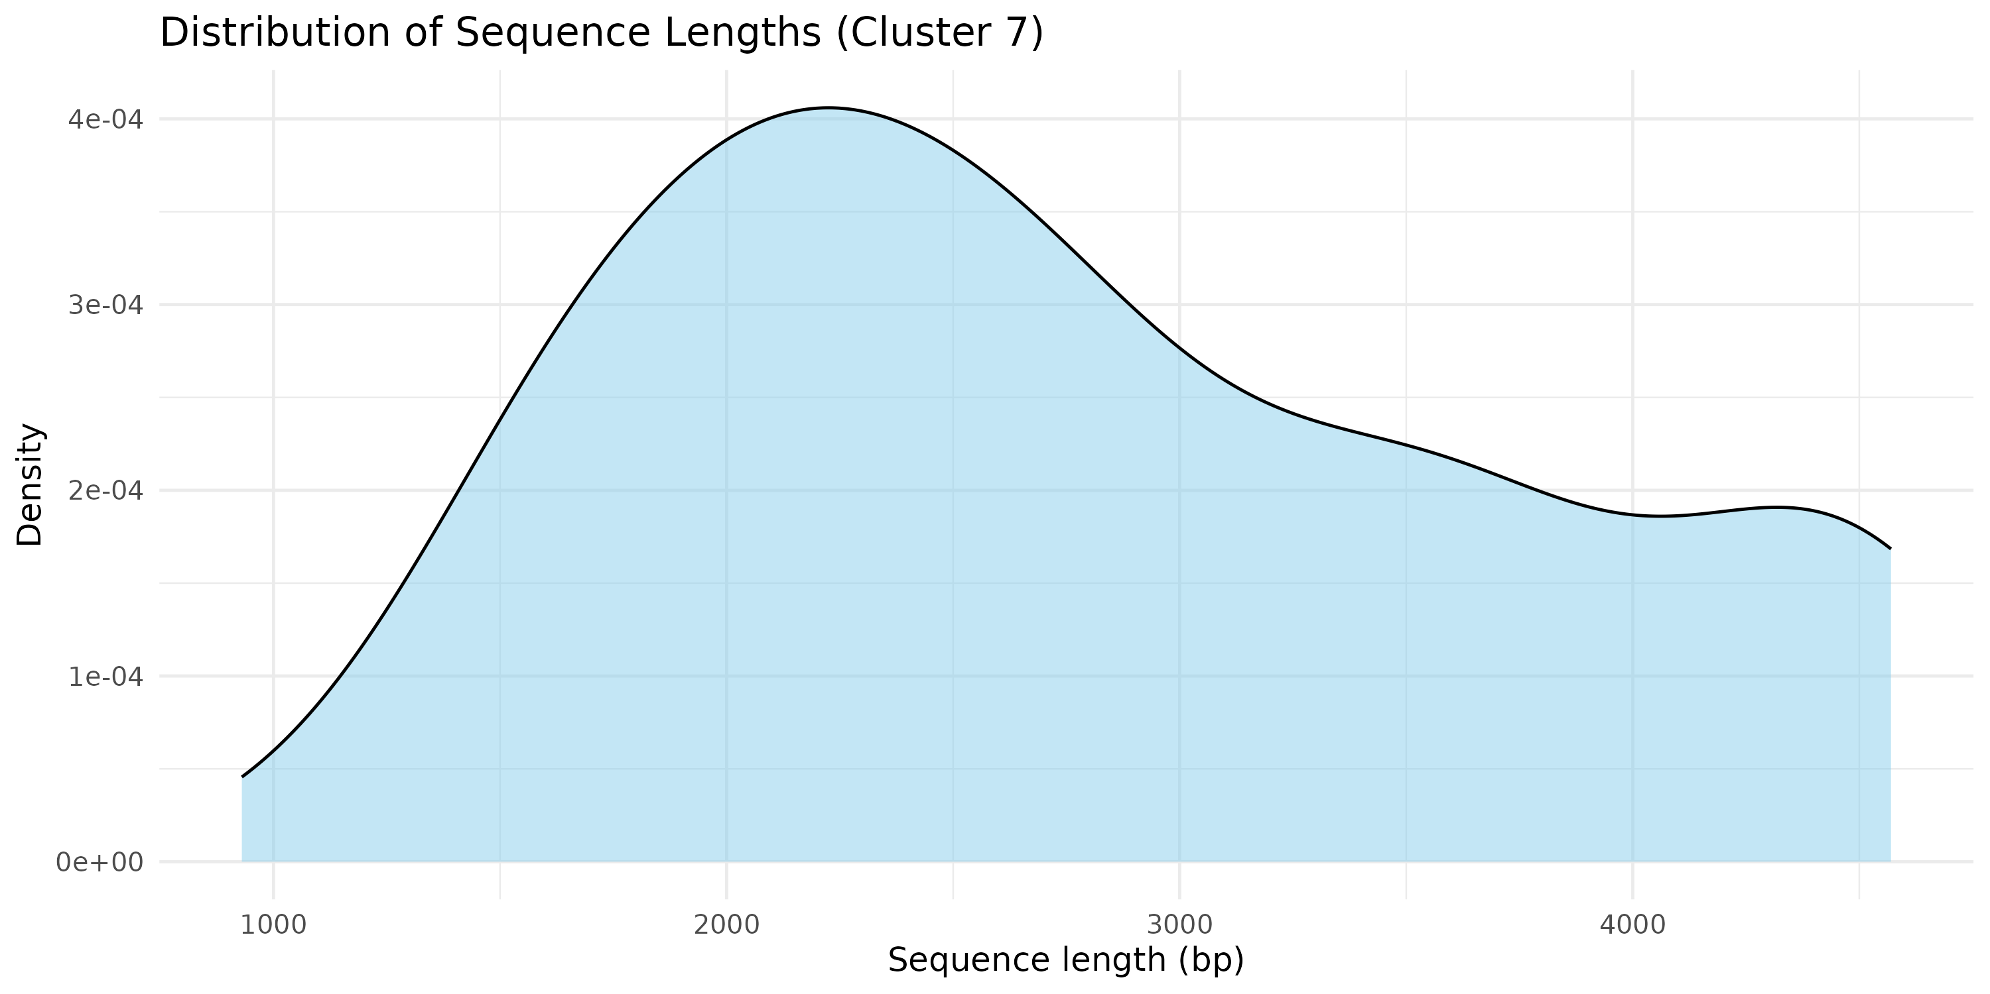
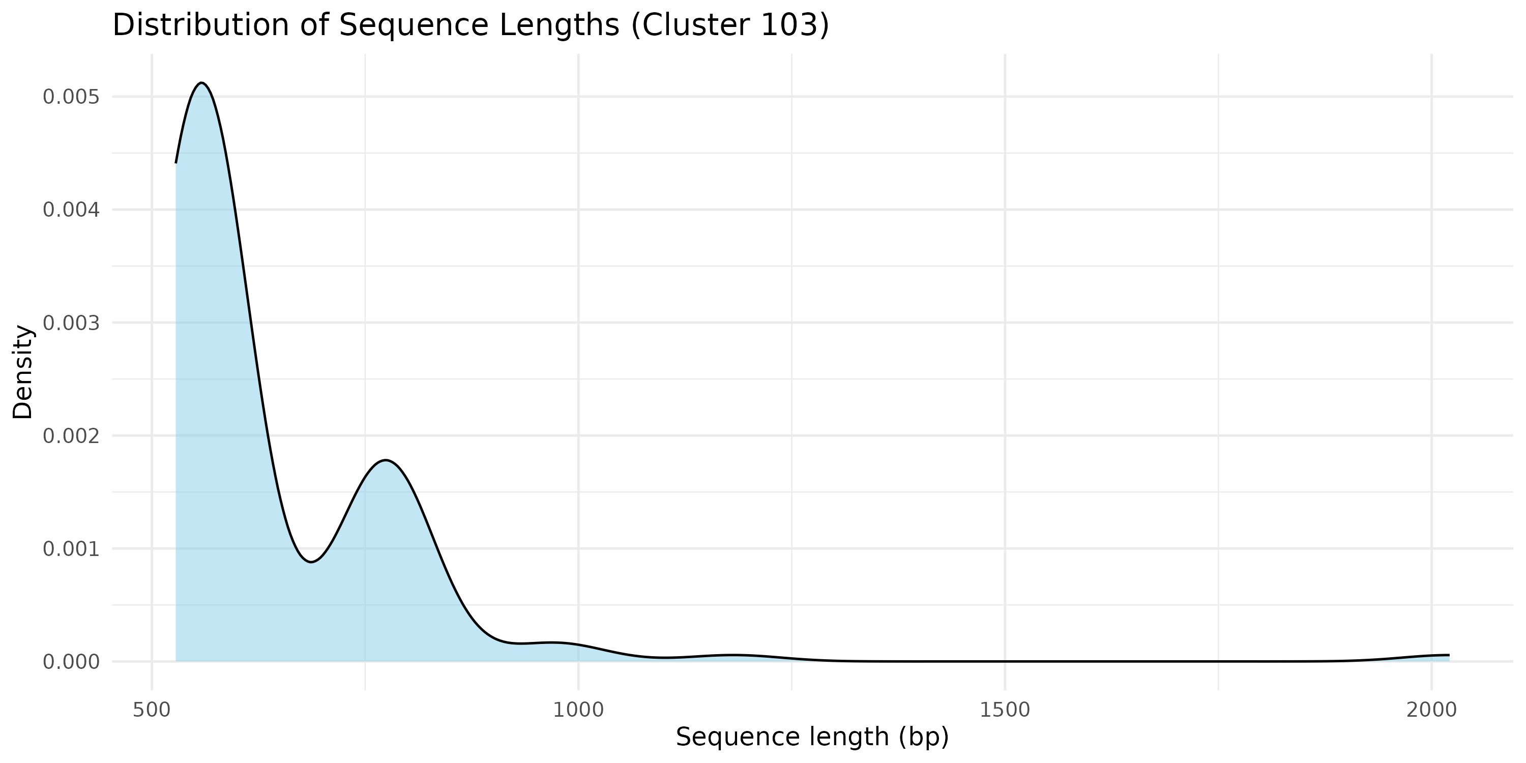
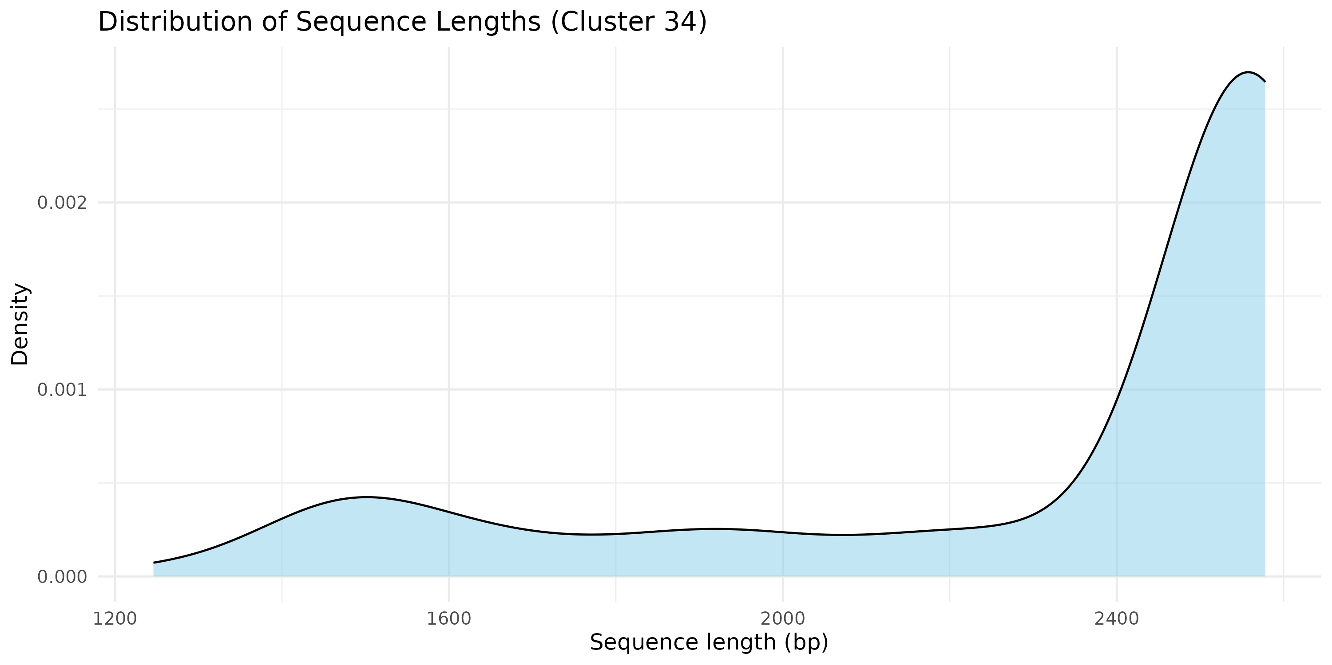
Clusterisation of filtered repeats of M. membranacea for primer design
Notes:
“Sequence length distributions for two large repeat clusters. Both clusters show tight length distributions around ~X–Y bp, indicating that the repeats (plus flanks) are consistently sized – an advantage for designing primers that amplify a well-defined product across all copies in each cluster.”

Slide 9
Primer design: DECIPHER (Wright et al. 2014, Environ. Microbiol. 16(5), 1354–1365), function DesignSignatures().
Parameters: 50 mM NaCl, 0.5 µM primer; product size 70–200 bp; primers designed on high-copy repeat clusters.
In silico PCR: NCBI Primer-BLAST (Ye et al. 2012, BMC Bioinformatics 13, 134).
Notes:
Following blast: All in silico PCR products correspond to M. membranacea repeat sequences (family86_cluster).
Note: pair Mm86_5 – additional hits to questionable loci (low-complexity region).
No off-target products were detected in other bryozoans or common sympatric taxa in the test database.

Slide 10
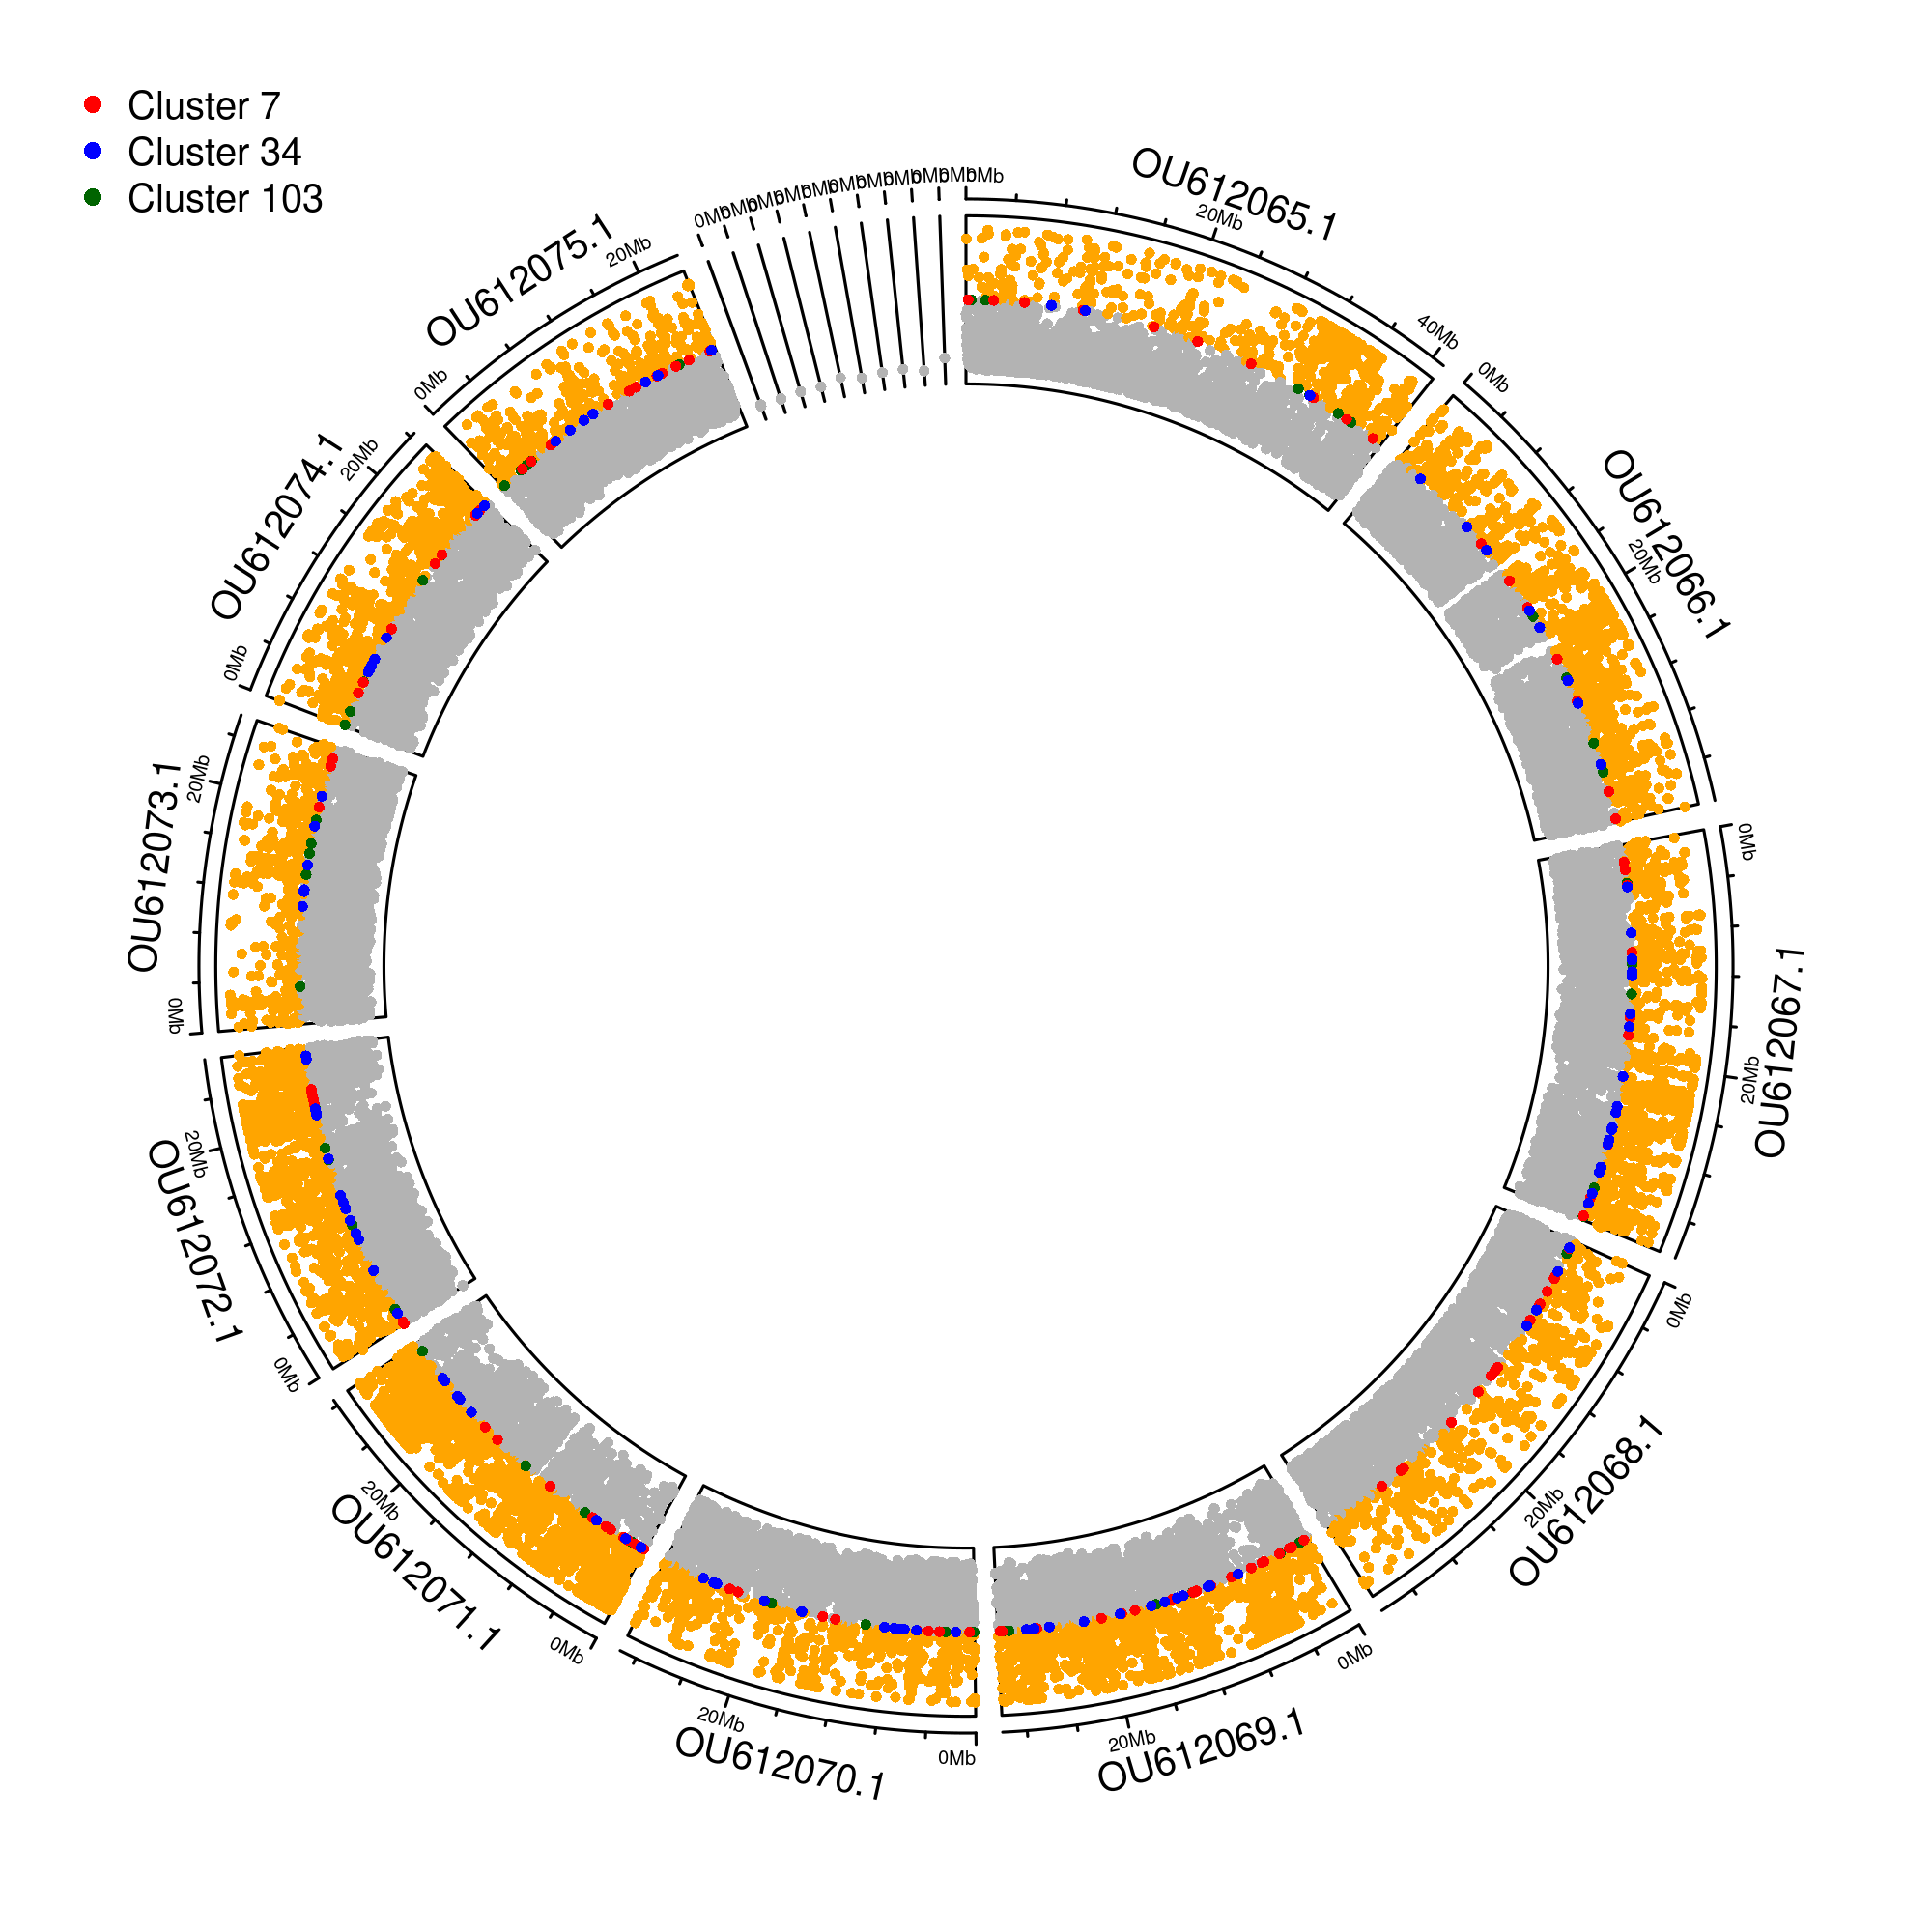
circos plot shows genome-wide repeat density in Membranipora and highlights the three CD-HIT repeat clusters used for primer design (verticality standardised), demonstrating that they are high-copy, widely distributed elements located in strongly repeat-rich regions of the genome.
Orange >50% repeats.
Orange regions indicate areas where more than 50% of the local sequence is repetitive – essentially repeat hotspots T.
reassuring, because many of our high-copy clusters and target families sit within these strongly repeat-rich regions
The genome is highly repeat-rich.
P
rimers are designed in the bits of the genome where repeats are densest - exactly what we want for a sensitive qPCR assay

