Slide 1

Group 1: Veera Supraja Koppisetty, Felix Ogbodu, Sindhura Surapaneni, Chuck Youngman, Albert Burroughs

Slide 2


We will combine two datasets to create a summary that shows all the movies in theatres and the streaming platforms
Project Summary

Slide 3
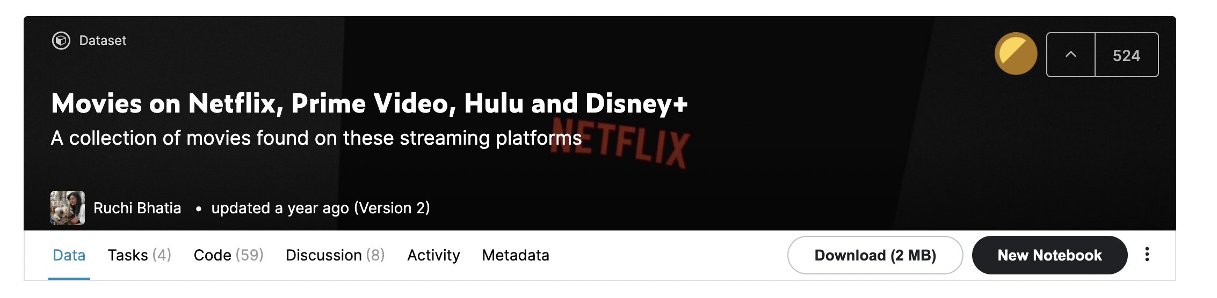

Extract
Datasets were derived from Kaggle(streaming platforms) and IMDb dataset
Streaming platforms: Netflix, Hulu, Prime Video, Disney+
IDMb: movies released in theaters
Movie Data: 1902-2020

Slide 4
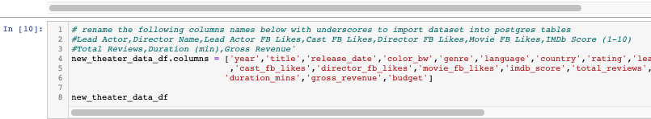
Transform
Converted released dates into years
Removed duplicate rows from dataset
Dropped all NaN values from dataset
Renamed column names
Punctuation, capital letters and special characters
Removed % from Rotten Tomatoes column

Slide 5
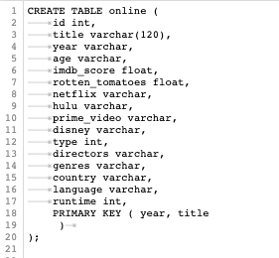
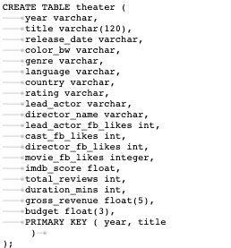
Load
After transformation we created new database(movies) and two tables(online & theaters)
Created two composite keys: Years & Title
Once composite keys were created we were able to load datasets into tables

Slide 6
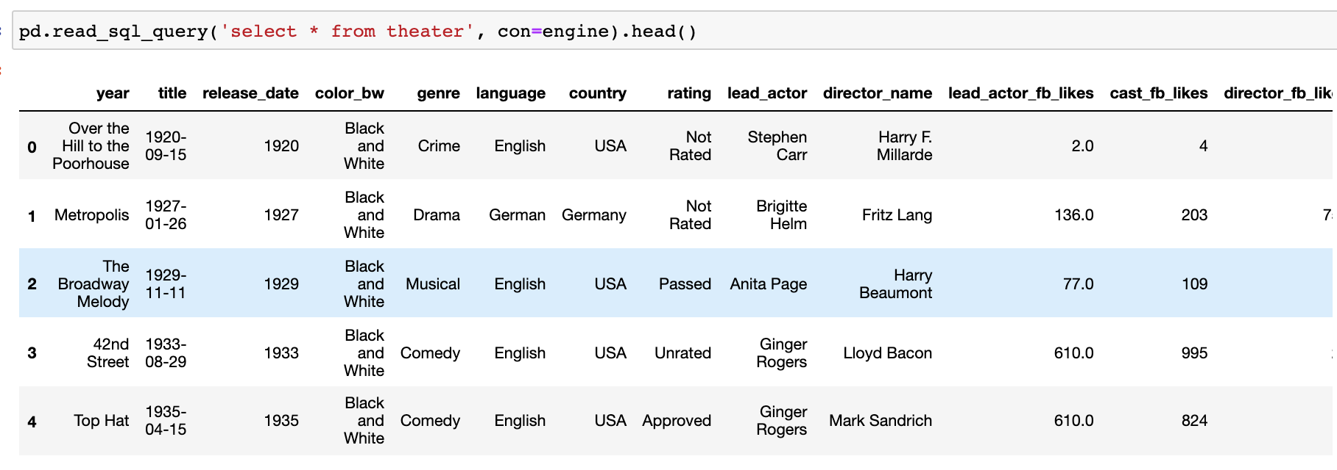
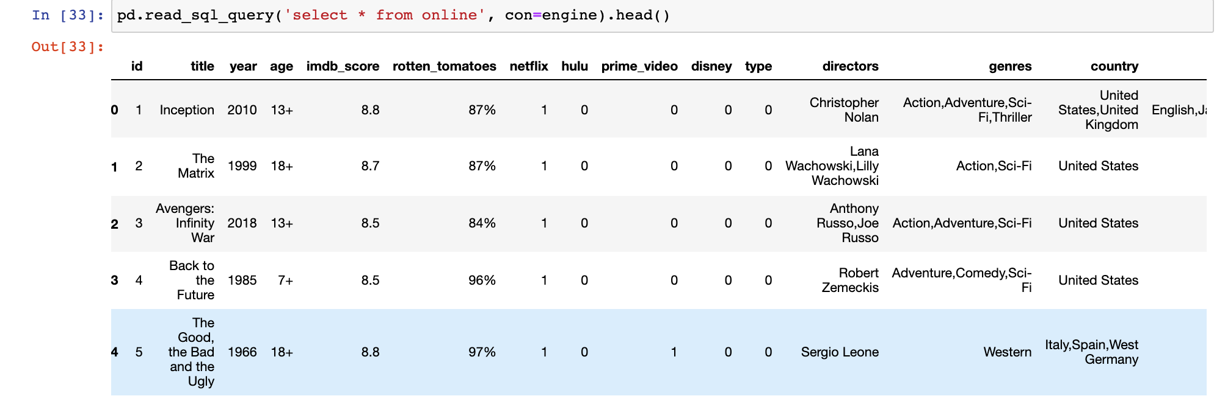
Select on both loaded tables looks as follows

Slide 7
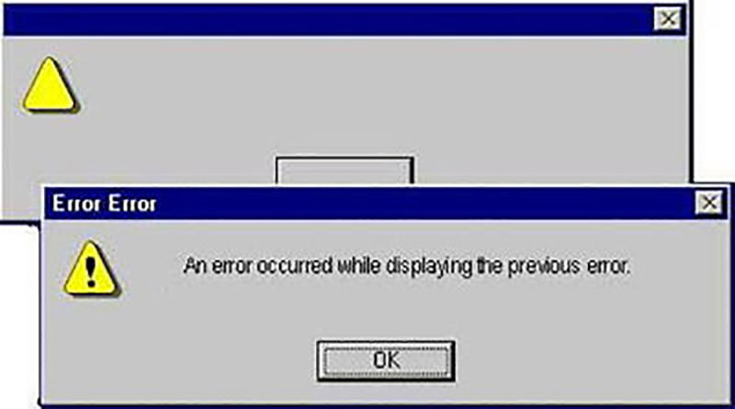
Post Mortem..
Identifying unique IDs
CREATED COMPOSITE KEYS FOR YEAR & TITLE TO BUILD RELATIONSHIP BETWEEN TABLES
Data cleanup
Columns, unique characters and SQL import

Slide 8

QUESTIONS?

