Slide 1
Rootless Containers with runC
Aleksa Sarai
Software Engineer
asarai@suse.de

Slide 2
Who am I?
Software Engineer at SUSE.
Student at University of Sydney.
  Physics and Computer Science.
Maintainer of runC.
Long-time Docker contributor and user.
Free Software advocate.

Slide 3
The Problem
Researcher wants to run some Python 3 code on a computing cluster.
  The cluster only supports Python 2.
So, researcher uses a container to package Python 3 – right?
  Drat! The administrator doesn’t want to install any new-fangled software.
The researcher tries to compile dependencies from scratch.
  Ha, ha. Don’t even get me started.
So, what should the researcher do?
  What if we could create and run containers without any privileges?

Slide 4
What are Linux containers made of?
Short answer: Namespaces.
  cgroups are not really required.
Long answer: A lot of duct tape, and some Linux Namespaces.
They isolate a process’s view of parts of the system.
  Except the things that don’t have namespaces. Like the kernel keyring.
The most interesting of which is the user namespace.
  You can “pretend” that an unprivileged user is root.

Slide 5
Unprivileged User Namespaces
Since Linux 3.8, unprivileged users can create user namespaces.
  It’s been mostly safe* since Linux 3.19.
All other namespaces are pinned to a user namespace.
  You can create a fully namespaced environment without privileges!
  Operations in the namespaces are more restricted than usual.
Only your user and group are mapped.

Slide 6
The Solution
Get a container runtime to implement rootless containers.
  Disable features in the runtime until the container runs!
… or you can just do it manually:
  unshare -UrmunipCf bash
  mount --make-rprivate / && mount --rbind rootfs/ rootfs/
  mount -t proc proc rootfs/proc
  mount -t tmpfs tmpfs rootfs/dev
  mount -t devpts -o newinstance devpts rootfs/dev/pts
  # ... skipping over a lot more mounting ...
  pivot_root rootfs/ rootfs/.pivot_root && cd /
  mount --make-rprivate /.pivot_root && umount -l /.pivot_root
  exec bash # finally

Slide 7
What works?
All basic functionality works with rootless containers.
Working | Broken
run | checkpoint [criu]
exec | restore [criu]
kill | pause [cgroups]
delete | resume [cgroups]
list | events [cgroups]
state | ps [cgroups]
spec | Detached containers [console]
create
start

Slide 8
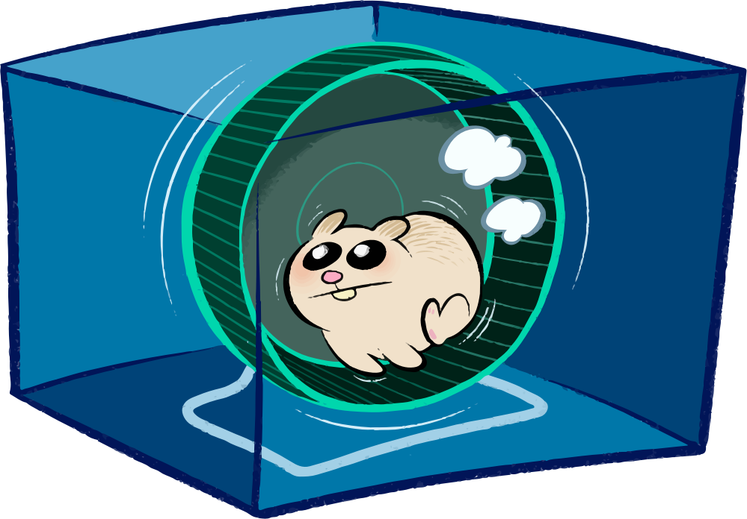
Demo time!
May the demo gods have mercy.

Slide 9
Consoles and runC
Pseudo-TTY allocation is done using the host’s /dev/ptmx.
  This can break in user namespaces.
This is a long-standing bug in libcontainer.
  Responsible for breaking sudo in Docker for years.
We need this to run our integration tests, and for create / start.
Solution: Do the allocation in the container and send a file descriptor over an AF_UNIX socket.

Slide 10
remainroot(1)
Certain syscalls will always fail inside a rootless container.
  setuid(2), setgid(2), chown(2), setgroups(2), mknod(2), etc.
Others will give confusing results.
  getgroups(2), waitid(2), etc.
Package managers and other tools can’t “drop privileges”.
  But we don’t have any privileges!
Solution: Write a tool to emulate GNU/Linux’s privilege model using ptrace(2).
  Currently works for most things, needs some more shims.
  https://github.com/cyphar/remainroot

Slide 11
What about cgroups?
cgroup access control is essentially a virtual filesystem.
  Everything under /sys/fs/cgroup is owned by root and has chmod go-w.
But most cgroupv1 controllers are hierarchical!
  And cgroupv2 is entirely hierarchical, by design.
  So why don’t we have unprivileged subtree management?
We need cgroups for a lot of different runC operations.
Solution: Submit kernel patches that implement unprivileged subtree management.
  Submitted and rejected.
This would be useful for regular processes too (think Chromium).

Slide 12
Networking
Unprivileged network namespaces aren’t useful.
  They only have a loopback interface.
To create a link to the host’s interface, you need CAP_NET_ADMIN in the host user namespace.
Solution: Don’t unshare the network namespace – use the host’s.
  This means you don’t get to use iptables(8).:
  … but at least you get network access!
There’s some movement in the kernel to fix this problem.

Slide 13
Other things left to do
ps uses cgroups to get the list of processes in a container.
  Solution: More AF_UNIX socket magic.
checkpoint and restore are currently disabled.
  CRIU 2.0 has support for unprivileged checkpointing.
    Not sure if it correctly checkpoints a rootless container.
  Unprivileged restore is on the roadmap.
Whilst cgroups are not generally solved, we can use them opportunistically.
  If we have write access to a controller, we should use it.

Slide 14
Show me the code!
Everything is in this pull request: opencontainers/runc#774.
  Please help us test this!
  Still needs some review and cleaning up.
“When will this be finished?”
  How many additional features do you need working?

Slide 15
Questions?

