Slide 1


Securing Container Runtimes
(How Hard Could It Be?)
Aleksa Sarai
Senior Software Engineer
@lordcyphar
<cyphar@cyphar.com>

Slide 2
PLEASE USE USER NAMESPACES
(Folks who did were not vulnerable to most of these bugs...)

Slide 3
container_runtime.pdf
Download and extract image archive into rootfs [see my OCIv2 talk].
Fork (and re-exec) to create proto-pid1.
  Child will exec() pid1’s code at end.
  Parent assists during setup.

Slide 4
container_runtime (2).pdf
Parent’s job:
  Move child process into correct cgroup.
  Set up and container’s veth or other network devices (if configured).
  Signal child to start.

Slide 5
container_runtime (3).pdf
Child’s job:
  Create or join namespaces (mount, pid, net, ipc, …, and hopefully user).
  Configure mountpoints for container process, pivot_root(new root).
  Configure seccomp filters, LSM labels, no_new_privs, process credentials, …
  Wait for parent signal, then execve(user’s code).

Slide 6
container_runtime (4).pdf
Other jobs:
  Spawn a new process inside the container while it’s running.
    Rather that creating and configuring namespaces, join existing ones.
  Modify existing container state (cgroup limits, network devices, …).
  Many more uninteresting things.

Slide 7
CVE-2014-????
docker cp didn’t do any path sanitisation.
  Oops.
  docker cp container:<symlink to /etc/shadow> w00t_w00t
Lesson learned:
  Maybe we should sanitise paths.

Slide 8
CVE-2015-{3627,3629,3630,3631}
Mostly related to bad configuration or permitting bad configurations.
  Oops.
Lessons learned:
  Don’t make those kinds of mistakes(?).
  VOLUME was probably a mistake.
  Containers are hard.

Slide 9
CVE-2016-9962
We kept open a file descriptor to the root filesystem while joining the container.
  Oops.
  Container could access host through /proc/$pid/fd/$n.
Lessons learned:
  procfs is terrifying.
  Make ourselves “non-dumpable” to block container process trickery.
    Turns out there were some kernel bugs here too…

Slide 10
CVE-2018-15664
Path sanitisation isn’t enough if the attacker can change the paths underneath you.
  Oops.
  RENAME_EXCHANGE can be used to swap (“symlink-exchange”) a component.
Lessons learned:
  Plain path sanitisation (as used to fix the 2014 bugs) is insufficient.
  Solving this properly is non-trivial (see how LXD has done it).

Slide 11
CVE-2019-5736
We could be tricked into re-executing ourselves, pinning /proc/self/exe.
  Oops.
  This clears the “non-dumpable” bit, but maintains /proc/self/exe.
  open(“/proc/self/exe”, O_RDONLY) then re-open it after the process dies.
Lessons learned:
  procfs is really terrifying.
  Make a copy of the runc binary each time, so overwriting does nothing.
  Maybe we should do some kernel work to block re-opens like this…

Slide 12
CVE-2019-19921
With custom images, you can use the symlink-exchange trick to mess with /proc.
  Oops.
  This means the container runtime can be tricked into not setting security labels.
  /proc/self/sched can be used as a no-op writeable procfs target.
    Ditto for /proc/self/environ.
Lessons learned:
  procfs is absolutely horrifying.
  VOLUME (as well as several of my life decisions) were a mistake.

Slide 13
What is the common theme?
Filesystem operations are really easy to screw up.
p r o c f s

Slide 14
Let’s make filesystem operations safe!

Slide 15
The Problem
/foo/bar/baz
baz might be a symlink. (Just use O_NOFOLLOW!)
bar might be a symlink. (Uhhh… sanitise it in userspace?)
foo might be attacker-controlled and thus bar can become a symlink. (Dammit.)
This is a solveable problem in userspace, but almost nobody does it correctly.

Slide 16
openat2
int openat2(int dfd, const char *path,
struct open_how *how, size_t size);
struct open_how {
u64 flags; // openat(2) flags
u64 mode; // openat(2) mode
u64 resolve; // RESOLVE_* flags
// future fields go here
};

Slide 17
openat2
#define RESOLVE_NO_SYMLINKS … /* Don’t traverse symlinks. */
#define RESOLVE_NO_MAGICLINKS … /* Don’t traverse magiclinks. */
#define RESOLVE_NO_XDEV … /* Don’t cross mounts. */
#define RESOLVE_IN_ROOT … /* Resolve within a root. */

Slide 18
libpathrs

Slide 19
Why Yet Another Library?
Even with openat2:
  Programs on old kernels still need to be hardened.
  Users need to be exceptionally careful when doing other VFS operations.

Slide 20
Introducing libpathrs!
Rust library (with C bindings, usable from almost any language).
Emulates openat2’s RESOLVE_IN_ROOT on older kernels.
Implements helpers that match most VFS syscalls (which are correctly written).
Includes some additional hardening (related to p̭r̙͈o͔̲̹c̩fs͔͔).

Slide 21
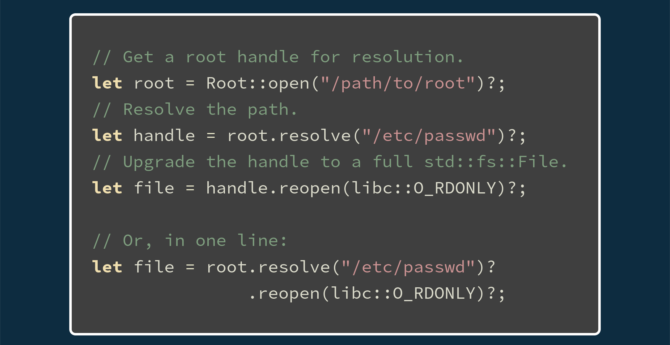
Usage
docs.rs/pathrs

Slide 22
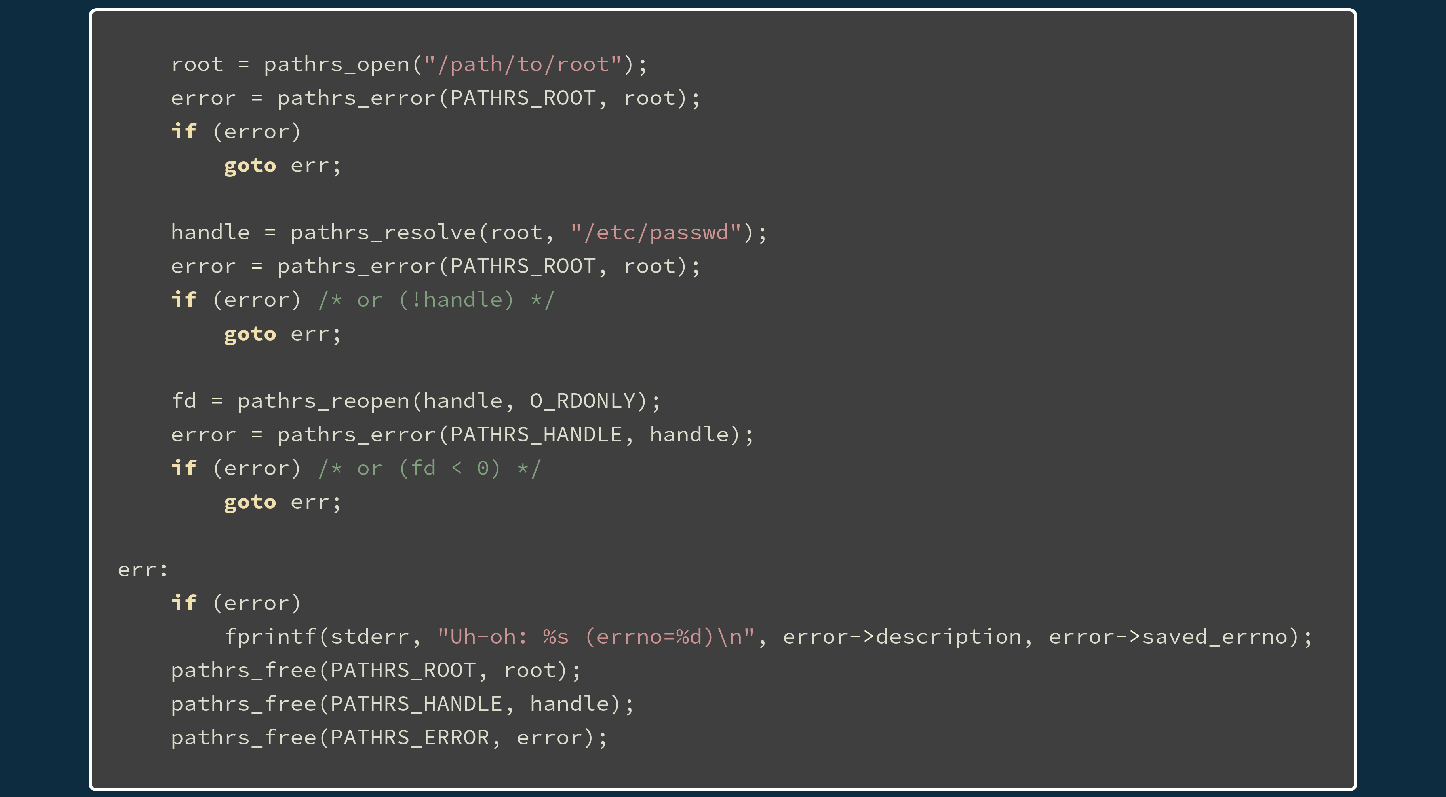
Usage
docs.rs/pathrs

Slide 23
Great! We’re all done, right?

Slide 24
l͎͕̹ͥẻ̜̀ͪ͂̄̒t͙̭̾̏̐͑̀'̪̝͍̟͌ͥ̒̇ś͔̈͛ͩ ̗ͮ̄̐͂͊ͯ̏h̠̗̍ͧä̬̖͎̲̊v̫̭̠͒͌e̜ͭ͒ͧ ͕͌̚a̪̔͌̊̀͊ ̭̓̈ͤ͋c͖͎̏ͣ̂h̑̍ͤ͂ͦͦ̄a̫̭̩ͦ̃͆̃ͨͭ̉tͩ̑̽͌̋̃ ͖̭ͅa̹̹͍b̤̝̗̎͊́͌ö̥̱́̾u̮̪̮̗ͯt͕̲͈̟͌̍͐̈ ͚̻p̟rͣ̊ͥ̎̃ͨͨọ̬͐̊͌̚cͬ̓̈́̓̌͒f͇̠̣̃͌s̟̹̥̉̆̌ͮͪ̄̐

Slide 25
The Problem
/proc/self/attr/exec
How do I make sure that I’m writing to the real procfs file?
  You can grab a /proc handle which is definitely real (the inode is 1).
  You can check if the target is a procfs file (but you aren’t sure it’s the right one).
  You can disable all symlink crossings a-la openat2 (or emulate it).
    Wait … how on earth do you check for bind-mounts?

Slide 26
y͙̦̩̼̦̜̫̝ͯ͊ė̲͇͖͖̹͔̗̞̆̈ͫ̎̃͋ͅå̯̻̗̤̝̮̥͌ͅḣ͕̺͙̬̠̲̯͒̎ͦ̾ͦ̏̚,̜̜̤̰̘̹̪̟ͯ̓̈̾̀̅̈́ ̺̼̗̹̞̰͓͆̋́̄͗ͥ̑w̥̱̳̣̎̐ͯh͈͈̠͈̯̺̩̣̏̉â̭͎͙̫̑t̬̥̳͖̠͔͒͌͛͊ ͇͓̙͇͓͇̼̂̈́̾͆̔ͨ̿ͅả͈͇̠͍̻̜̯͊͊b̩̮͚̭͙̮̱͈̦̎͒͛͛̓͗̑o̖̗͖̬̝̘̘͒̽͛ͤͅu̼̲̗̺̝ͬͪͥͩ͊͂̒͆t̫̜̖̙̯̙̂̓̄ ̱̙̪̿b̭͙́͋i̼̟ͩͭ̈̃̑̽n̜͙̰̒ͫ͗̂ͅḍ̮̖̭͙̩̈́̂̓̆̔͆̽-̟̟̰̹͇̣ͭͪͅm̼ͤ͛̏͋͂̒̐͋o̥͙ͭ̄̂ͣͨ͐̉u̜̳̺̭̲͔̝̻̎ͨ̎̅ͨͬͣ͆̇n̤̞͍̯̗ͫͦͅt̰̓͗ͧͩ̈́͗̇̚s̱̬̺͒̂͊̈͌̽?͕̼̦̘̣̼̆̉̍

Slide 27
There is no way on Linux to be verify if you’ve crossed a bind-mount (until openat2).

Slide 28
å͇̺͚̘̩͍̞̺̜͕̹̟͙̘̿ͣ̍͐̀̍͒n̤̱̪̠͈̯̜̐ͦ͑͂̃d̳͓͖̝̝̬̦̠͙͙̍̍̇ͮ̒̌̈́ ̻̰̭̟͓̣͍̤̦̫̼̘͑͛͋̎t̗̱̯̼͍̩̭͉̳̓͗̃̉ͬͭ̽ͯͧ̅͆ͨͯḫ̠̲̙̖͉͍̙̖̖̱̦̹̝̮͚̖͗͊́͗͗̋̑̒͒̈ͥ͑͊͐͂̾͂͗e̩̹͎̻̗̫̝̻̟͇̟͖̮͎ͤ̄ͬ̓͌́̊̇n̗͎͍͈̥͎̗ͦ̈́̌ͤ̇ͭ̓ͨ̈͗ͣͯ̇̊̽̅̾̔ ̪͎̭̪̫̝̠͖͇̰̫̮̬̜̰̽͐̂̎ͬ̔ͣͤ́̇̑̋ͅͅt̫̤͙̰̫̣͓̪̥̊̓ͧͨ̇ͤ̓͒ͪh̬̩͓̝̫̻̝̣͕̙͙̍͋͛̀ͥ̓̏ͮ̓͒͒͋ĕ̟̱̫̹͐̇ͪ̈r̤̦͔̖͓̩̟̦̝̰̬̲̟̂̑ͩͧ͋͐͆͆ͫͪ̅͊̐̀ë̩̻̦͍̯̟͉̘̠̮͈͆ͨ͐̑̿̽ͤ̎'̺̤͖̪̞͙̱̭̖̤͇̠͑̀̈ͩ̒̄ͪ͋̃̏ͪs͔͈̫̻̹̺̺̥̺͚̤̱͖̬̱ͤ̒̒ͪ͗͊̉͆̌ͬ͆͒̏ ̬̺̻̗͎̭̻͎̯̖̖̝͉̤͈̙̙̞̳̂́ͩ̑ͯ̇͊̀̓̽m̺̜̩͉̮̜̘̦̘̤̺̺̗͍̩͎ͬ͆̔ͩ̿̾̄͂̉ͮ̚̚a̪͍͈̬̥͎ͯ̈ͯ͋̀ͩ̃̾̑̽̈ͤ̇̋͋̚g͎͖̟͍̝̱͕̙̳ͤ̆ͭ́̋ͪ̎ͯ̋̂ͣ̃́̒̑ͩ̒̄ỉ̯̹̟̺̬̫͒̈͌̒̔ͫ͋̓̍̍ͯ͌͐̈̔̊̚c̥̰̬̻͔̥͈̰̦̲͖ͭ̅̾͂̈̃̈ͨ͑̾ͨ͛̽̐̎̓-̗̱̺͓̯̱̳̥̦̫̭͖̫̟̏̆͛͊̔ͣ̋͐͋́̄͗̾ͪͅl̖̟̤̬̝̠̹͇̺͉͖̮͙̬̲̋̄͊ͣ̋ͨ̚ȋ̻̭͈̟͎̐͊ͪ̎̏͐̀̔n͚̺̞͙͖̼̱̘͛͊ͯͪͩͭ̓ͧͩ̆̇̂̈́k̟̹͚̘͍̺̬͆̌̔ͫ̇ͭ͂s͕̞̭͚̜͉͕͕̖̜̗̲̗̯͔̣̈́͊̒̓̎̃ͮ̉ͧͥ̐ͫ̇̓̚

Slide 29
m̝̮͒ͅa͇̿̾̂̀ͨg̳̭͎̼̱̐͒ͅi̱͉͉̩̥̦̒̍̑̊̅́ͧc͕̯̪͔-͎͛l̠̲̰̪̂i͙̮̱̠̙̬ͭ̏̀͑͛ͥ̚ͅǹ̳̼̗͍̟̣̒͌͐ͫ̅k̽s̥ͧ̽͌͋
/proc/self/fd/$n
/proc/self/exe

Slide 30
m̝̮͒ͅa͇̿̾̂̀ͨg̳̭͎̼̱̐͒ͅi̱͉͉̩̥̦̒̍̑̊̅́ͧc͕̯̪͔-͎͛l̠̲̰̪̂i͙̮̱̠̙̬ͭ̏̀͑͛ͥ̚ͅǹ̳̼̗͍̟̣̒͌͐ͫ̅k̽s̥ͧ̽͌͋
/proc/self/fd/$n
/proc/self/exe
Y̖̺̬̣̋ͯͥ̆ͣ̔̚O̼̪̬̤̓͌̑̽̑̇͋ͤ̓̚U͖̯͓̗̺̳̱ͣ̇̓̆̀́ͫ͑̈́̇ͬͮͨ ͈̗̱̗̦̳̯̎̉̐̓ͨ̇̔̀̃̑̿̚C̫̦̤̥̼̒͒ͪͧ̈̽ͬA̲̰̖̫̪̳̰̳̱͂̌̈́̅ͥͮ͛̃̔ͮͧͮ͑N͓̩̰͚̗̳͕̣̱̣̻ͥ̑ͥ͑ͤ̄ͪ͊ ͍̼͎̘̟̆̀ͩ̔͌̑͑ͩͦ͛͂ͤ͑B̗̗̳̹̤̯̙̹̬̭͓̟̑̃̓͛̒ͦͯ͂̂̋̿͒͌̍̄̿I̼͈̖̜̘͕̻̥͔̖̝̫̫̎ͪ̔̏̅ͪ̅̄͌ͤͣ̔͋ͅN͇̝̣͚̖̤̜̰̝̈́̔̒ͫͪ͊͒ͭ̇ͤ̚D̝̙͖̻̝̥͇̼͚͖̾ͨͮ͊́̉͑̈́̓̊̏̈́͊ͥ̓ͫ͋ͥ-̺̦͚̭̔̉̃̓̃̿̐͋ͦ̊́̃͑̔ͨ̌ͅM̳͍͙̥̼̟͈ͦ̃̓ͣ͊O͍̳̤͎̲̟̞͍̜͐ͮ̉͆̃̍̄̔̓ͧͦ̿̄ͦ̔ͯȔ̙̥͎̤͍͚̬̹͙̗͓̹̪̜̬̹̩̃̅̌̄̐͛̆͊͌N͎͕͙̭̜̤̪͇̩̠̭͖̥̥̝͚̺ͬ̈́ͬͅT̬͕̟͚͇̣̱͍͓͎̗̘͇̜͔̟̭̜̿̋̌̓̔̇̃͒͛͐ͧ̆ ̩̰̗͉̲̹̜̼̣̈̋̽̿Ô̝̩̯̙͚̖ͣ́̈́ͯ̈́͒̚V͉͈̩̭̯̻̭̓̆̋̋̏̎ͯ̈͛̃̊ͩ͒͆ͅE͕͔̲̪̯͓̣̦̖̱͙ͭͭ̿͐̆̇ͅͅR̗̺̺̤̰̟̥̬̦͔͕̖̞̜̮͇͚͂ͫ͑̂ͯ̓̿ͣ̏̒̚ͅ ͔̭̱̰͚͙͔̹͚̹͖ͩ͊̋ͪ̏̔ͩŜ̗̭̞̦̫̹̈́̾̈́̄̈ͮͦ̌̐ͥ͒̋ͤͣ̇Y̥̪͇̰̳̥̔̽̄̅͂̃ͦͬ͒ͥͭ̽̊ͣ͋͋̍ͅM͈̱͉̼̪̼̳͙͛ͭͧ̒͑ͦL͔̪̮̰̘̩̭͍̖̄͗̈ͥ̌̿̏͋͒ͅI̙̰͈̣͕̗̦̩̻̮̜͉͔ͦͤ́̐̍ͤ̃̉͑͆ͬ̽N̞̘͚̞ͪ͆̆͐́̑̀ͥ̌̔̌̿͐̚K͚͓̝͙̙̪̪ͥ̋͐͋ͦ̓̉ͮ̂S̻̤͖͎̲̩̫͎̥̈́ͭͯͦ̈͊͒̉̒̽͌̉

Slide 31
*incomprehensible rambling*

Slide 32
Next Steps?
Stabilise the base libpathrs C API.
Start porting programs to libpathrs.
  Needs Go bindings to port umoci.
Continue kernel hardening work (which libpathrs can support opportunisically).
  Lots of work needed to make p̦̗̖̖̠̼ͩͧ͊̿ͫ̃ro͙̼͊̊̇̄̏̂̾c̺̣͊ͤͯf͉͔̱͕͔s̹̞̃̔ safe to use.

Slide 33
Links
openat2
  lwn.net/Articles/767547
  lwn.net/Articles/796868
libpathrs
  github.com/openSUSE/libpathrs
  docs.rs/pathrs
github.com/cyphar/talks

Slide 34
Questions?

Slide 35
Magic-link Restriction
Don’t allow a read-only magic-link to be re-opened as read-write.
  Requires lots of fun semantics with O_PATH.
  Doesn’t break userspace (based on my testing).
  Needs to cover up a lot of different holes.

Slide 36
O_EMPTYPATH?
openat(fd, “”, O_EMPTYPATH | O_RDWR);

Slide 37
Built-in procfs handle?
openat(AT_PROCFD, “self/fd/$n”, O_RDWR);
setupfd = fsopen(“procfs”, FSOPEN_CLOEXEC);
procfd = fsmount(setupfd, FSMOUNT_CLOEXEC, 0);
openat(procfd, “self/fd/$n”, O_RDWR);

Slide 38
Pidfd-based /proc/self ??
selffd = pidfd_open(getpid(), 0);
pidfd_get_resource(selffd, PIDFD_EXE,
O_RDONLY); // ???
openat(selffd, “exe”, O_RDONLY); // ???

