Slide 1
how can we make procfs safe?
current state of the art and a few libpathrs updates
Aleksa Sarai (SUSE)
cyphar@cyphar.com

Slide 2
threat model
We are executing in an environment where a user has managed to mess with the filesystem and possibly mounts.
We want to be able to detect if we are being tricked into operating on a different path than the one we expected.
Main usecase is container runtimes, but basically any program operating in or on chroots would benefit.

Slide 3
what’s special about procfs?
With openat2(RESOLVE_*), any non-procfs filesystem path can be accessed safely with various resolution restrictions.
With procfs, we require more than just the path be resolved “reasonably”, we want a specific procfs endpoint to be reached. The core issue is that /proc/self/environ and /proc/self/sched exist.

Slide 4
current status
(non-magiclinks)
In Linux 5.6, openat2(2) made this safe:
openat(“/proc”, O_PATH)
Check the f_type (fstatfs) and stx_ino (statx).
openat2(<procfsfd>, “<pid>/attr/current”,
{RESOLVE_NO_XDEV|RESOLVE_NO_SYMLINKS})

Slide 5
what’s the issue with magiclinks?
We can’t use RESOLVE_NO_XDEV because they are almost always crossing a mountpoint. But you can also mount on top of them.
We can’t use RESOLVE_NO_SYMLINKS for obvious reasons.

Slide 6
current status
(magiclinks)
It turns out this is safe since Linux 5.8 (w/CAP_SYS_ADMIN):
open_tree(“/proc”, OPEN_TREE_CLONE | AT_RECURSIVE)
Check the f_type (fstatfs) and stx_ino (statx).
openat2(<procfsfd>, “<pid>”, {O_PATH,
RESOLVE_NO_XDEV|RESOLVE_NO_SYMLINKS})
statx(<procselffd>, “exe”, AT_SYMLINK_NOFOLLOW)
    Check whether STATX_ATTR_MOUNT_ROOT is set.
    If not, safe to use (no races because of OPEN_TREE_CLONE).
(See this example program.)

Slide 7
why does this work?
(and why might it break in the future?)
The safety of this setup relies on several undocumented behaviours:
OPEN_TREE_CLONE mounts are an O_PATH to a bind-mount and there is no way for an external process to change any overmounts.
    Returned tree is an anonymous mount namespace.
      Even a CAP_SYS_ADMIN user in a different mountns cannot mount into it.
    Mount propagation to the clone is explicitly disabled.

Slide 8
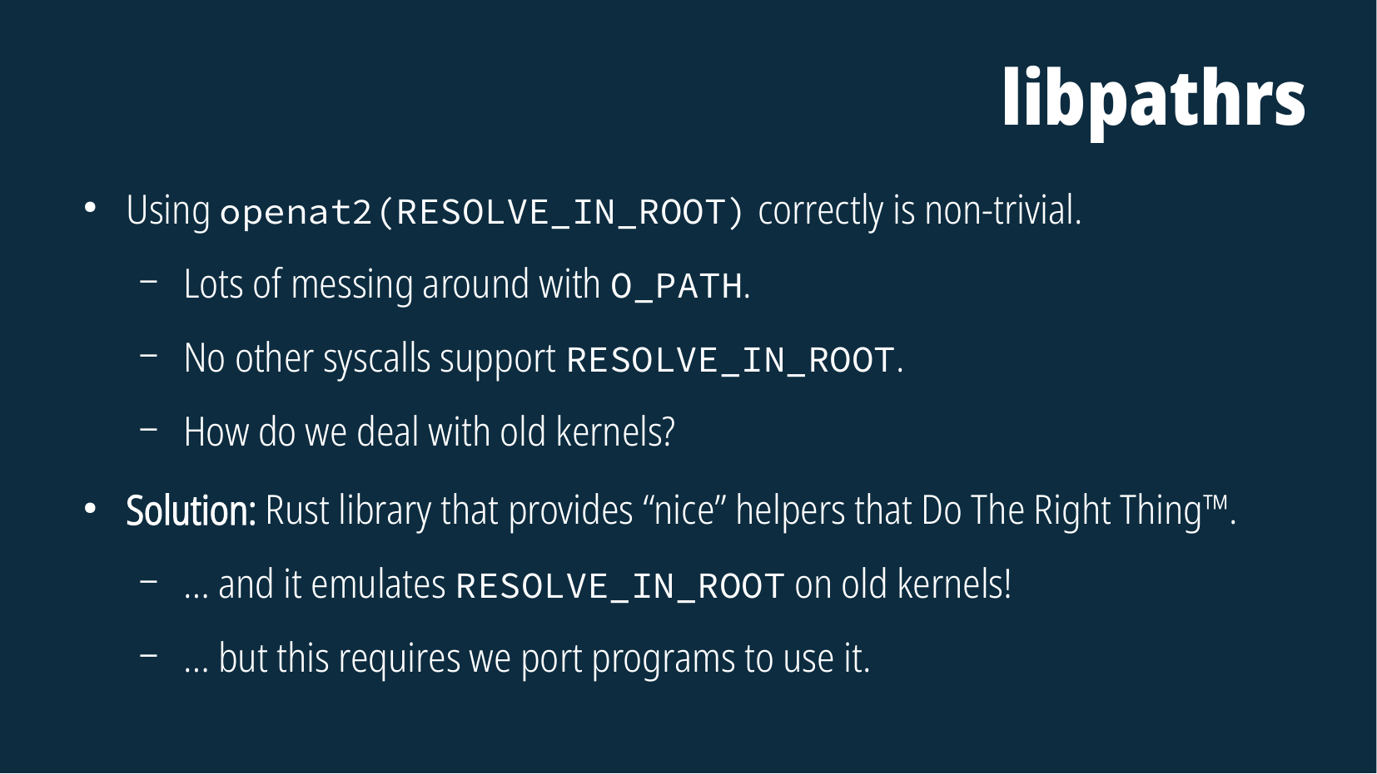

Slide 9
an update on libpathrs
Safe wrappers for procfs.
Cache a safe open_tree’d procfs handle.
procself_get(“exe”) – or something…
Sane C API (which then can be used with Go nicely).
Go programs are used to being able to call .Close() many times.
Should we remove the footgun-guards and just pass fds?

Slide 10
an update on libpathrs
How to model the (new and old) mount API?
We want to use the new one to avoid using /proc.
Should we abstract the whole thing or just expose the old one?
How much of the VFS API should be replicated by libpathrs?
In theory, any operation which has AT_EMPTY_PATH is okay.
How much should we trust library users to not footgun themselves?

Slide 11
an update on libpathrs
https://github.com/openSUSE/libpathrs
Still being worked on. Plan to port umoci to this first.

