Slide 1
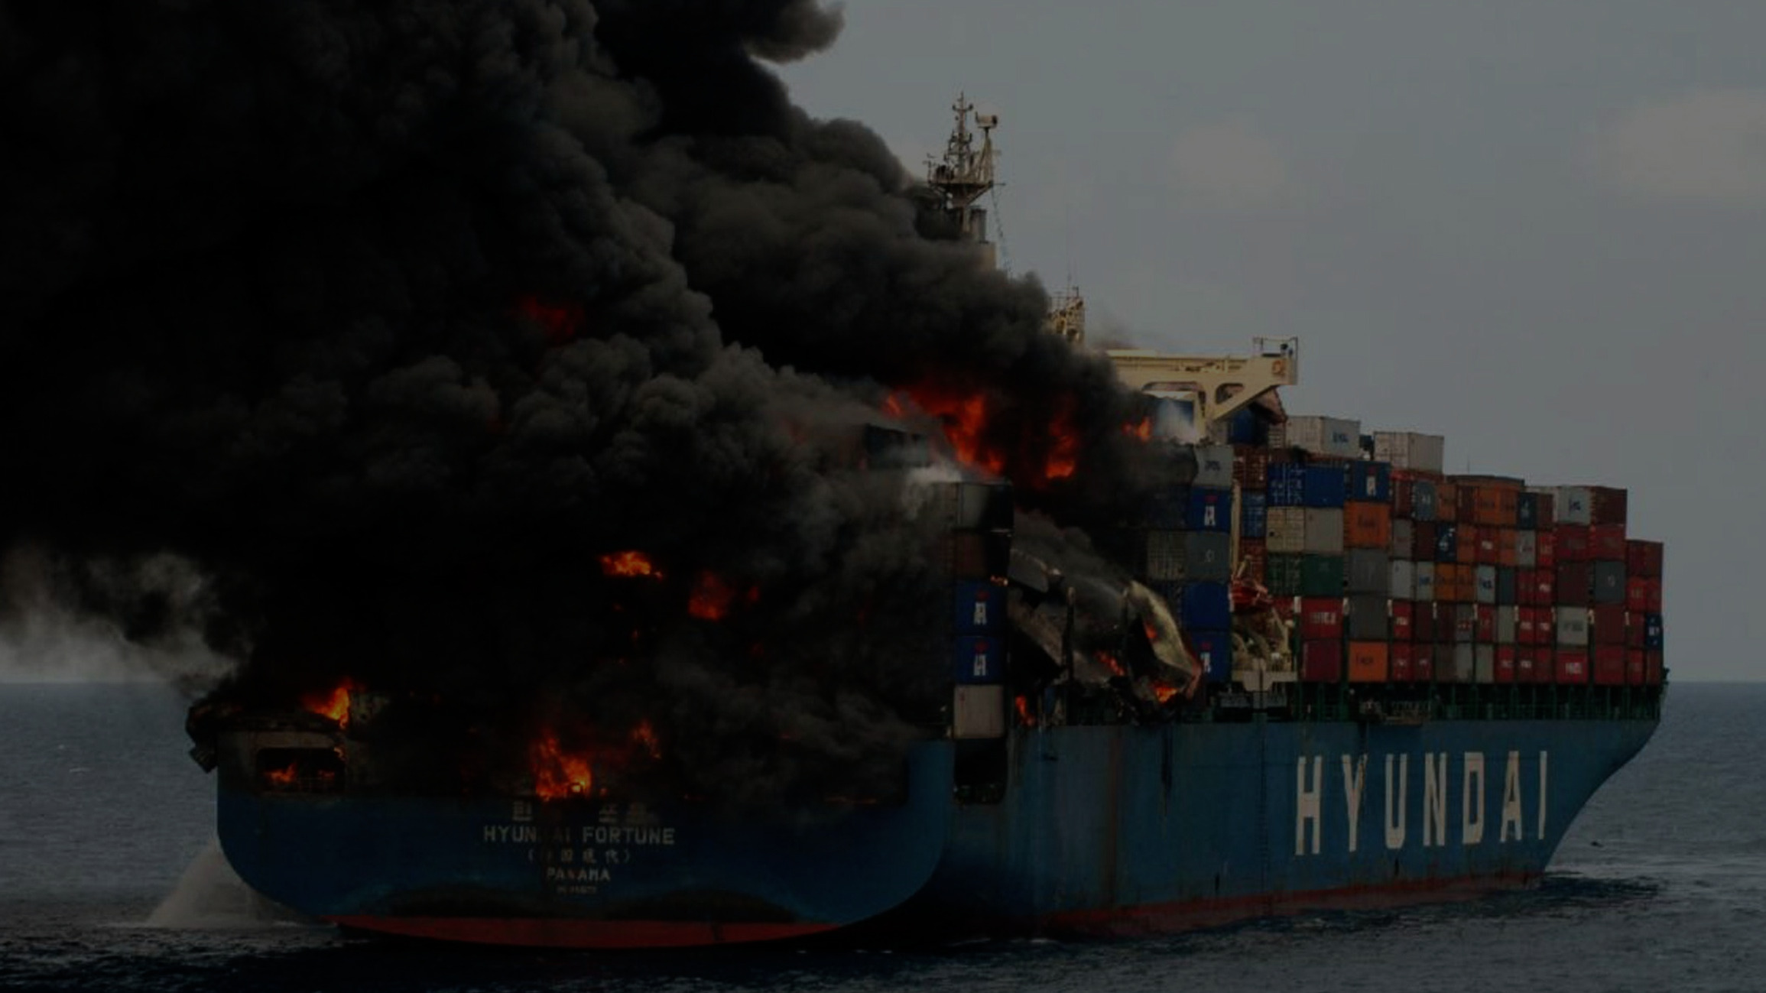
Securing Container Runtimes
“How Hard Can It Be?”
Notes:
* Last talk – unlike most other speakers I’m the harbinger of doom.
* Comes from the last year or so of discussion with other container runtime developers and kernel engineers.
* Still lots of sticky problems with container security.
* Quite technical, but I’ll try to mix it up with some high-level overviews to help get the point across.
* Lots to talk about, need to compress it (even if Angie offered me more time to talk about this.)

Slide 2
% whoami
name:
Aleksa Sarai
job:
Senior Software Engineer @ SUSE
status:
Really hoping that nobody finds
several CVEs over the weekend
because of this talk.
Notes:
* Worked on container runtimes for many years.
* I maintain runc, the OCI specs, and have done a fair amount of kernel work related to containers.
* I’m hoping nobody drops a CVE after this talk – I’ve just moved and so would love to be able to get some sleep. If you find a security bug please wait until Monday before pinging me.

Slide 3

Container attacks that are outright kernel bugs.
Obvious security goofs like zero-auth remote code execution.
(Sadly that wasn’t a joke – see CVE-2014-3499
… and CVE-2014-9357.)
Notes:
* Pure-kernel bugs are everyone else’s problem too.
- Not to mention that container runtimes’ seccomp profiles actually block most 0days.
* Yes, there were remote RCEs in Docker.

Slide 4

Everything else.
Our focus is on bugs involving interactions between runtimes and malicious container code.
Notes:
* Container runtimes need to interact with container processes for all sorts of operations, and so that interface is the main thing we care about.

Slide 5

ALWAYS.
USE.
USER.
NAMESPACES.
Notes:
* If you tune out for the rest of this talk – please remember this one thing.
* Repeat after me: “I will use user namespaces.”
* Some container runtime attacks have been patched by doing safety checks related to user namespaces.
- Kernel developers consider turning off user namespaces to be an insecure setup by definition.
- If you want the hundreds of kernel protections related to user namespaces, then you need to use them.

Slide 6
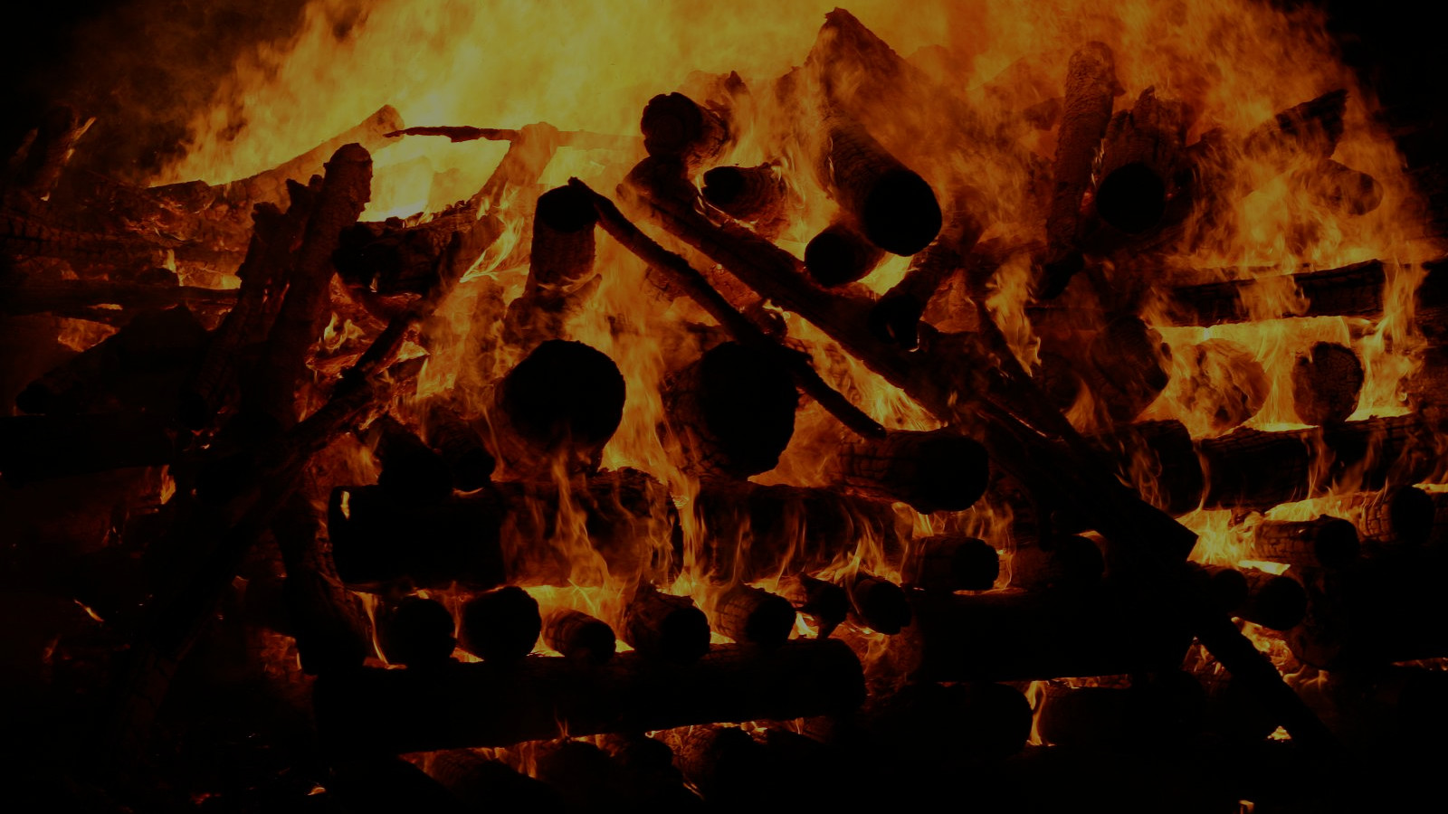
Broken Configuration
Let’s start with some kindling.
CVE-2017-16539
CVE-2016-8867
CVE-2015-3630
CVE-2016-10124
Notes:
* Containers aren’t real.
* We need to construct them, and that requires a lot of intrusive work and configuration.
* So, human errors can cause pretty big issues.
* Discussions about combining these interfaces have happened but large flame wars erupted over it.
* CVE-2016-8867: Ambient Capabilities
* CVE-2016-10124: Not creating a new console.
* CVE-2015-3630: /proc/asound and others.
* CVE-2017-16539: /proc/scsi.

Slide 7
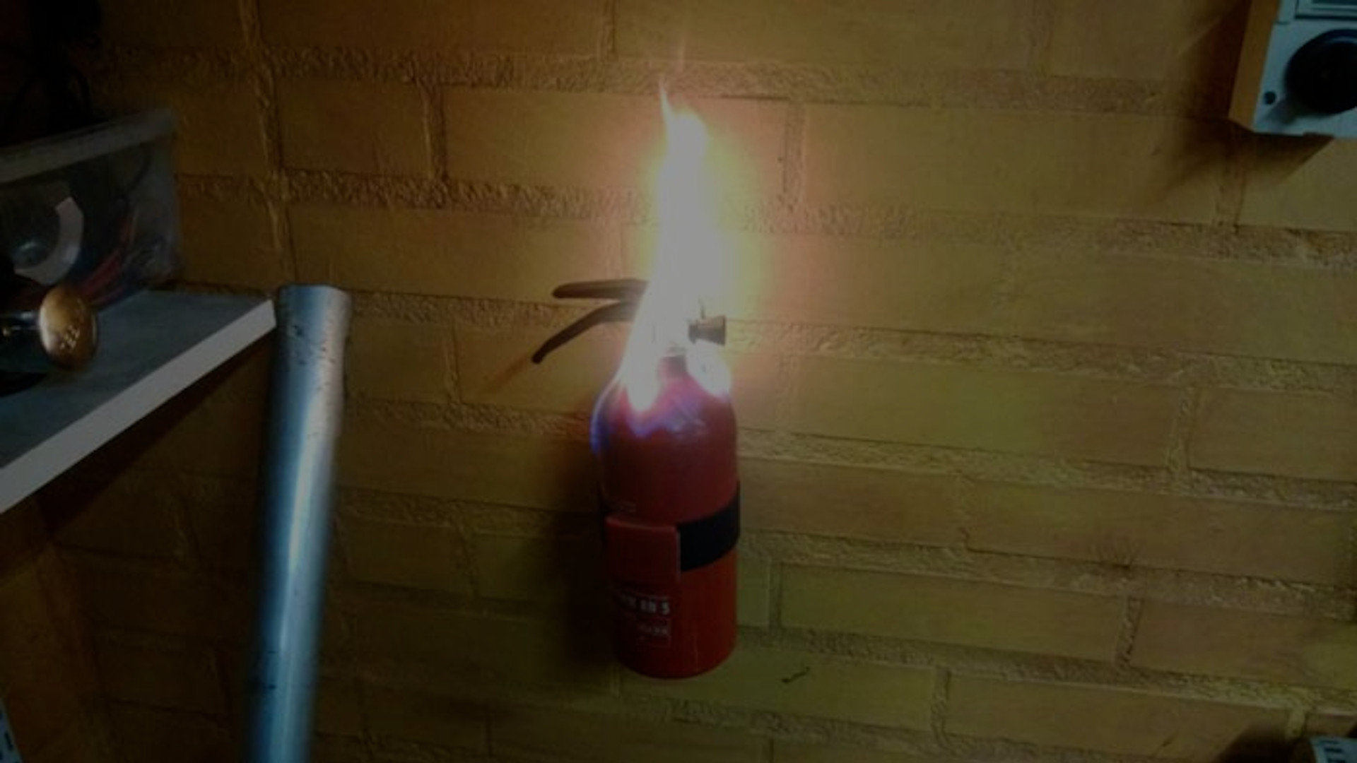
CVE-2016-9962
Administrative Operations
Yes, the fire extinguisher is also on fire.
CVE-2019-5736
Notes:
* Many administrative operations are not atomic – because of the fact it’s a bunch of different interfaces combined.
* So, there’s all sorts of strange circumstances where you can abuse currently-executing container runtimes to do bad things.
* CVE-2016-9962: /proc/$attach/fd/$n gives rootfs
* CVE-2019-5736: execve(/proc/self/exe) attack

Slide 8

CVE-2015-1335
CVE-2015-1340
CVE-2015-1334
CVE-2015-1331
CVE-2015-3627
The Filesystem
“Everything is a file” – a great idea until you find out they’re highly flammable.
CVE-2014-6407
CVE-2018-15664
CVE-2019-10152
[Honestly, most of procfs.]
Notes:
* If there is one recurring issue, it’s the filesystem.
- USE USER NAMESPACES
* There’s one filesystem (VFS) for the whole system, so any cracks can be exploited pretty badly.
* procfs makes this even worse because it has so many weird knobs.

Slide 9

CVE-2019-10152
[Your CVE Here.]
CVE-2016-9962
CVE-2015-1340
The Kernel Interfaces
There are some issues.
CVE-2018-15664
CVE-2016-10124
CVE-2015-3630
CVE-2016-8867

Slide 10

A Trivial Example
Creating a console for a container.

Slide 11
mfd = open(“/ctr/dev/ptmx”, O_RDWR);
num = ioctl(nfd, TIOCGPTN);
asprintf(&path, “/ctr/dev/pts/%d”, num);
sfd = open(path, O_RDWR);
/* dup2 sfd over stdio of container. */

Slide 12
mfd = open(“/ctr/dev/ptmx”, O_RDWR);
num = ioctl(nfd, TIOCGPTN);
asprintf(&path, “/ctr/dev/pts/%d”, num);
sfd = open(path, O_RDWR);
/* dup2 sfd over stdio of container. */

Slide 13
mfd = open(“/ctr/dev/ptmx”, O_RDWR);
sfd = ioctl(nfd, TIOCGPTPEER);
/* dup2 sfd over stdio of container. */

Slide 14
mfd = open(“/ctr/dev/ptmx”, O_RDWR);
sfd = ioctl(nfd, TIOCGPTPEER);
/* dup2 sfd over stdio of container. */

Slide 15

Solutions?

Slide 16

(Well, some of them.)

Slide 17
int openat2(int dirfd,
const char *path,
const struct open_how *how);
// ... and fix procfs magic-links.

Slide 18
struct open_how {
uint32_t flags;
union {
uint16_t mode;
uint16_t upgrade_mask;
};
uint16_t resolve;
uint64_t reserved[7]; /* must be zeroed */
};

Slide 19
struct open_how {
uint32_t flags;
union {
uint16_t mode;
uint16_t upgrade_mask;
};
uint16_t resolve;
uint64_t reserved[7]; /* must be zeroed */
};

Slide 20
struct open_how {
uint32_t flags;
union {
uint16_t mode;
uint16_t upgrade_mask;
};
uint16_t resolve;
uint64_t reserved[7]; /* must be zeroed */
};

Slide 21
/* how->resolve flags for openat2(2). */
#define RESOLVE_NO_XDEV 0x01
#define RESOLVE_NO_MAGICLINKS 0x02
#define RESOLVE_NO_SYMLINKS 0x04
#define RESOLVE_BENEATH 0x08
#define RESOLVE_IN_ROOT 0x10

Slide 22
/* how->resolve flags for openat2(2). */
#define RESOLVE_NO_XDEV 0x01
#define RESOLVE_NO_MAGICLINKS 0x02
#define RESOLVE_NO_SYMLINKS 0x04
#define RESOLVE_BENEATH 0x08
#define RESOLVE_IN_ROOT 0x10

Slide 23
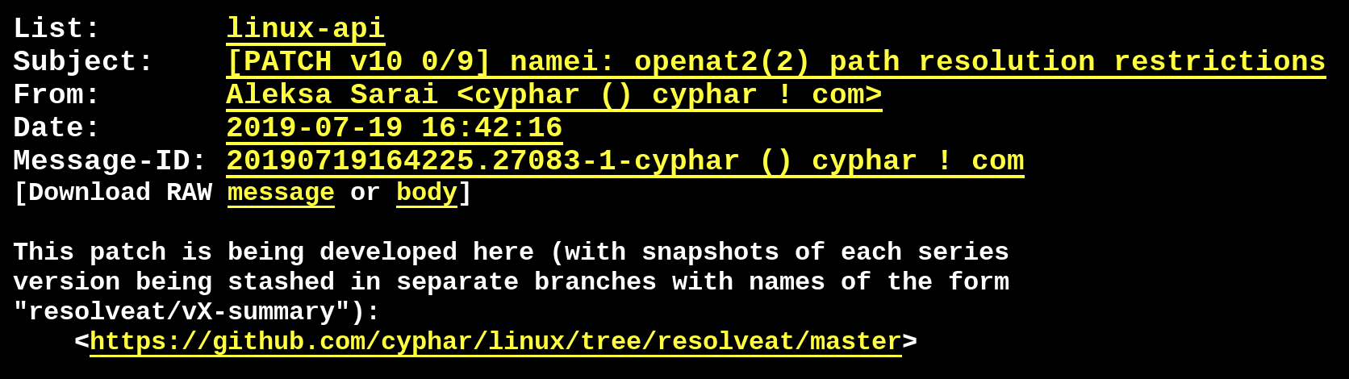
marc.info/?l=linux-api&m=156355459919115
github.com/cyphar/linux [branch: resolveat/master]

Slide 24
int openat2(int dirfd,
const char *path,
const struct open_how *how);

Slide 25
int openat2(int dirfd,
const char *path,
const struct open_how *how);
Nobody is using openat(2) right now!

Slide 26
int openat2(int dirfd,
const char *path,
const struct open_how *how);
Oh, and the new interface is tricky to use correctly...
Nobody is using openat(2) right now!

Slide 27
int openat2(int dirfd,
const char *path,
const struct open_how *how);
Oh, and the new interface is tricky to use correctly...
Nobody is using openat(2) right now!
Also, how do we deal with old kernels?

Slide 28
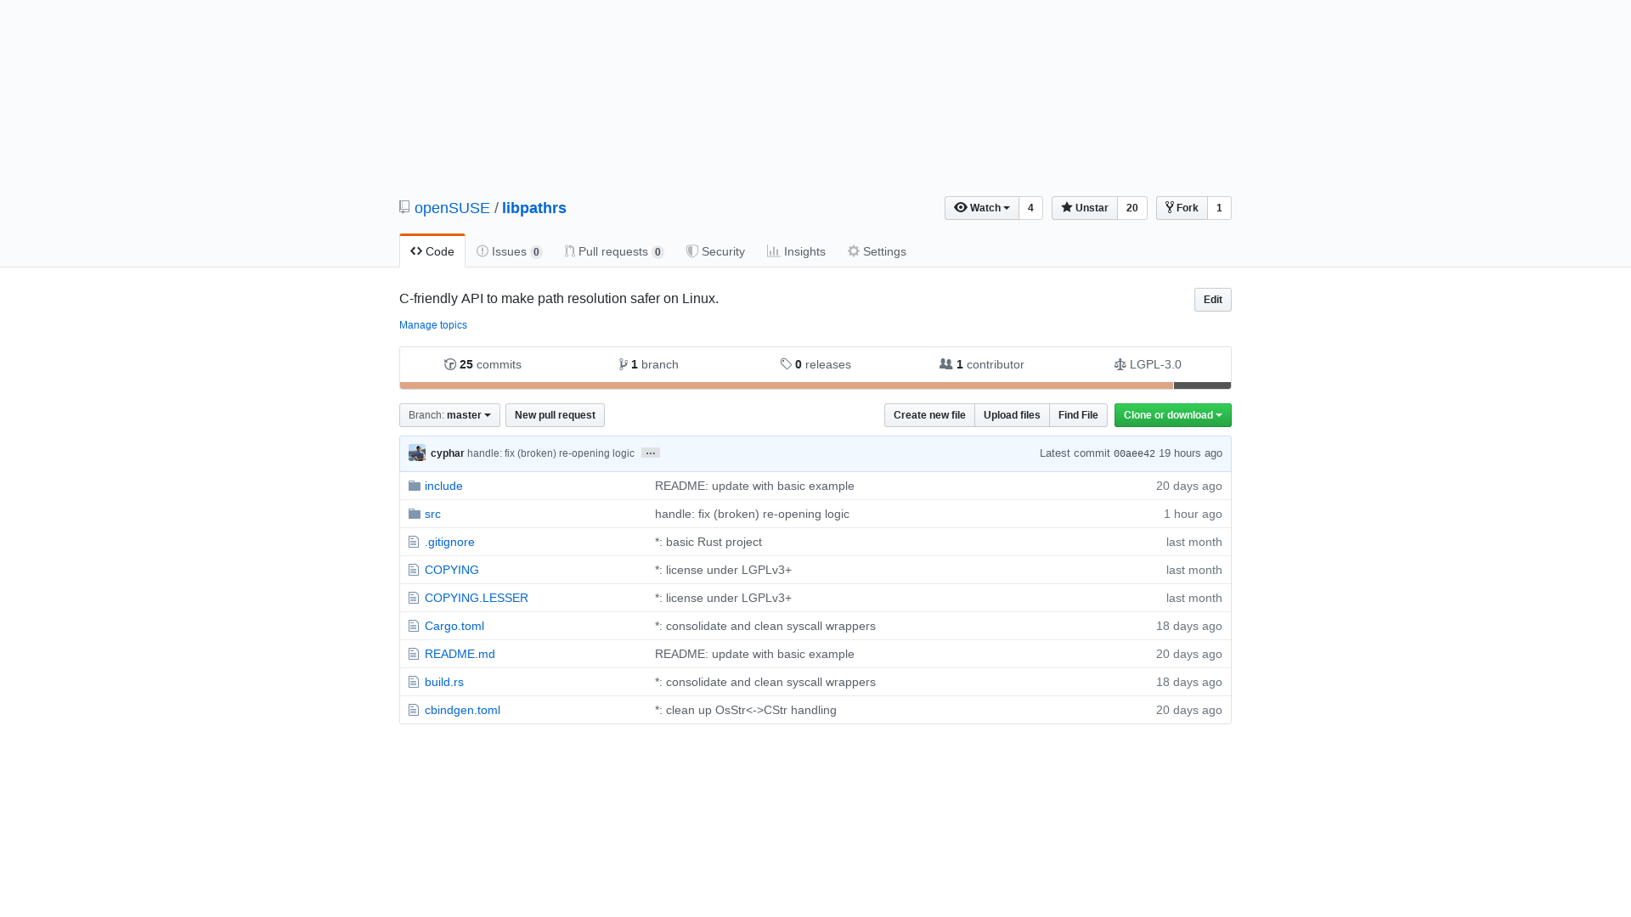

Slide 29
use pathrs::*;
let root = Root::open("/path/to/root")?;
let handle = root.resolve("/etc/passwd")?;
let file = handle.reopen(libc::O_RDONLY)?;

Slide 30
#include <pathrs.h>
root = pathrs_open("/path/to/root");
if (!root)
goto err;
handle = pathrs_inroot_resolve(root, "/etc/passwd");
if (!handle)
goto err;
fd = pathrs_reopen(handle, O_RDONLY);
if (fd < 0)
goto err;

Slide 31
import pathrs
root = pathrs.Root("/path/to/root")
with root.resolve("/etc/passwd").reopen(os.O_RDONLY) as f:
pass # Do whatever you like with f.

Slide 32

Demo

Slide 33

Great! We’re all done right?
Unfortunately not.

Slide 34

We need (you)sers!

Slide 35
int pidfd_send_signal(int pidfd, ...);
// and CLONE_PIDFD
https://lwn.net/Articles/784831/

Slide 36

Questions?

