Slide 1
Demystifying Container Security
A whirlwind tour of container security features
Aleksa Sarai
Senior Software Engineer
asarai@suse.com
Valentin Rothberg
Container Core Specialist
vrothberg@suse.com

Slide 2
What is a Linux Container?

Slide 3
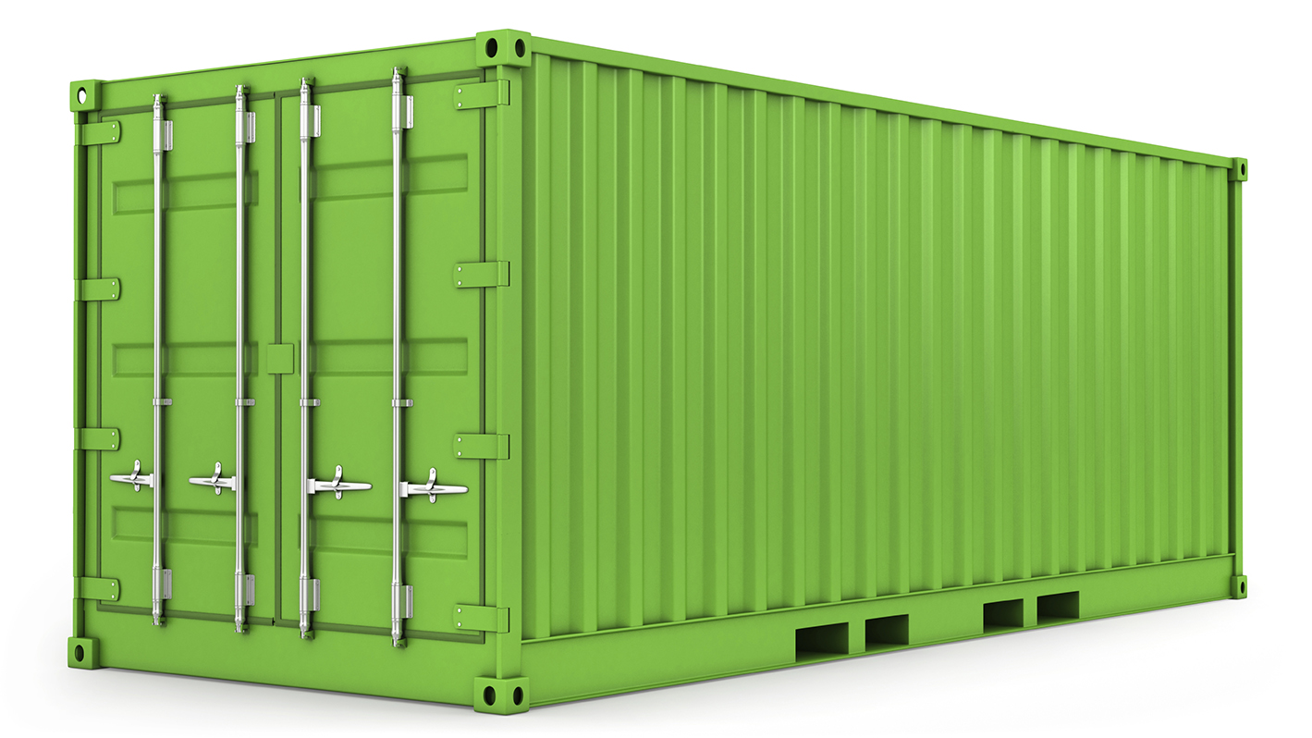
Introduction to Linux Containers
At the core, containers are just processes running on the host
  Effective mechanisms to secure, isolate, control and multiplex resources
Various use cases ranging from CI to micro-services
  Increasing popularity
Security skepticism is common and necessary
  Our talk demystifies containers security

Slide 4
Namespaces and Control Groups
The core of what makes a container a container

Slide 5
Linux Namespaces
Kernel mechanism to isolate a process’s view of the system
  Network devices, stacks, ports, etc.
  Mount points
  Process IDs
  User and group IDs
  Host- and NIS domain name
  Inter-process communication
  Control groups

Slide 6
Linux Control Groups
Control resources for groups of processes
  CPU
  Memory
  Devices
  Block I/O
  Freezer
  Network priority
  Processes
1/5
3/5
1
2
3
CPU Time
Network Priority

Slide 7
Namespaces vs Control Groups
The core of what makes a container a container
Very different purposes
  Namespaces are for isolation and multiplexing
  Control Groups are for resource control
More sophisticated versions of older Unix facilities
  Namespaces are (sort of) an extension of chroot
  Control Groups are an extension of ulimit

Slide 8
Demo
Namespaces and Control Groups

Slide 9
Capabilities
A more granular way of providing privileges than just “root”
  Examples include mounting, loading kernel modules, network configuration
What's the goal of capabilities?
  If compromised, the process has limited rights
  It's safer than running with full-root privileges
Open source Docker container engine provides support for giving containers limited capabilities
  By default, “root” in a container doesn’t have a full set of capabilities

Slide 10
Demo
Capabilities

Slide 11
SECCOMP
Linux technology that allows fine-grained syscall blocking
  Block by syscall number, arguments, architecture, eBPF filter, etc.
  Used in many projects such as Chromium, Firefox, OpenSSH
Open source Docker container engine has a default whitelist profile
  Support for custom profiles
  Note: Writing your own profile can be quite tedious
  Default profile has protected against kernel 0-days
Works on any Linux system regardless of Linux Security Module

Slide 12
Demo
SECCOMP

Slide 13
AppArmor
Linux technology that provides path-based access control
  Block certain types of access to paths, network resources, capabilities, etc.
  Provides auditing capabilities
Open source Docker container engine has a default profile and supports custom profiles
  Note: Writing AppArmor profiles can also be tedious
    See https://github.com/jessfraz/bane and https://github.com/docker-slim/docker-slim
  AppArmor makes creating profiles based on "normal usage" simple
Default Linux Security Module on SUSE Linux Enterprise
  Seen as an easier to administer alternative to SELinux

Slide 14
Demo
AppArmor

Slide 15
Runtime Security
dockerd still runs as root
  Users with access to dockerd have effective root access
  rkt still has a similar problem, despite having better least-privilege principles
Open source Docker container engine has support for access control plugins
  Very few available – they’re hard to implement
  Custom authentication is not implemented (only client certificates supported)
Only give access to dockerd to trusted users!

Slide 16
Runtime Security
Vulnerabilities in a container engine can cause host exploits
  Docker's default security profiles have protected against Linux kernel 0-days
  Security is all about layers
    Requiring a container-engine exploit is another layer
  User namespaces can help resolve some of the risks
Future directions and research:
  Rootless containers, a project within the Open Container Initiative
  Lots of ongoing work to secure kernel primitives used by containers

Slide 17
Best Practices
Putting software in a container is safer than on your host
  But that doesn’t mean you should abandon common sense
Some best practices to get you started:
  Don't run as root, and if you do, use capabilities
  Don’t use your entire host filesystem as a volume, only use what you need
  Don't make your container a VM, put different services in different containers
  Don’t run “unconfined”, tailor your security profiles to fit your needs

Slide 18

Image Security
Study from 2017 (Shu et al., CODASPY ‘17)
  50% of images have not been updated in 200 days
  85% of latest official images have been updated in less than 14 days
  Counter measures are easy!
  Don’t run untrusted images, audit them like any other software
Portus has integrated image scanning
  Seamless administration of an on-premise image registry
  Integrated access control (e.g., LDAP, OAuth2)
  zypper-docker brings our package management to the world of containers
  CoreOS Clair for additional image scanning

Slide 19

Image Security
Open Build Service
  Supports building various kinds of images using KIWI
  Tracks package dependencies of built images
    Unique feature in the container ecosystem
  Updating images is easy, secure and automated

Slide 20
Take-Home Message
Running a service inside container is safer than running it outside a container.

