Slide 1

Path Safety
“in the Trenches”
Aleksa Sarai – github.com/cyphar
Founding Engineer @ Amutable
FOSDEM 2026-01-31
CC-BY-SA 4.0

Slide 2
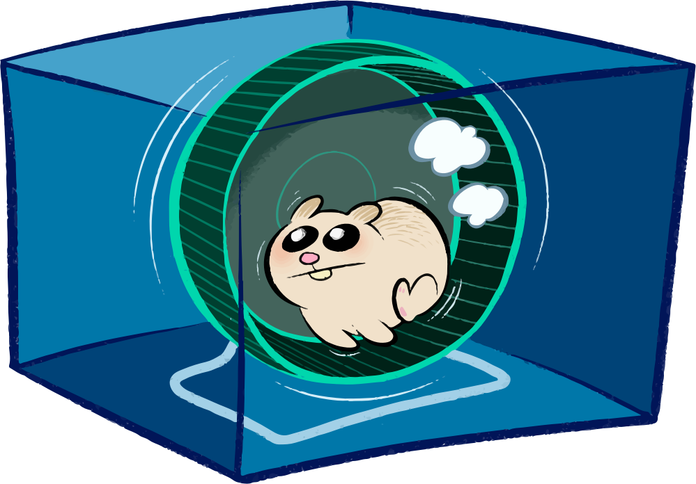
runc

Slide 3
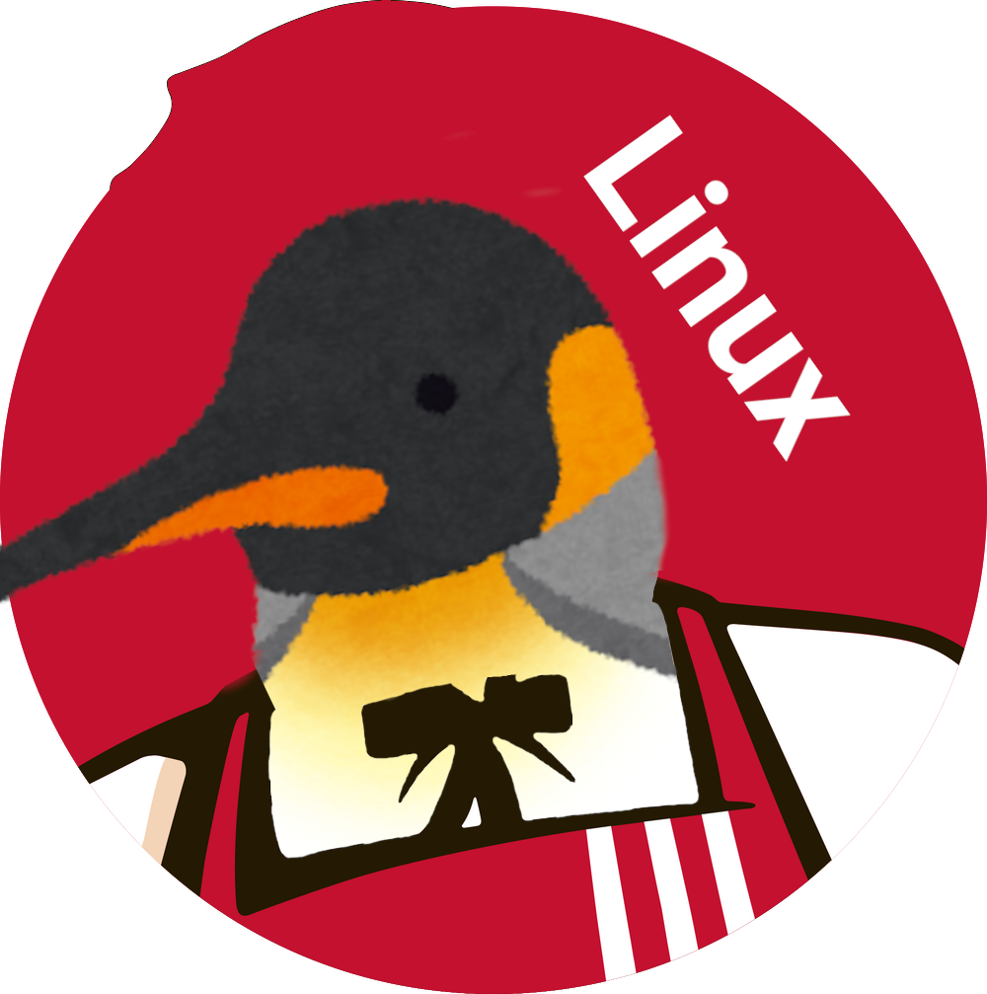
kubernetes
cri-o
containerd
runc
buildah
docker
podman

Slide 4
$ cat config.json
{
"process": { ... },
"root": { "path": "path/to/rootfs" },
"mounts": [
{ "destination": "/proc", "type": "proc" },
...
],
"linux": {
"resources": { "devices": [ ... ] },
"namespaces": [ ... ],
...
}
}

Slide 5
$ cat config.json
{ ... }
$ runc run ctr-name
ctr# ...

Slide 6
path safety
“regular” path safety
“strict” path safety (procfs)

Slide 7
regular path safety
When operating on a path, a path component might be swapped with a symlink or moved.
Classic time-of-check-to-time-of-use attacks abound.

Slide 8
example: regular path (un)safety
int fd1 = open("/rootfs/etc/foo", O_CREAT|O_TRUNC|O_RDWR, 0755);
int fd2 = open("/rootfs/etc/hosts", O_NOFOLLOW|O_RDONLY);
mkdir("/rootfs/foo", 0755);
mkdir("/rootfs/foo/bar", 0755);
link("/rootfs/foo/bar/baz", "/rootfs/foo/bar/boop");
unlink("/rootfs/foo/bar/baz");

Slide 9
example: regular path (un)safety
int fd1 = open("/rootfs/etc/foo", O_CREAT|O_TRUNC|O_RDWR, 0755);
int fd2 = open("/rootfs/etc/hosts", O_NOFOLLOW|O_RDONLY);
mkdir("/rootfs/foo", 0755);
mkdir("/rootfs/foo/bar", 0755);
link("/rootfs/foo/bar/baz", "/rootfs/foo/bar/boop");
unlink("/rootfs/foo/bar/baz");

Slide 10
surely this isn’t that common…

Slide 11
surely this isn’t that common…
CVE-2017-1002101
CVE-2018-15664
CVE-2019-16884
CVE-2019-19921
CVE-2021-30465
CVE-2023-27561
CVE-2023-28642
CVE-2024-1753
CVE-2024-45310
CVE-2024-0132
CVE-2024-0133
CVE-2024-9676
CVE-2025-31133
CVE-2025-52565
… and so on …

Slide 12
regular path safety – openat2
int openat2(int dirfd, const char *path,
struct open_how *how, size_t size);
struct open_how {
u64 flags; /* O_* flags */
u64 mode; /* O_CREAT file mode */
u64 resolve; /* resolution flags */
};

Slide 13
regular path safety – openat2
Most programs can make do with one of the following:
  RESOLVE_IN_ROOT – chroot(2)-like lookups
  RESOLVE_BENEATH – restricted lookups
  RESOLVE_NO_SYMLINKS – better O_NOFOLLOW (/ still escapes)
Requires the program to primarily use file descriptors.

Slide 14
example: regular path safety (i)
int root = open("/rootfs", O_DIRECTORY|O_PATH);
struct open_how how = { .resolve = RESOLVE_IN_ROOT };
how.flags = O_CREAT|O_TRUNC|O_RDWR;
how.mode = 0755;
int fd1 = openat2(root, "/etc/foo", &how, sizeof(how));
how.flags = O_NOFOLLOW|O_TRUNC|O_RDWR;
how.mode = 0;
int fd2 = openat2(root, "/etc/hosts", &how, sizeof(how));

Slide 15
example: regular path safety (ii)
int root = open("/rootfs", O_DIRECTORY|O_PATH);
struct open_how how =
{ .flags = O_DIRECTORY|O_PATH,
.resolve = RESOLVE_IN_ROOT };
int dfd = openat2(root, "/foo", &how, sizeof(how));
mkdirat(dfd, "bar", 0755); /* mkdir(/rootfs/foo/bar) */

Slide 16
regular path safety – O_PATH
Implement per-component lookups in userspace (very finicky).
Still requires file-descriptor-based code.
Usually needs readlink("/proc/self/fd/$n") verification.
See: systemd’s chaseat, Go’s os.Root, libpathrs.

Slide 17
libpathrs
Rust library that wraps the most commonly needed filesystem operations on a root filesystem with friendly™ C FFI interfaces.
  Also has Go and Python bindings.
  pathrs-lite – pure-Go port.
Transparently supports openat2 and the O_PATH fallback.

Slide 18
example: libpathrs (c)
#include "<pathrs.h>"
int root = pathrs_open_root("/rootfs"); /* or open(2) */
int fd1 = pathrs_inroot_creat(root, "/etc/foo",
O_RDWR|O_TRUNC, 0644);
int fd2 = pathrs_inroot_open(root, "/etc/hosts",
O_NOFOLLOW|O_RDONLY);
pathrs_inroot_hardlink(root, "/foo/bar/baz", "/foo/bar/boop");
pathrs_inroot_unlink(root, "/foo/bar/baz");

Slide 19
example: libpathrs (rust)
use pathrs::{Root, flags::OpenFlags};
let root = Root::open("/path/to/root")?;
// Resolve and open a file.
let passwd = root
.resolve("/etc/passwd")?
.reopen(OpenFlags::O_RDONLY)?;
// ... or ...
let passwd = root.open_subpath(
"/etc/passwd", OpenFlags::O_RDONLY
)?;
// Create a new file and open it (O_CREAT).
let newfile = root.create_file(
"/etc/newfile",
OpenFlags::O_RDWR,
&Permissions::from_mode(0o755),
)?;
// Create a symlink.
let newfile = root.create(
"/link",
&InodeType::Symlink("/target".into()),
)?;
// mkdir -p
let dir = root.mkdir_all(
"/foo/bar/baz",
&Permissions::from_mode(0o755),
)?;
// rm -r
root.remove_all("/foo/bar")?;
// See the docs for more info.

Slide 20
strict path safety
/proc/self/attr/exec,
/proc/self/mountinfo,
/proc/sys/$sysctl, etc.

Slide 21
strict path safety
For certain pseudo-filesystems we need to ensure we are operating on an exact path.
  procfs is most critical.
Overmounts or fake mounts can trick us into doing dangerous operations or make operations a no-op.

Slide 22
example: strict path (un)safety
int lfd = open("/proc/self/attr/exec", O_RDWR);
dprintf(lfd, "exec docker-default\n");
int pfd = open("/proc/sys/net/ipv4/ping_group_range", O_RDWR);
dprintf(pfd, "0 0\n");
int reopen = open("/proc/thread-self/fd/123", O_RDWR);
execve("/proc/self/exe", ...);

Slide 23
surely not!

Slide 24
okay, it’s a bit less common…
CVE-2019-16884
CVE-2019-19921
CVE-2025-52881

Slide 25
example: strict path safety
int procfd = open("/proc", O_DIRECTORY|O_PATH);
/* check PROC_SUPER_MAGIC and PROC_ROOT_INO */
struct open_how how =
{ .flags = O_WRONLY,
.resolve = RESOLVE_BENEATH|RESOLVE_NO_XDEV };
int lfd = openat2(procfd, "self/attr/exec", &how, sizeof(how));
dprintf(lfd, "exec docker-default\n");

Slide 26

example: strict path safety
int procfd = open("/proc", O_DIRECTORY|O_PATH);
/* check PROC_SUPER_MAGIC and PROC_ROOT_INO */
struct open_how how =
{ .flags = O_WRONLY,
.resolve = RESOLVE_BENEATH|RESOLVE_NO_XDEV };
int lfd = openat2(procfd, "self/attr/exec", &how, sizeof(how));
dprintf(lfd, "exec docker-default\n");

Slide 27
magic-links?
/proc/self/exe,
/proc/self/fd/$n,
/proc/self/root, etc.

Slide 28
example: strict path safety
int procfd = open("/proc", O_DIRECTORY|O_PATH);
/* check PROC_SUPER_MAGIC and PROC_ROOT_INO */
struct open_how how =
{ .flags = O_RDWR,
.resolve = RESOLVE_BENEATH|RESOLVE_NO_XDEV };
int reopen = openat2(procfd, "thread-self/fd/123",
&how, sizeof(how));

Slide 29

example: strict path safety
int procfd = open("/proc", O_DIRECTORY|O_PATH);
/* check PROC_SUPER_MAGIC and PROC_ROOT_INO */
struct open_how how =
{ .flags = O_RDWR,
.resolve = RESOLVE_BENEATH|RESOLVE_NO_XDEV };
int reopen = openat2(procfd, "thread-self/fd/123",
&how, sizeof(how));

Slide 30
example: strict path safety
int procfd = open("/proc", O_DIRECTORY|O_PATH);
/* check PROC_SUPER_MAGIC and PROC_ROOT_INO */
struct open_how how =
{ .flags = O_DIRECTORY,
.resolve = RESOLVE_BENEATH|RESOLVE_NO_XDEV };
int fdfd = openat2(procfd, "thread-self/fd", &how, sizeof(how));
/* validate no overmounts */
int reopen = openat(fdfd, "123", O_RDWR);

Slide 31
example: strict path safety
int procfd = open("/proc", O_DIRECTORY|O_PATH);
/* check PROC_SUPER_MAGIC and PROC_ROOT_INO */
struct open_how how =
{ .flags = O_DIRECTORY,
.resolve = RESOLVE_BENEATH|RESOLVE_NO_XDEV };
int fdfd = openat2(procfd, "thread-self/fd", &how, sizeof(how));
/* validate no overmounts */
int reopen = openat(fdfd, "123", O_RDWR);

Slide 32

example: strict path (un)safety
int procfd = open("/proc", O_DIRECTORY|O_PATH);
/* check PROC_SUPER_MAGIC and PROC_ROOT_INO */
struct open_how how =
{ .flags = O_DIRECTORY,
.resolve = RESOLVE_BENEATH|RESOLVE_NO_XDEV };
int fdfd = openat2(procfd, "thread-self/fd", &how, sizeof(how));
/* validate no overmounts */
int reopen = openat(fdfd, "123", O_RDWR);

Slide 33
man 2 fsopen man 2 fspick man 2 fsconfig man 2 fsmount man 2 open_tree* man 2 move_mount
Brand New!
Buy 0
Get 7
FREE!
Get Yours Today!

Slide 34
example: strict path safety
int procfd = open("/proc", O_DIRECTORY|O_PATH);
/* check PROC_SUPER_MAGIC and PROC_ROOT_INO */
struct open_how how =
{ .flags = O_DIRECTORY,
.resolve = RESOLVE_BENEATH|RESOLVE_NO_XDEV };
int fdfd = openat2(procfd, "thread-self/fd", &how, sizeof(how));
/* validate no overmounts */
int reopen = openat(fdfd, "123", O_RDWR);

Slide 35
example: strict path safety
int fsfd = fsopen("proc", 0);
fsconfig(fsfd, FSCONFIG_CMD_CREATE, NULL, 0, 0);
int procfd = fsmount(fsfd, 0, MOUNT_ATTR_NOEXEC|...);
struct open_how how =
{ .flags = O_DIRECTORY,
.resolve = RESOLVE_BENEATH|RESOLVE_NO_XDEV };
int fdfd = openat2(procfd, "thread-self/fd", &how, sizeof(how));
/* for open_tree(2) -- validate no overmounts */
int reopen = openat(fdfd, "123", O_RDWR);

Slide 36
example: strict path safety
int fsfd = fsopen("proc", 0);
fsconfig(fsfd, FSCONFIG_CMD_CREATE, NULL, 0, 0);
int procfd = fsmount(fsfd, 0, MOUNT_ATTR_NOEXEC|...);
struct open_how how =
{ .flags = O_DIRECTORY,
.resolve = RESOLVE_BENEATH|RESOLVE_NO_XDEV };
int fdfd = openat2(procfd, "thread-self/fd", &how, sizeof(how));
/* for open_tree(2) -- validate no overmounts */
int reopen = openat(fdfd, "123", O_RDWR);

Slide 37
example: strict path safety
int fsfd = fsopen("proc", 0);
fsconfig(fsfd, FSCONFIG_CMD_CREATE, NULL, 0, 0);
int procfd = fsmount(fsfd, 0, MOUNT_ATTR_NOEXEC|...);
struct open_how how =
{ .flags = O_DIRECTORY,
.resolve = RESOLVE_BENEATH|RESOLVE_NO_XDEV };
int fdfd = openat2(procfd, "thread-self/fd", &how, sizeof(how));
/* for open_tree(2) -- validate no overmounts */
int reopen = openat(fdfd, "123", O_RDWR);

Slide 38
example: libpathrs (c)
#include "<pathrs.h>"
int lfd = pathrs_proc_open(PATHRS_PROC_SELF,
"attr/exec", O_WRONLY);
dprintf(lfd, "exec docker-default\n");
int pfd = pathrs_proc_open(PATHRS_PROC_ROOT,
"sys/net/ipv4/ping_group_range",
O_RDWR);
dprintf(pfd, "0 0\n");
int reopen = pathrs_reopen(123, O_RDWR); // or pathrs_proc_open

Slide 39
example: libpathrs (rust)
use pathrs::{flags::OpenFlags, procfs::*};
// Open *regular* file.
let attr_file = ProcfsHandle::new()?
.open(
ProcfsBase::ProcThreadSelf,
"attr/exec",
OpenFlags::O_WRONLY,
)?;
// Create your own private handle.
let handle =
ProcfsHandleBuilder::new()
.unmasked(true)
.build()?;
// Open a magic-link.
let exe = ProcfsHandle::new()?.open_follow(
ProcfsBase::ProcSelf,
"exe",
OpenFlags::O_RDONLY,
)?;
// Equivalent to readlinkat(fd, "").
let fd_path = ProcfsHandle::new()?.readlink(
ProcfsBase::ProcThreadSelf,
format!("fd/{}", file.as_raw_fd()),
OpenFlags::O_RDONLY,
)?;

Slide 40
“wait, why do we care about this?”

Slide 41
runc

Slide 42
threat models
runc (currently) has no real threat model.
Most vulnerabilities have been “misconfiguration” bugs.
Higher-level runtimes let unprivileged users do wacky things.
Most people still don’t use user namespaces.

Slide 43
pop quiz!

Slide 44
is this a vulnerability? (i)
$ cat config.json
{
"linux": { "namespaces": [] },
...
}

Slide 45

is this a vulnerability? (i)
$ cat config.json
{
"linux": { "namespaces": [] },
...
}

Slide 46
is this a vulnerability? (ii)
$ cat config.json
{
"mounts": [
...,
{ "destination": "/host",
"source": "/",
"type": "bind",
"options": [ "rbind" ] }
],
...
}

Slide 47

is this a vulnerability? (ii)
$ cat config.json
{
"mounts": [
...,
{ "destination": "/host",
"source": "/",
"type": "bind",
"options": [ "rbind" ] }
],
...
}

Slide 48
is this a vulnerability? (iii)
$ cat config.json
{
"mounts": [
...,
{ "destination": "/volume",
"source": "/some/volume/path",
"type": "bind",
"options": [ "rbind" ] },
...
],
...
}

Slide 49

is this a vulnerability? (iii)
$ cat config.json
{
"mounts": [
...,
{ "destination": "/volume",
"source": "/some/volume/path",
"type": "bind",
"options": [ "rbind" ] },
...
],
...
}

Slide 50
CVE-2025-31133 / CVE-2025-52565
$ cat config.json
{
"mounts": [
...,
{ "destination": "/volume",
"source": "/some/volume/path",
"type": "bind",
"options": [ "rbind" ] },
...
],
...
}

Slide 51
CVE-2025-31133 / CVE-2025-52565
/volume is a symlink to /dev.
Racing process swaps files in /some/volume/path
with symlink to /proc/sys/kernel/core_pattern:
  CVE-2025-31133 – /dev/null (masked files)
  CVE-2025-52565 – /dev/pts/0 (/dev/console)
Bind-mount source becomes /proc/sys/kernel/core_pattern, creating a rw bind-mount to a masked procfs file.

Slide 52
solutions
Added much stricter validation of special inodes we use.
  Takeaway: “Safe” major:minor numbers are very handy.
Mountpoint creation was moved to libpathrs (pathrs-lite).
  Everything is now (mostly) file-descriptor-based.
  Takeaway: Wow, regular path safety is a good idea!
TIOCGPTPEER for consoles.

Slide 53
is this a vulnerability? (iv)
$ cat config.json
{
"mounts": [
...,
{ "destination": "/proc",
"source": "/fake/procfs",
"type": "bind",
"options": [ "rbind" ] },
],
...
}

Slide 54

is this a vulnerability? (iv)
$ cat config.json
{
"mounts": [
...,
{ "destination": "/proc",
"source": "/fake/procfs",
"type": "bind",
"options": [ "rbind" ] },
],
...
}

Slide 55
is this a vulnerability? (v)
$ cat config.json
{
"mounts": [
...,
{ "destination": "/proc/1/attr/apparmor/exec",
"source": "/proc/1/sched",
"type": "bind",
"options": [ "rbind" ] },
],
...
}

Slide 56

is this a vulnerability? (v)
$ cat config.json
{
"mounts": [
...,
{ "destination": "/proc/1/attr/apparmor/exec",
"source": "/proc/1/sched",
"type": "bind",
"options": [ "rbind" ] },
],
...
}

Slide 57
is this a vulnerability? (v)
$ cat config.json
{
"mounts": [
...,
{ "destination": "/proc/1/attr/apparmor/exec",
"source": "/proc/1/sched",
"type": "bind",
"options": [ "rbind" ] },
],
...
}
Rejected!

Slide 58
is this a vulnerability? (vi)
$ cat config.json
{
"mounts": [
...,
{ "destination": "/foo", "source": "/some/cache/path",
"type": "bind", "options": [ "rbind" ] },
{ "destination": "/foo/link/thread-self/attr/apparmor",
"source": "/some/other-cache/path",
"type": "bind", "options": [ "rbind" ] },
],
...
}

Slide 59

is this a vulnerability? (vi)
$ cat config.json
{
"mounts": [
...,
{ "destination": "/foo", "source": "/some/cache/path",
"type": "bind", "options": [ "rbind" ] },
{ "destination": "/foo/link/thread-self/attr/apparmor",
"source": "/some/other-cache/path",
"type": "bind", "options": [ "rbind" ] },
],
...
}

Slide 60
CVE-2025-52881
$ cat config.json
{
"mounts": [
...,
{ "destination": "/foo", "source": "/tmp/cache-foo",
"type": "bind", "options": [ "rbind" ] },
{ "destination": "/foo/link/thread-self/attr/apparmor",
"source": "/tmp/cache-apparmor",
"type": "bind", "options": [ "rbind" ] },
],
...
}

Slide 61
CVE-2025-52881
/tmp/cache-apparmor/exec is a symlink to a fun target:
  /proc/1/sched – (no-op)
  /proc/sysrq-trigger (crash – "exec docker-default")
Racing process swaps /foo/link symlink between /proc and dummy directory.
  This bypassed our anti-/proc mount checks.
/proc/sys/kernel/core_pattern allows a container escape.

Slide 62
solutions
Additional hardening when doing mounts.
  Takeaway: We really should’ve switched to the new mount API much earlier.
Switch to libpathrs (pathrs-lite) procfs API for writes.
  Also, audited all write paths for misdirectable writes.
  Takeaway: Protecting against everything is quite hard.

Slide 63
runc todos
Move our mount infrastructure to fsopen / open_tree.
  Masked path application will finally be atomic.
Do a deeper audit of all path-based code in runc.
Switch to libpathrs for runc builds.
  pathrs-lite can use libpathrs as a backend.

Slide 64
kernel todos
Still some nice-to-have extensions for openat2.
  RESOLVE_NO_DOTDOT?
  rootfd / cwdfd split?
Blocking all magic-link overmounts would help a lot.
  Most have been blocked since 6.12.

Slide 65
general takeaways
Use openat2 or libpathrs (for Go, maybe pathrs-lite).
  Switch to a more file-descriptor based design.
  Doubly so if you need to touch /proc.
Every pathname syscall is potentially dangerous.

Slide 66

questions?
(rants, pitchforks…?)
CC-BY-SA 4.0

Slide 67
fun issues

Slide 68
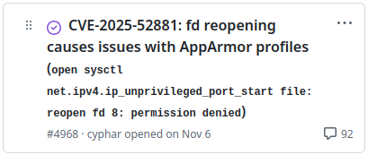
apparmor, d_path, pain

Slide 69
apparmor, d_path, pain
Nested containers (under LXC).
AppArmor returns -EACCES for /proc/sys/net/... write.
Triggered by switch to fsopen("proc").

Slide 70
apparmor, d_path, pain
deny /proc/sys/[^fknu]*{,/**} wklx,
deny /proc/sys/n[^e]*{,/**} wklx,
deny /proc/sys/ne[^t]*{,/**} wklx,
deny /proc/sys/net?*{,/**} wklx,
...

Slide 71
apparmor, d_path, pain
deny /proc/sys/[^fknu]*{,/**} wklx,
deny /proc/sys/n[^e]*{,/**} wklx,
deny /proc/sys/ne[^t]*{,/**} wklx,
deny /proc/sys/net?*{,/**} wklx,
...
deny /sys/[^fdck]*{,/**} wklx,
deny /sys/k[^e]*{,/**} wklx,
...

Slide 72
apparmor, d_path, pain
deny /proc/sys/[^fknu]*{,/**} wklx,
deny /proc/sys/n[^e]*{,/**} wklx,
deny /proc/sys/ne[^t]*{,/**} wklx,
deny /proc/sys/net?*{,/**} wklx,
...
deny /sys/[^fdck]*{,/**} wklx,
deny /sys/k[^e]*{,/**} wklx,
...

Slide 73
runc
AppArmor

Slide 74
runc
AppArmor
int procfd = fsopen("proc");
aa_path_name() ⇒ "/"

Slide 75
runc
AppArmor
int procfd = fsopen("proc");
int fd = openat(procfd,
"sys/foo/bar", ...);
aa_path_name() ⇒ "/"
aa_path_name() ⇒ "/sys/foo/bar"

Slide 76
runc
AppArmor
int procfd = fsopen("proc");
int fd = openat(procfd,
"sys/foo/bar", ...);
aa_path_name() ⇒ "/"
aa_path_name() ⇒ "/sys/foo/bar"
-EACCES

Slide 77
apparmor, d_path, pain
int fsfd = fsopen("tmpfs", 0);
fsconfig(fsfd, FSCONFIG_CMD_CREATE, NULL, 0, 0);
int tmpfd = fsmount(fsfd, 0, MOUNT_ATTR_NOEXEC|...);
mkdirat(tmpfd, "sys", 0755);
openat(tmpfd, "sys/foo", O_CREAT, 0755); /* EACCES */

Slide 78
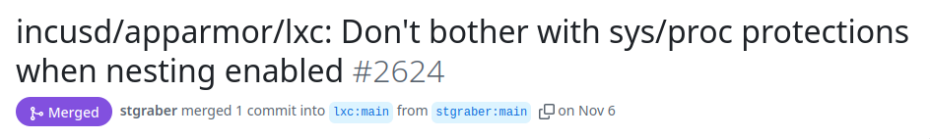
apparmor, d_path, pain

Slide 79
dangling symlinks
Previously we would expand dangling symlinks.
  /foo/bar → /some/non-existant/path
  /foo/bar/baz → /some/non-existant/path/baz
Some users depend on this behaviour…
  Emulating it with file descriptors is quite hard.
Solution: Expand the path and then use that as the user path.

Slide 80
questions?
(rants, pitchforks…?)
CC-BY-SA 4.0

