Slide 1
Extensible Syscalls
Christian Brauner (Canonical)
<christian.brauner@ubuntu.com>
Aleksa Sarai (SUSE)
<cyphar@cyphar.com>

Slide 2
Groundhog Day
We need an agreement on how we design future APIs.
  Same argument with each new API proposal.
  Either people want ...
to have a full-blown multiplexer that is so generic that ideally it spans multiple APIs at once; or
individual syscalls for each operation.
We’ve burned userspace and ourselves with both of them already.
  There are no good guidelines to follow for developers.
Notes:
CHRISTIAN

Slide 3
Groundhog Day
We should have documented stronger requirements for newer syscalls.
  A baseline of extensibility for new syscalls (to avoid the renameat2/readlinkat/dup/accept/… problem).
  Note that we’re not proposing that using structs in syscalls is the new baseline for extensibility. The baseline of extensibility should be the requirement of a flag argument.
    Arguably this is the case today, though there are quite a few syscalls without a flag argument that should have one…
Notes:
CHRISTIAN

Slide 4
Alternative ways of dealing with extensions
Always require a new syscall.
  Costly for userspace to adapt their codebases to new syscalls all the time. This is especially true for shared libraries (doubly so with seccomp).
  That’s the other extreme of having full-blown ioctl-style multiplexers.
  64-bit flag arguments.
Add a new flag and have a fun time with va_arg (fcntl-style).
  Glibc has had “fun” with this (O_TMPFILE), and it’s pretty damn ugly.
  64-bit flag arguments.
Fixed-size struct with “enough” padding.
  We are bad at predicting the future.
  Why not go the extra step and not worry about having good predictions?
Buy a time machine and skip extensions.
  Can I have one too, please?
  128-bit flag arguments (probably).
Notes:
ALEKSA

Slide 5
Extensible structs - a modest compromise
Introduction of new syscalls is a pain for userspace.
  There should be a compromise between having a dedicated syscall for everything and stuffing everything into a single syscall.
Extensible structs are a modest proposal one step further from flag-based extensibility but far away from ioctl madness:
creat(2) -- open(2) -- openat2(2) -- prctl(2) -- ioctl(2)
Notes:
ALEKSA/CHRISTIAN

Slide 6
Why add more fuel to the fire?
Support APIs that can be expected to grow beyond just adding flags.
Need a better compromise between maintainability and simplicity.
Alternatives are inconvenient (there are better uses for time travel).
Better to deal with this fire here and now rather than having the same (derailing) argument on every patchset, which discourages new contributors and leads to inconsistent APIs.
  And we can document the conclusions of this discussion to avoid bringing this issue up again.
Notes:
ALEKSA/CHRISTIAN

Slide 7
Extensible structs
int openat2(int fd, const char *path,
struct open_how *how, size_t usize);
New fields always appended.
  Zero value in new fields means “old behavior”
(ksize == usize) Copy the struct verbatim.
(ksize > usize) Copy usize bytes, zero-fill trailing bytes.
(ksize < usize) Copy ksize bytes, check if trailing bytes are zeroed. If non-zero bytes are present, return -E2BIG.
Dedicated kernel helper called copy_struct_from_user().
struct open_how how = {
.flags = O_RDONLY,
.resolve = RESOLVE_IN_ROOT,
.newfield = SOME_NEW_FLAG,
};
int fd = openat2(dfd, path,
&how, sizeof(how));
/* -E2BIG if .newfield not supported. */
/* -EINVAL if O_RDONLY not supported. */
if (fd < 0)
return -1;
Notes:
ALEKSA

Slide 8
No more multiplexers
Extensible structs are _not_ multiplexers. They especially need to be discerned from multiplexers with polymorph types passed through a void pointer or a union or a long...
  For example, bpf(2) is a multiplexer making use of extensible structs not an extensible struct based syscall.
  Most people don’t want to introduce any new polymorph multiplexers. That seems almost universally agreed upon.
  glibc is explicitly advising against the introduction of new multiplexers as they are hard to deal with in shared libraries.
Notes:
CHRISTIAN

Slide 9
va_arg … more like bad_arg
va_arg style extension (as used by multiplexers like fcntl(2) and prctl(2)) deserve explicit mention:
  Ugly to use due to the need to indicate which arguments should be ignored (either through flags or command enum).
  Are limited to 5-6 arguments depending on architecture.
  Glibc has to call va_arg(3) unconditionally because they don’t know if a future command will require more arguments (the upshot is that they pass garbage from the stack and hope the kernel ignores it and there’s enough data in the stack).
Notes:
ALEKSA

Slide 10
The “cr*p insertion vector” argument
Someone raised the concern that extensible structs can be abused to “sneak in” problematic features without sufficient review, while being forced to introduce a new syscall in order to support the same new feature would cause a more thorough review.
Notes:
CHRISTIAN
Fwiw, features get snuck in by routing them through subtrees where only a subset of people are subscribed.

Slide 11
The “cr*p insertion vector” argument
There are at least four counter-points:
For a start, the features that prompted that reaction were all caught during review so there’s doubt that this is even a real problem. Especially for high-profile subsystems such as the vfs and core kernel.
To the extent that this is a problem, it is no more of a problem than with flags and other extension designs -- subsystem maintainers should already be reviewing ABI changes enough to avoid this. All this design adds is the ability to easily add new fields to structs…
Notes:
ALEKSA/CHRISTIAN

Slide 12
The “cr*p insertion vector” argument
It is debatable that syscalls prompt a more thorough review. We have a bunch of syscalls with very questionable APIs (keyctl(2), dup(2), etc.). There’s even an LWN article about it.
All of the existing “questionable features” proposed could be applied to flags (O_MAYEXEC was originally an openat(2) patch). Is the ability to easily add new fields to existing struct arguments really the only thing stopping questionable features from being snuck in?
Notes:
ALEKSA/CHRISTIAN
We should mention that sneaking patches by maintainers and not having a list for changes that have kernel-wide implications but are not uapi changes are a major problem.

Slide 13
Checking for supported features
Userspace needs to know what features are supported in a given syscall. This is usually done by having a (painful) trial and error approach.
  Userspace has to write elaborate cosplay scenarios where we have to exercise the feature to see if it works without borking the system.
  Emulation makes this worse because emulated syscalls act strange.
  This is maybe fine for long-running system daemons but it certainly isn’t workable for shared libraries or shorter-running programs (nor for our sanity -- see the LXD code for this).
It should be possible to do this in a much simpler way -- and thanks to the design of extensible struct argument syscalls we can do it in a manner which is backward- and forward-compatible.
Notes:
CHRISTIAN

Slide 14
Checking for supported features
Here’s an initial proposal.
Already discussed on libc-alpha mailing list in the context of clone3(2) and more broadly at Linux.conf.au 2020.
Syscall is no-op (returns some errno) and “returns” version of struct where:
  All valid flag bits in flag fields are set.
  All non-flag fields are filled with 0xFF. (Could be implemented as way of describing limits for fields.)
Userspace then looks at the final struct to determine feature support.
struct clone_args arg = {
// (1 << 63)
.flags = SUPPORTED_BITS
};
int ret = clone3(&arg, sizeof(arg));
assert(ret < 0); // always fails
if (errno != E_SUPPORTED_BITS_NOOP) {
// kernel without feature check
if (errno == EINVAL)
args = CLONE3_INIT_VERSION;
else
return -1;
}
bool abc_supported = args.flags & CLONE_ABC;
bool xyz_supported = args.xyz != 0;
Notes:
ALEKSA

Slide 15
Checking for supported features
(ksize == usize) Copy the struct verbatim.
(ksize > usize) Copy usize bytes, any trailing bytes on the kernel side are ignored.
(ksize < usize) Copy ksize bytes, zero-fill the trailing (usize - ksize) bytes (unknown extensions have their zero value defined as the “old behaviour”).
New copy_struct_to_user() helper.
struct clone_args arg = {
// (1 << 63)
.flags = SUPPORTED_BITS
};
int ret = clone3(&arg, sizeof(arg));
assert(ret < 0); // always fails
if (errno != E_SUPPORTED_BITS_NOOP) {
// kernel without feature check
if (errno == EINVAL)
args = CLONE3_INIT_VERSION;
else
return -1;
}
bool abc_supported = args.flags & CLONE_ABC;
bool xyz_supported = args.xyz != 0;
Notes:
ALEKSA

Slide 16
Making this part of the kernel docs
Documentation/process/adding-syscalls.rst is of questionable currency.
  Our first attempt to update it went largely unnoticed.
Proposal to update adding-syscalls.rst:
  Formalise how extensible structs are intended to be used.
    perf_event_open is currently mentioned
    … but clone3/openat2 are more modern.
  Mention new variable argument or type polymorph multiplexers are not encouraged.
  Mention syscalls with a flag argument for extensibility should use unsigned int.
  Describe common issues the glibc folks have (such as pointer types in structs, et al) as well as “C annoyances” such as explicit padding and aligned fields.
Notes:
ALEKSA/CHRISTIAN

Slide 17
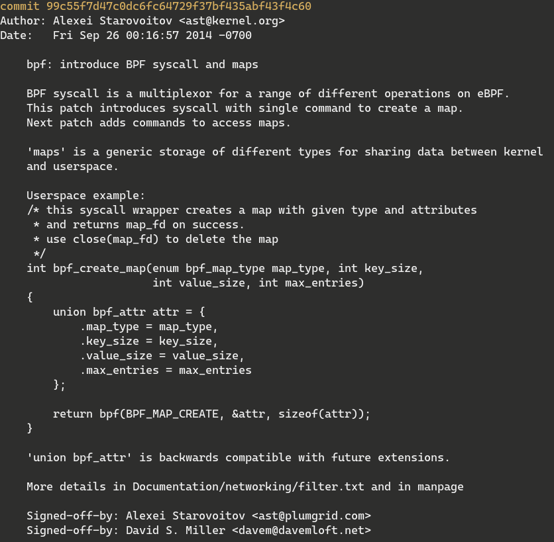

Slide 18
va_arg … more like really_bad_arg
va_arg style multiplexers cause even more issues for glibc in general:
  Different argument types cause confusion.
  size_t and long cannot be differentiated and this causes issues on x32-compat due to differences between the kernel and C calling conventions (kernel requires zero or sign extension).
  Changing a type of an argument for a single variant requires us to port all users of the syscall to a new version (see futex(2) and 64-bit time_t -- all futex users needed to be ported even though only a few futex operations actually use time_t).
Notes:
We have to differentiate between long arguments and size_t arguments. X32 psABI doesn’t define
what the upper 32 bits are but the kernel ABI used the regular x86_64 code,
Which expects either sign extension or zero extension.
- flag type conventions (only for arguments)
If you add a flag to a syscall to keep it extensible use unsigned int
Keep it consistent because we have long, int,unisnged int
Glibc has a hard time dealing with longs because their size is architecture specific and depending on the calling convention of the underlying architectures and you might end up in trouble beacuse of sign or zero extension.
in_compat_syscall()
Multiplexer-Syscalls (fcntl, ioctl, socketcall, futex, and open() with O_TMPFILE).
They are very problematic wrt to extensibility, espe cially when the types and number of arguments vary between
The different variants. Compare the problem with open(), O_TMPFILE and the mod_t argument.
fcntl() solves this by always calling va_arg() internally even if the operation doesn’t have an additional argument.
For prctl() we do it the same way now. Because the TCB (thread-local storage stuff) is on the stack at the moment
There is always enough data, even on architectures like i386, which pass the arguments on the stack.
But this is not clean/elegant. We cannot differentiate between size_t and long in userspace for multiplexer syscalls.
For that to be possible we would have to built-in the constants for the different multiplexer operations into glibc.
Multiplexing syscalls are problematic for changes like 64-bit time_t (see the y2038 problem).
Only a few obscure futex operations are affected by that because the rest of them has no
time relevatnt operations. Because of the multiplexer all applications using futexes have to be
ported to the 64-bit syscall.
/proc and file descriptors are problematic for glibc: /proc is not always mounted and applications expect that we don’t
open any additional file descriptors permanently. For the time of a single function call it’s okay. But when we return to
the application all the file descriptors should be closed (because of closeall for example).

