Slide 1






CONTAINER IMAGES CONSIDERED HARMFUL
Aleksa Sarai
Senior Software Engineer – SUSE
asarai@suse.de
Notes:
Spiel about who you are.
What is the OCI?
(Make joke about title?)

Slide 2
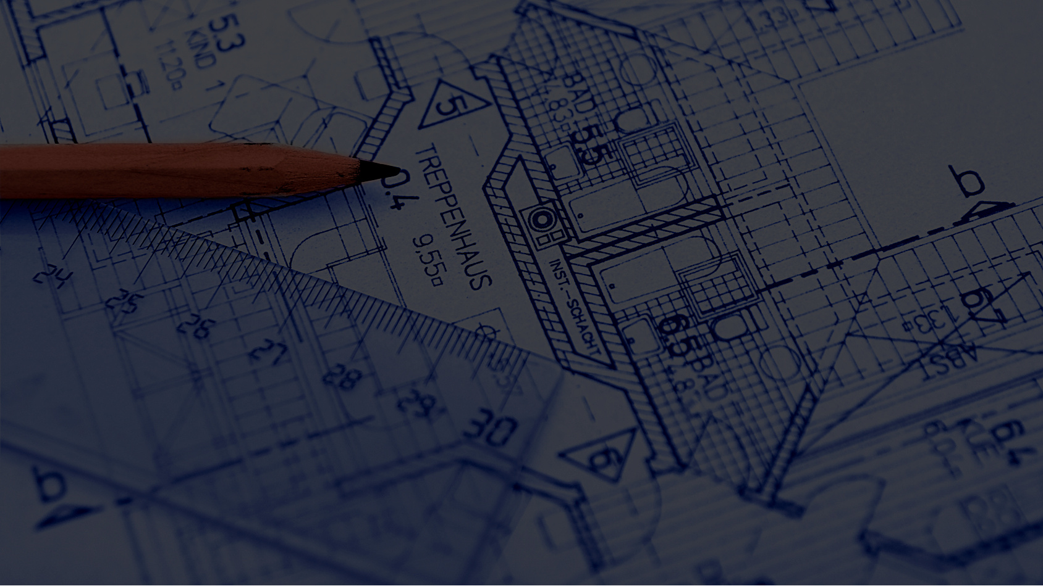
“From First Principles”
What do we really want?
© 2011 Forgemind ArchiMedia
Notes:
Lets take a first-principles approach.
Most container image formats have a variety of problems.
What are some properties we really want in a format?

Slide 3
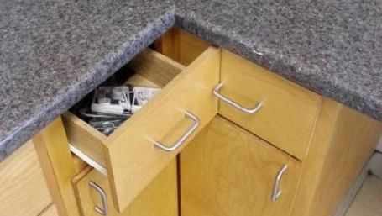
(Aside from the obvious.)
Notes:
Aside from the obvious like:
Self-contained.
Machine-independent.
And so on.

Slide 4
Deduplicated (transfer and storage).
Parallelisable (transfer and extraction).
Reproducible (canonical representation).
Non-avalanching.
Transparent.
Notes:
Deduplication of transfer and storage are two different concepts.
Transfer: gzip transport or delta-rpms.
Storage: zfs send+recv with dedup enabled.
We want to not pull bits we already have, and want good copy-on-write storage semantics (at least) for everything in our image.

Slide 5
Deduplicated (transfer and storage).
Parallelisable (transfer and extraction).
Reproducible (canonical representation).
Non-avalanching.
Transparent.
Notes:
We want to use all of our CPUs. Let’s use formats that don’t stop us from doing that without reason.
Transfer: HTTP/2 push is already quite useful.
Extraction: *sigh about tar*

Slide 6
Deduplicated (transfer and storage).
Parallelisable (transfer and extraction).
Reproducible (canonical representation).
Non-avalanching.
Transparent.
Notes:
Reproducible builds are fairly trendy in distributions circles.
Let’s not use a format that makes reproducibility awful. And preferably have a canonical representation to avoid silly disagreements.

Slide 7
Deduplicated (transfer and storage).
Parallelisable (transfer and extraction).
Reproducible (canonical representation).
Non-avalanching.
Transparent.
Notes:
We want to have the minimal number of new things to download for small changes. Similar to deduplication but this is a more design-centric argument.
Think “bad hash algorithm”.

Slide 8
Deduplicated (transfer and storage).
Parallelisable (transfer and extraction).
Reproducible (canonical representation).
Non-avalanching.
Transparent.
Notes:
Do you know what’s running in your containers?
In distribution circles (especially openSUSE and OBS) this is something we’ve had for ages and is important for auditing and being able to know what’s going on.
Containers have nothing like this, and the current state-of-the-art is scanning-oriented.

Slide 9
Deduplicated (transfer and storage).
Parallelisable (transfer and extraction).
Reproducible (canonical representation).
Non-avalanching.
Transparent.
Notes:
How many do you think most container image formats have in a sufficiently useful way?

Slide 10
(This slide intentionally left blank.)
Notes:
Probably less than you thought.

Slide 11
index
Content-Addressable Store
config
manifest
layer₁
…
layer_{n}
Notes:
OCI ~ Docker
The entire thing is content-addressed. The arrows are smart pointers which use the hash of the target.
They are all JSON objects, with tar objects at the bottom (one for each layer and are applied in oldest-first order).
I will be ranting about the tar construction.

Slide 12
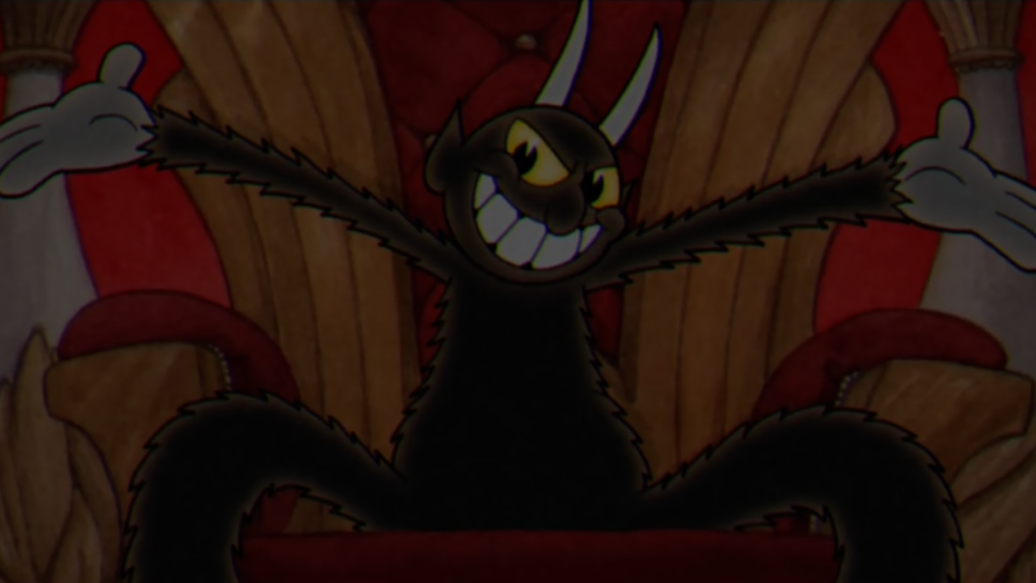
Devil’s Advocate
© 2017 StudioMDHR
Notes:
Some argue that the usage of tar archives is fine. I will get into counter-examples but first let me play devil’s advocate.

Slide 13

https://xkcd.com/927/
“It’s a POSIX standard!”
Notes:
It’s in POSIX (though I could rant about that for a long time) and has language bindings (and I will rant about this for a bit later).

Slide 14

“It’s the obvious choice.”
Notes:
Everyone knows about tar, and so why not use it to represent whole filesystems?

Slide 15

“Layer-level deduplication is Good EnoughTM.”
Notes:
Maybe it’s not pefect but it works well enough, and if you know enough about the format you can work around its issues.
(It is actually broken which is why I mentioned it as a property that’s missing).

Slide 16

“Show me the money examples!”

Slide 17
layer₁
layer₂
Header
Header
10GB
Data
10GB
Data
% touch /foo
Notes:
Metadata only-changes cause a full data copy-up.
On extraction the data is re-extracted for no good reason (layers are extracted in-order which is why parallel extraction is not possible)!
Solutions:
Metadata-only tar headers. Solaris has this but it’s not part of POSIX.

Slide 18
layer₁
layer₂
Header
Header
10GB
Data
10GB
Data
% echo >> /foo
Notes:
Minor changes require a full copy-up of everything.
Solutions:
Chunking extension. There are some extensions (multi-archive) but they’re incompatible and just cause a bunch of issues.

Slide 19
opensuse/tumbleweed₁
opensuse/tumbleweed₂
/bin/bash
/bin/bash
/bin/zsh
/bin/zsh
/usr/bin/ping
% oci-pull image
/usr/bin/ping
/usr/bin/blah
/usr/bin/blah
/usr/share/man/**
/usr/share/man/**
/usr/lib/foo.so
/usr/lib/foo.so
/usr/lib64/bar.so
Notes:
Distributions are single-layer.
Each time you re-pull an existing image you redownload the whole thing.
Do we need to? No.
Solution:
LXD has a solution for this (binary diffs similar to delta-rpms).
File-level granularity? Not sure.

Slide 20
% oci-pull ubuntu
% oci-pull opensuse
ubuntu:18.04
opensuse/tumbleweed
/bin/bash
/bin/bash
/bin/zsh
/bin/zsh
/usr/bin/apt
/usr/bin/ping
/usr/bin/ping
/usr/bin/zypper
/usr/share/man/**
/usr/share/man/**
/usr/lib/libc.so
/usr/lib/libc.so
Notes:
Honestly, distributions are all very similar.
But we redownload glibc and bash (and man pages) each time we pull an image.
Solutions:
Cross-image dedup requires some sort of chunking.

Slide 21
% oci-build myimg
% oci-build myimg
myimg₁
myimg₂
/foo/**
/foo/**
≠
/opt/bar/**
/usr/share/man/**
/usr/share/man/**
/usr/lib/libc.so
/usr/lib/libc.so
/opt/bar/**
Notes:
Tar has many ways you can have an equivalent image and any single change makes the deduplication useless.
Solutions:
Make a canonical representation that is a subset of tar (problems: we don’t have that, and doing it is hard because every implementation would have to match it.)

Slide 22

Ranting is all well and good.
But how can we do better?

Slide 23
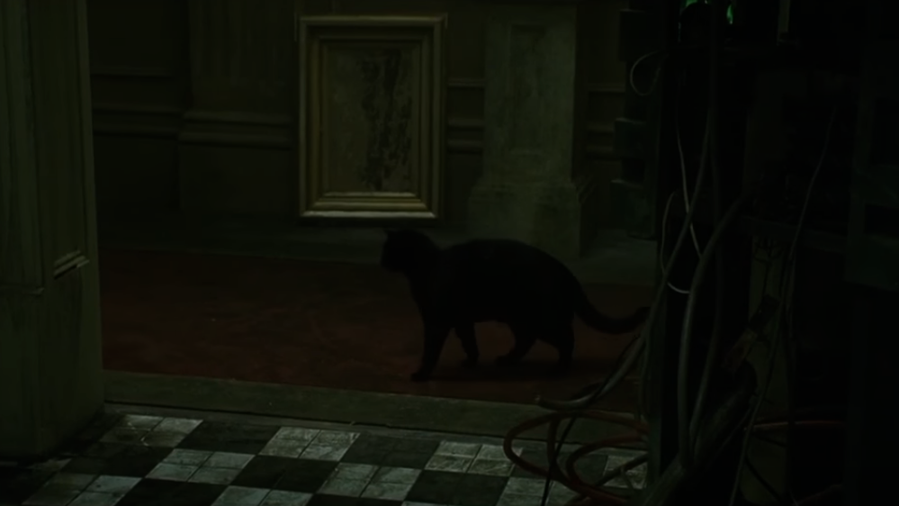
Tangent – Backups.
We’ve been here before.

Slide 24
Pictured: A Humble File.

Slide 26
foo

Slide 27
bar

Slide 29
baz

Slide 30
baz

Slide 31
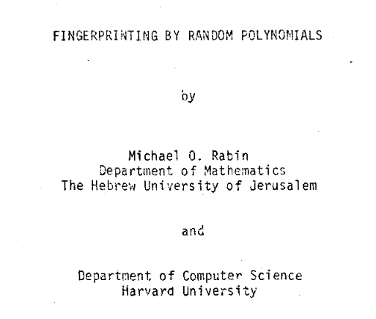
We have to go back (to 1981)!
Content-Defined Chunking

Slide 32
Pictured: A(nother) Humble File.

Slide 33
foo

Slide 34
bar

Slide 35
bar

Slide 37
baz

Slide 38
baz

Slide 39
Per-Snapshot Merkle Tree (of Chunks)
Deduplicated, parallelisable and non-avalanching.
Notes:
Just with chunking and using a per-snapshot merkle tree we get almost all of the features we want.

Slide 40
With a canonical representation!
dir
snap
meta
file
c₁
c₂
c₃
c₄
Notes:
And here’s how we’d bundle together these chunks into an image. Note that the metadata is separate and we have a merkle tree that can be extracted in parallel.
And you get deduplication between layers and between distinct images. All for free!

Slide 41
dir
snap
meta’
file
c₁
c₂
c₃
c₄
Notes:
Metadata-only changes have no copy-up effect.
You also always know what the latest version of the data is.

Slide 42
Intra-layer, inter-layer, and even inter-image deduplication!
dir
snap
meta
file
c₁
c₂’
c₃
c₄
Notes:
And chunk-level changes only affect the minimal amount of bits.

Slide 43
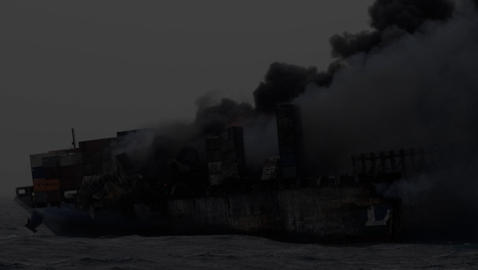
Storage?
*Incoherent rambling about copy_file_range.*

Slide 44
}
What is actually in
this thing?

Slide 45

Transparency.
It’s important.

Slide 46
libfoobar=1.3.37
+
Package Manifest

Slide 47
We can do better, so let’s do better.

