Slide 1

Operating System Security:
Attacking Container Runtimes
Aleksa Sarai
Senior Software Engineer [SUSE]
<cyphar@cyphar.com>

Slide 2
The Plan
A brief introduction to containers (20’).
Filesystems and path resolution attacks (20’).
Other miscellaneous container runtime attacks (10’).
Q & A.

Slide 3
Containers?

Slide 4
tl;dr
Containers are a secure^{[citation needed]} way of running multiple isolated services on a single machine without incurring the performance and resource overhead of VMs.
  Virtual machines → hardware virtualisation → the hardware is a lie.
  Containers → operating system virtualisation → the OS environment is a lie.
Widely adopted in the past few years (Docker, Kubernetes, et al).

Slide 5
tl;dr
Virtual Machines
Containers
App
Sys.
App
Sys.
Application
Kernel
Kernel
System
Services
Application
“Hardware”
“Hardware”
Kernel
Hardware

Slide 6
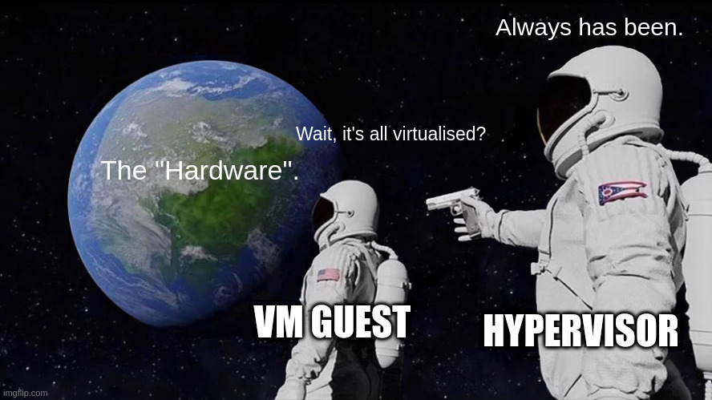
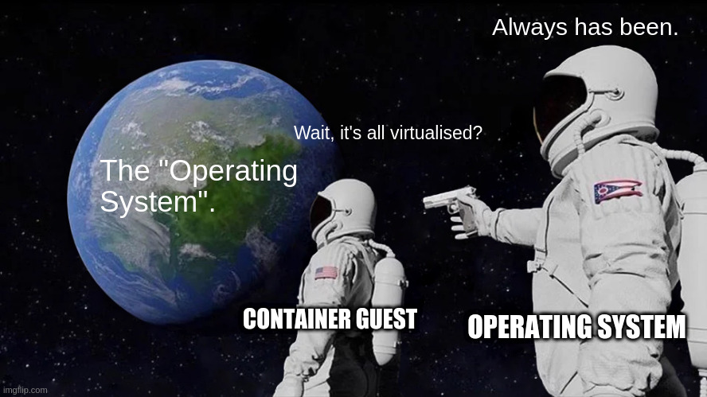
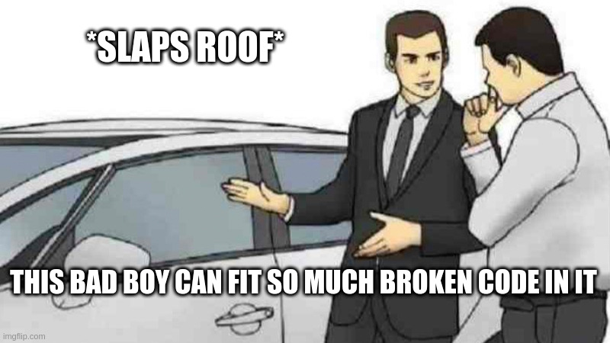
tl;dr in meme form
Virtual Machines
Containers
App
Sys.
App
Sys.
Kernel
Kernel
“Hardware”
“Hardware”
Kernel
Hardware

Slide 7
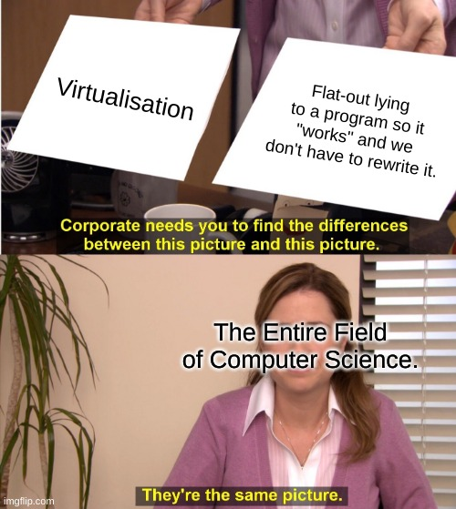

Slide 8
A Brief History Lesson.
1967: IBM CP-40 is “first real VM”
1972: IBM System/370 can host VMs.
Required additional support for
hardware accelerated virtualisation.
2000s: Intel VT-x (‘05), AMD-V (‘06).
First “full virtualisation” support for x86
by adding instructions to “fake” ring-0.
1960s: Time-sharing systems.
1970s: Multi-user systems (Unix).
chroot(2) (‘79).
2000s: Introduction of containers.
FreeBSD Jails (‘00), Linux vServer (‘01),
Solaris Zones (‘05), OpenVZ (‘05),
LXC (‘08), Docker (‘13).
Interesting talk on (part of) this history: https://youtu.be/hgN8pCMLI2U

Slide 9
chroot
First “container” concept – introduced in Unix v7.
Run a normal program, but pretend a host directory is the root ("/").
  (In theory) service cannot access anything outside "/".
  Operating system virtualises (lies about) the filesystem layout.
Widely used for running file sharing and web servers for decades.

Slide 10
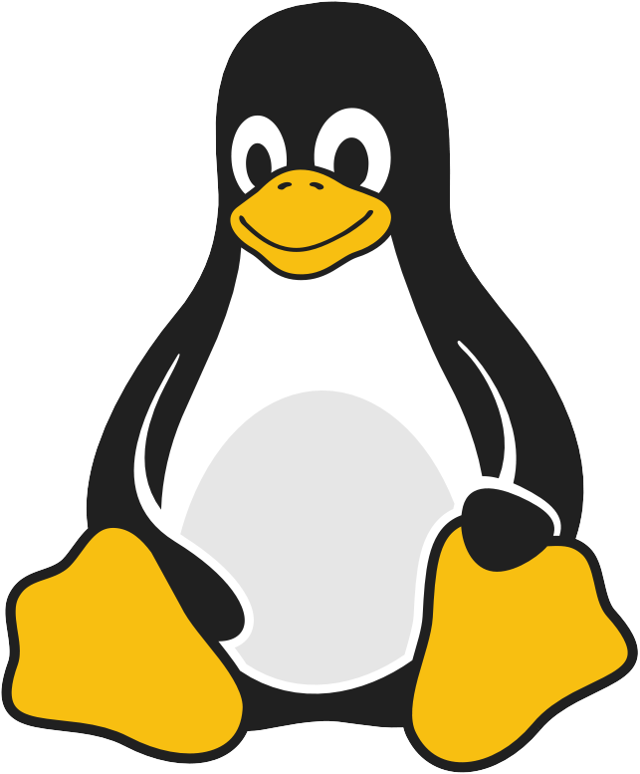
chroot
[good_program.gif]
Host Filesystem
/
etc/
shadow
var/run/
bank-records.csv
home/pedram/
test-answers.txt
var/www/htdocs/
index.php
forum.php
Yo, can you pass me a handle to
/var/www/htdocs/index.php?
Sure, here you go!

Slide 11
chroot
[evil_program.gif]
Host Filesystem
/
etc/
shadow
var/run/
bank-records.csv
home/pedram/
test-answers.txt
var/www/htdocs/
index.php
forum.php
Yo, can you pass me a handle to
/home/pedram/test-answers.txt?
Sure, here you go!

Slide 12
chroot
[good_program.gif]
Host Filesystem
/
home/pedram/
test-answers.txt
chroot/
bin/
good_program
evil_program
var/www/htdocs/
index.php
Yo, can you pass me a handle to
/var/www/htdocs/index.php?
Sure, here you go!

Slide 13
chroot
[evil_program.gif]
Host Filesystem
/
home/pedram/
test-answers.txt
chroot/
bin/
good_program
evil_program
var/www/htdocs/
index.php
Yo, can you pass me a handle to
/home/pedram/test-answers.txt?
No idea what you’re on about.

Slide 14
chroot
Sounds good, isn’t that enough?

Slide 15
chroot
[evil_program.gif]
[evil_program.gif]
Yo, can I listen to packets on
0.0.0.0:443?
Yo, can I connect to
https://secret-network.local:1337?
Sure, go right ahead!
Sure, go right ahead!

Slide 16
chroot
[evil_program.gif]
[evil_program.gif]
[evil_program.gif]
[evil_program.gif]
Yo, can I fork-bomb you?
Yo, can I fork-bomb you?
Yo, can I send SIGKILL
[security_policy_daemon]?
Yo, can I fork-bomb you?
Sure, go right ahead!
Sure, go right ahe---[crash]

Slide 17
Containers
Conceptually very similar to chroot(2), except now the kernel lies about:
  Whether any other processes are on the system. [PID Namespace]
  What network resources are available. [Network Namespace]
  What privileges the contained program has. [User Namespace]
  … [Time, IPC, UTS, …]
And resource limits can be applied to these processes (akin to Unix’s ulimits).
  No more fork-bombs or memory exhaustion tricks. [cgroups]

Slide 18
Container Runtimes
Unlike other systems (FreeBSD Jails, Solaris Zones, …) Linux Containers are a Rube Goldberg machine of security features and isolation primitives.
  The operating system provides individual knobs to configure them, but the final configuration is entirely up to userspace.
Container runtimes (runc, LXC, …) perform this and similar management tasks.
  Tools like Docker are built on top of lower-level tools like runc.
  They (generally speaking) run as root and interact with container resources.

Slide 19
Attacking the Container Runtime
Filesystem Race Conditions

Slide 20
Container Filesystem
Container filesystems are just regular directories – think back to chroot(2).
  (Though these days we actually use pivot_root(2).)
Container runtimes have to do lots of operations on the container filesystem as root.
  Obvious examples are docker cp, but many other implicit operations too.
  Remember the container has write access to its filesystem!
  Confused deputy attacks.

Slide 21
Obvious Attacks
$ docker cp container:../../../etc/shadow shadow
$ docker cp container:symlink_to_etc_shad shadow

Slide 22
Filesystem Races
We added some safe resolution checks to Docker in 2014, but they had a flaw:
  Time of Check, Time of Use (TOCTOU).
  We sanitised the path before opening it …
  … but there’s a race window between sanitisation and opening.
This is actually a fairly common Unix bug which is quite hard to get right.

Slide 23
The Problem
/foo/bar/baz
baz might be a symlink. (Just use O_NOFOLLOW!)
bar might be a symlink. (Uhhh… sanitise it in userspace?)
foo might be attacker-controlled and thus bar can become a symlink. (Dammit.)
This is a solveable problem, but almost nobody does it correctly.

Slide 24

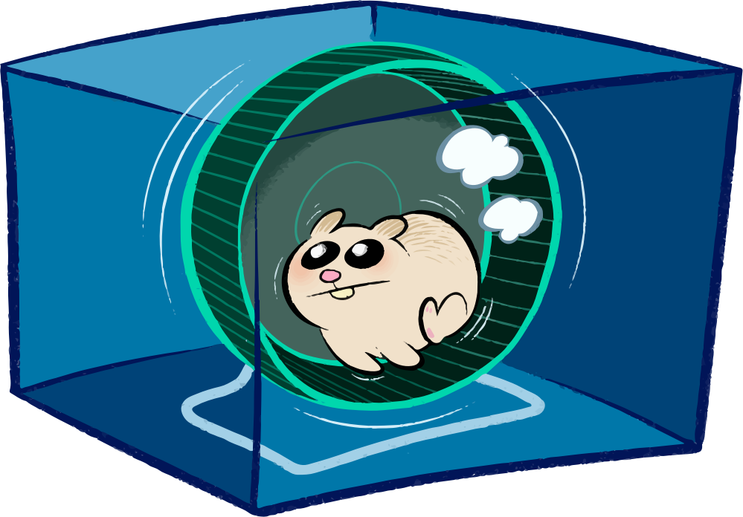
CVE-2018-15664
safe
unsafe
/foo
/bar/baz
RENAME_EXCHANGE
/bar2
symlink to /etc
docker cp
ctr:/foo/bar/shadow shadow

Slide 25
Solution
Always grab a stable handle (a file handle) to the target path and then check that.
  If the path moves, the file handle moves with it.
Unfortunately we haven’t fully implemented this (it’s quite hard to get right).

Slide 26
Attacking the Container Runtime
Some Other Fun Issues

Slide 27
procfs
/proc is a very scary and magical Linux filesystem.
  It is an kernel API which has a lot of holes in it.
  Quite a few container breakouts were discovered by (ab)using procfs.

Slide 28
The Kernel Is Shared
Containers
Application
System
Services
Application
Host Programs
Application
System
Services
Container
Runtime
Kernel
Hardware

Slide 29
The Kernel Is Shared
Containers
Application
System
Services
Application
Container
Runtime
Kernel
Hardware

Slide 30
The Kernel Is Shared
Containers
Attacker
System
Services
Application
fd
Container
Runtime
Kernel
Hardware

Slide 31
CVE-2016-9962
We kept open a file descriptor to the root filesystem while joining the container.
  Container could access host through /proc/$pid/fd/$n.
Lessons learned:
  Make ourselves “non-dumpable” to block container process trickery.
    Turns out there were some kernel bugs here too…

Slide 32
The Kernel Is Shared
Containers
mount
write security labels
Attacker
System
Services
Application
Container
Runtime
Kernel
Hardware

Slide 33
CVE-2019-19921
With custom images, you can use the symlink-exchange trick to mess with /proc.
  This means the container runtime can be tricked into not setting security labels.
  /proc/self/sched can be used as a no-op writeable procfs target.
    Ditto for /proc/self/environ.
Lessons learned:
  procfs is like staring into a bottomless abyss, filled with pain and CVEs.
  VOLUME were a mistake, as were several of my life decisions at this point.

Slide 34
Any Questions?
… or I can discuss some defensive measures.
Slides are available at github.com/cyphar/talks.

Slide 35
let’s make filesystem operations safe!

Slide 36
the (old) solution
/foo/bar/baz
For each component:
  Open the next component (with O_NOFOLLOW) relative to the current one.
  Handle symlinks in userspace by keeping track of the “text” path.
  Do some double-checking along the way through /proc and hope it works.
Very hard to get right, and it looks like nobody is actually doing it.

Slide 37
the new solution
int openat2(int dfd, const char *path,
struct open_how *how, size_t size);
struct open_how {
u64 flags; // openat(2) flags
u64 mode; // openat(2) mode
u64 resolve; // RESOLVE_* flags
// future fields go here
};

Slide 38
openat2
#define RESOLVE_NO_SYMLINKS … /* Don’t traverse symlinks. */
#define RESOLVE_NO_MAGICLINKS … /* Don’t traverse magiclinks. */
#define RESOLVE_NO_XDEV … /* Don’t cross mounts. */
#define RESOLVE_IN_ROOT … /* Resolve within a root. */

Slide 39
so, are we done?
Not by a long shot.
It’s hard to get this stuff right, and even with openat2:
  Programs on old kernels still need to be hardened.
  Users need to be exceptionally careful when doing other VFS operations.
  Programs need to be restructured to use file descriptors everywhere.

Slide 40
a library to make path resolution safe.

Slide 41
a library to make path resolution safe.

Slide 42
libpathrs

Slide 43
libpathrs
(a library to make path resolution safe.)

Slide 44
libpathrs
(a library to make path resolution safe.)
(it’s also written in rust.)

Slide 45
introducing libpathrs!
Rust library (with C bindings, usable from almost any language).
Emulates openat2’s RESOLVE_IN_ROOT on older kernels.
Implements helpers that match most VFS syscalls (which are correctly written).
Includes some additional hardening (related to p̭r̙͈o͔̲̹c̩fs͔͔).

Slide 46
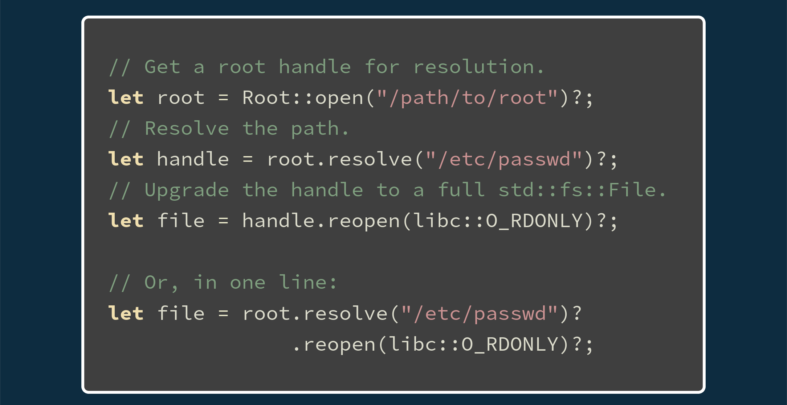
usage
docs.rs/pathrs

Slide 47
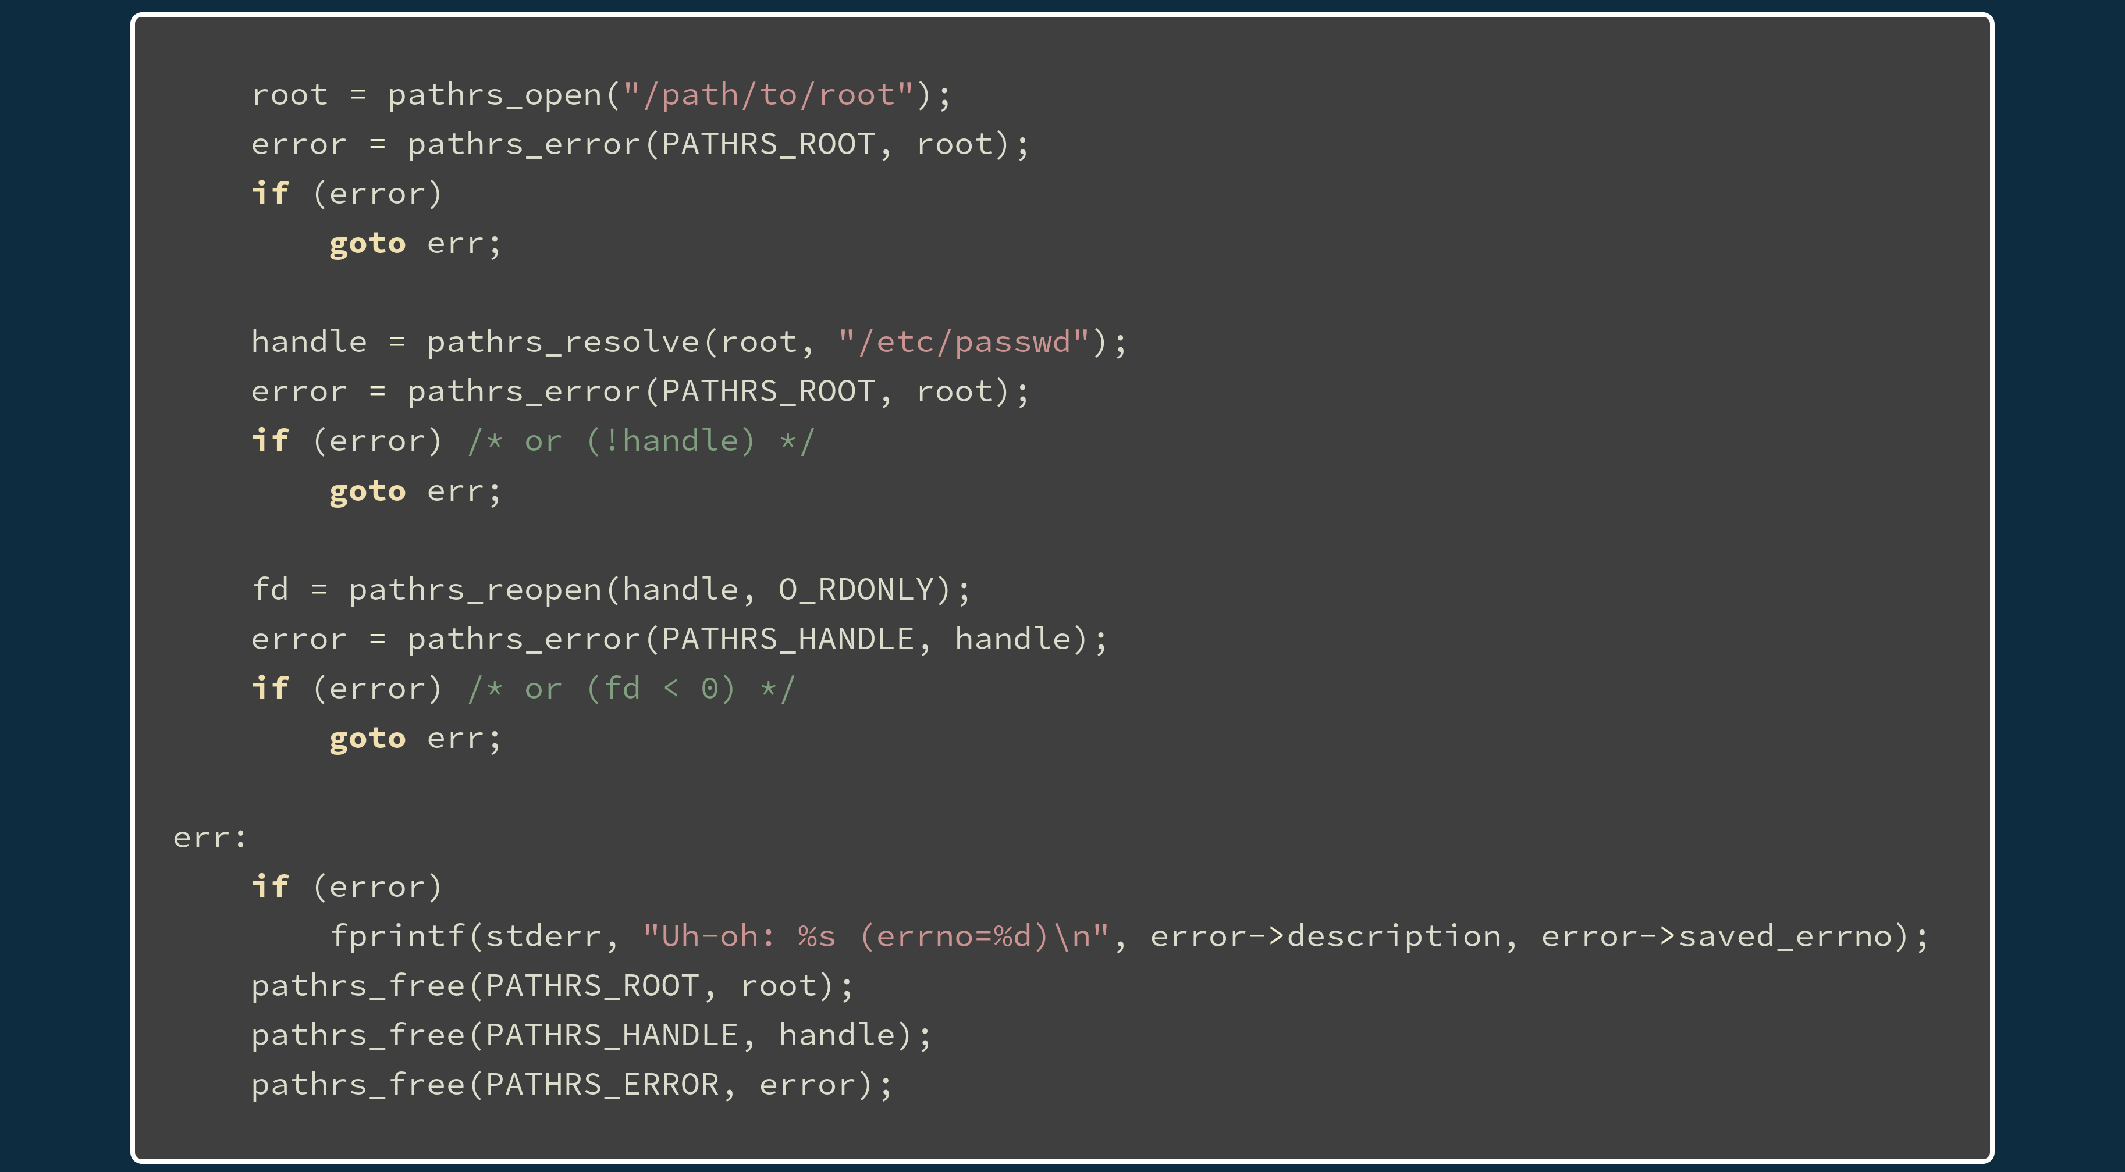
usage
docs.rs/pathrs

Slide 48
demo time.

Slide 49
great!
now we’re all done, right?

Slide 50
l͎͕̹ͥẻ̜̀ͪ͂̄̒t͙̭̾̏̐͑̀'̪̝͍̟͌ͥ̒̇ś͔̈͛ͩ ̗ͮ̄̐͂͊ͯ̏h̠̗̍ͧä̬̖͎̲̊v̫̭̠͒͌e̜ͭ͒ͧ ͕͌̚a̪̔͌̊̀͊ ̭̓̈ͤ͋c͖͎̏ͣ̂h̑̍ͤ͂ͦͦ̄a̫̭̩ͦ̃͆̃ͨͭ̉tͩ̑̽͌̋̃ ͖̭ͅa̹̹͍b̤̝̗̎͊́͌ö̥̱́̾u̮̪̮̗ͯt͕̲͈̟͌̍͐̈ ͚̻p̟rͣ̊ͥ̎̃ͨͨọ̬͐̊͌̚cͬ̓̈́̓̌͒f͇̠̣̃͌s̟̹̥̉̆̌ͮͪ̄̐

Slide 51
the other problem
/proc/self/attr/exec
How do I make sure that I’m writing to the real procfs file?
  You can grab a /proc handle which is definitely real (the inode is 1).
  You can check if the target is a procfs file (but you aren’t sure it’s the right one).
  You can disable all symlink crossings a-la openat2 (or emulate it).
    Wait … how on earth do you check for bind-mounts?

Slide 52
y͙̦̩̼̦̜̫̝ͯ͊ė̲͇͖͖̹͔̗̞̆̈ͫ̎̃͋ͅå̯̻̗̤̝̮̥͌ͅḣ͕̺͙̬̠̲̯͒̎ͦ̾ͦ̏̚,̜̜̤̰̘̹̪̟ͯ̓̈̾̀̅̈́ ̺̼̗̹̞̰͓͆̋́̄͗ͥ̑w̥̱̳̣̎̐ͯh͈͈̠͈̯̺̩̣̏̉â̭͎͙̫̑t̬̥̳͖̠͔͒͌͛͊ ͇͓̙͇͓͇̼̂̈́̾͆̔ͨ̿ͅả͈͇̠͍̻̜̯͊͊b̩̮͚̭͙̮̱͈̦̎͒͛͛̓͗̑o̖̗͖̬̝̘̘͒̽͛ͤͅu̼̲̗̺̝ͬͪͥͩ͊͂̒͆t̫̜̖̙̯̙̂̓̄ ̱̙̪̿b̭͙́͋i̼̟ͩͭ̈̃̑̽n̜͙̰̒ͫ͗̂ͅḍ̮̖̭͙̩̈́̂̓̆̔͆̽-̟̟̰̹͇̣ͭͪͅm̼ͤ͛̏͋͂̒̐͋o̥͙ͭ̄̂ͣͨ͐̉u̜̳̺̭̲͔̝̻̎ͨ̎̅ͨͬͣ͆̇n̤̞͍̯̗ͫͦͅt̰̓͗ͧͩ̈́͗̇̚s̱̬̺͒̂͊̈͌̽?͕̼̦̘̣̼̆̉̍

Slide 53
There is no way on Linux to be verify if you’ve crossed a bind-mount (until openat2).

Slide 54
å͇̺͚̘̩͍̞̺̜͕̹̟͙̘̿ͣ̍͐̀̍͒n̤̱̪̠͈̯̜̐ͦ͑͂̃d̳͓͖̝̝̬̦̠͙͙̍̍̇ͮ̒̌̈́ ̻̰̭̟͓̣͍̤̦̫̼̘͑͛͋̎t̗̱̯̼͍̩̭͉̳̓͗̃̉ͬͭ̽ͯͧ̅͆ͨͯḫ̠̲̙̖͉͍̙̖̖̱̦̹̝̮͚̖͗͊́͗͗̋̑̒͒̈ͥ͑͊͐͂̾͂͗e̩̹͎̻̗̫̝̻̟͇̟͖̮͎ͤ̄ͬ̓͌́̊̇n̗͎͍͈̥͎̗ͦ̈́̌ͤ̇ͭ̓ͨ̈͗ͣͯ̇̊̽̅̾̔ ̪͎̭̪̫̝̠͖͇̰̫̮̬̜̰̽͐̂̎ͬ̔ͣͤ́̇̑̋ͅͅt̫̤͙̰̫̣͓̪̥̊̓ͧͨ̇ͤ̓͒ͪh̬̩͓̝̫̻̝̣͕̙͙̍͋͛̀ͥ̓̏ͮ̓͒͒͋ĕ̟̱̫̹͐̇ͪ̈r̤̦͔̖͓̩̟̦̝̰̬̲̟̂̑ͩͧ͋͐͆͆ͫͪ̅͊̐̀ë̩̻̦͍̯̟͉̘̠̮͈͆ͨ͐̑̿̽ͤ̎'̺̤͖̪̞͙̱̭̖̤͇̠͑̀̈ͩ̒̄ͪ͋̃̏ͪs͔͈̫̻̹̺̺̥̺͚̤̱͖̬̱ͤ̒̒ͪ͗͊̉͆̌ͬ͆͒̏ ̬̺̻̗͎̭̻͎̯̖̖̝͉̤͈̙̙̞̳̂́ͩ̑ͯ̇͊̀̓̽m̺̜̩͉̮̜̘̦̘̤̺̺̗͍̩͎ͬ͆̔ͩ̿̾̄͂̉ͮ̚̚a̪͍͈̬̥͎ͯ̈ͯ͋̀ͩ̃̾̑̽̈ͤ̇̋͋̚g͎͖̟͍̝̱͕̙̳ͤ̆ͭ́̋ͪ̎ͯ̋̂ͣ̃́̒̑ͩ̒̄ỉ̯̹̟̺̬̫͒̈͌̒̔ͫ͋̓̍̍ͯ͌͐̈̔̊̚c̥̰̬̻͔̥͈̰̦̲͖ͭ̅̾͂̈̃̈ͨ͑̾ͨ͛̽̐̎̓-̗̱̺͓̯̱̳̥̦̫̭͖̫̟̏̆͛͊̔ͣ̋͐͋́̄͗̾ͪͅl̖̟̤̬̝̠̹͇̺͉͖̮͙̬̲̋̄͊ͣ̋ͨ̚ȋ̻̭͈̟͎̐͊ͪ̎̏͐̀̔n͚̺̞͙͖̼̱̘͛͊ͯͪͩͭ̓ͧͩ̆̇̂̈́k̟̹͚̘͍̺̬͆̌̔ͫ̇ͭ͂s͕̞̭͚̜͉͕͕̖̜̗̲̗̯͔̣̈́͊̒̓̎̃ͮ̉ͧͥ̐ͫ̇̓̚

Slide 55
m̝̮͒ͅa͇̿̾̂̀ͨg̳̭͎̼̱̐͒ͅi̱͉͉̩̥̦̒̍̑̊̅́ͧc͕̯̪͔-͎͛l̠̲̰̪̂i͙̮̱̠̙̬ͭ̏̀͑͛ͥ̚ͅǹ̳̼̗͍̟̣̒͌͐ͫ̅k̽s̥ͧ̽͌͋
/proc/self/fd/$n
/proc/self/exe

Slide 56
m̝̮͒ͅa͇̿̾̂̀ͨg̳̭͎̼̱̐͒ͅi̱͉͉̩̥̦̒̍̑̊̅́ͧc͕̯̪͔-͎͛l̠̲̰̪̂i͙̮̱̠̙̬ͭ̏̀͑͛ͥ̚ͅǹ̳̼̗͍̟̣̒͌͐ͫ̅k̽s̥ͧ̽͌͋
/proc/self/fd/$n
/proc/self/exe
Y̖̺̬̣̋ͯͥ̆ͣ̔̚O̼̪̬̤̓͌̑̽̑̇͋ͤ̓̚U͖̯͓̗̺̳̱ͣ̇̓̆̀́ͫ͑̈́̇ͬͮͨ ͈̗̱̗̦̳̯̎̉̐̓ͨ̇̔̀̃̑̿̚C̫̦̤̥̼̒͒ͪͧ̈̽ͬA̲̰̖̫̪̳̰̳̱͂̌̈́̅ͥͮ͛̃̔ͮͧͮ͑N͓̩̰͚̗̳͕̣̱̣̻ͥ̑ͥ͑ͤ̄ͪ͊ ͍̼͎̘̟̆̀ͩ̔͌̑͑ͩͦ͛͂ͤ͑B̗̗̳̹̤̯̙̹̬̭͓̟̑̃̓͛̒ͦͯ͂̂̋̿͒͌̍̄̿I̼͈̖̜̘͕̻̥͔̖̝̫̫̎ͪ̔̏̅ͪ̅̄͌ͤͣ̔͋ͅN͇̝̣͚̖̤̜̰̝̈́̔̒ͫͪ͊͒ͭ̇ͤ̚D̝̙͖̻̝̥͇̼͚͖̾ͨͮ͊́̉͑̈́̓̊̏̈́͊ͥ̓ͫ͋ͥ-̺̦͚̭̔̉̃̓̃̿̐͋ͦ̊́̃͑̔ͨ̌ͅM̳͍͙̥̼̟͈ͦ̃̓ͣ͊O͍̳̤͎̲̟̞͍̜͐ͮ̉͆̃̍̄̔̓ͧͦ̿̄ͦ̔ͯȔ̙̥͎̤͍͚̬̹͙̗͓̹̪̜̬̹̩̃̅̌̄̐͛̆͊͌N͎͕͙̭̜̤̪͇̩̠̭͖̥̥̝͚̺ͬ̈́ͬͅT̬͕̟͚͇̣̱͍͓͎̗̘͇̜͔̟̭̜̿̋̌̓̔̇̃͒͛͐ͧ̆ ̩̰̗͉̲̹̜̼̣̈̋̽̿Ô̝̩̯̙͚̖ͣ́̈́ͯ̈́͒̚V͉͈̩̭̯̻̭̓̆̋̋̏̎ͯ̈͛̃̊ͩ͒͆ͅE͕͔̲̪̯͓̣̦̖̱͙ͭͭ̿͐̆̇ͅͅR̗̺̺̤̰̟̥̬̦͔͕̖̞̜̮͇͚͂ͫ͑̂ͯ̓̿ͣ̏̒̚ͅ ͔̭̱̰͚͙͔̹͚̹͖ͩ͊̋ͪ̏̔ͩŜ̗̭̞̦̫̹̈́̾̈́̄̈ͮͦ̌̐ͥ͒̋ͤͣ̇Y̥̪͇̰̳̥̔̽̄̅͂̃ͦͬ͒ͥͭ̽̊ͣ͋͋̍ͅM͈̱͉̼̪̼̳͙͛ͭͧ̒͑ͦL͔̪̮̰̘̩̭͍̖̄͗̈ͥ̌̿̏͋͒ͅI̙̰͈̣͕̗̦̩̻̮̜͉͔ͦͤ́̐̍ͤ̃̉͑͆ͬ̽N̞̘͚̞ͪ͆̆͐́̑̀ͥ̌̔̌̿͐̚K͚͓̝͙̙̪̪ͥ̋͐͋ͦ̓̉ͮ̂S̻̤͖͎̲̩̫͎̥̈́ͭͯͦ̈͊͒̉̒̽͌̉

Slide 57
*incomprehensible rambling*

Slide 58
next steps
Stabilise the base libpathrs C API.
Start porting programs to libpathrs.
Continue kernel hardening work (which libpathrs can support opportunisically).
  Lots of work needed to make p̦̗̖̖̠̼ͩͧ͊̿ͫ̃ro͙̼͊̊̇̄̏̂̾c̺̣͊ͤͯf͉͔̱͕͔s̹̞̃̔ safe to use.

Slide 59
links
openat2 (in Linux 5.6)
  lwn.net/Articles/767547
  lwn.net/Articles/796868
  man 2 openat2
libpathrs
  github.com/openSUSE/libpathrs
  docs.rs/pathrs
github.com/cyphar/talks

Slide 60
questions?

Slide 61
magic-link restriction
Don’t allow a read-only magic-link to be re-opened as read-write.
  Requires lots of fun semantics with O_PATH.
  Doesn’t break userspace (based on my testing).
  Needs to cover up a lot of different holes.

Slide 62
O_EMPTYPATH?
openat(fd, “”, O_EMPTYPATH | O_RDWR);

Slide 63
built-in procfs handle?
openat(AT_PROCFD, “self/fd/$n”, O_RDWR);
setupfd = fsopen(“procfs”, FSOPEN_CLOEXEC);
procfd = fsmount(setupfd, FSMOUNT_CLOEXEC, 0);
openat(procfd, “self/fd/$n”, O_RDWR);

Slide 64
pidfd-based /proc/self ??
selffd = pidfd_open(getpid(), 0);
pidfd_get_resource(selffd, PIDFD_EXE,
O_RDONLY); // ???
openat(selffd, “exe”, O_RDONLY); // ???

