Slide 1


DREAM Preterm Birth Prediction Challenge
Luka Erdeljanović
2020/3381
Genome informatics

Slide 2
Challenge Description
Construct a machine-learning model which can predict the gestational age based on gene expressions from blood samples
Select a batch of genes which is of most interest for the prediction
Evaluate the model using a set of metrics for regression and K-fold cross-validation
More details: DREAM Preterm Birth Prediction Challenge

Slide 3
Input Data
735 samples in total
367 samples for training, the rest for validation
Over 32,000 gene expressions in each
Conclusion: sparse data, huge number of input variables – identify most relevant genes

Slide 4
Data Pre-processing and Model Setup
Work performed using Python’s SciKit Learn, Numpy and Pandas
Grab the most important features using SciKit’s SelectKBest feature selection
Empirically set K=8,000 out of a total of over 32,000 features
Potential improvement point: identify and remove outliers in the samples and improve the selection of K (run more tests with different values).
Create models – Linear regression is the base model in a number of different setups

Slide 5
Linear Regression models
SciKit’s default LinearRegression model (min. Residual Sum of Squares)
Ridge regression (Linear Regression with Tikhonov/L2 regularization)
In theory: should be used with large amount of features which have balanced effect on the outcome
Lasso regression (Linear Regression with L1 regularization)
In theory: should be used with small amount of features which have a large impact on the outcome; less robust on outliers than L2
These models were run in 2 variants – normalized data and default data
Number of different learning gradients (alpha) used for regularization:
0.0001, 0.001, 0.01, 0.1, 0.5, 1, 10, 100, 1000, 10000

Slide 6


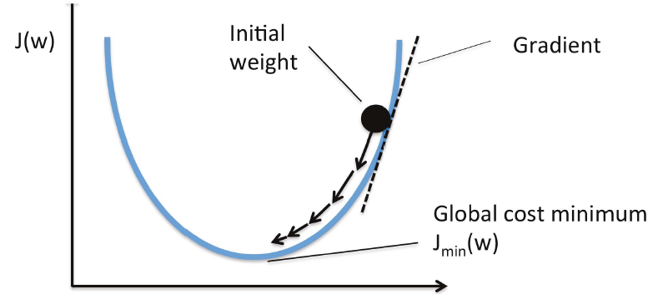
Linear Regression Basics
Hypothesis – our mathematical representation:
Error and Loss function:
Find the minimum:
Up to 100.000 iterations

Slide 7
Learning Process
Error metric

Slide 8
Learning Process

Slide 9
Learning Process
Error metric is minimized

Slide 10
And Another Thing…
Regularization: we want to train our models for the real world, not the training data (prevent “overfitting”)
Normalized data: scale the input data down to the same level (e.g. from 0 to 1)

Slide 11
Evaluation
K-Fold cross-validation used (10-fold)
Split the data in 10 groups
Train the models on 9 of the 10 groups [90% will be used for training, 10% for validation]
Capture the performance of the models on the last group (validation)
Now swap the validation group with one of the training groups
Repeat 10 times so that each group is validated

Slide 12
Evaluation Results – Training Data
Model | Root Mean Square Error
Linear Regression – default – Normalized Data | 4.230825
Ridge regression – Normalized – α = 0.0001 | 4.231278
Ridge regression – Normalized with various α | …
Ridge regression – α = 0.0001 | 4.532076
Ridge regression – various α | …
Linear Regression – default | 4.532554
Lasso Regression – Normalized – α = 0.0001 | 5.529481
Lasso Regression – α = 0.0001 | 5.703381

Slide 13
Validation Results
But how do they perform in reality?
Regular run – no cross-validation:
Model | Root Mean Square Error
Lasso Regression – Normalized data – various alpha | 8.108839
Lasso Regression – various alpha | 8.108839
Lasso Regression – various alpha and normalization | …
Ridge Regression – Normalized - Alpha=10000 | 8.111026
Ridge Regression – Normalized with various α | …
Linear Regression – Normalized data | 9.618984
… | …
Linear Regression | 10.111103
… | …
Lasso Regression – Alpha=0.0001 | 10.614017

Slide 14
Conclusions
“Normalizing” data is critical, as is the adequate selection of features
Training and reality are different - and might trick you!
Potential improvements could be made
Better handling of data (perhaps stratification?)
Removing outliers
Bigger training sets (of course)
Mixing the data differently (not allowed, but would be interesting…)

Slide 15
Thank you
Questions?
luka.erdeljanovic@gmail.com
github.com/cypher93/genomska_informatika

