Slide 1
Software Quality Engineering
(CSE302)
Instructor
Humaira Afzal
Lecturer
humairaafzal@ciitlahore.edu.pk

Slide 2
Course Information
Learning Objectives
prepare students for
Understanding Software quality engineering
Its role in software development lifecycle
Quality issues , SQA plan, execution,
Defect removal techniques, reporting, monitor and control to insure standard compliance..

Slide 3
Grading
First Sessional Test 10%
Second Sessional Test 15%
Quizzes/Assignments 25%
Terminal Examination 50%

Slide 4
Rules
Mobile phones -Silent
Arrive on time!
If you do not understand a point, raise your hand and ask me to explain or contact during office hours
No disruption!!!! No Misconduct!!!!
80% Attendance
REMEMBER: Your first priority must be your studies

Slide 5
What is software?
We can define it as:
  Instructions (Computer Programs) that when executed provide
  desired features
  functions and
  performance.
  The data on which the program operates is also considered a part of the software.
  Documents that describe the use of the Programs.

Slide 6
Software costs
Software costs often dominate computer system costs. The costs of software on a PC are often greater than the hardware cost.
Software costs more to maintain than it does to develop. For systems with a long life, maintenance costs may be several times development costs.
Software Quality engineering is concerned with cost-effective software development.

Slide 7
Software costs
Roughly 60% of costs are development costs, 40% are testing costs. For custom software, evolution costs often exceed development costs.
Costs vary depending on the type of system being developed and the requirements of system attributes such as performance and system reliability.
Distribution of costs depends on the development model that is used.

Slide 8
What is a software process?
A set of activities whose goal is the development or evolution of software.

Slide 9
SDLC-Overview
SDLC is a process followed for a software project, within a software organization. It consists of a detailed plan describing
  How to develop
  Maintain
  Replace and alter
  Enhance specific software.
The life cycle also defines a methodology for improving the quality of software and the overall development process

Slide 10
SDLC-Stages
A typical Software Development life cycle consists of the following stages:
Planning and Requirement Analysis
Defining Requirements
Designing the product architecture
Building or Developing the Product
Testing the Product
Deployment in the Market and Maintenance

Slide 11
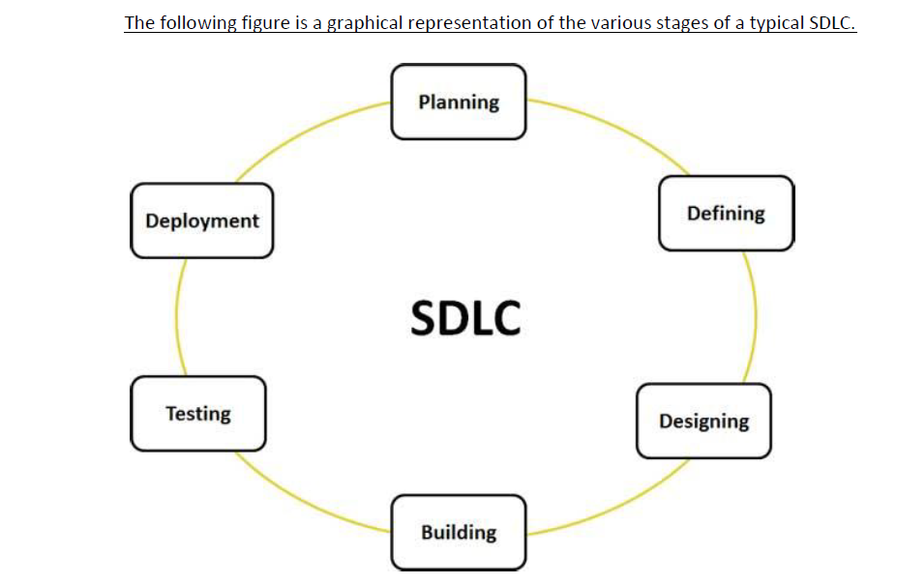

Slide 12
Importance of software
A person might be involved with software more than 100 times, often without even realizing that.
We might use a computer
To check email or weather
Kitchen appliances
  Malfunction in ones family microwave ?
  Software quality is becoming important even for HA.
Traffic signals are now computer controlled
Mostly we use credit cards in a computerized gasoline pumps.

Slide 13
Importance of software
Our bank system is highly computerized
  Could operate with out high quality software?
Software directly related to our jobs.
Use of telephones, fax, e-mail or internet ,all of these requires Software
Hotel arrangements will be handled by computers and software
Air plane & Air traffic control is highly computerized
Medical Instruments and diagnostic procedures are now computerized
Errors or defects in medical…,safety devices, aircraft instruments..?

Slide 14
Importance of Software
Business decision-making
  Have to analyze your data
Software quality is critical to a number of major business issues, including
Reduces time to market for new products
Minimizes the risk of serious operating failures and delays
Minimizes the risk of business failures, which may be attributed directly to poor quality or poor software quality

Slide 15
Software Quality
Software quality or quality is a difficult topic to define
Concept of quality is somewhat like the concept of beauty?

Slide 16
Definition: software quality engineering
Software Quality Engineering:
“The function of software quality that assures that quality is built into the software by performing analyses, investigations on the requirements, design, code and verification processes and results to assure that reliability, maintainability, and other quality factors are met. “

Slide 17
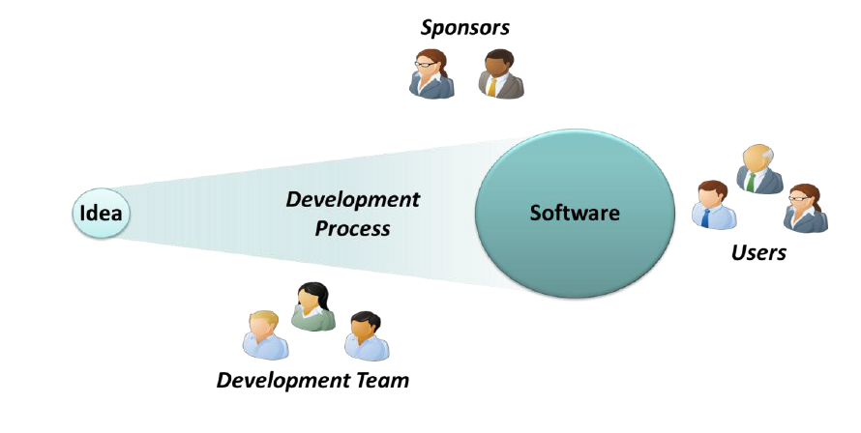
Who Cares About Software Quality?
In thinking about software quality, it’s useful to focus on three groups of people who care about its value, as Figure shows.

Slide 18
Who Cares About Software Quality?
The software’s users, who apply this software to some problem.
The development team that creates the software.
The sponsors of the project, who are the people paying for the software’s creation.
we can divide software quality into three aspects:
  functional quality
  structural quality
  and process quality

Slide 19
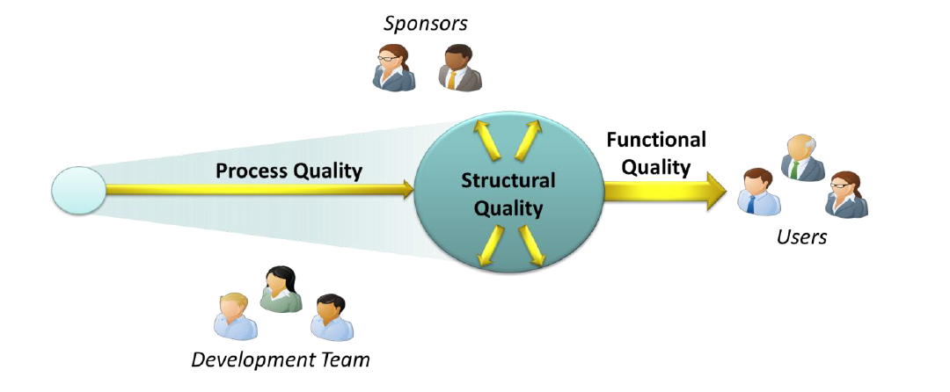
Defining Software Quality: Three Aspects

Slide 20
Functional Quality
Functional quality means that the software correctly performs the tasks it’s intended to do for its users.
Among the attributes of functional quality are:
Meeting the specified requirements.
Creating software that has few defects.
Good enough performance.
Ease of learning and ease of use.
Software testing commonly focuses on functional quality.

Slide 21
Structural Quality
means that the code itself is well structured.
Code testability. Is the code organized in a way that makes testing easy?
Code maintainability. How easy is it to add new code or change existing code without introducing bugs?
Code understandability. Is the code readable
Code security. Does the software allow common attacks such as buffer overruns and SQL injection?

Slide 22
Process Quality
The quality of the development process
The most obvious attributes of process quality include these:
Meeting delivery dates. Was the software delivered on time?
Meeting budgets. Was the software delivered for the expected amount of money?
If a process has the first two attributes—software delivered on time and on budget—but so stresses the development team that its best members quit, it isn’t a quality process.
True process quality means being consistent from one project to the next.

Slide 23
Software Quality: Conclusion
The meaning of quality will center around six key factors
Low levels of defects when deployed
High reliability, or the capability of running without crashes or strange results
High user-satisfaction
Effective customer support when problems do occur
Rapid repairs for defects

