Slide 1
SQE in Software Processes

Slide 2
Enlarging the Scope
Enlarging the scope from QA to QE
QA activities need additional support
  setting up quality goals
  planning for QA
  monitoring QA activities
  feedback for project management and quality improvement
QA Activities+ Above Activities = Software Quality Engineering (SQE)

Slide 3
Quality Engineering (QE)
A fact already established:
  Different consumers have different quality expectations
Goal is to meet or exceed these quality expectations
  through the selection & execution of appropriate QA activities
  while minimizing the cost and other project risks
To ensure that these quality goals are met through the selected QA activities
  various measurements need to be taken parallel to the QA activities themselves

Slide 4
Quality Engineering (QE)
Major group of activities in QE Process
  Pre-QA activities
  In-QA activities
  Post-QA activities

Slide 5
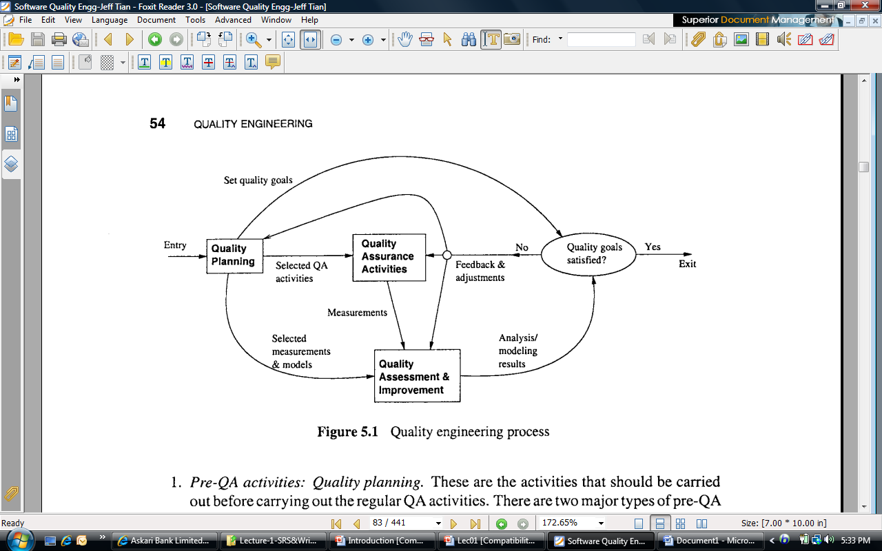
Quality Engineering (QE)

Slide 6
Pre-QA Activities
Activities that should be carried out before carrying out the regular QA activities
Two major types of pre-QA Activities
  Setting up specific quality goals
  Forming an overall QA strategy
    Select appropriate QA activities to perform
    Choose appropriate quality measures

Slide 7
In-QA Activities
Executing planned QA activities
Handling discovered defects

Slide 8
Post-QA Activities
Quality measurement, assessment and improvement
Post-QA does not mean after the finish of QA activities
  May run in parallel to QA activities

Slide 9
QA ACTIVITIES IN SOFTWARE PROCESSES
SQE process forms an integral part of the overall SE process
QA activities can be integrated into the software activities
The focus of QA is on defect handling, to make sure that
  each problem reported by customers is logged, analyzed, and resolved.
complete tracking record is kept…why?

Slide 10
SQE in Software Processes
Pre-QA activities
  Quality planning as part of project planning
  Example: in waterfall process this is typically carried out in the phase for
    market analysis
    requirement gathering, and
    product specification
  These activities provide valuable information about customer expectations
    Quality goals can be set accordingly

Slide 11
SQE in Software Processes
Pre-QA activities in incremental/iterative and agile processes
  Performed not only at start of whole project, but at beginning of each sub-part
  Goals, QA alternatives, and measurement techniques are selected at start of each iteration
  Overall quality goals may evolve from these sub-goals

Slide 12
SQE in Software Development Processes
Post-QA (measurement, analysis/modeling and feedback):
  As part of project monitoring and management

Slide 13
SQA – Life Cycle
SQA specific activities- conducted throughout the SDLC
referred as - SQA Life Cycle
Initialization Phase:
Writing and reviewing management plan by QA department
Verifying specified standards, procedures and processes in plan
Requirement Phase:
Assuring that
SR are complete and testable
SR are properly expressed as functional, performance and interface requirements
Design Phase:
Assuring that
Approved design standards followed
All SR are collected to software components etc.

Slide 14
SQA – Software Life Cycle
Implementation phase:
Auditing the results of coding and design activities including schedule in Software development phase, status of all deliverable items.
Auditing configuration management activity
Integration and testing Phase:
Assuring
Readiness of all deliverables items and after testing ,test reports are complete and correct.
All test run according to test plans and procedures
Acceptance and Delivery Phase:
Assuring
The readiness of all deliverable items

Slide 15
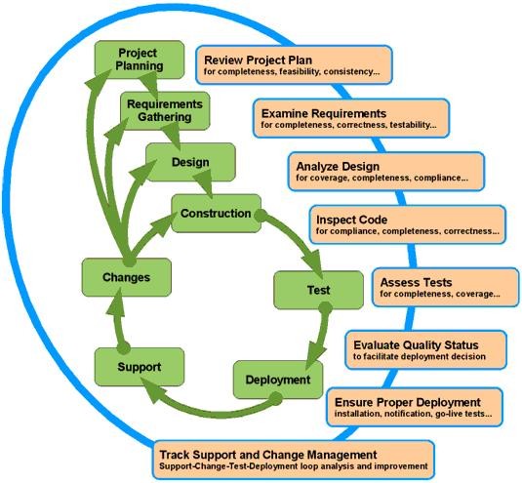
SQA – Software Life Cycle

Slide 16
SQA Activities
In order to maintain a high level of quality , the following SQA activities maybe identified:
1. Revision
A draft version of an artifact /document submitted by the group will be evaluated by the members of SQA team.
Review is composed of
Walkthrough
Inspection
Formal Review
2. Process Evaluation
SQA team is expected to
Define the process standards such as how reviews should be conducted, and when reviews should be held
Monitor the development process to ensure that the standards are being followed
Report the software project management and to customer

Slide 17
SQA Activities
3.Software Standards
Develop and maintain the product and process standards
Documentation Standards
Specify contents for planning, control , and product documentation
Design Standards
Standards for evaluation of design
Code standards
Specify the language in which the code is to be written and define any restrictions on use of language features

Slide 18
SQA Group
SQA Group
People involved in quality assurance activities:
Activities:
- apply technical methods and measures
- conduct formal technical review
perform well-planned software testing
The SQA group’s role -> serves as the customer’s in-house representative
and assist the software engineering team in achieving high-quality

