Slide 1
Real Fluid based on realistic animation of liquid by Nick foster and Dimitri metaxas
Cse 328 project spring 2017

Slide 2
Introduction
Realistic Animation of Liquid
Nick Foster & Dimitri Metaxas
Published June 3, 1996
Animate fluid using Navier-Stokes equation
Assume fluid is Newtonian (mass and momentum are always conserved)
Assume fluid is incompressible (e.g. water)

Slide 3
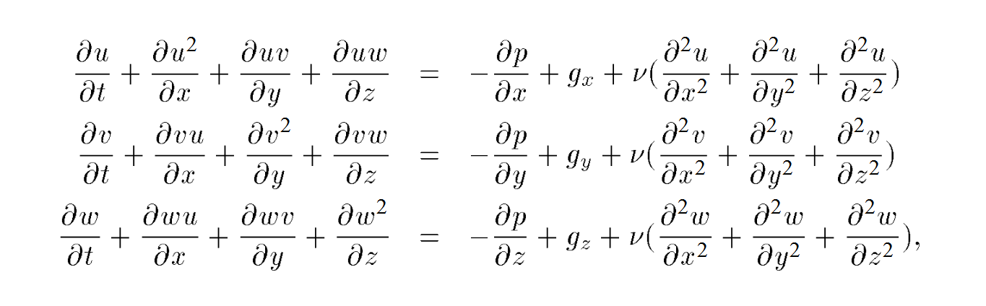
Navier-stokes equation

Slide 4
Navier-stokes equation
Velocity vectors at each time-step

Slide 5
Navier-stokes equation
Change in the velocity based on the grid dimensions

Slide 6
Navier-stokes equation
Change due to pressure in each cell

Slide 7
Navier-stokes equation
Body functions (e.g. gravity) acting on the entire system

Slide 8
Navier-stokes equation
Adjustments due to viscosity of the fluid

Slide 9
MY GOAL
Animate Liquid in a 2D mesh
Implement a discretized solution of the Navier-Stokes equation
Use a staggered grid and apply the Navier-Stokes equation on all cells
Create a vector field with proper boundary conditions
Introduce particles that determine the structure of the fluid
Animate these particles to simulate fluid motion

Slide 10
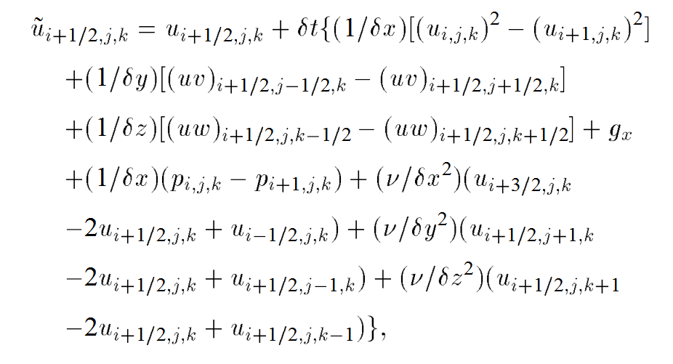
Discretization

Slide 11
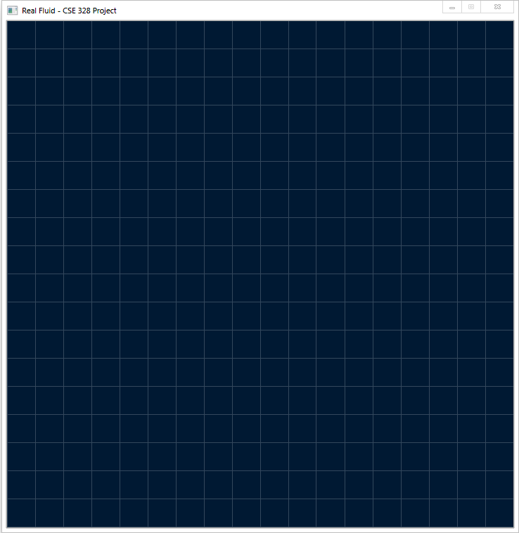
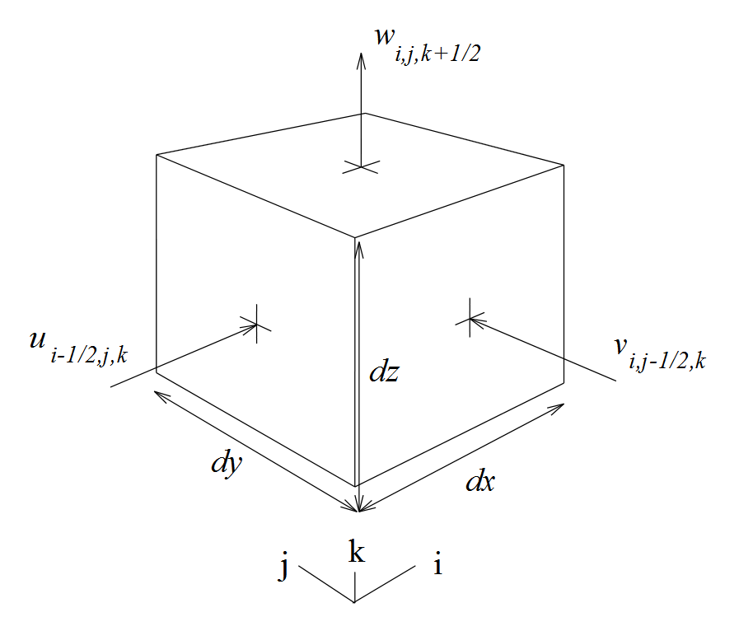
STAGGERED vector field

Slide 12
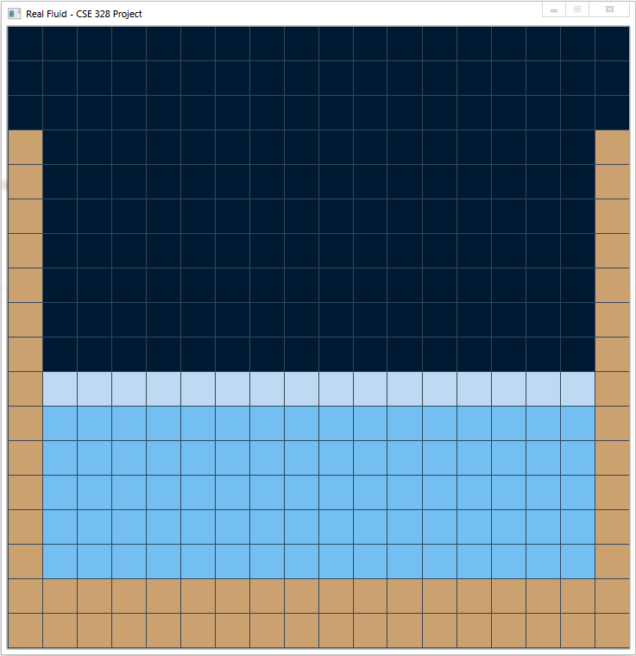
CELL types
4 different types of cells are defined:
Empty – The surrounding medium (air)
Surface – The part of fluid touching Empty cells
Full – Body of the liquid
Solid – Solid obstacles
Empty
Surface
Full
Solid

Slide 13
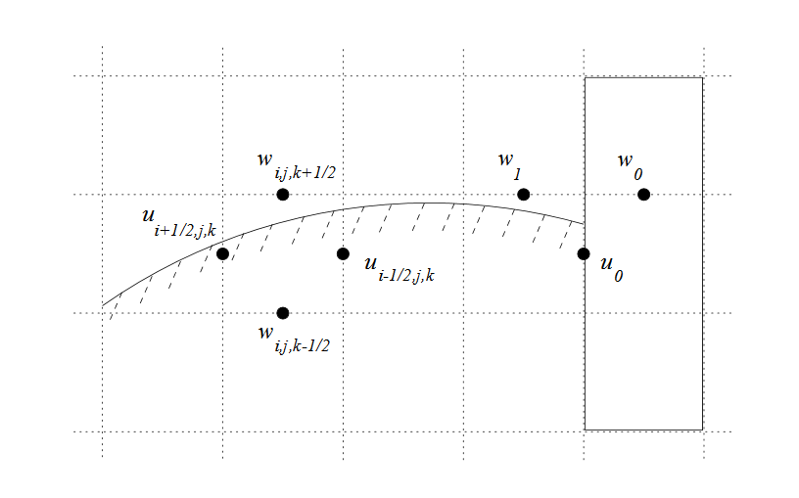
Boundaries
Boundary conditions must be defined:
Solid Obstacle – Homogenized but special

Slide 14
Boundaries
Boundary conditions must be defined:
Inflow Boundaries
Inflow boundaries continually introduce new particles
Velocities are predefined and held constant over runtime
Outflow Boundaries
Outflow boundaries are left alone mostly
Velocities are set according to adjacent fluid cells
Allowed to relax to let fluid flow out of the system

Slide 15
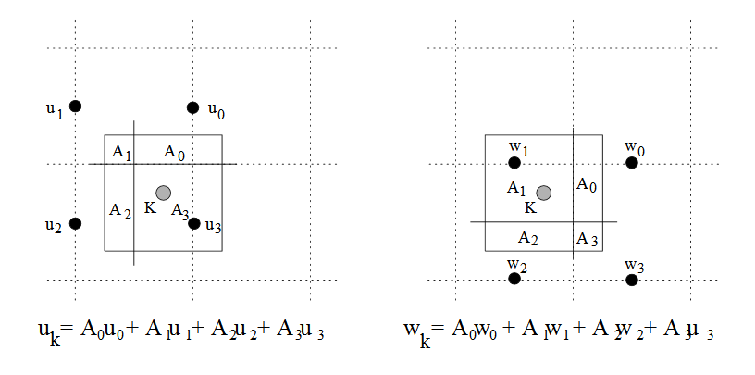
Tracking fluid position
Fluid Position is tracked by massless particles:
Particles are used to define the surface and structure of the fluid, not the contents
The position of a particle is updated based on an area interpolating function:

Slide 16
Tracking fluid position
Particles highlight the full range of internal fluid motion:
Particles do not define the mass of the fluid. Hence, they have no effect on the computations.
Particles are used to define the position of the fluid exactly, regardless of how fine or coarse the vector grid is.
Particles efficiently demonstrate violent phenomena like fluid crashing on a solid obstacle.

Slide 17
Tracking fluid position
Particles also define the cell types:
If a cell contains no particles, it is Empty.
If a cell contains any particles, and adjacent to an Empty cell, it is Surface.
If a cell contains any particles, and is not a Surface cell, it is Full.

