Slide 1
Sentiment analysis Steam Reviews
NLP Project spring 2016

Slide 2
Introduction
What is sentiment analysis?
Process of computationally identifying opinions expressed in a piece of text and predicting if the attitude of a writer towards a particular topic/product is positive or negative.
Why Steam Reviews?
Large user base
Diverse lexicons

Slide 3

Our goal
Analyze a review
Extract phrases that express sentiments
Determine the polarity of those phrases
Correctly predict the sentiment of a review

Slide 4
How we do it
Training
Scrape Steam’s website
Parse scraped data
Tag the review bodies with a POS tagger
Extract phrasal lexicons
Save the phrases to the database

Slide 5
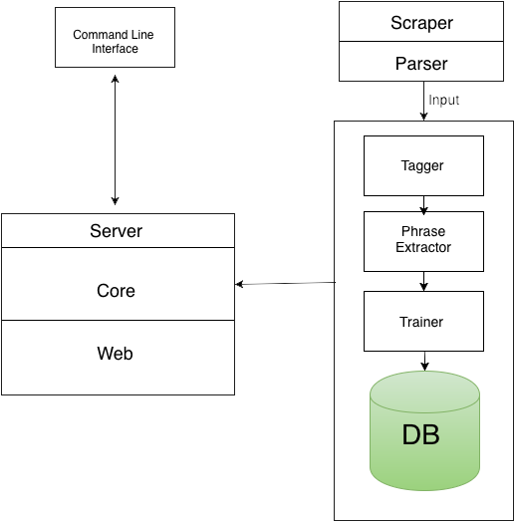

Slide 6
How we do it
Testing
Choose game to test on
Use training data from every other game
Use the counts of relevant phrases to compute polarity
Compute average polarity of a review
Predict if review is a recommendation

Slide 7
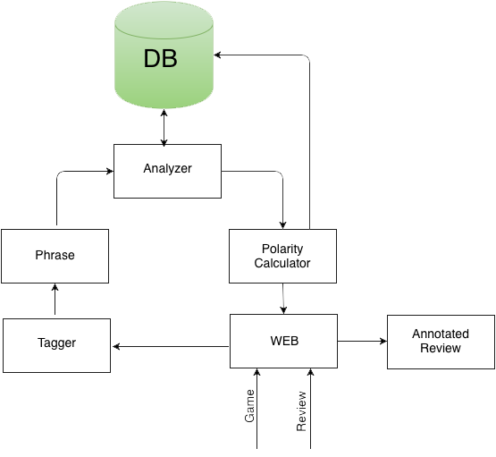

Slide 8
implementation
Web Application
Asynchronous
Decoupled
Performant
Scalable

Slide 9
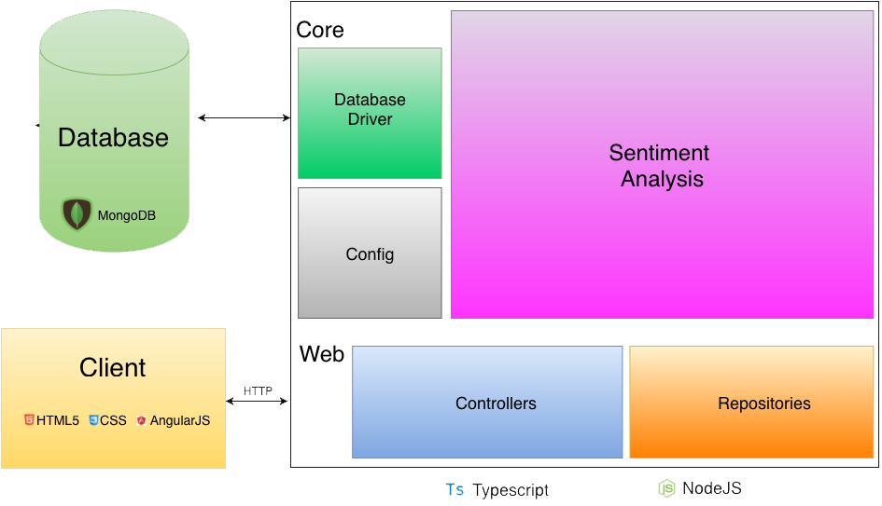

Slide 10
Enough presenting more demoing

