Slide 1
Sentiment analysis Steam Reviews
NLP Project spring 2016

Slide 2
Introduction
What is sentiment analysis?
Process of computationally identifying opinions expressed in a piece of text and predicting if the attitude of a writer towards a particular topic/product is positive or negative.

Slide 3
Introduction
Why Steam Reviews?
Large user base
Diverse lexicons

Slide 4
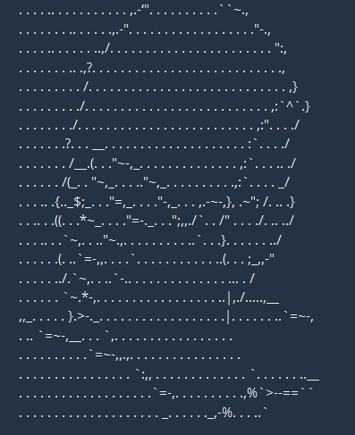
Introduction
Why Steam Reviews?
Large user base
Diverse lexicons

Slide 5

Our goal
Analyze a review
Extract segments that express sentiments
Determine the attitude of those segments
Correctly predict the sentiment of a review

Slide 6
How we do it
Train
Test
Evaluate

Slide 7
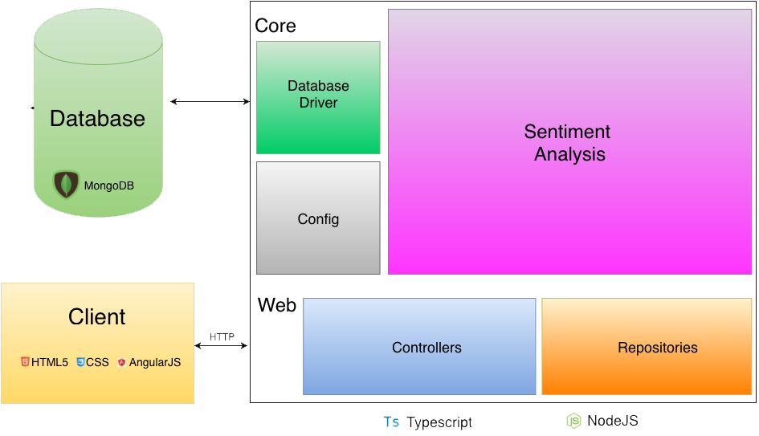

Slide 8
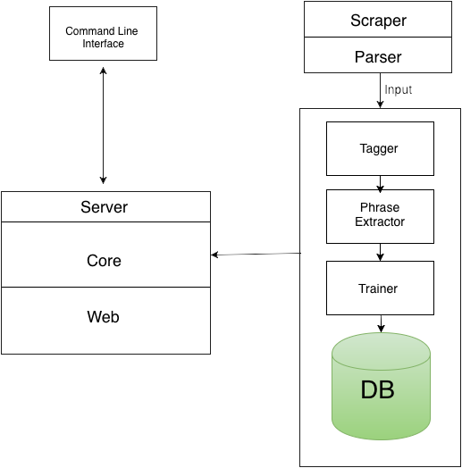
TRAINING

Slide 9
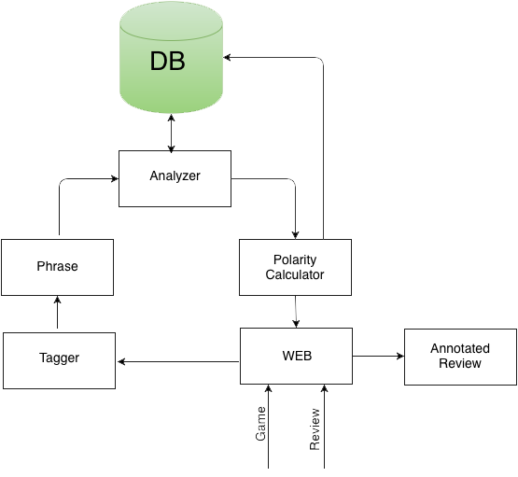
TESTING

Slide 10
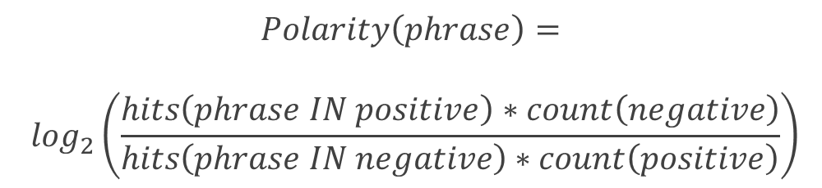
$$Polarity\left(phrase\right)=$$
$$\log_{2}\left(\frac{hits\left(phrase IN positive\right)∗count\left(negative\right)}{hits\left(phrase IN negative\right)∗count\left(positive\right)}\right)$$
TESTING

Slide 11
Enough presenting more demoing

