Slide 1

Reactive Extensions

Slide 2
Agenda
Define Rx
Background
Subject
Observables and Observers
Operators
Life Cycle Management
Future
NuGet

Slide 3
Pre-Requisite
IEnumerable<T>
Lambda
Delegates
LINQ

Slide 4
What is Rx ?
Rx is a library for composing asynchronous and event-based programs using observable collections.
Notes:
Being Reactive means having some data flow and the notion of time associated with it.
Modern applications need to “react” to what comes their way.
Interactive programming on the contrary drives the environment through the application.
Rx allows you to compose events together.
X = a + b ; value of x once calculated remains unchanged even if a and b change …so the application needs to React to change in a and b

Slide 5
Why Rx ?
We now live in a cloud based asynchronous mobile event driven environment.

Slide 6
What is Rx ?
Asynchronous and event-based
Composition
Observable collections
Notes:
Rx looks to simplify both Asynchronous and Event based programming models.
Combining asynchronous data sources is a difficult with a lot of code , too difficult and messy.
Observable sequences …keyboard events to mouse clicks everything can act as a data source.
Events are hidden data sources , Rx brings them out in the front.
Rx gives us the ability to treat Events as first class objects.
No more explicitly subscribing and unsubscribing from events.

Slide 7
What is Rx ?
Observables
LINQ
Schedulers
Notes:
Observables represent the asynchronous data streams
LINQ represents the set of operators to process
Schedulers give the ability to parameterize concurrency

Slide 8
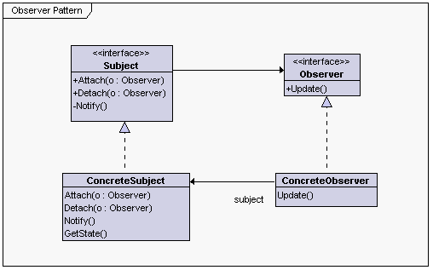
Observer Pattern
Notes:
Classic design pattern , Inspiration for Rx.
Observers observe Observables (Subjects).
When something about the subject changes , notify the Subscribers /Observers.
They then take the action needed with the notification.

Slide 9
Key Interfaces
interface IEnumerable <out T>{
IEnumerator <T> GetEnumerator()
}
interface IEnumerator <out T>{
bool MoveNext();
//throws Exception
T Current {get;}
}
interface IObservable <out T>
{
IDisposable Subscribe(IObserver <T> o )
}
interface IObserver < in T>{
void OnCompleted();
T OnNext { set ; }
void OnError ( Exception e)
}

Slide 10
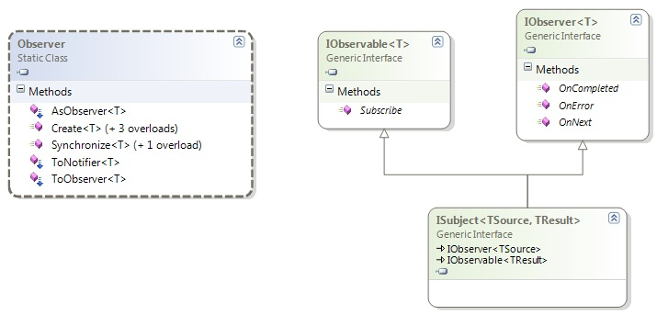
Key Interfaces
Notes:
Subject acts both as an Observer and as an Observable.
The Static Observer class gives the methods to create the Observers.

Slide 11
Subjects
Subject<T>
ReplaySubject<T>
BehaviorSubject<T>
AsyncSubject<T>
Remember everything
Remember last value
Provide a Default Value
Remember the last value
Publish when completed

Slide 12
Tune into Mr. Observable
Create
–Specify a delegate when a subscription is made
-non-blocking
Start
- turn your long running Func<T> calls into Observables
Notes:
Observables are similar to events i.e.
we can declare an observable ,
publish to the Observable,
and subscribe to the event
In Rx unlike events there are can be Types that are merely publishers or just subscribers.
Observables have the notion of completion unlike events.
Plus , Observables are First class objects in .net unlike events , this means we can pass them around ,store and construct them.

Slide 13
Cold and Hot Observables
Cold Streams are passive and start publishing on request
- on demand streams
- rss feeds
Hot Streams are active and publish regardless of subscriptions.
- price ticks from a trading exchange
- mouse ticks
Notes:
Defer makes a hot observable cold. Publish makes a cold observable hot.
If calling Subscribe on an observable sequence may cause side-effects, then you can say that the observable is cold; otherwise, it is hot.
Observable.Range returns a cold observable because each time that you call Subscribe you'll observe the entire range; i.e., the side-effect is that the range is recreated each time you call Subscribe.
f you were to Publish the observable first, then it becomes hot so that multiple calls to Subscribe share the same subscription side-effects, you may call Subscribe on the hot observable after the Range has already begun pushing values, in which case late subscriptions simply won't observe any values they've missed.

Slide 14
Schedulers
Execution Context
Current Thread
Thread Pool
Execution Policy
Priority Queue
FIFO,LIFO etc..
Clock
Parameterization with time
Relative and Absolute time
New Thread etc..

Slide 15
Schedulers
Name | Execution Context | Execution Policy | Clock
Thread Pool | Thread Pool | ASAP | Local
Dispatcher | UI Thread | Priority FIFO | Local
Event Loop | Dedicated | FIFO | Local
Immediate | Current Thread | Immediate | Local
Remote | Another Process | FIFO | Remote Machine Time
Test | Current Thread | FIFO | Virtual time

Slide 16
Life Cycle Management
Subscribe and Unsubscribe
Handle Exception
Fail over & Retry
Notes:
Subscribing to notifications from an Observable
Subscription returns an IDisposable through which we can dispose of the Subscription
Errors are also published just like values
When streams fail , we can hop on to another data stream or just wait and then retry on the same stream

Slide 17
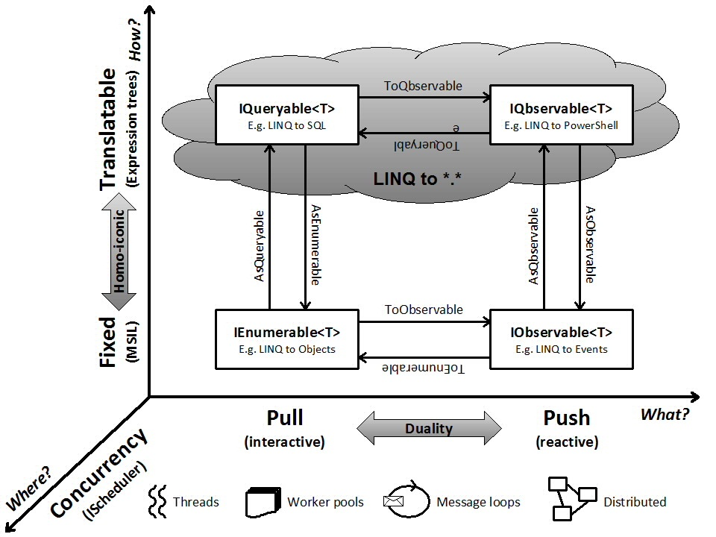
Notes:
IObservable is the dual of IEnumerble and IQbservable( pronounced as IQueryableObservable) is the mathematical dual of IQueryable
The dual programming model →Pull based systems to Push based systems
Notion of time with concurrency and schedulers, i.e. when to perform operations on data
Homo-Iconicity is the ability to interchangeably represent code as data. In the above figure IQueryable<T> takes in an expression tree as input while as IEnumerable<T> takes in IL(Intermediate Language) code as input.
Note:- I did not make this model, it was made by Microsoft .

Slide 18
Rx v/s TPL
Rx
consuming streams
performing non-blocking async work like web requests
TPL
internal parallelisation of work
Composing "streams" of events together
Linq style operations
performing non-blocking async work like web requests
performing work flows and continuations

Slide 19
Rx v/s TPL
Rx
Do I have control over the data and when it arrives ?
Am I am the owner of the data and need to manage computations ?
Am I managing multiple results, and need to choose from them based on time?
Rx
TPL

Slide 20
Await-ING C# 5
Async/Await in C# 5
Task<T>

Slide 21
Q & A

