Slide 1
ElectrOnline: an e-Commerce Website
Presented by,
Team Kafka
(Deepen, Nikhila, Nitin, Vishal)

Slide 2
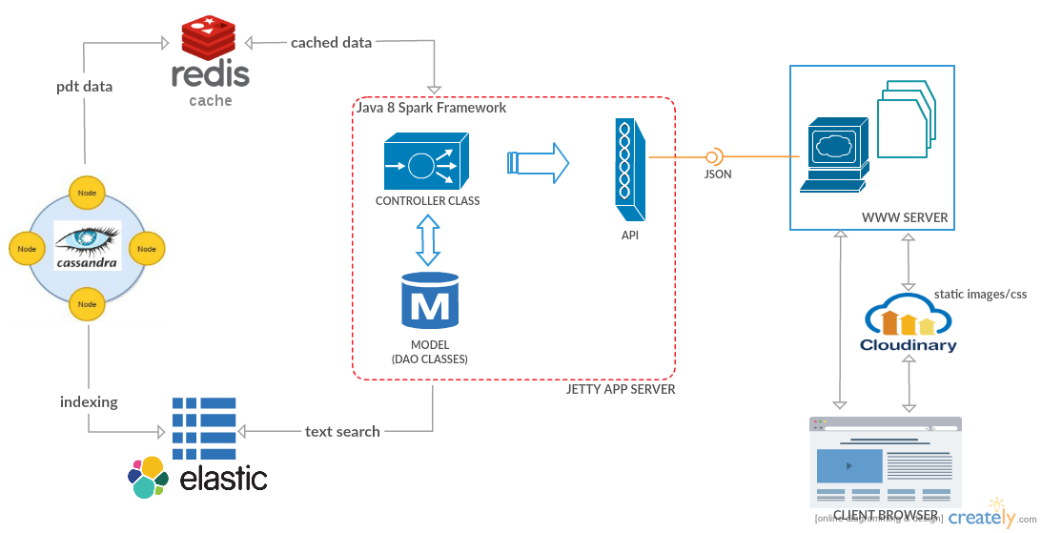
Architecture

Slide 3
DEMO time !!

Slide 4
Features
Near Real-Time search
Instant search
Fuzzy search
Caching
Unstructured Text and Data Management

Slide 5
Thank you !!

