Slide 1
RankMiner
Predicting Phone Agent Attrition
Vishal Punjabi, Mohammed Ihtesham

Slide 2
PROBLEM STATEMENT
Discover the reason for high attrition rate among agents based on the static agent data and audio features of the calls made by each of them.
Based on the reasons above, develop a predictive model to identify the agents who are most probable to leave the company voluntarily.

Slide 3
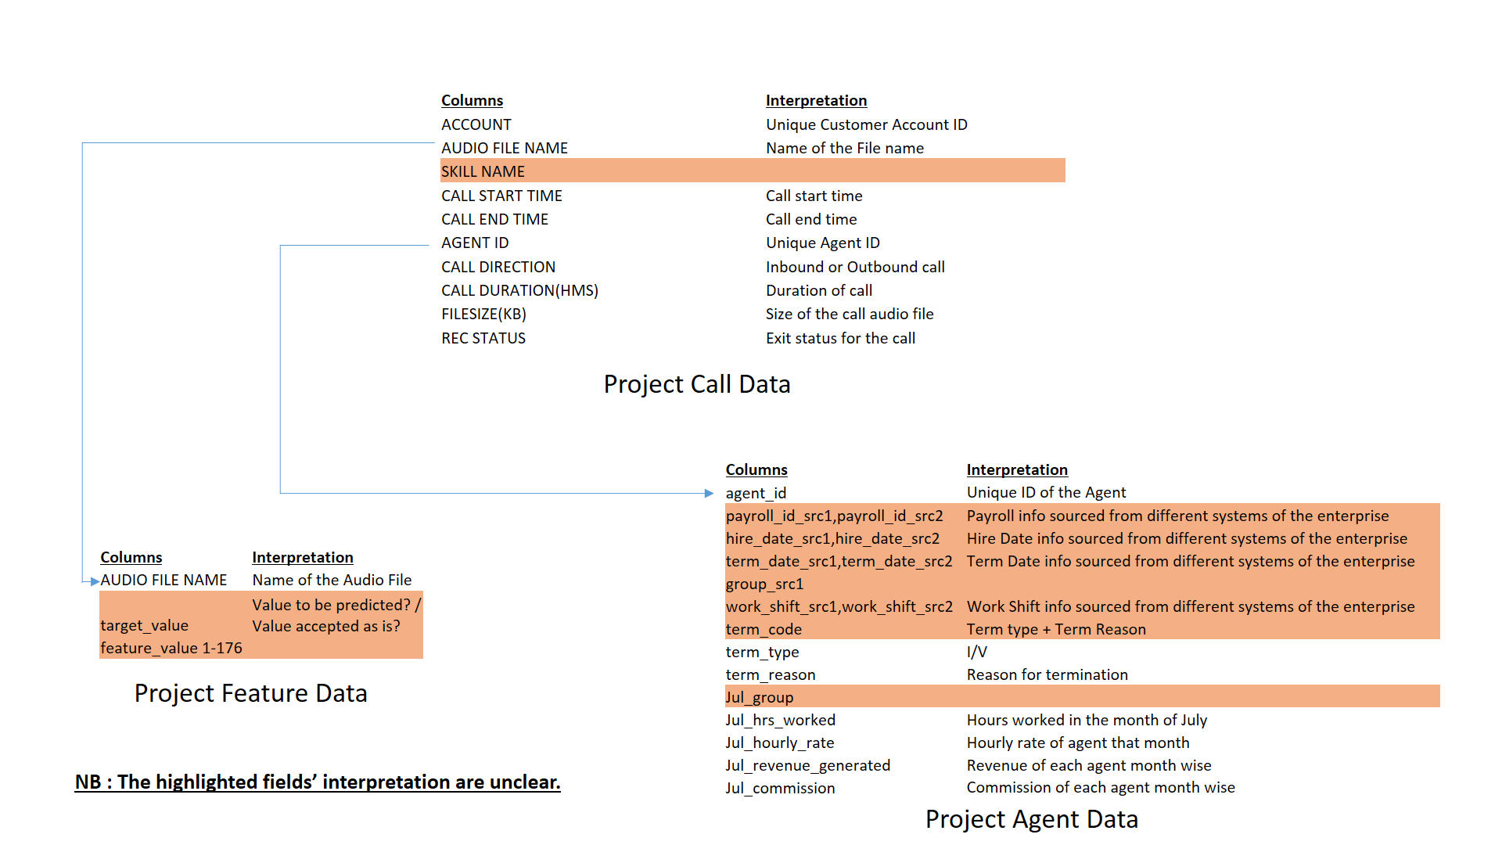
DATA EXPLORATION

Slide 4
DATA EXPLORATION (cont..)
Agent Data Set – Data for 298 agents with 43 attributes.
Call data Set - Information of all the calls made by each agent. It has 170429 rows and ten attributes such as duration, start time, end time, call outcome etc.
Call feature data set – It contains 62245 rows where for each row of call the agents behaviour is statistically calculated and recorded across as 178 features. The call features includes speech of the call (total speaking time, etc.), negative emotion (e.g. anger), positive emotion (e.g. joy) and proportional measures of negative/positive emotions, emotional/unemotional speech.

Slide 5
DATA ISSUES
Empty values in the data set.
The data for some columns are pulled from two different sources.
  The columns for which data is coming from two different data sources, source 1 is assumed to be authentic.
Data present in the dataset are in mixed case (Upper and Lower). They may cause issues during statistical analysis.
  To reduce inconsistencies all textual data are converted to upper case.
Two outliers each in Agent and Call data set were removed.
Target of some audio files in feature data set are blank.

Slide 6
DATA ISSUES (cont..)
A single work group has different code and description. For example, "INB DSH” and "DSH" refer to the same DISH group.
  Inconsistencies like this are handled by replacing it with a single value for same sub groups but different codes.
There are rows of Work groups which have value “#N/A” for agents and months.
  These values are replaced with “OTHER” work group to handle missing values and not to loose agents from analysis.
Column names in the data set are dot separated.
  Dots are replaced with underscore to avoid errors while running R code.

Slide 7
VISUALIZATIONS
The correlation matrix presents a numerical relationship between predictors and helps to identify which predictors have a direct and which one have indirect relationship among them.
From the graph, it can be confirmed that agents who left the company voluntarily were a group who were generating lesser revenue as compared to the agents who did not leave the company.

Slide 8
VISUALIZATIONS (cont..)

Slide 9
DATA PREPARATION AND MATCHING
Agent and Call Data
  Removing unwanted columns
  Renaming columns
  Feature Engineering
    Last group
    No of working months
    Productivity
    Commission rate
    No of calls attended
    Median call duration
    Call Negativity rate
    Skill group difference
    Functional group
    And more..

Slide 10
DATA PREPARATION AND MATCHING (cont..)
Feature Data
  Grouping based on categories (Call speech, Positive emotions, Negative emotions, positive negative emotion proportions and other miscellaneous qualities)
  Synchronizing Target Values for each agent in Feature Data.
  Aggregate Agents and Target values across feature and call data
  New target variable defined (1-voluntary 0-Not terminated or Involuntary termination)
  Scaling and Aggregating Feature Data by Agent ID
    In-built scaling (-1 to 1) with mean and mode aggregation
    Custom scaling (0-1) with mean and mode aggregation
  Principle Component Analysis on the above scaled and aggregated data
  3 datasets prepared
    Mean Aggregation with 0-1 Scaling
    Mode Aggregation with 0-1 Scaling
    Mean Aggregation of Feature categories with 0-1 Scaling

Slide 11
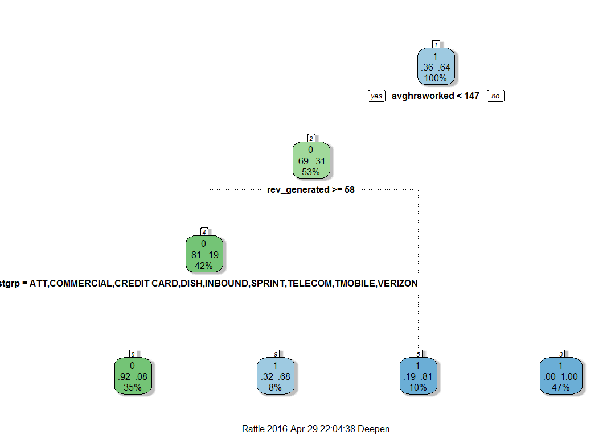
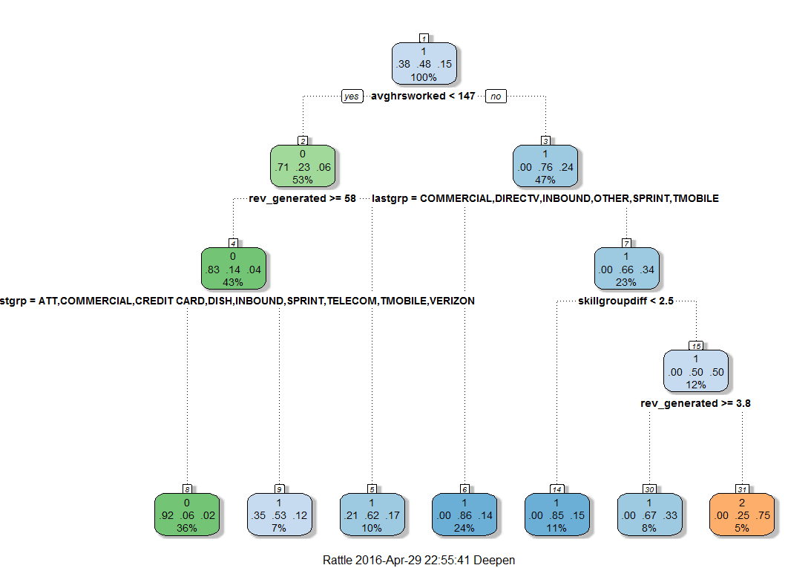
PREDICTIVE MODELING
Decision Trees on Agent and Call Data (validated using Logistic Regression)
Recall Accuracy = 92.7%
Recall Accuracy = 81.25%

Slide 12
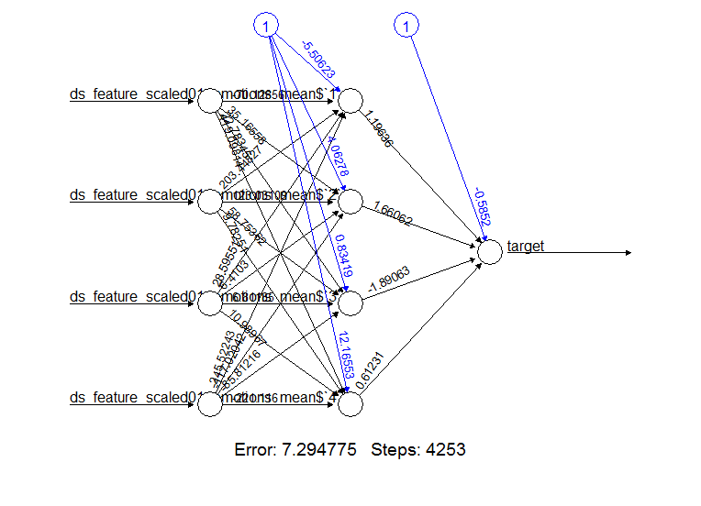
PREDICTIVE MODELING (cont..)
Three models (ANN’s) were run independently on Feature Data
  Top 4 PCA components (98.5% var) aggregated by mean for 117 agents
    Recall Accuracy - 76.72%
  Top 6 PCA components (99.2% var) aggregated by mode for 117 agents
    Recall Accuracy – 81.9%
  Top 1 PCA component from each of the 4 categories in feature dataset i.e. 4 PCAs (each > 85% var)
    Recall Accuracy – 83.62%

Slide 13
RESULTS
Agent and Call Data
  Recall accuracy ~ 93%
  Test accuracy > 80%
Feature Data
  Recall accuracy ~ 83%
  Test accuracy > 70%

Slide 14
CONCLUSION
Agents who are working for greater number of hours are leaving the company ~ 76% Voluntarily and 24% Involuntarily.
Agents who leave voluntarily are probably over burdened with their work
Agents who have left Involuntarily or fired might be the cause of some unproductive hours being added to the timesheet over time.
Agents who have generated less revenue for the company ~60% of the employees have left voluntarily.
Certain “Groups” have higher attrition rates
Call Features alone can help predict attrition with more than 75% accuracy.

Slide 15
FUTURE WORK
More variable selection techniques like Lasso or Random Forests.
Multivariate Analysis and more Logistic regressions on feature data
Bayesian Probabilistic models on feature and agent data together.
Ensemble models and boosting algorithms
Consider more data

Slide 16
THANK YOU

