Slide 1
RankMiner
Draft Update: 4/5/2016
Predicting phone agent attrition
Group 2
Mohammed Ihtesham
Deepen Panchal
Vishal Punjabi
Paridhi Varma

Slide 2
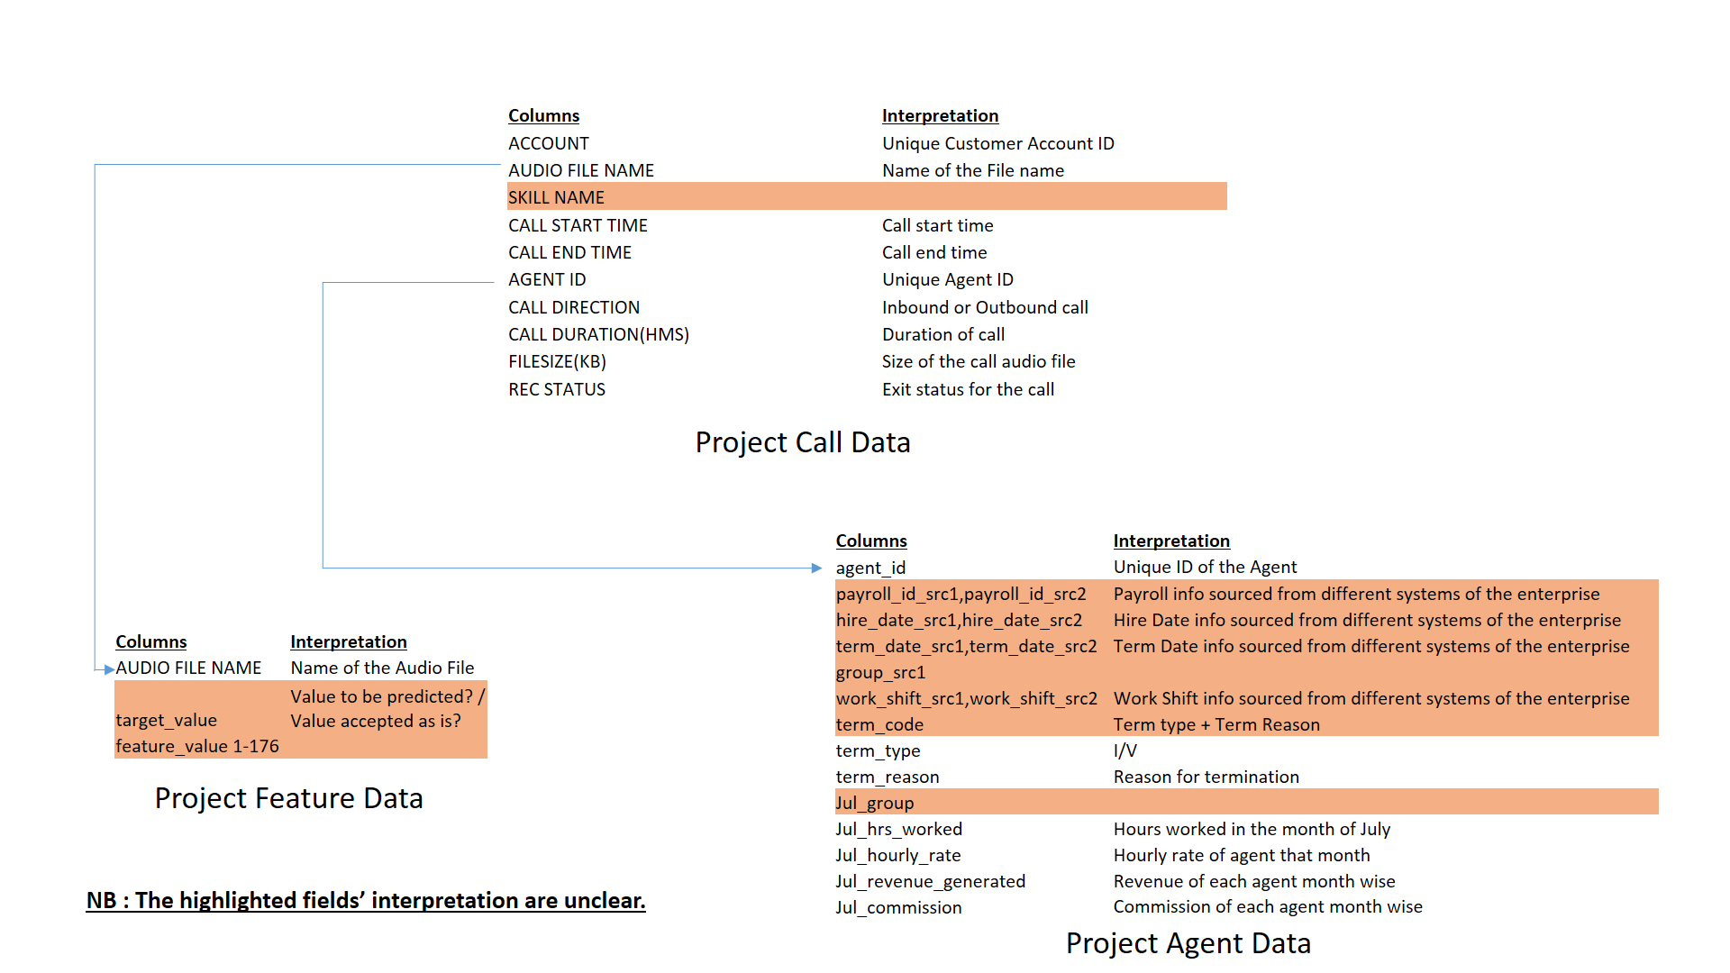
Data Diagram

Slide 3
Data Description
Brief Description of Tables:
Agent_data : This table contains data related to agents working the company and has information like hiring date, termination date, termination reason, shift time, work group he/she belongs to, payroll group of the agent, details of the revenue generated by the agent from the month of July to December, earned commission and monthly base pay rate. The data have been aggregated from eight different data sources.
Call_data: This table has information about the calls placed by agents and debtor account ID, start and end time of call, call duration, call direction whether it was inbound or outbound, collection group, call outcome and the audio file name which contains the saved conversation in mp3 format.
Feature_data: This table is used to save additional details of calls placed by agents and has data like audio file name as explained earlier, target values and 176 audio-recording based features. This table has details of calls which are there in Call_data table.

Slide 4
Business Questions
Agent data
what is src1 and src2 in some columns? difference? significance?
what values in work shift? AM/PM/ PM MOD? SS?
what is group_src1?
what is $mnth$ group?
on what basis $mnth$_commission is determined?
each of the months have a grp -- not all the months have data for a given employee, can we assume that the employee would belong to the same group for the next month if it is blank? Also, some employee has their group changing - is that legit?
do we consider blank values in columns as blank or is there any default value to be used?

Slide 5
Business Questions (cont..)
Call data
can we replace all blanks in call_direction column as "outbound"?
what is skill name? what do different values indicate? What does a blank value for this field indicate?
any call that does not have a skill name associated to it does not have a 'Call end time'. How are they 2 linked? and the same does not have a 'call direction'
what are values in Rec Status: PTP Arranged,Agent Cust 3/4, DNC,RPC, PTP?
Feature data
what does target variable mean? is it whether the agent left the company or not or something else?

