Slide 1

FABRIC RAYFIN APPS
Geo Wind Twin
Command Center
An ontology-grounded, 3D digital-twin command center for wind fleets — built on Microsoft Fabric, and fallback-safe by design.
React 19 · Vite · Three.js
Microsoft Fabric
Fallback-safe
Reusable template
Fabric Rayfin
01

Slide 2



THE PROBLEM
Wind operations live in disconnected tools
Fragmented context
THE GOAL
Telemetry, alarms, asset topology and maintenance history sit in separate systems.
One grounded command center
See the whole fleet, live, on one 3D map
Drill any turbine to its component & device signals
Confirm cause on the ontology graph
Dispatch the right technician with evidence
Ask questions in plain language
Export a mission report for handoff
Slow triage
Controllers stitch the story by hand — losing time when every minute of downtime costs energy.
Inconsistent dispatch
Without a shared, grounded view, who-to-send and what-to-fix decisions vary by operator.
Fabric Rayfin
02

Slide 3




WHAT IS RAYFIN
Fabric Apps, natively hosted
Modern web stack
HOW IT CONNECTS
React 19 + Vite + Three.js + Vitest — a real SPA with a 3D engine, not a dashboard tile.
Rayfin App · React + Three.js
Runs inside Fabric
The app is hosted by the Fabric shell; a postMessage host bridge wires it to workspace data.
Fabric Host Bridge · postMessage
Provisioned by the Rayfin CLI
rayfin writes workspace / item / tenant IDs and deploys the static app to Fabric.
Microsoft Fabric Workspace
Fallback-safe
No connection? It runs on synthetic telemetry and a local engine, then lights up real data.
Same code runs locally (dev) and inside the Fabric portal — append devUri to preview live changes in the host.
Fabric Rayfin
03

Slide 4

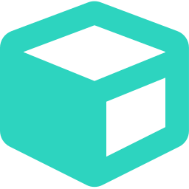





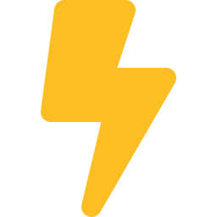
THE APP AT A GLANCE
One command center, eight capabilities
Fleet map
Digital twin
Ontology graph
Analytics
Live multi-site 3D geospatial map.
Per-turbine component & device diagnostics.
Trace asset links and dependencies.
Trends, deltas and the power curve.
Dispatch
Ask Fabric IQ
Mission report
Live or simulated
Match & assign the right technician.
Natural-language, grounded answers.
Exportable evidence & handoff.
Real telemetry, or synthetic fallback.
Fabric Rayfin
04

Slide 5




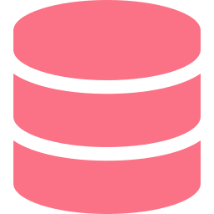
ARCHITECTURE
Front-end views over Fabric backends
Operator
Rayfin App
Map · Digital Twin · Graph · Dispatch · Ask IQ · Analytics
Fabric Host Bridge · postMessage
RTI
Semantic Model
Ontology + Graph
Data Agent
TurbineDevice
Eventhouse / KQL
KPIs / DAX
Digital twin
NL Q&A
Writeback
FALLBACK-SAFE Synthetic telemetry generator · Local offline engine — the app always runs, then upgrades to live data when connections are set.
Fabric Rayfin
05

Slide 6
BACKEND USAGE — AND WHY
Every Fabric seam earns its place
Real-Time Intelligence (Eventhouse / KQL)
Why: high-volume time-series at scale, queried where it lands.
The telemetry backbone — live and near-real-time turbine signals stream in.
Semantic Model (Direct Lake / DAX)
Why: governed, reusable metrics instead of ad-hoc math in the UI.
Aggregates readings into fleet KPIs and per-turbine history.
Ontology + Graph model
Why: status and relationships are grounded, not hard-coded.
The digital twin's backbone — asset topology, component→device links, sensor thresholds.
Ontology Data Agent
Why: ask in plain language, answers stay tied to real entities.
Powers Ask Fabric IQ with ontology-grounded natural-language answers.
TurbineDevice + writeback
Why: operator context and configuration survive across sessions.
Persists the twin's device graph, notes and dispatch actions back to Fabric.
Fabric Rayfin
06

Slide 7



DESIGN PRINCIPLE
Fallback-safe by design
Demo anywhere
ASK FABRIC IQ — GRACEFUL ROUTING
No Fabric wiring required — the app runs on a synthetic telemetry generator out of the box.
Fabric Data Agent
live · fabriciq
falls back to
Progressive enhancement
Set connection aliases and it lights up real data, live — no code changes.
Ontology-grounded engine
grounded · ontology
falls back to
Local engine
Honest by default
offline · deterministic
The UI labels the active source truthfully and flags telemetry as simulated until wired.
Fabric Rayfin
07

Slide 8



THE DIGITAL TWIN
Why an ontology-grounded twin
Real asset topology
ONTOLOGY HIERARCHY
Fleet → Site → Turbine → Component → Device — modelled, not guessed.
Fleet
Thresholds drive status
Site
Sensor bands from the ontology classify healthy / warning / alarm consistently.
Turbine
Persisted device graph
The twin's second-level device graph loads from Fabric (TurbineDevice) with a bundled fallback.
Component (rotor…)
Editable in-app
Device (pitch-control…)
A Twin Graph Admin panel lets operators tune labels, properties and camera vectors.
Fabric Rayfin
08

Slide 9


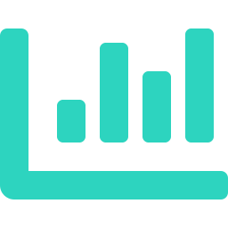

ASK FABRIC IQ
Plain-language answers, grounded
Natural language
Answer
98% sure
Ask about output, alarms, vibration, wind or dispatch notes — no query language.
4 turbines in alarm: SITE-TX-WT-05, SITE-DK-WT-03, SITE-DK-WT-04, SITE-IN-WT-07. 14 in warning.
Grounded in the ontology
Answers stay tied to real turbines, sites and thresholds — not free-form guesses.
FLEET SNAPSHOT
Generates a visual
● healthy ● warning ● alarm
Each answer ships a fleet-health snapshot so the number has instant context.
📄 Mission report
📊 Go to Analytics
Graceful routing
Suggested next steps appear as soon as an answer exists.
Data Agent → ontology engine → local — always answers, always honest about the source.
Fabric Rayfin
09

Slide 10
GUIDED DEMO
One incident, detection to resolution
1
Frame
2
Locate
3
Twin
4
Graph
Top incident auto-framed
Filter map to the site
Click rotor → device
Trace related nodes
5
Dispatch
6
Support
7
Ask IQ
8
Report
Match & raise work order
Call field & close loop
Prioritize in plain language
Analytics → mission report
~92 s
8
See / Action
Mission report
end-to-end run
guided steps
cues per page
exportable finale
Fabric Rayfin
10

Slide 11


REUSABLE PATTERN
One engine, many industries
The guided script and backend seams are data-driven from a per-domain manifest — the same Rayfin engine powers each variant with its own nouns, components and evidence.
Wind Turbine
Solar Farm
Oil & Gas Refinery
Global multi-site wind fleet
France PV plants
Worldwide process units
Gearbox · Generator
WindTurbine ontology
This app
Inverter · Combiner · Tracker
SolarFarm ontology
solar-france-rayfin
Pump · Compressor · Exchanger
OilGasRefinery ontology
refinery-worldwide-rayfin
Fabric Rayfin
11

Slide 12




WHY IT MATTERS
From telemetry to decisions — faster
Faster triage
Consistent dispatch
One grounded view collapses tool-switching into a single guided flow.
The right technician, matched on skills, site and load — with evidence.
Evidence & handoff
Reusable template
Every run compiles an exportable mission report with a full timeline.
Ship new industry variants from the same engine and manifest.
Ontology-grounded. Fabric-native. Fallback-safe.
apps/wind-turbine-rayfin · built on Fabric Rayfin (React 19 · Vite · Three.js · Vitest)
Fabric Rayfin
12

