Slide 1
Tableau → Power BI
Evidence-Backed Migration Engine
Migrate Tableau workbooks and Prep flows to PBIP and Fabric-ready artifacts
150
Focused Tests
133+
DAX Conversions
190
Visual Types
6
Reports Migrated
5/6
Openability Pass

Slide 2
Executive Summary — End-to-End Value
Full-Stack Migration Pipeline
Optimization at Every Level
📥 INPUT — TWB / TWBX / TDS / Prep / Hyper / Server API
Data Layer
Smart M queries • incremental refresh
connection parameterization
Semantic Layer
DAX optimizer (IF→SWITCH • COALESCE)
Time Intelligence auto-inject
SortByColumn • displayFolder • isHidden
▼
🔍 EXTRACT — 23 object types → 23 JSON intermediate files
▼
Visual Layer
190 visual mappings • conditional format
theme extraction • responsive layout
reference lines • tooltips
Security Layer
RLS roles • USERPRINCIPALNAME()
ZIP slip / XXE defense
credential redaction
🧮 CONVERT — 133+ DAX formulas • 43 M transforms • 87 connectors
▼
⚙️ GENERATE — TMDL semantic model • PBIR v4.0 report • themes
▼
Migration ROI & Business Impact
🧠 OPTIMIZE — DAX AST rewriter • Time Intelligence inject • auto-fix
⏱️
95%+
Time Saved
vs. manual rework
💰
~$0
Tooling Cost
Python stdlib only
🎯
5/6
Openability
one UC80 blocker set
🔒
0
Runtime Claims
without authorized evidence
▼
✅ VALIDATE — QA suite • governance • lineage • comparison report
▼
🚀 DEPLOY — PBI Service • Fabric • bundle • multi-tenant • gateway
Static validation is deterministic • Live Desktop/Fabric evidence is explicit • Every approximation and blocker remains visible

Slide 3
Migration Pipeline — 2-Step Architecture
📄 Tableau Source
.twb / .twbx / .tds
Prep flows (.tfl)
🔍 EXTRACT
Parse XML → 23 JSON
files (worksheets,
calcs, datasources…)
⚙️ GENERATE
TMDL Semantic Model
PBIR v4.0 Report
Power Query M
📊 Power BI
.pbip project
Open in PBI Desktop
(March 2025+)
→
→
→
↓ optional
23 Extracted Object Types:
🏭 Fabric Mode
Lakehouse + Dataflow
Notebook + DirectLake
+ Pipeline
🚀 Deploy to PBI Service / Fabric
worksheets • dashboards • datasources • calculations • parameters • filters
stories • actions • sets • groups • bins • hierarchies • sort orders
aliases • custom SQL • user filters (→ RLS) • hyper file data
--output-format fabric

Slide 4
Key Features
🔄 Complete Extraction
23 object types from .twb/.twbx
Prep flows, Hyper files, Server API
🧮 133+ DAX Conversions
LOD, table calcs, RANK, WINDOW
cross-table RELATED/LOOKUPVALUE
📊 190 Visual Types
Bar, line, map, treemap, Sankey
combo, gauge, word cloud, KPI
🔌 87 Data Connectors
SQL Server, Snowflake, BigQuery
Databricks, Oracle, Excel, CSV…
🧠 Smart Semantic Model
Calendar, hierarchies, calc groups
field params, RLS, perspectives
M identifier auto-quoting
⚡ DAX Optimizer
IF→SWITCH, COALESCE, constant
folding, Time Intelligence inject
🔗 Shared Semantic Model
Multi-WB merge, fingerprint match
Jaccard scoring, thin reports
🔍 QA Suite & Auto-Fix
17 auto-fix patterns, governance
lineage map, comparison reports
🏭 Fabric-Native Output
Lakehouse, Dataflow Gen2, PySpark
DirectLake, Data Pipeline
🚀 Deploy Anywhere
PBI Service, Fabric, gateway
bundle deploy, multi-tenant
📈 Assessment & Strategy
9-category readiness scoring
Import/DQ/Composite advisor
🧪 Runtime Evidence
Injected executor boundary
fixtures, tolerances, mismatch paths

Slide 5
133+ DAX Conversions — Highlights
Category
Tableau
DAX
LOD Fixed
{FIXED [customer] : SUM([qty])}
CALCULATE(SUM([qty]),
ALLEXCEPT('T','T'[customer]))
LOD Exclude
{EXCLUDE [channel] : SUM([rev])}
CALCULATE(SUM([rev]),
REMOVEFILTERS('T'[channel]))
Iterator
SUM(IF [status]="OK" THEN [qty])
SUMX('Tbl',
IF([status]="OK", [qty], 0))
Table Calc
RUNNING_SUM(SUM([sales]))
CALCULATE(SUM([sales]),
FILTER(ALL('T'),…))
Rank
RANK(SUM([revenue]))
RANKX(ALL('T'),
SUM('T'[revenue]))
Cross-Table
[col] from other table
RELATED('Other'[col]) or
LOOKUPVALUE(…)
Security
USERNAME()
USERPRINCIPALNAME()
Null
ISNULL / ZN / IFNULL
ISBLANK / IF(ISBLANK,…)

Slide 6
Lineage Map — Source-to-Target Traceability
Every migration produces lineage_map.json — visualized in the HTML dashboard
Tableau
Datasource.Table
Calculations
(formulas)
PBI Semantic Model
(tables, measures,
relationships)
Report Pages
(visuals, filters)
→
→
→
📦 Tables
Tableau datasource.table
→ PBI table name
🧮 Calculations
Tableau calc formula
→ PBI measure/column + type
🔗 Relationships
From Table[Col]
→ To Table[Col] + cardinality
📊 Worksheets
Tableau worksheet name
→ PBI report page
HTML Dashboard: searchable/sortable tables per category • flow diagrams • stat cards • multi-workbook aggregation

Slide 7
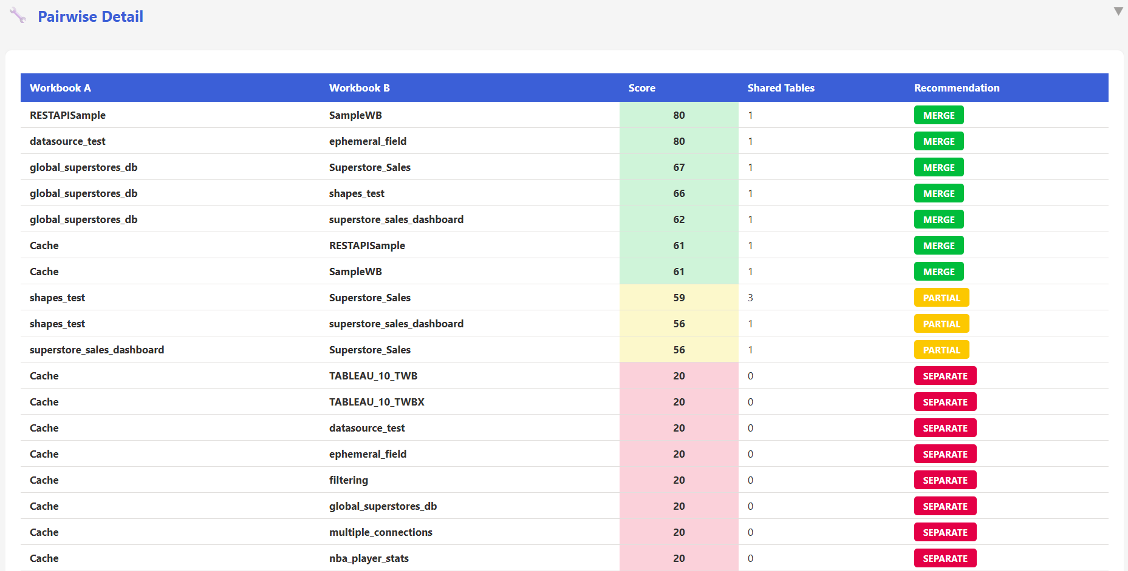
Shared Semantic Model — Multi-Workbook Merge
←
📊 Report A (thin)
📄 Workbook A
📦 Shared
Semantic Model
(ONE model)
→
🔗 MERGE
Fingerprint matching
Jaccard scoring
Conflict resolution
←
📊 Report B (thin)
📄 Workbook B
→
→
←
📊 Report C (thin)
📄 Workbook C
→
byPath → SharedModel
• SHA-256 fingerprint-based table matching across workbooks
• Jaccard column overlap scoring (0–100 merge score)
• Measure, column, relationship deduplication & conflict resolution
• Global assessment: pairwise merge scoring + BFS clustering
• Bundle deployment: shared model + thin reports → Fabric workspace

Slide 8
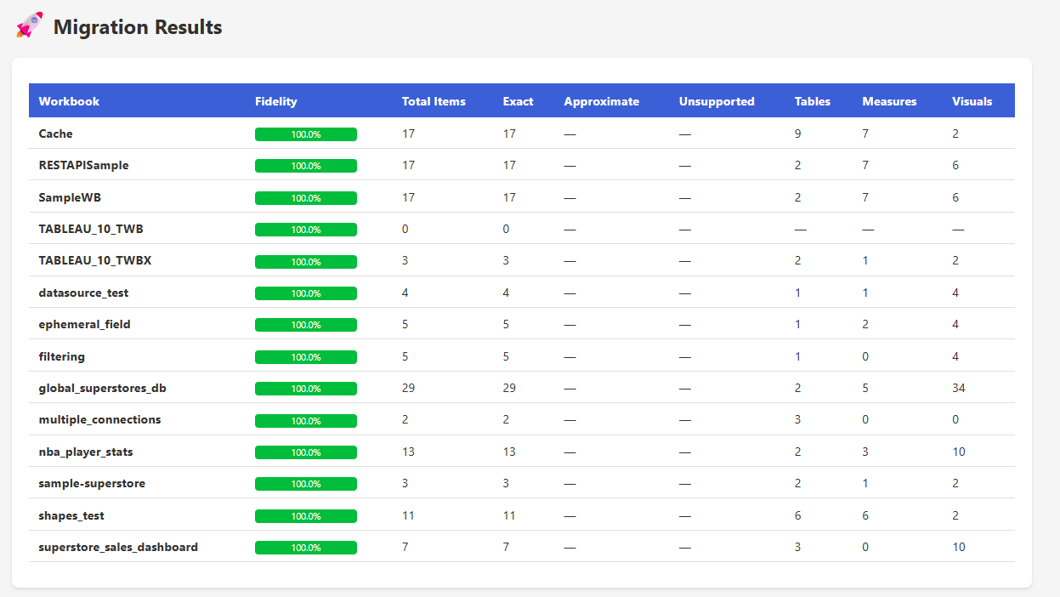
Current Portfolio — 6 Reports Migrated
6/6
PBIP Projects
Generated
5/6
Openability
Passed
1
Blocked
(UC80)
150
Focused
Tests
v48
Roadmap
Track
Migrated reports — openability passed
Blocked but generated: UC80
Salesforce
TDB Maintenance
Missing semantic reference: Surveillance IPE Historique vision_domaine
nba_player_stats
superstore_sales_dashboard
Missing visual measure: Show % (Indicateur Nat) - Domaine
World Indicators
All other static openability checks passed
Six PBIP projects generated. Five pass static openability; live Desktop/Fabric evidence remains not_run.

Slide 9
Post-Migration Automation & QA
Validate
(.pbip JSON/TMDL)
Auto-Fix
(17 DAX patterns)
Governance
(naming, PII, labels)
Compare
(Tableau vs PBI)
qa_report.json
(pass/fail/score)
→
→
→
→
python migrate.py workbook.twbx --qa
🔧 Validator Auto-Fix
17 Tableau→DAX leak patterns:
ISNULL→ISBLANK, ZN→IF(ISBLANK),
ELSEIF→IF, ==→=, or→||, and→&&
📜 RLS PowerShell
Auto-generate .ps1 scripts for
Azure AD RLS role assignment
via Power BI REST API
🔑 Credential Template
JSON placeholder file for each
datasource connection — ready
for DevOps pipeline injection
🔗 Lineage Map
lineage_map.json tracks every
object: tables, calcs, rels,
worksheets → HTML dashboard

Slide 10
Testing & CI/CD Pipeline
🔍 Lint
flake8 + ruff
🧪 Test
150 focused tests
Python 3.14
✅ Validate
Strict .twbx
migrations
📦 Staging
Fabric deploy
🚀 Production
Manual approval
→
→
→
→
Focused release validation:
Category
Count
Coverage
Quality report
31 tests
Policies, fixtures, runtime evidence
Semantic validation
6 tests
LOD, partitions, filter context
M validation
42 tests
Power Query syntax and gates
CLI/refactor
49 tests
Batch, flags, migration paths
Skill docs
15 tests
Flag and workflow documentation
Focused total
150 tests
All selected release checks green

Slide 11
Operational Surfaces — From Developer Tool to Handoff
Developer surfaces
VS Code extension
Notebook API v2
DAX/Tableau syntax grammars
Plugin SDK + marketplace
Agent surfaces
Copilot skill + flag reference
MCP tools: assess, migrate, QA, parity
Grounded remediation and Q&A
Secret-safe deployment guardrails
Enterprise surfaces
Tableau Server/Cloud download
Portfolio assessment and lineage
Prep-flow analysis
OAuth, gateway, RLS and credentials templates
Quality surfaces
Openability and Desktop probe
Self-healing and recovery ledger
Visual/data/interface fidelity
Evidence manifest and policy profiles
Delivery surfaces
PBIP/PBIR/TMDL output
Fabric six-artifact scaffold
PDF/PPTX/report packages
Power BI Service and Fabric deployment
Safety boundary
Local status is static unless runtime evidence exists
Semantic execution defaults to not_run
AI suggests; deterministic validators decide
Credentials and customer data stay out of fixtures
One versioned evidence contract connects CLI, batch, MCP, Notebook, VS Code, and Fabric metadata.

Slide 12
Next Steps
1. Open the five passing .pbip projects in Power BI Desktop
2. Review and remediate the two UC80 reference blockers
3. Run quality with --quality-policy enterprise or production
4. Load sanitized semantic fixtures with expected rows and tolerances
5. Connect an authorized Power BI/Fabric semantic executor
6. Run Desktop reopen, refresh, and Fabric post-deploy validation
python migrate.py quality WORKBOOK --quality-policy production

