Slide 1





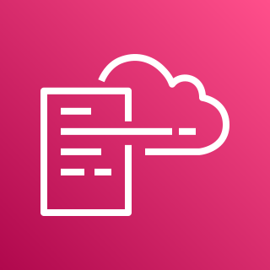





AWS Cloud
Organization Management Account (OU: Root)
All Existing and Future Organization Member Accounts
1.0
Home Region
2.0
1.5
1.8
Home Region
1.1
DLQ
Alarm Topic
AWS CloudFormation
2.1
1.3
1.6
1.10
AWS CloudFormation
2.3
Regional Event Rules
Lambda Function
S3 Account Settings
S3 Account Settings
1.7
1.9
CloudWatch Log Group
SNS Topic
Global Region
Global Region
1.2
1.4
2.2
IAM Roles
Global Event Rules
S3 Block Account Public Access Role

