Slide 1
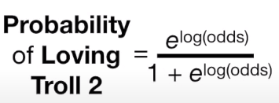
n번째 Predict
Residual
=
Observed Prob
-
n-1번째GBTR 예측P
0번째GBTR 예측P
Initail Prob
=
Log(Odds)
(초기값에서만 같음)
To Log(odds)
Tranformer
( )다시 logit Function으로 확률값으로 전환
=
Log(Odds)
(초기값에서만 같음)
1번째GBTR 예측P
Initail Prob
+
LearningRate
x
1번째 Predict
Residual
To Log(odds)
Tranformer
To Log(odds)
Tranformer
( )
다시 logit Function으로 확률값으로 전환
=
Log(Odds)
(초기값에서만 같음)
2번째GBTR 예측P
Initail Prob
+
LearningRate
x
1번째 Predict
Residual
+
LearningRate
x
2번째 Predict
Residual

