Slide 1
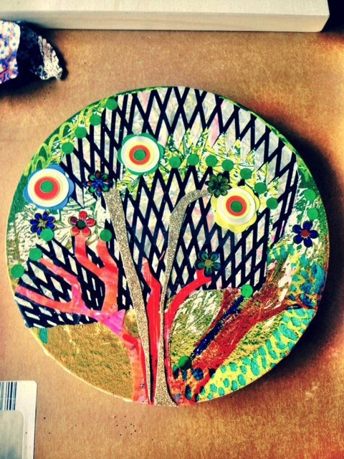
Tree 2014, Collage, screen print and paint on canvas 15cm diameter

Slide 2
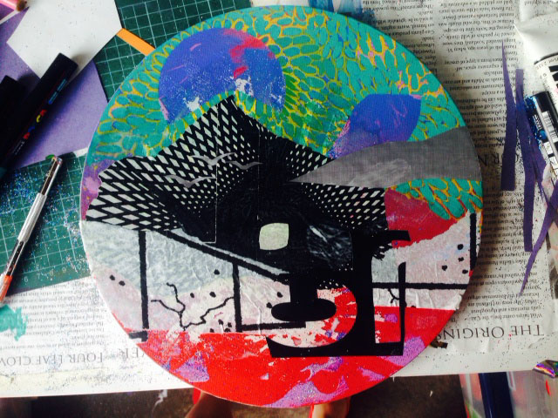
Ice Fracking 2014, Collage and paint on canvas, 25cm diameter

Slide 3
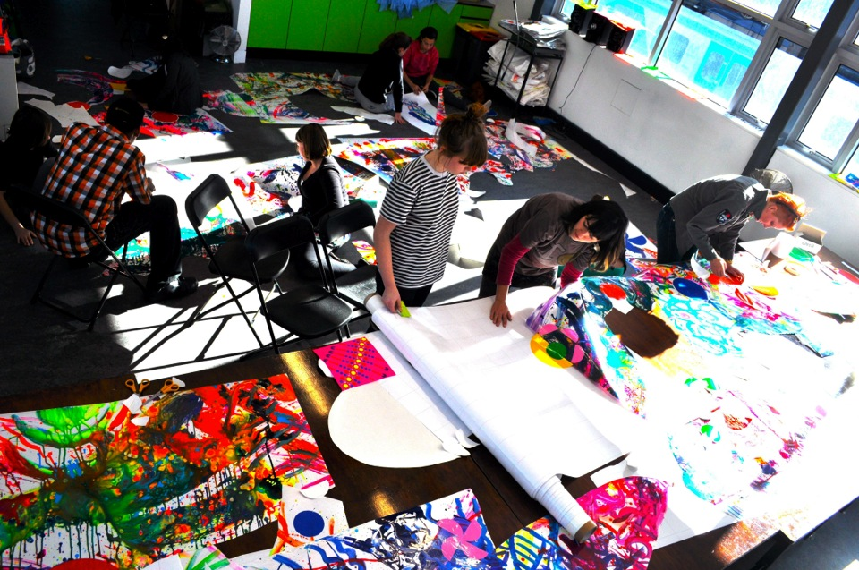
Chroma Cut Project, 2009, SIGNAL Art space, Melbourne

Slide 4
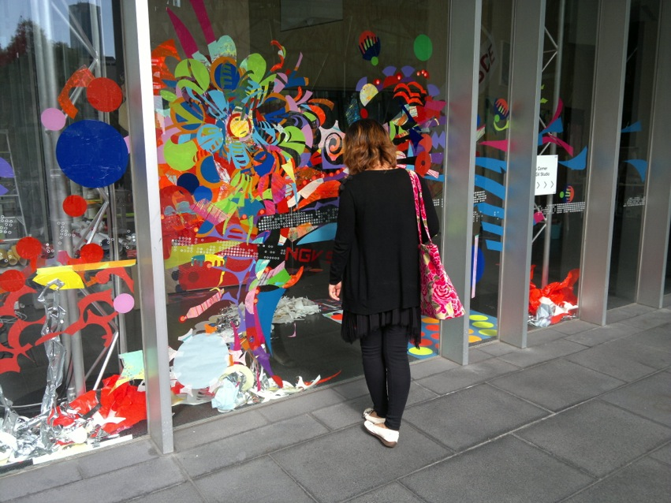
Window installation @ Fluroesce Studio Residency, 2012, National Gallery of Victoria

Slide 5
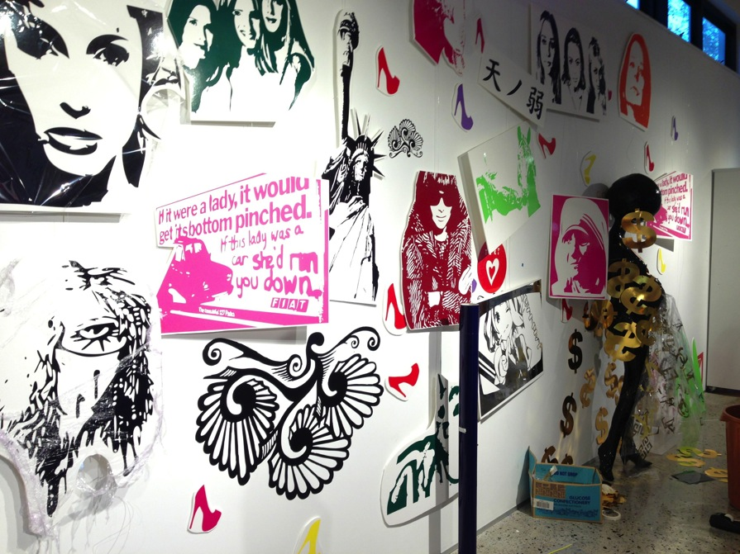
Wall Installation from the Vinyl Chic Sticker Boutique,
Perth Institute of Contemporary Arts Spark Lab Residency, 2013

Slide 6
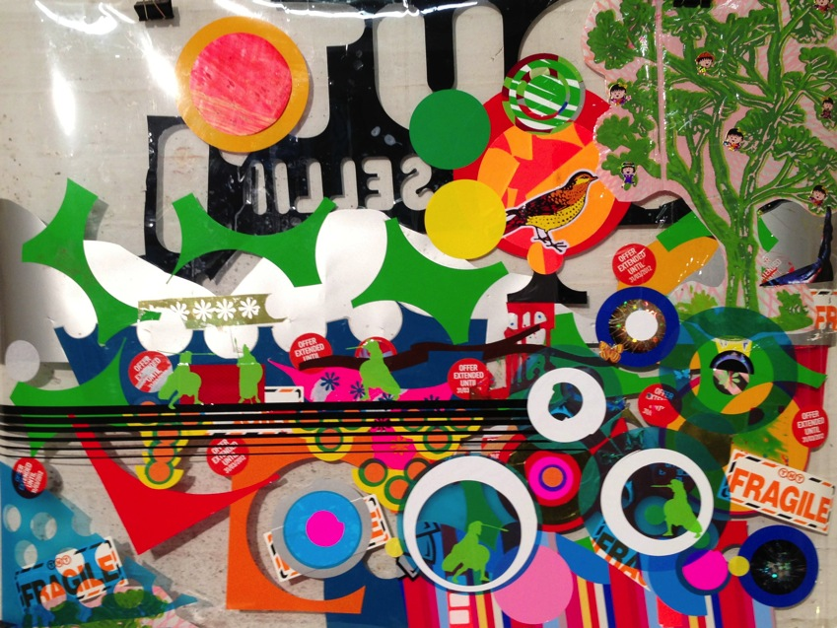
Perfect Tree Scape, 2013 Vinyl and collage on Acetate 60cm x 82cm

Slide 7
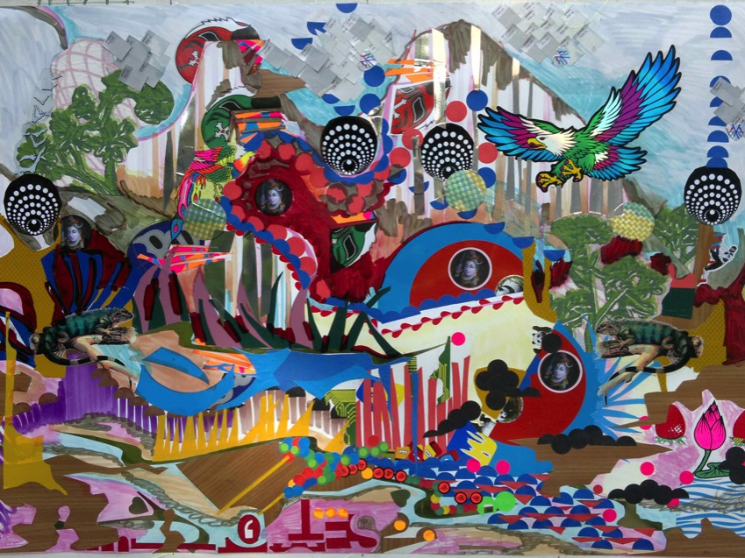
Doof Mountain 2012, collage, stickers and ink on tyvek 78cm x 92cm

Slide 8
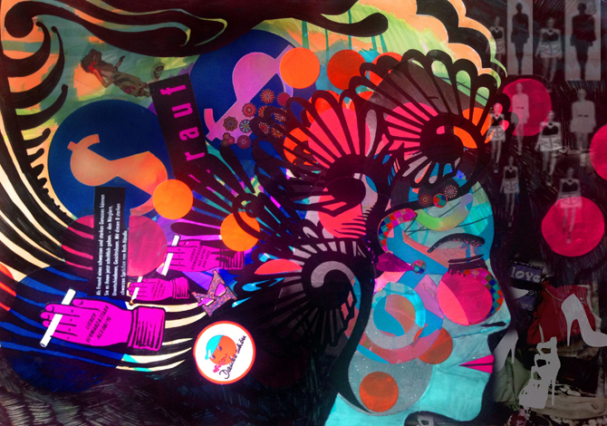
Berlin Dreaming 2013 Digital manipulation, collage and ink on paper

