Slide 1
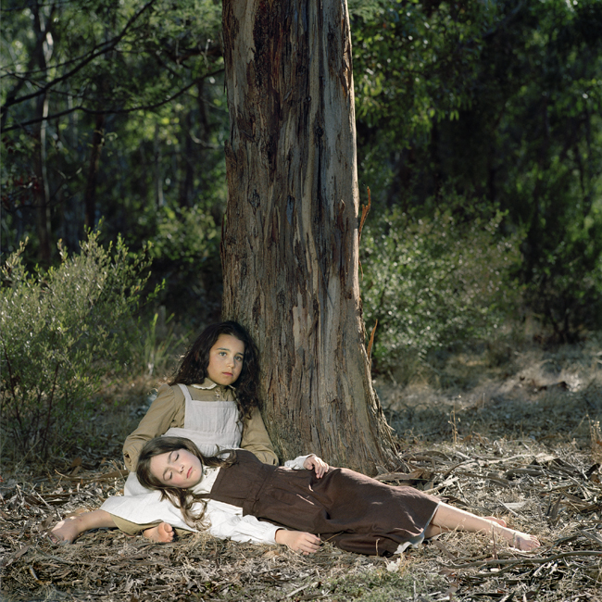
Polixeni Papapetrou
By the Yarra #1 1857, 2006
(Pigment ink print 105 cm x 105 cm)

Slide 2
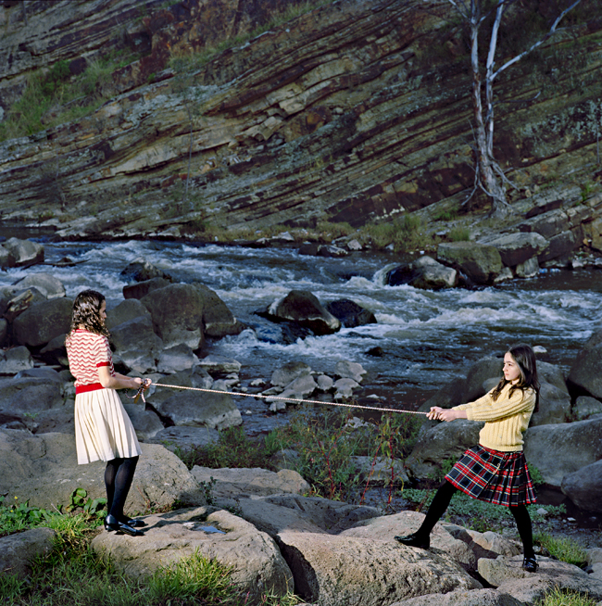
Polixeni Papapetrou
Dights Falls, 2008
(Pigment ink print 105 cm x 105 cm)

Slide 3
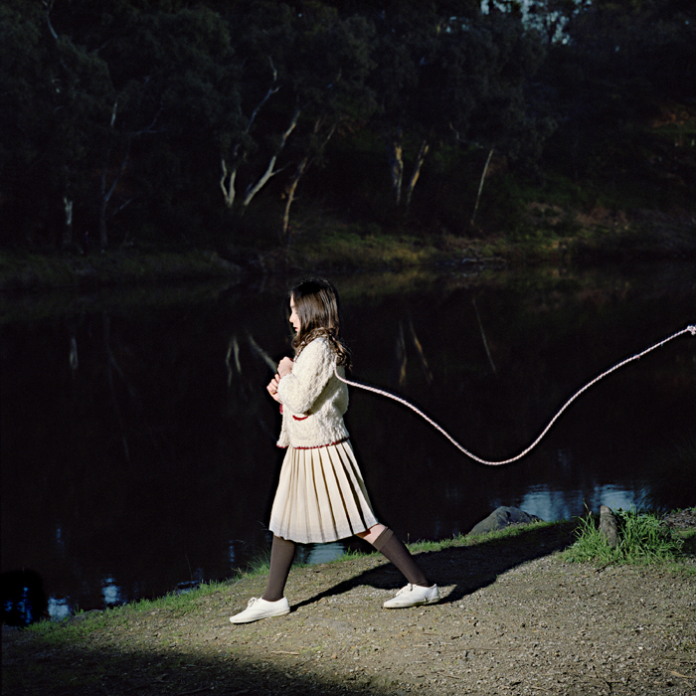
Polixeni Papapetrou
Dreams are like water, 2008
(Pigment ink print 105 cm x 105 cm)

