Slide 1
Analýza procesov
Department of Information Networks
Faculty of Management Science and Informatics
University of Žilina
5. prednáška
Juraj Smieško

Slide 2
Lineárna regresia
Jednonásobná lineárna regresia
viacparametrickými funkciami

Slide 3
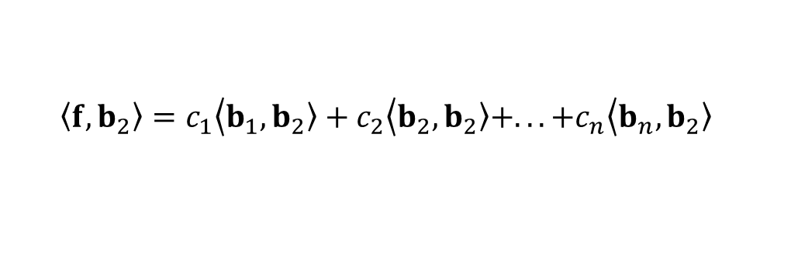
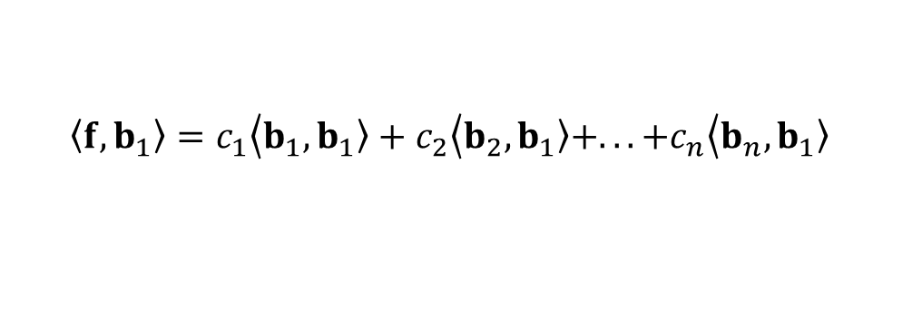
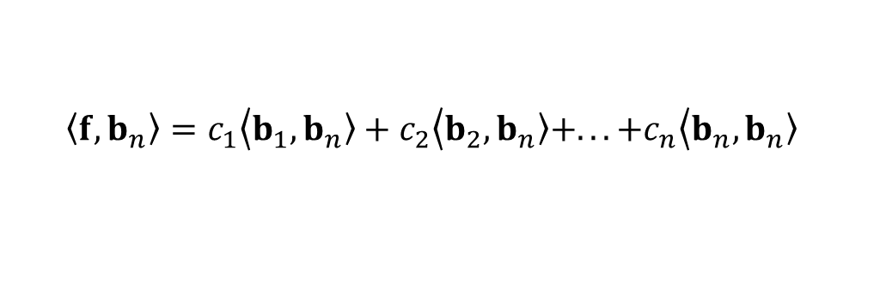

Lineárna viacparametrická regresia
$$t=\left(t_{1},t_{2},t_{3},...,t_{N}\right)$$
Regresná funkcia:
$$\left\langle f\right.,\left.b_{1}\right\rangle =c_{1}\left\langle b_{1}\right.,\left.b_{1}\right\rangle +c_{2}\left\langle b_{2}\right.,\left.b_{1}\right\rangle +...+c_{n}\left\langle b_{n}\right.,\left.b_{1}\right\rangle$$
$$\left\langle f\right.,\left.b_{2}\right\rangle =c_{1}\left\langle b_{1}\right.,\left.b_{2}\right\rangle +c_{2}\left\langle b_{2}\right.,\left.b_{2}\right\rangle +...+c_{n}\left\langle b_{n}\right.,\left.b_{2}\right\rangle$$
$$\left\langle f\right.,\left.b_{n}\right\rangle =c_{1}\left\langle b_{1}\right.,\left.b_{n}\right\rangle +c_{2}\left\langle b_{2}\right.,\left.b_{n}\right\rangle +...+c_{n}\left\langle b_{n}\right.,\left.b_{n}\right\rangle$$

Slide 4
Regresia dvojparametrickou funkciou
$$t=\left(t_{1},t_{2},t_{3},...,t_{N}\right)$$
$$c_{1} \left\langle b_{1},b_{1}\right\rangle +c_{2}\left\langle b_{2},b_{1}\right\rangle =\left\langle f,b_{1}\right\rangle$$
$$f=\left(f_{1},f_{2},f_{3},...,f_{N}\right)$$
$$c_{1} \left\langle b_{1},b_{2}\right\rangle +c_{2}\left\langle b_{2},b_{2}\right\rangle =\left\langle f,b_{2}\right\rangle$$
Regresná priamka
$$y\left(t\right)=a+b.t$$
$\tilde{f}=\left(a+b.t_{1},a+b.t_{2},a+b.t_{3} ,...,a+b.t_{N}\right)$ =
$=\left(a,a,a,...,a \right)$ + $\left(b.t_{1},b.t_{2},b.t_{3} ,...,b.t_{N}\right)=$
$=a\left(1,1,1,...,1 \right)$ + $b\left(t_{1},t_{2},t_{3} ,...,t_{N}\right)$ =
$=ab_{1}$ + $bb_{2}$
$b_{1}$ = (1,1,1,...,1)
$b_{2}$ = ($t_{1},t_{2},t_{3} ,…,t_{N}$)

Slide 5
Regresia dvojparametrickou funkciou
$$t=\left(t_{1},t_{2},t_{3},...,t_{N}\right)$$
$$c_{1} \left\langle b_{1},b_{1}\right\rangle +c_{2}\left\langle b_{2},b_{1}\right\rangle =\left\langle f,b_{1}\right\rangle$$
$$f=\left(f_{1},f_{2},f_{3},...,f_{N}\right)$$
$$c_{1} \left\langle b_{1},b_{2}\right\rangle +c_{2}\left\langle b_{2},b_{2}\right\rangle =\left\langle f,b_{2}\right\rangle$$
Regresná priamka
$$t=\left(0,1,2,3,4 \right)$$
$$t$$ | 0 | 1 | 2 | 3 | 4
$$f$$ | 1 | 1 | 3 | 6 | 9
$$\tilde{f}$$ | -0.2 | 1.9 | 4 | 6.1 | 8.2
$f$-$\tilde{f}$ | 1.2 | -0.9 | -1 | -0.1 | 0.8
$$f=\left(1, 1, 3, 6, 9 \right)$$
$\tilde{f}=ab_{1}$ + $bb_{2}$
$$y\left(t\right)=a+b.t$$
$b_{1}$ = (1,1,1,1,1)
$$5a+10b=20$$
$$a+2b=4$$
$$a+2b=4$$
$b_{2}$ = (0,1,2,3,4)
$$10a+30b=61$$
$$a+3b=6.1$$
$b=2.1$
$a=−0.2$
$$y\left(t\right)=−0.2+2.1.t$$

Slide 6
Regresia dvojparametrickou funkciou
$$t=\left(t_{1},t_{2},t_{3},...,t_{N}\right)$$
$$c_{1} \left\langle b_{1},b_{1}\right\rangle +c_{2}\left\langle b_{2},b_{1}\right\rangle =\left\langle f,b_{1}\right\rangle$$
$$f=\left(f_{1},f_{2},f_{3},...,f_{N}\right)$$
$$c_{1} \left\langle b_{1},b_{2}\right\rangle +c_{2}\left\langle b_{2},b_{2}\right\rangle =\left\langle f,b_{2}\right\rangle$$
Regresná priamka
$$t=\left(0,1,2,3,4 \right)$$
$$t$$ | 0 | 1 | 2 | 3 | 4
$$f$$ | 1 | 1 | 3 | 6 | 9
$$\tilde{f}$$ | -0.2 | 1.9 | 4 | 6.1 | 8.2
$f$-$\tilde{f}$ | 1.2 | -0.9 | -1 | -0.1 | 0.8
$$f=\left(1, 1, 3, 6, 9 \right)$$
$\tilde{f}=ab_{1}$ + $bb_{2}$
$$y\left(t\right)=a+b.t$$
$b_{1}$ = (1,1,1,1,1)
$${\left\|e\right\|}^{2}=1.44+0.81+1+0.01+0.64=3.9$$
$b_{2}$ = (0,1,2,3,4)
$$y\left(t\right)=−0.2+2.1.t$$

Slide 7
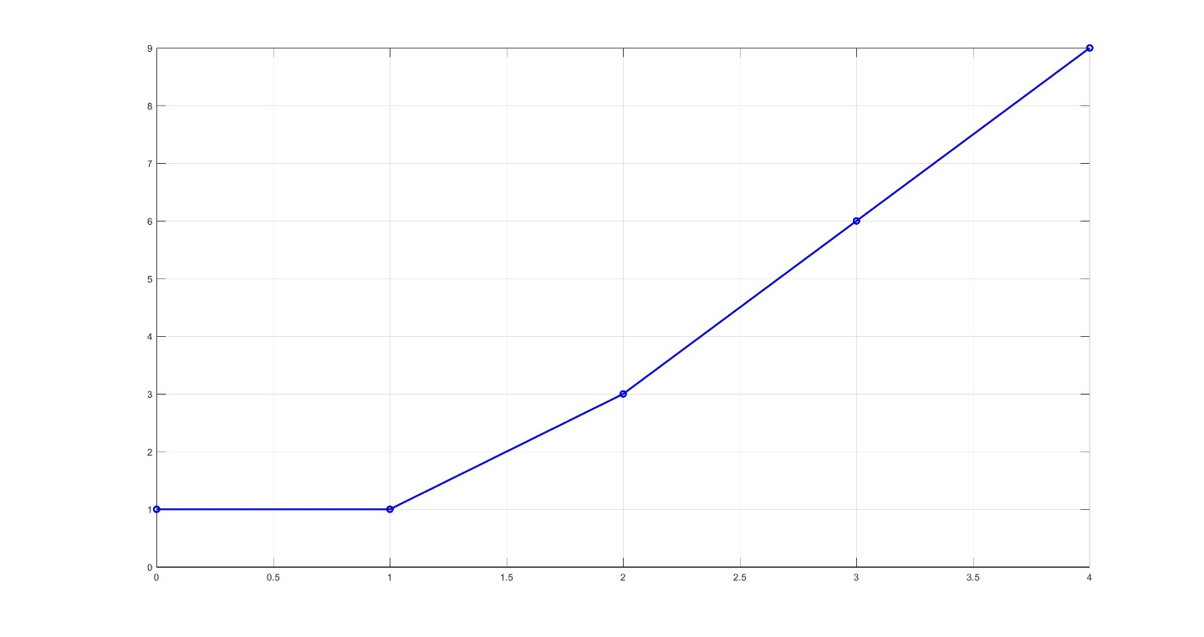
Regresia dvojparametrickou funkciou
$$t=\left(t_{1},t_{2},t_{3},...,t_{N}\right)$$
$$c_{1} \left\langle b_{1},b_{1}\right\rangle +c_{2}\left\langle b_{2},b_{1}\right\rangle =\left\langle f,b_{1}\right\rangle$$
$$f=\left(f_{1},f_{2},f_{3},...,f_{N}\right)$$
$$c_{1} \left\langle b_{1},b_{2}\right\rangle +c_{2}\left\langle b_{2},b_{2}\right\rangle =\left\langle f,b_{2}\right\rangle$$
Regresná priamka
$$t=\left(0,1,2,3,4 \right)$$
$$f=\left(1, 1, 3, 6, 9 \right)$$
$$f$$
$$y\left(t\right)=a+b.t$$
$b_{1}$ = (1,1,1,1,1)
$b_{2}$ = (0,1,2,3,4)

Slide 8
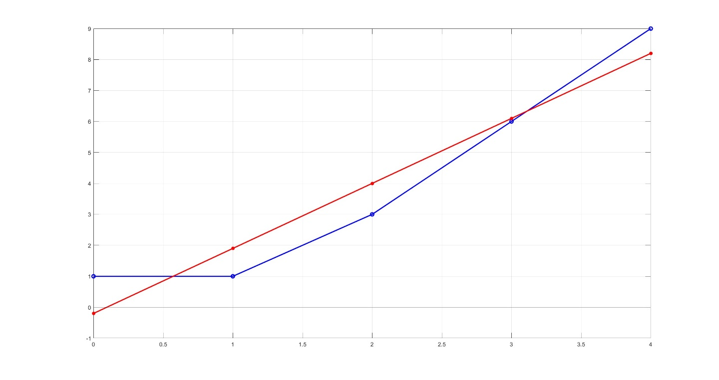
Regresia dvojparametrickou funkciou
$$t=\left(t_{1},t_{2},t_{3},...,t_{N}\right)$$
$$c_{1} \left\langle b_{1},b_{1}\right\rangle +c_{2}\left\langle b_{2},b_{1}\right\rangle =\left\langle f,b_{1}\right\rangle$$
$$f=\left(f_{1},f_{2},f_{3},...,f_{N}\right)$$
$$c_{1} \left\langle b_{1},b_{2}\right\rangle +c_{2}\left\langle b_{2},b_{2}\right\rangle =\left\langle f,b_{2}\right\rangle$$
Regresná priamka
$$t=\left(0,1,2,3,4 \right)$$
$$f=\left(1, 1, 3, 6, 9 \right)$$
$$f$$
$$y\left(t\right)=a+b.t$$
$b_{1}$ = (1,1,1,1,1)
$$\tilde{f}$$
$b_{2}$ = (0,1,2,3,4)

Slide 9
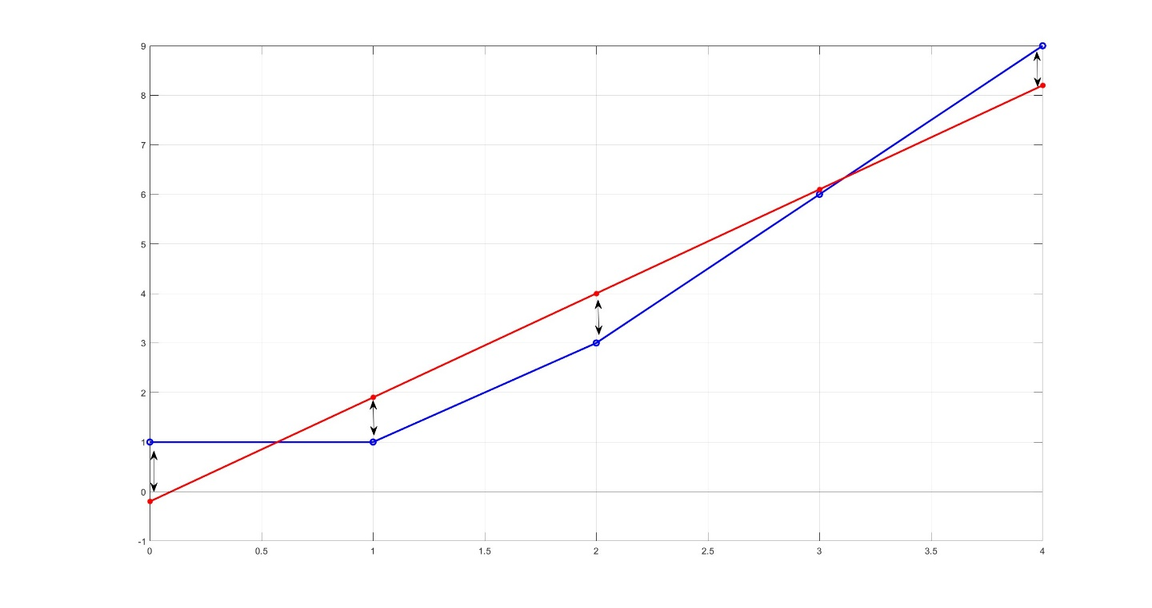
Regresia dvojparametrickou funkciou
$$t=\left(t_{1},t_{2},t_{3},...,t_{N}\right)$$
$$c_{1} \left\langle b_{1},b_{1}\right\rangle +c_{2}\left\langle b_{2},b_{1}\right\rangle =\left\langle f,b_{1}\right\rangle$$
$$f=\left(f_{1},f_{2},f_{3},...,f_{N}\right)$$
$$c_{1} \left\langle b_{1},b_{2}\right\rangle +c_{2}\left\langle b_{2},b_{2}\right\rangle =\left\langle f,b_{2}\right\rangle$$
Regresná priamka
$$t=\left(0,1,2,3,4 \right)$$
$$f\tilde{ − f}=(1.2, −0.9, −1,−0.1,0.8)$$
$$f=\left(1, 1, 3, 6, 9 \right)$$
$$f$$
$$y\left(t\right)=a+b.t$$
$b_{1}$ = (1,1,1,1,1)
$$\tilde{f}$$
$b_{2}$ = (0,1,2,3,4)

Slide 10






Polynomická regresia
$$t=\left(t_{1},t_{2},t_{3},...,t_{N}\right)$$
Kvadratická regresná funkcia
$y\left(t\right)=a+b.t$ $+c. t^{2}$
$\tilde{f}=\left(a+b.t_{1}+c.t_{1}^{2},a+b.t_{1}+c.t_{2}^{2},...,a+b.t_{N}+c.t_{N}^{2},\right)$ =
$=\left(a,a,...,a \right)$ + $\left(b.t_{1},b.t_{2},...,b.t_{N}\right) \text{+ }\left(c.t_{1}^{2},c.t_{2}^{2},...,c.t_{N}^{2}\right)=$
$=a\left(1,1,...,1 \right)$ + $b\left(t_{1},t_{2},...,t_{N}\right)$ $\text{+}c\left(t_{1}^{2},t_{2}^{2},...,t_{N}^{2}\right)$=
$=ab_{1}$ + $bb_{2}$ + $cb_{2}$
$b_{1}$ = (1,1,...,1)
$b_{2}$ = ($t_{1},t_{2},…,t_{N}$)
$b_{3}$ = ($t_{1}^{2},t_{2}^{2},…,t_{N}^{2}$)

Slide 11















Regresia trojparametrickou funkciou
$$t=\left(t_{1},t_{2},t_{3},...,t_{N}\right)$$
$$f=\left(f_{1},f_{2},f_{3},...,f_{N}\right)$$
Kvadratická regresná funkcia
$$t=\left(0,1,2,3,4 \right)$$
$$t$$ | 0 | 1 | 2 | 3 | 4
$$f$$ | 1 | 1 | 3 | 6 | 9
$$f=\left(1, 1, 3, 6, 9 \right)$$
$y\left(t\right)=a+b.t$ $+c. t^{2}$
$b_{1}$ = (1,1,1,1,1)
$$5a+10b+30c=20$$
$a=0.8$
$b_{2}$ = (0,1,2,3,4)
$$10a+30b+100c=61$$
$$b=0.1$$
$$30a+100b+354=211$$
$$c=0.5$$
$b_{3}$ = (0,1,4,9,16)

Slide 12


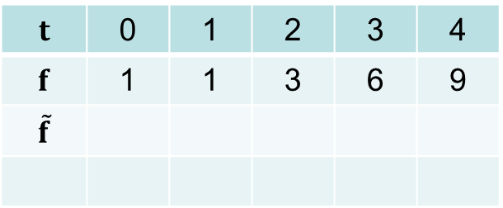
Regresia trojparametrickou funkciou
$$t=\left(t_{1},t_{2},t_{3},...,t_{N}\right)$$
$$f=\left(f_{1},f_{2},f_{3},...,f_{N}\right)$$
Kvadratická regresná funkcia
$$t=\left(0,1,2,3,4 \right)$$
$$t$$ | 0 | 1 | 2 | 3 | 4
$$f$$ | 1 | 1 | 3 | 6 | 9
$$\tilde{f}$$
$$f=\left(1, 1, 3, 6, 9 \right)$$
$y\left(t\right)=a+b.t$ $+c. t^{2}$
$b_{1}$ = (1,1,1,1,1)
$\tilde{f}=0.8b_{1}$ + 0.1$b_{2 }\text{+ 0.1}b_{3}$
= $\left(0.8, 1.4, 3, 5.6, 9.2 \right)$
$b_{2}$ = (0,1,2,3,4)
$b_{3}$ = (0,1,4,9,16)

Slide 13
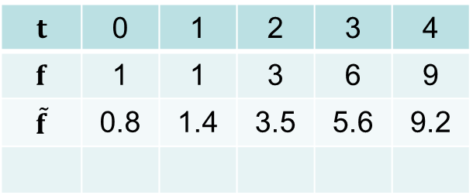
Regresia trojparametrickou funkciou
$$t=\left(t_{1},t_{2},t_{3},...,t_{N}\right)$$
$$f=\left(f_{1},f_{2},f_{3},...,f_{N}\right)$$
Kvadratická regresná funkcia
$$t=\left(0,1,2,3,4 \right)$$
$$t$$ | 0 | 1 | 2 | 3 | 4
$$f$$ | 1 | 1 | 3 | 6 | 9
$$\tilde{f}$$ | 0.8 | 1.4 | 3.5 | 5.6 | 9.2
$$f=\left(1, 1, 3, 6, 9 \right)$$
$y\left(t\right)=a+b.t$ $+c. t^{2}$
$b_{1}$ = (1,1,1,1,1)
$\tilde{f}=0.8b_{1}$ + 0.1$b_{2 }\text{+ 0.1}b_{3}$
= $\left(0.8, 1.4, 3, 5.6, 9.2 \right)$
$b_{2}$ = (0,1,2,3,4)
$b_{3}$ = (0,1,4,9,16)

Slide 14
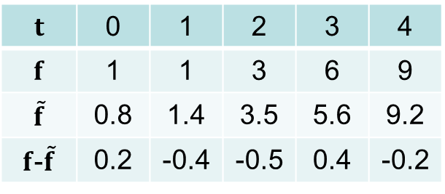
Regresia trojparametrickou funkciou
$$t=\left(t_{1},t_{2},t_{3},...,t_{N}\right)$$
$$f=\left(f_{1},f_{2},f_{3},...,f_{N}\right)$$
Kvadratická regresná funkcia
$$t=\left(0,1,2,3,4 \right)$$
$$t$$ | 0 | 1 | 2 | 3 | 4
$$f$$ | 1 | 1 | 3 | 6 | 9
$$\tilde{f}$$ | 0.8 | 1.4 | 3.5 | 5.6 | 9.2
$f$-$\tilde{f}$ | 0.2 | -0.4 | -0.5 | 0.4 | -0.2
$$f=\left(1, 1, 3, 6, 9 \right)$$
$y\left(t\right)=a+b.t$ $+c. t^{2}$
$b_{1}$ = (1,1,1,1,1)
$\tilde{f}=0.8b_{1}$ + 0.1$b_{2 }\text{+ 0.1}b_{3}$
= $\left(0.8, 1.4, 3, 5.6, 9.2 \right)$
$b_{2}$ = (0,1,2,3,4)
$${\left\|e\right\|}^{2}=0.04+0.16+0.25+0.16+0.04=0.65$$
$b_{3}$ = (0,1,4,9,16)

Slide 15
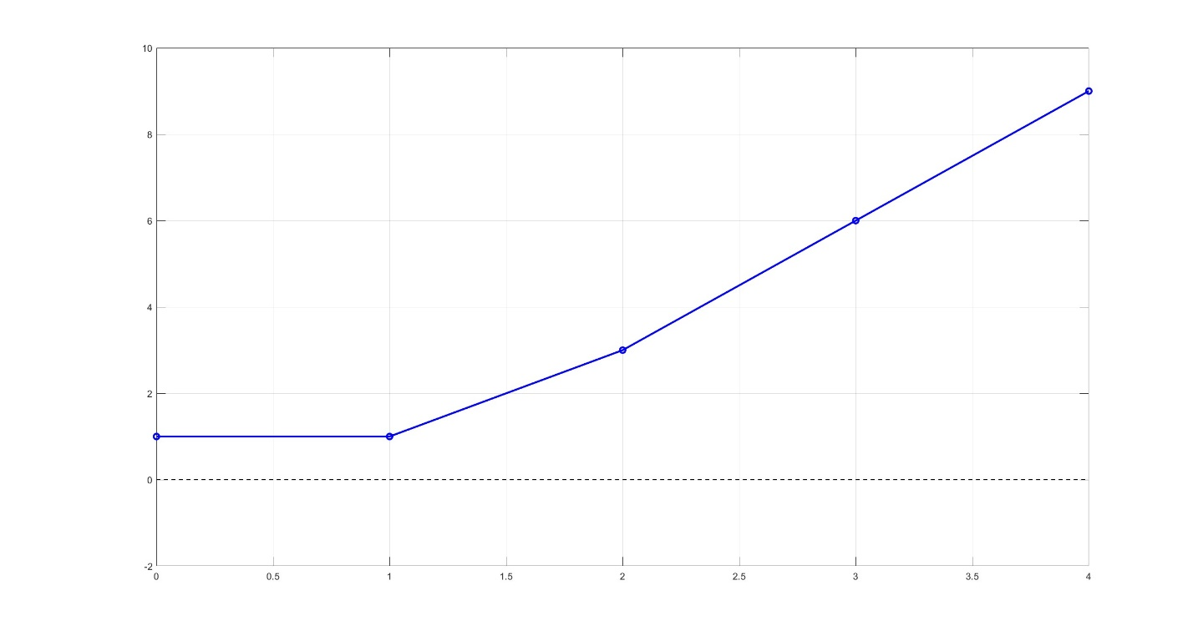
Regresia trojparametrickou funkciou
$$t=\left(t_{1},t_{2},t_{3},...,t_{N}\right)$$
$$f=\left(f_{1},f_{2},f_{3},...,f_{N}\right)$$
Kvadratická regresná funkcia
$$t=\left(0,1,2,3,4 \right)$$
$$f=\left(1, 1, 3, 6, 9 \right)$$
$y\left(t\right)=a+b.t$ $+c. t^{2}$
$b_{1}$ = (1,1,1,1,1)
$b_{2}$ = (0,1,2,3,4)
$b_{3}$ = (0,1,4,9,16)

Slide 16
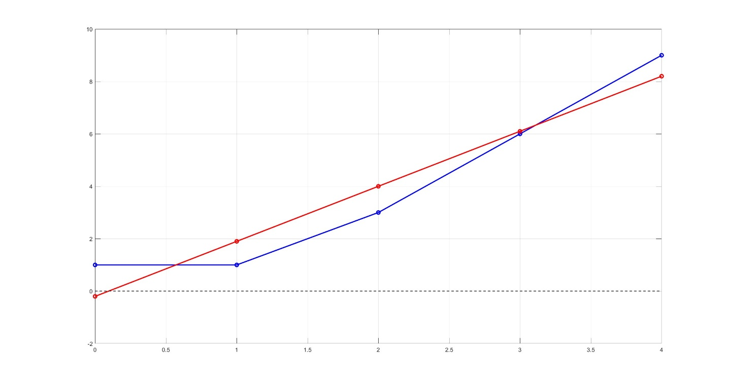

Regresia trojparametrickou funkciou
$$t=\left(t_{1},t_{2},t_{3},...,t_{N}\right)$$
$$f=\left(f_{1},f_{2},f_{3},...,f_{N}\right)$$
Kvadratická regresná funkcia
$$t=\left(0,1,2,3,4 \right)$$
$$f=\left(1, 1, 3, 6, 9 \right)$$
$y\left(t\right)=a+b.t$ $+c. t^{2}$
$$y\left(t\right)=−0.2+2.1.t$$
$b_{1}$ = (1,1,1,1,1)
$b_{2}$ = (0,1,2,3,4)
$b_{3}$ = (0,1,4,9,16)

Slide 17
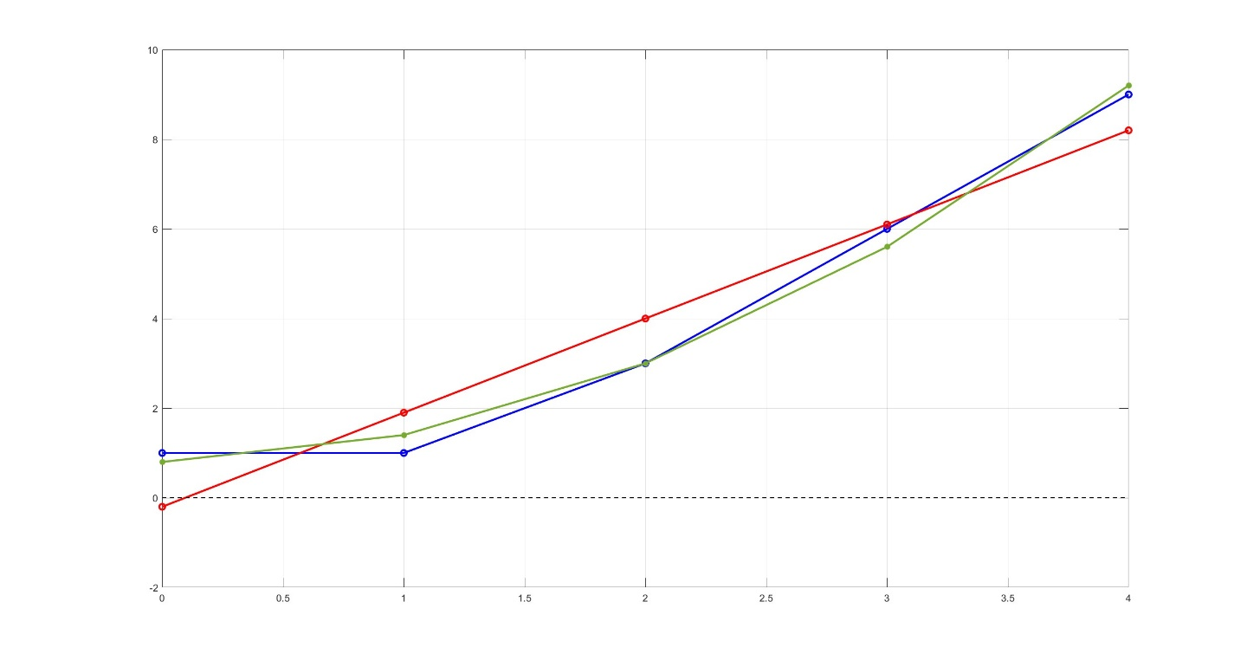

Regresia trojparametrickou funkciou
$$t=\left(t_{1},t_{2},t_{3},...,t_{N}\right)$$
$$f=\left(f_{1},f_{2},f_{3},...,f_{N}\right)$$
Kvadratická regresná funkcia
$$t=\left(0,1,2,3,4 \right)$$
$$f=\left(1, 1, 3, 6, 9 \right)$$
$y\left(t\right)=a+b.t$ $+c. t^{2}$
$$y\left(t\right)=−0.2+2.1.t$$
$b_{1}$ = (1,1,1,1,1)
$\tilde{f}$ = $\left(0.8, 1.4, 3, 5.6, 9.2 \right)$
$b_{2}$ = (0,1,2,3,4)
$b_{3}$ = (0,1,4,9,16)

Slide 18
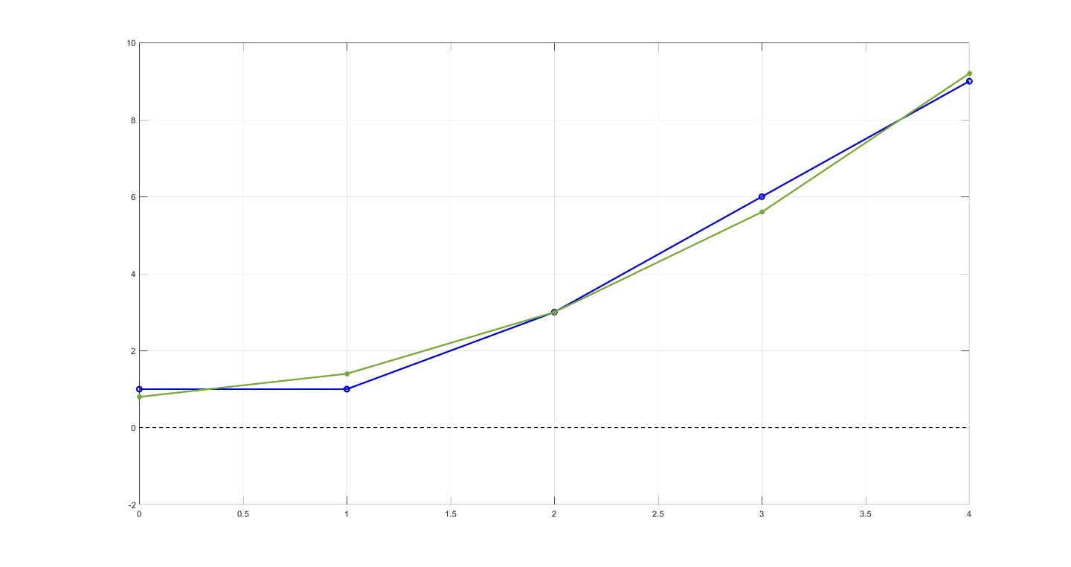
Regresia trojparametrickou funkciou
$$t=\left(t_{1},t_{2},t_{3},...,t_{N}\right)$$
$$f=\left(f_{1},f_{2},f_{3},...,f_{N}\right)$$
Kvadratická regresná funkcia
$$t=\left(0,1,2,3,4 \right)$$
$$f=\left(1, 1, 3, 6, 9 \right)$$
$y\left(t\right)=a+b.t$ $+c. t^{2}$
$b_{1}$ = (1,1,1,1,1)
$\tilde{f}$ = $\left(0.8, 1.4, 3, 5.6, 9.2 \right)$
$b_{2}$ = (0,1,2,3,4)
$b_{3}$ = (0,1,4,9,16)

Slide 19
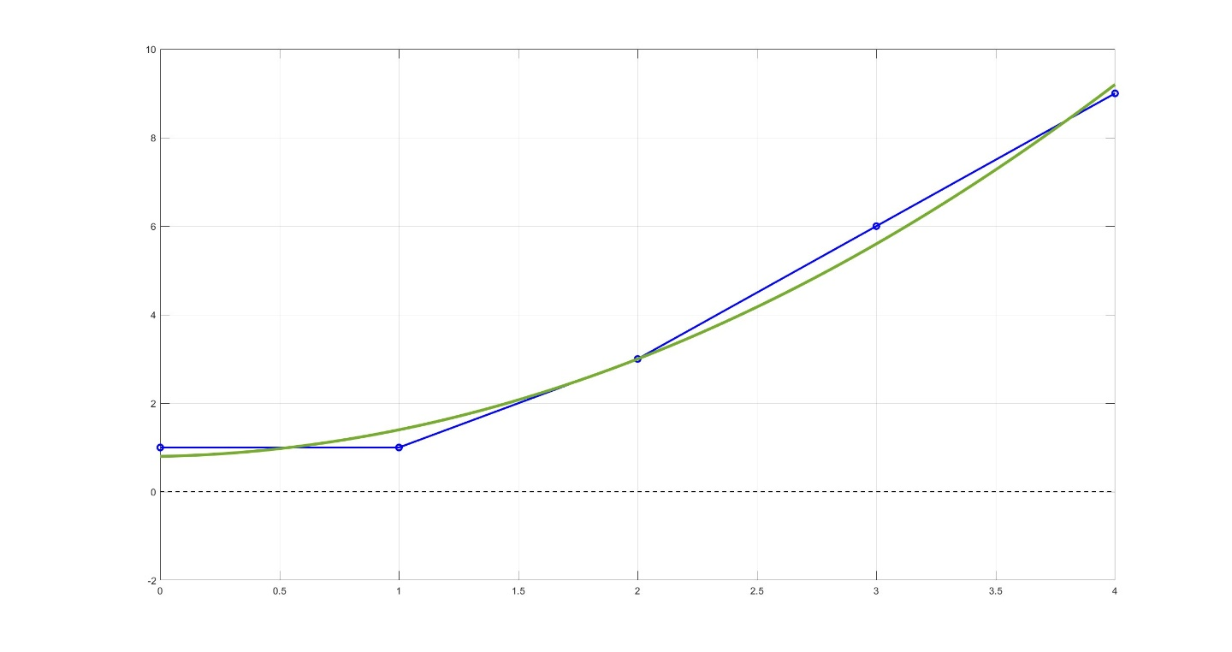

Regresia trojparametrickou funkciou
$$t=\left(t_{1},t_{2},t_{3},...,t_{N}\right)$$
$$f=\left(f_{1},f_{2},f_{3},...,f_{N}\right)$$
Kvadratická regresná funkcia
$$t=\left(0,1,2,3,4 \right)$$
$$f=\left(1, 1, 3, 6, 9 \right)$$
$y\left(t\right)=0.8+0.1t$ $+0.5t^{2}$
$y\left(t\right)=a+b.t$ $+c. t^{2}$
$b_{1}$ = (1,1,1,1,1)
$b_{2}$ = (0,1,2,3,4)
$b_{3}$ = (0,1,4,9,16)

Slide 20
Polynomická regresia
Jednonásobná lineárna regresia
viacparametrickými funkciami

Slide 21
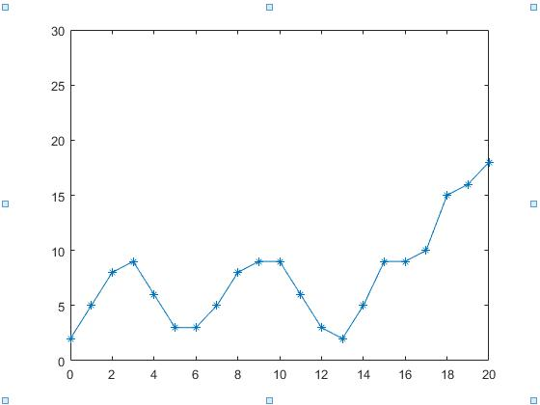
Polynomická regresia
polynomická regresia:

Slide 22
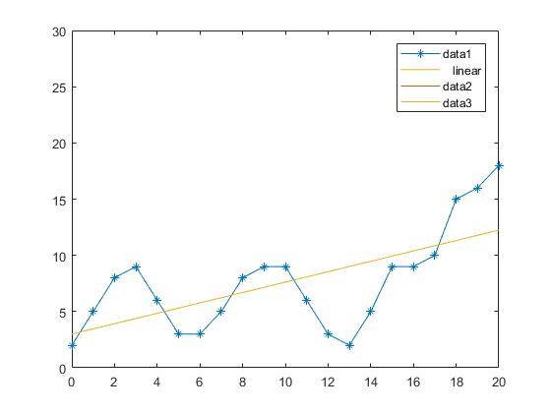
Polynomická regresia
polynomická regresia:

Slide 23
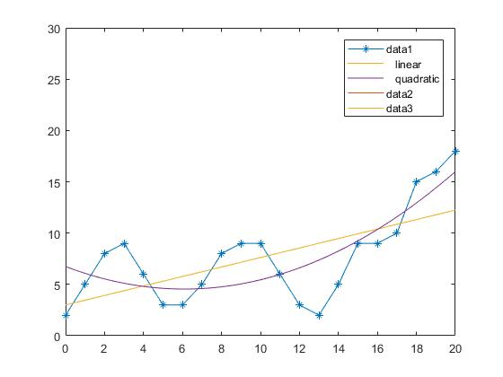
Polynomická regresia
polynomická regresia:

Slide 24
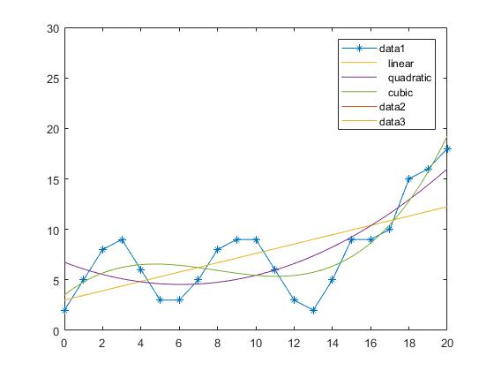
Polynomická regresia
polynomická regresia:

Slide 25
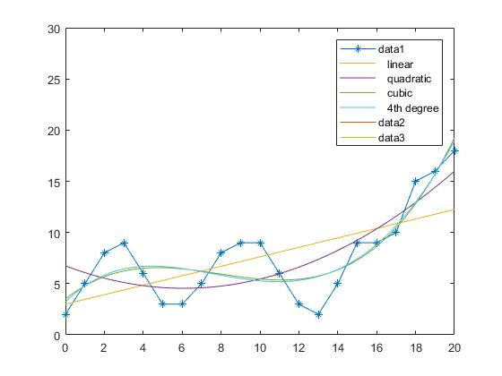
Polynomická regresia
polynomická regresia:

Slide 26
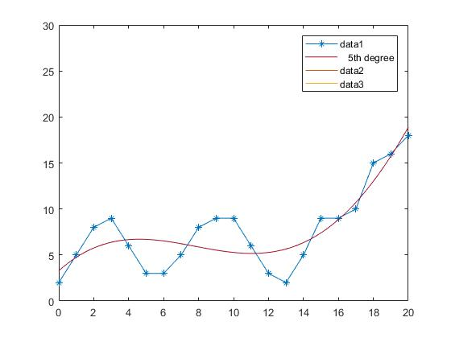
Polynomická regresia
polynomická regresia:

Slide 27
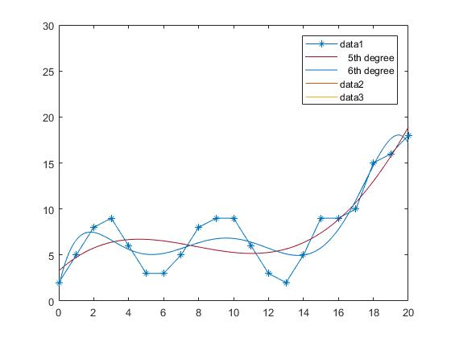
Polynomická regresia
polynomická regresia:

Slide 28
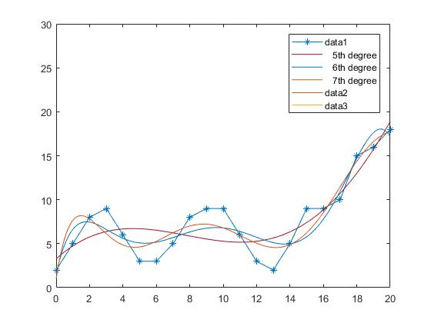
Polynomická regresia
polynomická regresia:

Slide 29
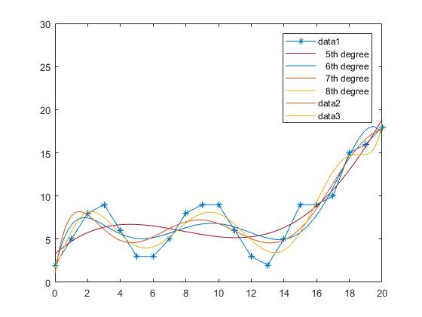
Polynomická regresia
polynomická regresia:

Slide 30
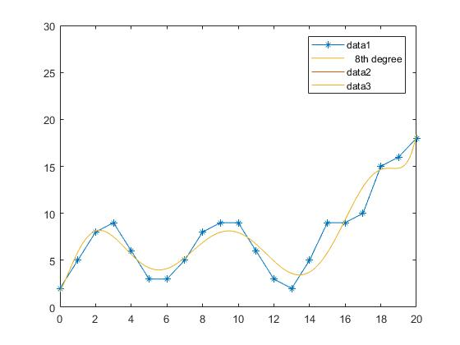
Polynomická regresia
polynomická regresia:

Slide 31



Lineárna viacparametrická regresia
lineárna regresia:
$$y(t)=c_{1}+c_{2}t^{4}+c_{2}t^{8}+c_{3}e^{−2t}+c_{5}\sin\left(0.5π⋅t\right)$$
polynomická regresia:
$$y(t)=c_{0}+c_{1}t+c_{2}t^{2}+c_{3}t^{3}+c_{4}t^{4}+…+c_{n}t^{n}$$
logaritmická regresia:
$$y(t)=a\ln\left(bt\right)$$
$y(t)=a\ln{b}$+ $a\ln{t}$

Slide 32



Lineárna viacparametrická regresia
lineárna regresia:
$$y(t)=c_{1}+c_{2}t^{4}+c_{2}t^{8}+c_{3}e^{−2t}+c_{5}\sin\left(0.5π⋅t\right)$$
polynomická regresia:
$$y(t)=c_{0}+c_{1}t+c_{2}t^{2}+c_{3}t^{3}+c_{4}t^{4}+…+c_{n}t^{n}$$
logaritmická regresia:
$$y(t)=a\ln\left(bt\right)$$
$y(t)=a\ln{b}$+ $a\ln{t}$
$$y(t)=c_{0}+c_{1}\ln{t}$$
$$c_{0}=a\ln{b}$$
$$c_{1}=a$$

Slide 33



Lineárna viacparametrická regresia
lineárna regresia:
$$y(t)=c_{1}+c_{2}t^{4}+c_{2}t^{8}+c_{3}e^{−2t}+c_{5}\sin\left(0.5π⋅t\right)$$
polynomická regresia:
$$y(t)=c_{0}+c_{1}t+c_{2}t^{2}+c_{3}t^{3}+c_{4}t^{4}+…+c_{n}t^{n}$$
logaritmická regresia:
$$y(t)=a\ln\left(bt\right)$$
$$y(t)=c_{0}+c_{1}\ln{t}$$
$$c_{0}=a\ln{b}$$
$$c_{1}=a$$

Slide 34
Linearizácia dát

Slide 35




Lineárna viacparametrická regresia
lineárna regresia:
$$y(t)=c_{1}+c_{2}t^{4}+c_{2}t^{8}+c_{3}e^{−2t}+c_{5}\sin\left(0.5π⋅t\right)$$
polynomická regresia:
$$y(t)=c_{0}+c_{1}t+c_{2}t^{2}+c_{3}t^{3}+c_{4}t^{4}+…+c_{n}t^{n}$$
logaritmická regresia:
$$y(t)=a\ln\left(bt\right)$$
$$y(t)=c_{0}+c_{1}\ln{t}$$
$$c_{0}=a\ln{b}$$
$$c_{1}=a$$
exponenciálna regresia:
$$y(t)=ae^{bt}$$
$$lny(t)=\ln\left(ae^{bt}\right)$$
$lny(t)=\ln{a}$+ $bt$
$$\ln{y}(t)=c_{0}+c_{1}t$$

Slide 36




Lineárna viacparametrická regresia
lineárna regresia:
$$y(t)=c_{1}+c_{2}t^{4}+c_{2}t^{8}+c_{3}e^{−2t}+c_{5}\sin\left(0.5π⋅t\right)$$
polynomická regresia:
$$y(t)=c_{0}+c_{1}t+c_{2}t^{2}+c_{3}t^{3}+c_{4}t^{4}+…+c_{n}t^{n}$$
logaritmická regresia:
$$y(t)=a\ln\left(bt\right)$$
$$y(t)=c_{0}+c_{1}\ln{t}$$
$$c_{0}=a\ln{b}$$
$$c_{1}=a$$
exponenciálna regresia:
$$y(t)=ae^{bt}$$
$$\ln{y}(t)=c_{0}+c_{1}t$$
$$c_{0}=\ln{a}$$
$$c_{1}=b$$

Slide 37




Lineárna viacparametrická regresia
lineárna regresia:
$$y(t)=c_{1}+c_{2}t^{4}+c_{2}t^{8}+c_{3}e^{−2t}+c_{5}\sin\left(0.5π⋅t\right)$$
polynomická regresia:
$$y(t)=c_{0}+c_{1}t+c_{2}t^{2}+c_{3}t^{3}+c_{4}t^{4}+…+c_{n}t^{n}$$
logaritmická regresia:
$$y(t)=a\ln\left(bt\right)$$
$$y(t)=c_{0}+c_{1}\ln{t}$$
$$c_{0}=a\ln{b}$$
$$c_{1}=a$$
exponenciálna regresia:
$$y(t)=ae^{bt}$$
$$\ln{y}(t)=c_{0}+c_{1}t$$
$$c_{0}=\ln{a}$$
$$c_{1}=b$$
mocninová regresia:
$$y(t)=at^{b}$$
$$lny(t)=\ln\left(at^{b}\right)$$
$lny(t)=\ln{a}$+ $b\ln{t}$
$$\ln{y}(t)=c_{0}+c_{1}\ln{t}$$

Slide 38



Lineárna viacparametrická regresia
lineárna regresia:
$$y(t)=c_{1}+c_{2}t^{4}+c_{2}t^{8}+c_{3}e^{−2t}+c_{5}\sin\left(0.5π⋅t\right)$$
polynomická regresia:
$$y(t)=c_{0}+c_{1}t+c_{2}t^{2}+c_{3}t^{3}+c_{4}t^{4}+…+c_{n}t^{n}$$
logaritmická regresia:
$$y(t)=a\ln\left(bt\right)$$
$$y(t)=c_{0}+c_{1}\ln{t}$$
$$c_{0}=a\ln{b}$$
$$c_{1}=a$$
exponenciálna regresia:
$$y(t)=ae^{bt}$$
$$\ln{y}(t)=c_{0}+c_{1}t$$
$$c_{0}=\ln{a}$$
$$c_{1}=b$$
mocninová regresia:
$$y(t)=at^{b}$$
$$\ln{y}(t)=c_{0}+c_{1}\ln{t}$$
$$c_{0}=\ln{a}$$
$$c_{1}=b$$

Slide 39
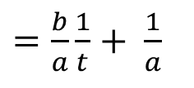
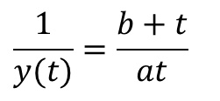
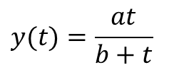
Lineárna viacparametrická regresia
lineárna regresia:
$$y(t)=c_{1}+c_{2}t^{4}+c_{2}t^{8}+c_{3}e^{−2t}+c_{5}\sin\left(0.5π⋅t\right)$$
polynomická regresia:
$$y(t)=c_{0}+c_{1}t+c_{2}t^{2}+c_{3}t^{3}+c_{4}t^{4}+…+c_{n}t^{n}$$
logaritmická regresia:
$$y(t)=a\ln\left(bt\right)$$
$$y(t)=c_{0}+c_{1}\ln{t}$$
$$c_{0}=a\ln{b}$$
$$c_{1}=a$$
exponenciálna regresia:
$$y(t)=ae^{bt}$$
$$\ln{y}(t)=c_{0}+c_{1}t$$
$$c_{0}=\ln{a}$$
$$c_{1}=b$$
mocninová regresia:
$$y(t)=at^{b}$$
$$\ln{y}(t)=c_{0}+c_{1}\ln{t}$$
$$c_{0}=\ln{a}$$
$$c_{1}=b$$
regresia racionálnou funkciou:
$$y(t)=\frac{at}{b+t}$$
$$\frac{1}{y(t)}=\frac{b+t}{at}$$
$=\frac{b}{a}\frac{1}{t}+ \frac{1}{a}$

Slide 40

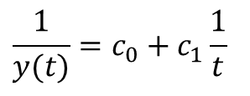

Lineárna viacparametrická regresia
lineárna regresia:
$$y(t)=c_{1}+c_{2}t^{4}+c_{2}t^{8}+c_{3}e^{−2t}+c_{5}\sin\left(0.5π⋅t\right)$$
polynomická regresia:
$$y(t)=c_{0}+c_{1}t+c_{2}t^{2}+c_{3}t^{3}+c_{4}t^{4}+…+c_{n}t^{n}$$
logaritmická regresia:
$$y(t)=a\ln\left(bt\right)$$
$$y(t)=c_{0}+c_{1}\ln{t}$$
$$c_{0}=a\ln{b}$$
$$c_{1}=a$$
exponenciálna regresia:
$$y(t)=ae^{bt}$$
$$\ln{y}(t)=c_{0}+c_{1}t$$
$$c_{0}=\ln{a}$$
$$c_{1}=b$$
mocninová regresia:
$$y(t)=at^{b}$$
$$\ln{y}(t)=c_{0}+c_{1}\ln{t}$$
$$c_{0}=\ln{a}$$
$$c_{1}=b$$
regresia racionálnou funkciou:
$$y(t)=\frac{at}{b+t}$$
$$\frac{1}{y(t)}=c_{0}+c_{1}\frac{1}{t}$$
$$c_{0}=1/a$$
$c_{1}=b$/a

Slide 41
Zhrnutie

Slide 42
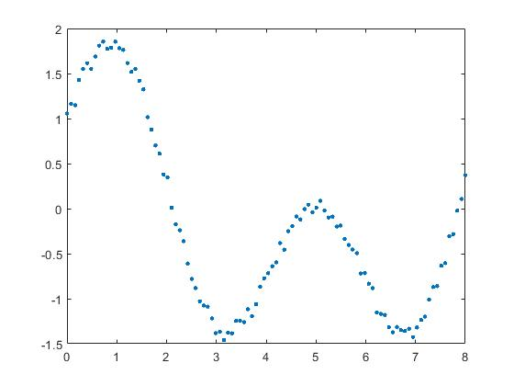
Jednonásobná Lineárna Viacparametrická Regresia
Regresná funkcia:
Riešenie úloh na základe závislosti procesu od času:

Slide 43
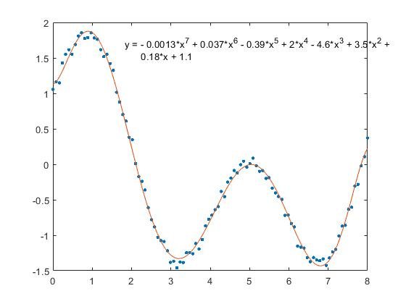
Jednonásobná Lineárna Viacparametrická Regresia
Regresná funkcia:
Riešenie úloh na základe závislosti procesu od času:
1. Interpolácia

Slide 44
Jednonásobná Lineárna Viacparametrická Regresia
Regresná funkcia:
Riešenie úloh na základe závislosti procesu od času:
1. Interpolácia

Slide 45
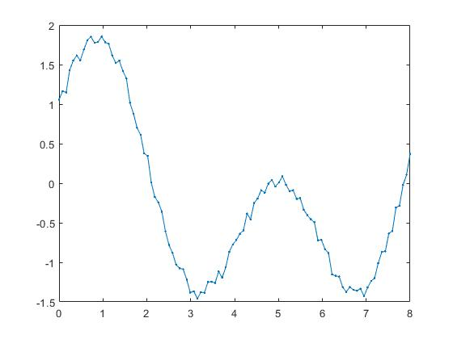
Jednonásobná Lineárna Viacparametrická Regresia
Regresná funkcia:
Riešenie úloh na základe závislosti procesu od času:
1. Interpolácia
2. Filtrácia

Slide 46
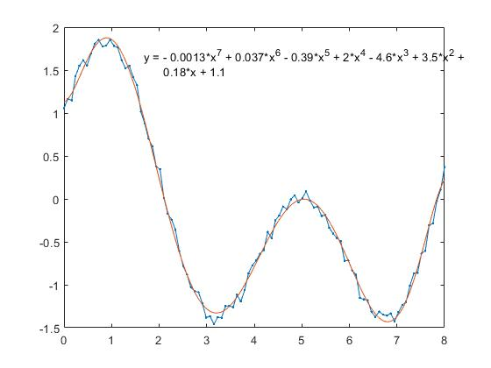
Jednonásobná Lineárna Viacparametrická Regresia
Regresná funkcia:
Riešenie úloh na základe závislosti procesu od času:
1. Interpolácia
2. Filtrácia
3. Predikcia

Slide 47
Jednonásobná Lineárna Viacparametrická Regresia
Regresná funkcia:
Riešenie úloh na základe závislosti procesu od času:
1. Interpolácia
2. Filtrácia
3. Predikcia
Chyba:

Slide 48
3. Zadanie
Polynomicka regresia

Slide 49
3. Zadanie: Polynomická regresia
odovzdanie zadania: nedela 4.11 do 23.55
iba formát pptx, iba jeden súbor
slide: zobrazené dáta, popis dát, zdroj
slide: preloziť cez data regresné polynómy Q1 (priamka) az Q4, uviesť koeficienty a chyby
slide: preloziť cez data regresné polynómy Q5 az Q8, uviesť koeficienty a chyby
urobiť úvahu, ktorý polynóm by ste vybrali (NIE kvôli najmenšej chybe)
netreba uvádzať zdrojový kód

Slide 50

Polynomická regresia
polynomická regresia:
$$y(t)=c_{0}+c_{1}t$$

Slide 51

Polynomická regresia
polynomická regresia:
$$y(t)=c_{0}+c_{1}t+c_{2}t^{2}$$

Slide 52

Polynomická regresia
polynomická regresia:
$$y(t)=c_{0}+c_{1}t+c_{2}t^{2}+c_{3}t^{3}$$

Slide 53

Polynomická regresia
polynomická regresia:
$$y(t)=c_{0}+c_{1}t+c_{2}t^{2}+c_{3}t^{3}+c_{4}t^{4}$$

Slide 54

Polynomická regresia
polynomická regresia:
$$y\left(t\right)=c_{0}+c_{1}t+c_{2}t^{2}+ ...+c_{5}t^{5}$$

Slide 55
Polynomická regresia
polynomická regresia:
$$y\left(t\right)=c_{0}+c_{1}t+c_{2}t^{2}…+c_{5}t^{5}+c_{6}t^{6}$$

Slide 56
Polynomická regresia
polynomická regresia:
$$y\left(t\right)=c_{0}+c_{1}t+c_{2}t^{2}…+c_{6}t^{6}+c_{7}t^{7}$$

Slide 57
Polynomická regresia
polynomická regresia:
$$y\left(t\right)=c_{0}+c_{1}t+c_{2}t^{2}…+c_{6}t^{6}+c_{7}t^{7}+c_{8}t^{8}$$

Slide 58
Polynomická regresia
polynomická regresia:
$$y\left(t\right)=c_{0}+c_{1}t+c_{2}t^{2}…+c_{6}t^{6}+c_{7}t^{7}+c_{8}t^{8}$$
p1 = 1.7433e-06
p2 = -0.00013443
p3 = 0.004129
p4 = -0.063932
p5 = 0.51691
p6 = -1.9833
p7 = 2.1934
p8 = 3.5221
p9 = 1.6827

Slide 59
- slide: prelozit cez data polynom Q8 s postupným odstranenim 3 koeficientov
s najmešími veľkosťami (absolútna hodnota), na slide budú dáta a 4 polynomické
regresne funkcie , povodna Q8 a 3 nove s členom t^8 a postupne s mensim poctom
parametrov, uviesť koeficienty a chyby
- urobiť krátku úvahu o výsledku
- slide: zdrojovy kod pre druhú časť zadania

Slide 60
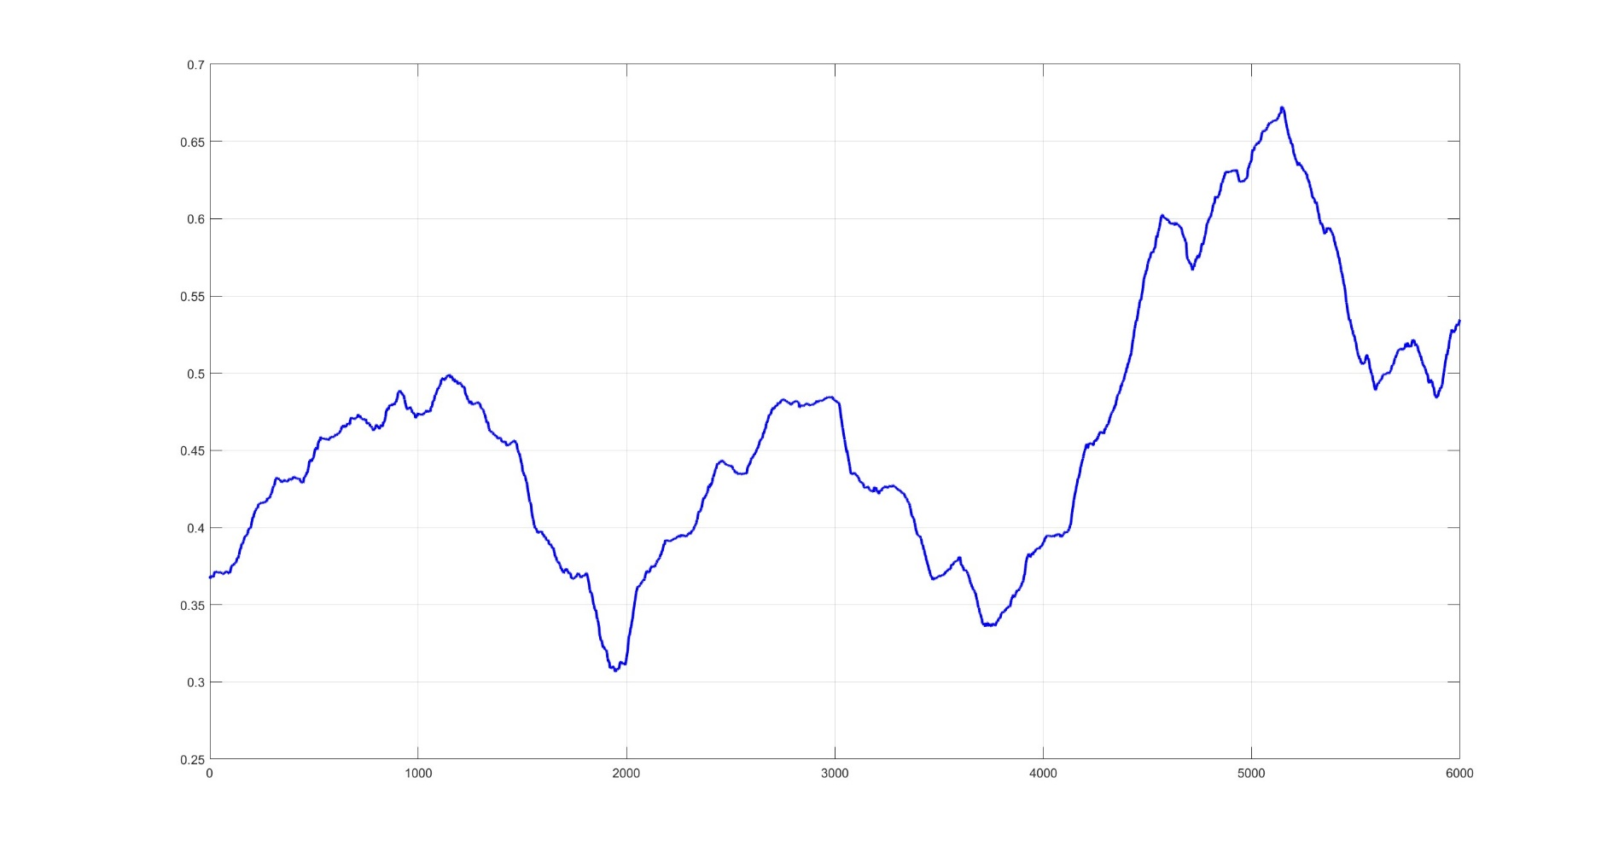
Polynomická regresia

Slide 61
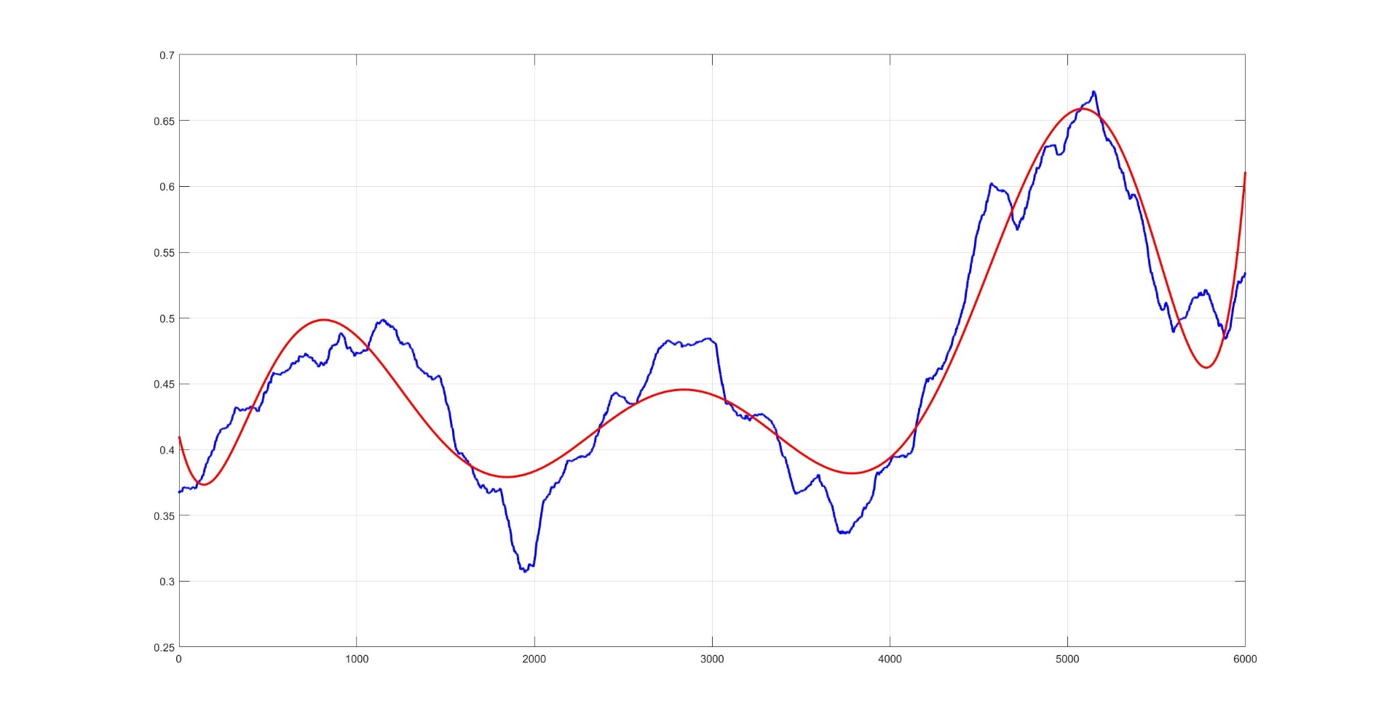
Polynomická regresia
polynomická regresia:
$$y(t)=c_{0}+c_{1}t+c_{2}t^{2}+c_{3}t^{3}+c_{4}t^{4}+c_{5}t^{5}+ c_{6}t^{6}+ c_{7}t^{7}+{ c}_{8}t^{8}$$

Slide 62
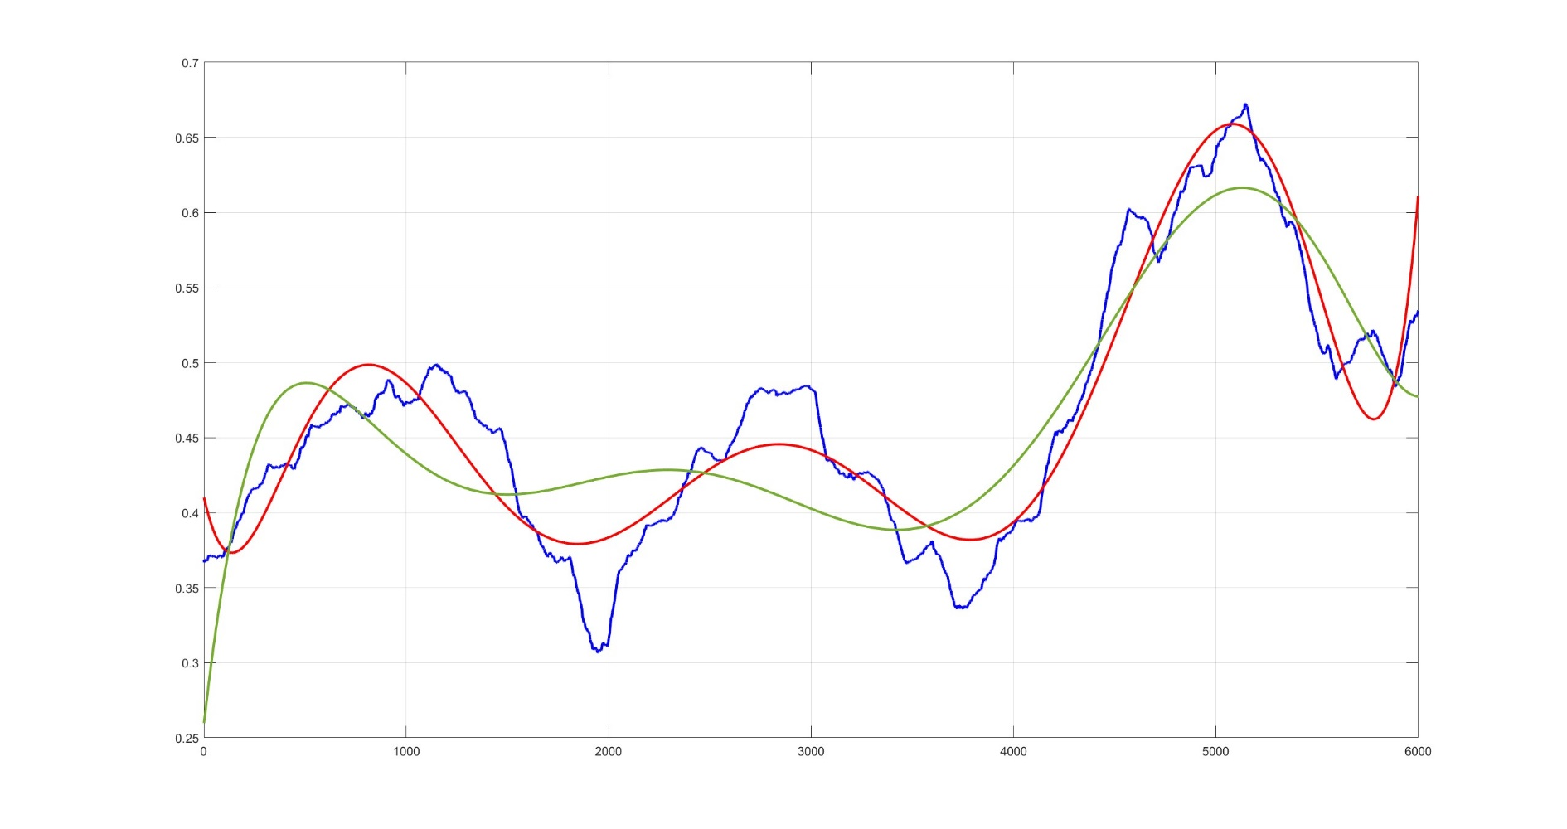
Polynomická regresia
polynomická regresia:
$y(t)=c_{0}+c_{1}t+c_{2}t^{2}+c_{3}t^{3}+c_{4}t^{4}+c_{5}t^{5}$ $+ c_{6}t^{6}$ $+ c_{8}t^{8}$

Slide 63
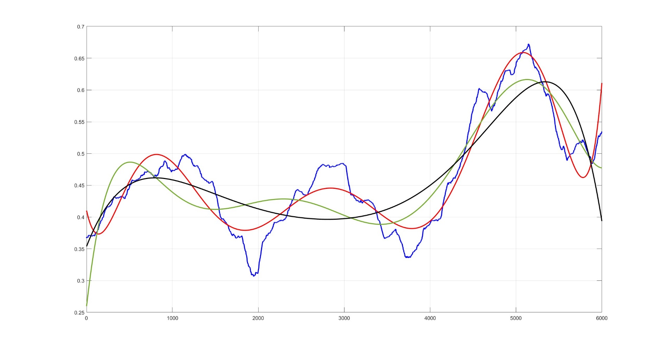
Polynomická regresia
polynomická regresia:
$y(t)=c_{0}+c_{1}t+c_{2}t^{2}+c_{3}t^{3}+c_{4}t^{4}+ c_{5}t^{5}$ $+ c_{8}t^{8}$

Slide 64
Lineárna regresia:
Maticový tvar

Slide 65
Lineárna trojparametrická regresia
$$t=\left(t_{1},t_{2},t_{3},...,t_{N}\right)$$
Regresná funkcia:

Slide 66
Lineárna trojparametrická regresia
$$t=\left(t_{1},t_{2},t_{3},...,t_{N}\right)$$
Regresná funkcia:

Slide 67
Lineárna trojparametrická regresia
$$t=\left(t_{1},t_{2},t_{3},...,t_{N}\right)$$
Regresná funkcia:

Slide 68
Lineárna viacparametrická regresia
$$t=\left(t_{1},t_{2},t_{3},...,t_{N}\right)$$
Regresná funkcia:

Slide 69

Lineárna viacparametrická regresia
$$t=\left(t_{1},t_{2},t_{3},...,t_{N}\right)$$
Regresná funkcia:
$$\left|e\right|= \left\lceil f−{\tilde{f}}_{P}\right\rceil$$

Slide 70
Priemet do ortogonálnej bázy:
Maticový tvar

Slide 71
Priemet do ortogonálnej bázy
OG báza podpriestoru:

Slide 72
Priemet do ortogonálnej bázy
OG báza podpriestoru:

Slide 73
Priemet do ortogonálnej bázy
OG báza podpriestoru:

Slide 74
Priemet do ortogonálnej bázy
OG báza podpriestoru:

Slide 75
Priemet do ortogonálnej bázy
OG báza podpriestoru:

Slide 76
Priemet do ortonormálnej bázy:
Maticový tvar

Slide 77
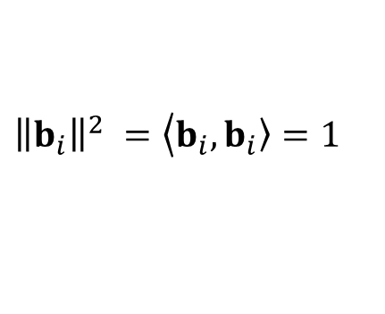
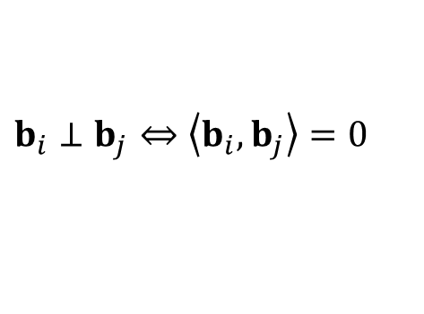
Priemet do ortogonálnej bázy
ON báza podpriestoru:
$$b_{i}⊥b_{j}⇔\left\langle b_{i}\right.,\left.b_{j}\right\rangle =0$$
$${\left\|b_{i}\right\|}^{2} =\left\langle b_{i}\right.,\left.b_{i}\right\rangle =1$$

Slide 78
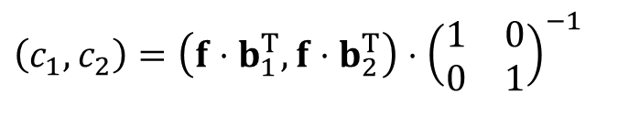
Priemet do ortogonálnej bázy
ON báza podpriestoru:
$$b_{i}⊥b_{j}⇔\left\langle b_{i}\right.,\left.b_{j}\right\rangle =0$$
$${\left\|b_{i}\right\|}^{2} =\left\langle b_{i}\right.,\left.b_{i}\right\rangle =1$$
$$\left(c_{1},c_{2}\right)=\left(f⋅b_{1}^{T},f⋅b_{2}^{T}\right)⋅{\left(\begin{matrix}1 & 0 \\ 0 & 1\end{matrix}\right)}^{−1}$$

Slide 79
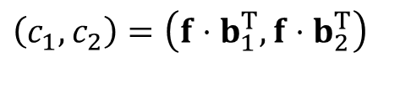
Priemet do ortogonálnej bázy
ON báza podpriestoru:
$$b_{i}⊥b_{j}⇔\left\langle b_{i}\right.,\left.b_{j}\right\rangle =0$$
$${\left\|b_{i}\right\|}^{2} =\left\langle b_{i}\right.,\left.b_{i}\right\rangle =1$$
$$\left(c_{1},c_{2}\right)=\left(f⋅b_{1}^{T},f⋅b_{2}^{T}\right)$$

Slide 80
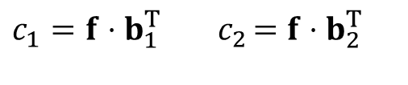
Priemet do ortogonálnej bázy
ON báza podpriestoru:
$$b_{i}⊥b_{j}⇔\left\langle b_{i}\right.,\left.b_{j}\right\rangle =0$$
$${\left\|b_{i}\right\|}^{2} =\left\langle b_{i}\right.,\left.b_{i}\right\rangle =1$$
$$c_{1}=f⋅b_{1}^{T}{ c}_{2}=f⋅b_{2}^{T}$$

Slide 81


Priemet do ortogonálnej bázy
ON báza podpriestoru:
$$b_{i}⊥b_{j}⇔\left\langle b_{i}\right.,\left.b_{j}\right\rangle =0$$
$${\left\|b_{i}\right\|}^{2} =\left\langle b_{i}\right.,\left.b_{i}\right\rangle =1$$
$$c=f⋅B^{T}$$
$${\tilde{f}}_{P}=c⋅B$$
$$c_{1}=f⋅b_{1}^{T}{ c}_{2}=f⋅b_{2}^{T}$$

Slide 82
Go chūmoku itadaki arigatōgozaimasu

