Slide 1

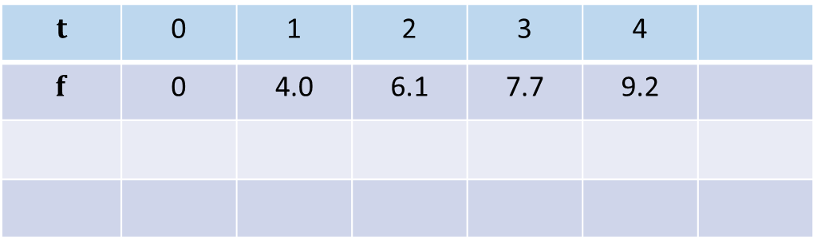
Cvicenie 5
$$y\left(t\right)=a.ln⁡(b.t)$$
$$t$$ | 0 | 1 | 2 | 3 | 4
$$f$$ | 0 | 4.0 | 6.1 | 7.7 | 9.2

Slide 2
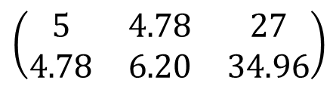






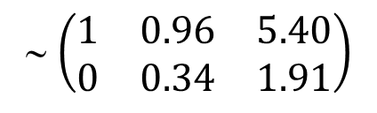
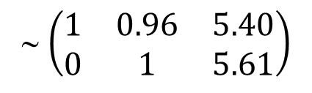








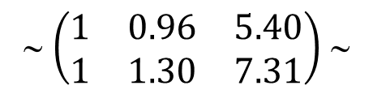

Cvicenie 5
$$y\left(t\right)=a.ln⁡(b.(t+1))$$
$=a.ln⁡(b)$ + $a.ln⁡(t+1)$
$=c_{1}$+${ c}_{2}.ln⁡(t+1)$
$$a.ln⁡(b)=c_{1}$$
$$a=c_{2}$$
$$t$$ | 0 | 1 | 2 | 3 | 4
$$f$$ | 0 | 4.0 | 6.1 | 7.7 | 9.2
$$b=exp⁡(c_{1}/a)$$
$$y\left(t\right)=$$
$=c_{1}$+${ c}_{2}.ln⁡(t+1)$
$$\left(\begin{matrix}5 & 4.78 & 27 \\ 4.78 & 6.20 & 34.96\end{matrix}\right)$$
∼ $\left(\begin{matrix}1 & 0.96 & 5.40 \\ 1 & 1.30 & 7.31\end{matrix}\right)$ ∼
$c_{2}=$ 5.61
$c_{1}=$ 0.01
$b_{1}$ = (1,1,1,1,1)
∼ $\left(\begin{matrix}1 & 0.96 & 5.40 \\ 0 & 0.34 & 1.91\end{matrix}\right)$
∼ $\left(\begin{matrix}1 & 0.96 & 5.40 \\ 0 & 1 & 5.61\end{matrix}\right)$
$$a=5.61$$
$b_{2}$ = (ln1, ln2, ln3, ln4, ln5)
$$b=1$$
$$y\left(t\right)=5.61∙ln⁡(t+1)$$

Slide 3

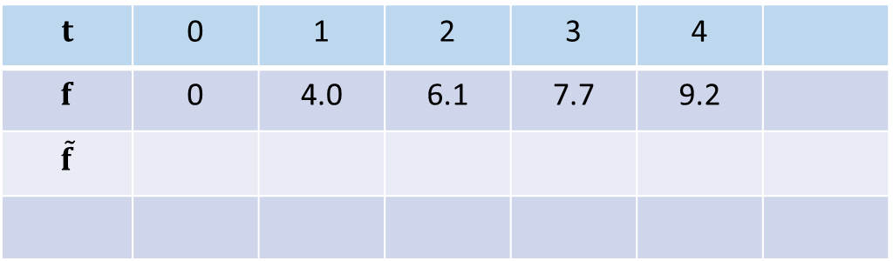



Cvicenie 5
$$y\left(t\right)=a.ln⁡(b.(t+1))$$
$=a.ln⁡(b)$ + $a.ln⁡(t+1)$
$=c_{1}$+${ c}_{2}.ln⁡(t+1)$
$$a.ln⁡(b)=c_{1}$$
$$a=c_{2}$$
$$t$$ | 0 | 1 | 2 | 3 | 4
$$f$$ | 0 | 4.0 | 6.1 | 7.7 | 9.2
$$\tilde{f}$$
$$b=exp⁡(c_{1}/a)$$
$$y\left(t\right)=5.61∙ln⁡(t+1)$$
$\tilde{f}=c_{1}b_{1}$+${ c}_{2}b_{2}$
$b_{1}$ = (1,1,1,1,1)
$b_{2}$ = (ln1, ln2, ln3, ln4, ln5)

Slide 4
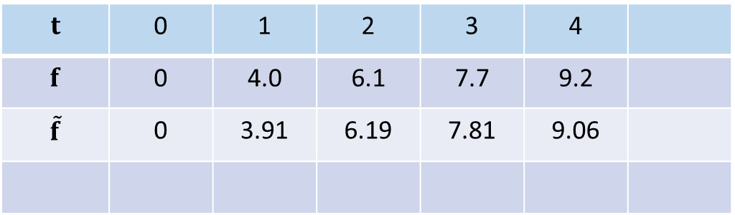
Cvicenie 5
$$y\left(t\right)=a.ln⁡(b.(t+1))$$
$=a.ln⁡(b)$ + $a.ln⁡(t+1)$
$=c_{1}$+${ c}_{2}.ln⁡(t+1)$
$$a.ln⁡(b)=c_{1}$$
$$a=c_{2}$$
$$t$$ | 0 | 1 | 2 | 3 | 4
$$f$$ | 0 | 4.0 | 6.1 | 7.7 | 9.2
$$\tilde{f}$$ | 0 | 3.91 | 6.19 | 7.81 | 9.06
$$b=exp⁡(c_{1}/a)$$
$$y\left(t\right)=5.61∙ln⁡(t+1)$$
$\tilde{f}=c_{1}b_{1}$+${ c}_{2}b_{2}$
$b_{1}$ = (1,1,1,1,1)
$b_{2}$ = (ln1, ln2, ln3, ln4, ln5)

Slide 5
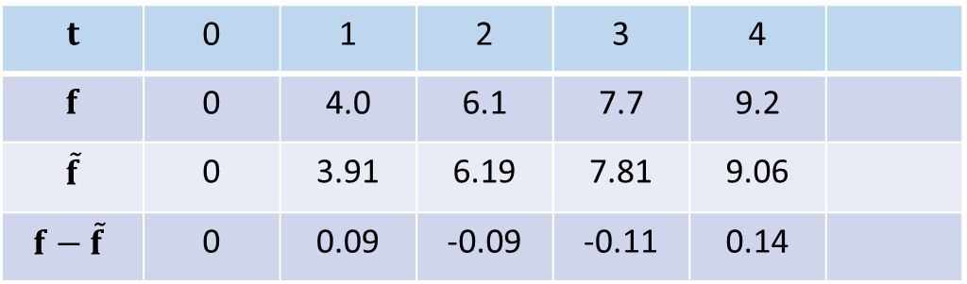
Cvicenie 5
$$y\left(t\right)=a.ln⁡(b.(t+1))$$
$=a.ln⁡(b)$ + $a.ln⁡(t+1)$
$=c_{1}$+${ c}_{2}.ln⁡(t+1)$
$$a.ln⁡(b)=c_{1}$$
$$a=c_{2}$$
$$t$$ | 0 | 1 | 2 | 3 | 4
$$f$$ | 0 | 4.0 | 6.1 | 7.7 | 9.2
$$\tilde{f}$$ | 0 | 3.91 | 6.19 | 7.81 | 9.06
$$f−\tilde{f}$$ | 0 | 0.09 | -0.09 | -0.11 | 0.14
$$b=exp⁡(c_{1}/a)$$
$$y\left(t\right)=5.61∙ln⁡(t+1)$$
$\tilde{f}=c_{1}b_{1}$+${ c}_{2}b_{2}$
$b_{1}$ = (1,1,1,1,1)
$b_{2}$ = (ln1, ln2, ln3, ln4, ln5)

Slide 6
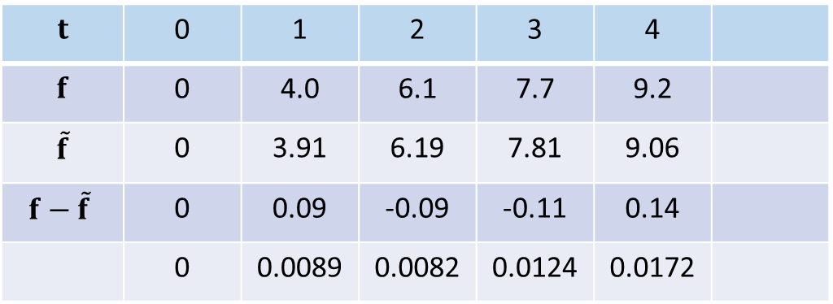
Cvicenie 5
$$y\left(t\right)=a.ln⁡(b.(t+1))$$
$=a.ln⁡(b)$ + $a.ln⁡(t+1)$
$=c_{1}$+${ c}_{2}.ln⁡(t+1)$
$$a.ln⁡(b)=c_{1}$$
$$a=c_{2}$$
$$t$$ | 0 | 1 | 2 | 3 | 4
$$f$$ | 0 | 4.0 | 6.1 | 7.7 | 9.2
$$\tilde{f}$$ | 0 | 3.91 | 6.19 | 7.81 | 9.06
$$f−\tilde{f}$$ | 0 | 0.09 | -0.09 | -0.11 | 0.14
 | 0 | 0.0089 | 0.0082 | 0.0124 | 0.0172
$$b=exp⁡(c_{1}/a)$$
$$y\left(t\right)=5.61∙ln⁡(t+1)$$
$\tilde{f}=c_{1}b_{1}$+${ c}_{2}b_{2}$
$b_{1}$ = (1,1,1,1,1)
$b_{2}$ = (ln1, ln2, ln3, ln4, ln5)

Slide 7

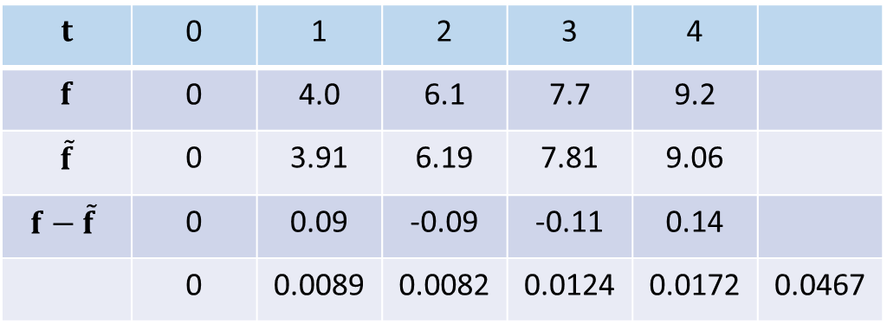

Cvicenie 5
$$y\left(t\right)=a.ln⁡(b.(t+1))$$
$=a.ln⁡(b)$ + $a.ln⁡(t+1)$
$=c_{1}$+${ c}_{2}.ln⁡(t+1)$
$$a.ln⁡(b)=c_{1}$$
$$a=c_{2}$$
$$t$$ | 0 | 1 | 2 | 3 | 4
$$f$$ | 0 | 4.0 | 6.1 | 7.7 | 9.2
$$\tilde{f}$$ | 0 | 3.91 | 6.19 | 7.81 | 9.06
$$f−\tilde{f}$$ | 0 | 0.09 | -0.09 | -0.11 | 0.14
 | 0 | 0.0089 | 0.0082 | 0.0124 | 0.0172 | 0.0467
$$b=exp⁡(c_{1}/a)$$
${\left\|e\right\|}^{2}=$ 0.0467
$\left\|e\right\|=$ 0.2161
$$y\left(t\right)=5.61∙ln⁡(t+1)$$
$\tilde{f}=c_{1}b_{1}$+${ c}_{2}b_{2}$
$b_{1}$ = (1,1,1,1,1)
$b_{2}$ = (ln1, ln2, ln3, ln4, ln5)

Slide 8

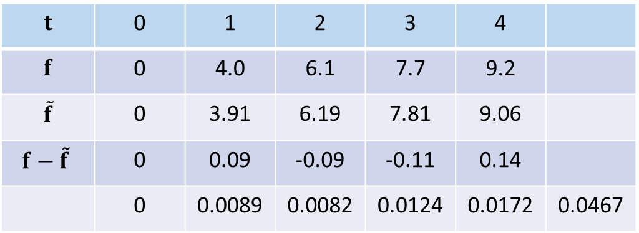

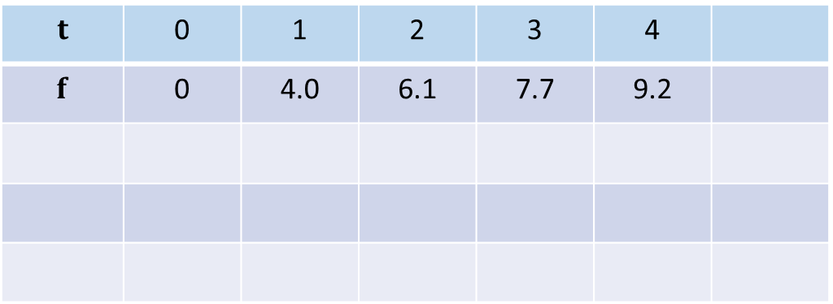

Cvicenie 5
$$y\left(t\right)=5.61∙ln⁡(t+1)$$
$$t$$ | 0 | 1 | 2 | 3 | 4
$$f$$ | 0 | 4.0 | 6.1 | 7.7 | 9.2
$$\tilde{f}$$ | 0 | 3.91 | 6.19 | 7.81 | 9.06
$$f−\tilde{f}$$ | 0 | 0.09 | -0.09 | -0.11 | 0.14
 | 0 | 0.0089 | 0.0082 | 0.0124 | 0.0172 | 0.0467
$\left\|e\right\|=$ 0.2161
$$y\left(t\right)=4.0066∙t^{0.5989}$$
4.0066
>> b
b =
0.5989
$$t$$ | 0 | 1 | 2 | 3 | 4
$$f$$ | 0 | 4.0 | 6.1 | 7.7 | 9.2

Slide 9
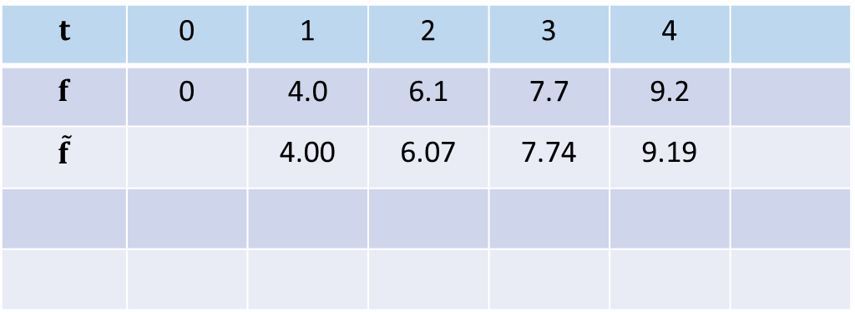
Cvicenie 5
$$y\left(t\right)=5.61∙ln⁡(t+1)$$
$$t$$ | 0 | 1 | 2 | 3 | 4
$$f$$ | 0 | 4.0 | 6.1 | 7.7 | 9.2
$$\tilde{f}$$ | 0 | 3.91 | 6.19 | 7.81 | 9.06
$$f−\tilde{f}$$ | 0 | 0.09 | -0.09 | -0.11 | 0.14
 | 0 | 0.0089 | 0.0082 | 0.0124 | 0.0172 | 0.0467
$\left\|e\right\|=$ 0.2161
$$y\left(t\right)=4.0066∙t^{0.5989}$$
$$t$$ | 0 | 1 | 2 | 3 | 4
$$f$$ | 0 | 4.0 | 6.1 | 7.7 | 9.2
$$\tilde{f}$$ |  | 4.00 | 6.07 | 7.74 | 9.19

Slide 10
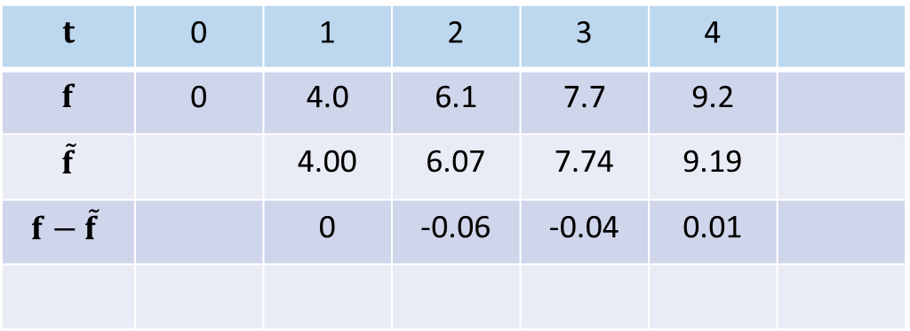
Cvicenie 5
$$y\left(t\right)=5.61∙ln⁡(t+1)$$
$$t$$ | 0 | 1 | 2 | 3 | 4
$$f$$ | 0 | 4.0 | 6.1 | 7.7 | 9.2
$$\tilde{f}$$ | 0 | 3.91 | 6.19 | 7.81 | 9.06
$$f−\tilde{f}$$ | 0 | 0.09 | -0.09 | -0.11 | 0.14
 | 0 | 0.0089 | 0.0082 | 0.0124 | 0.0172 | 0.0467
$\left\|e\right\|=$ 0.2161
$$y\left(t\right)=4.0066∙t^{0.5989}$$
$$t$$ | 0 | 1 | 2 | 3 | 4
$$f$$ | 0 | 4.0 | 6.1 | 7.7 | 9.2
$$\tilde{f}$$ |  | 4.00 | 6.07 | 7.74 | 9.19
$$f−\tilde{f}$$ |  | 0 | -0.06 | -0.04 | 0.01

Slide 11
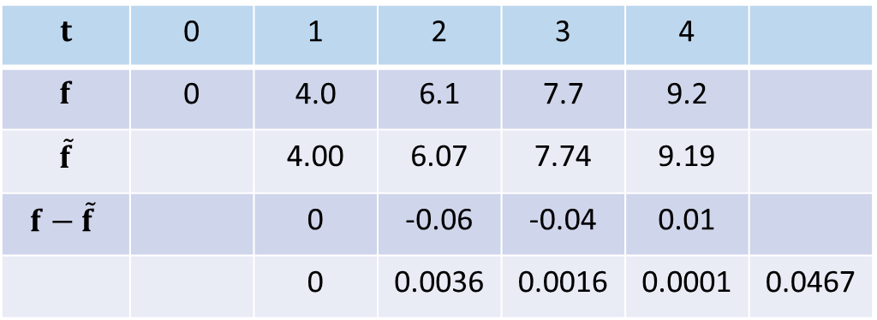
Cvicenie 5
$$y\left(t\right)=5.61∙ln⁡(t+1)$$
$$t$$ | 0 | 1 | 2 | 3 | 4
$$f$$ | 0 | 4.0 | 6.1 | 7.7 | 9.2
$$\tilde{f}$$ | 0 | 3.91 | 6.19 | 7.81 | 9.06
$$f−\tilde{f}$$ | 0 | 0.09 | -0.09 | -0.11 | 0.14
 | 0 | 0.0089 | 0.0082 | 0.0124 | 0.0172 | 0.0467
$\left\|e\right\|=$ 0.2161
$$y\left(t\right)=4.0066∙t^{0.5989}$$
$$t$$ | 0 | 1 | 2 | 3 | 4
$$f$$ | 0 | 4.0 | 6.1 | 7.7 | 9.2
$$\tilde{f}$$ |  | 4.00 | 6.07 | 7.74 | 9.19
$$f−\tilde{f}$$ |  | 0 | -0.06 | -0.04 | 0.01
 |  | 0 | 0.0036 | 0.0016 | 0.0001 | 0.0467

Slide 12

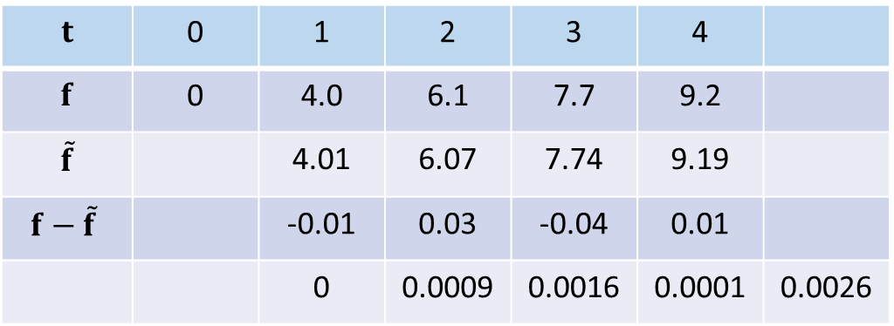
Cvicenie 5
$$y\left(t\right)=5.61∙ln⁡(t+1)$$
$$t$$ | 0 | 1 | 2 | 3 | 4
$$f$$ | 0 | 4.0 | 6.1 | 7.7 | 9.2
$$\tilde{f}$$ | 0 | 3.91 | 6.19 | 7.81 | 9.06
$$f−\tilde{f}$$ | 0 | 0.09 | -0.09 | -0.11 | 0.14
 | 0 | 0.0089 | 0.0082 | 0.0124 | 0.0172 | 0.0467
$\left\|e\right\|=$ 0.2161
$$y\left(t\right)=4.0066∙t^{0.5989}$$
$$t$$ | 0 | 1 | 2 | 3 | 4
$$f$$ | 0 | 4.0 | 6.1 | 7.7 | 9.2
$$\tilde{f}$$ |  | 4.01 | 6.07 | 7.74 | 9.19
$$f−\tilde{f}$$ |  | -0.01 | 0.03 | -0.04 | 0.01
 |  | 0 | 0.0009 | 0.0016 | 0.0001 | 0.0026
$\left\|e\right\|=$ 0.0494

