Slide 1
Analýza procesov
Department of Information Networks
Faculty of Management Science and Informatics
University of Žilina
3. prednáška
Juraj Smieško

Slide 2


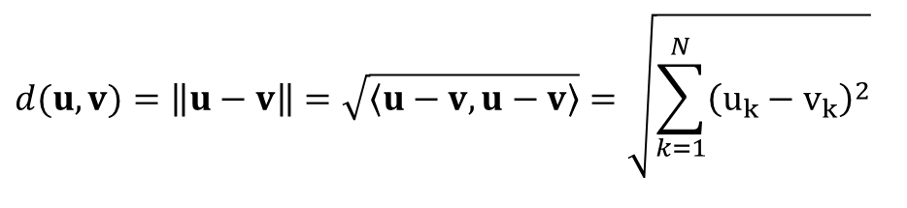
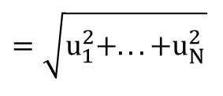
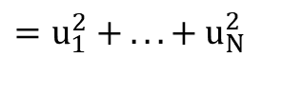

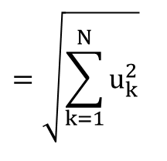
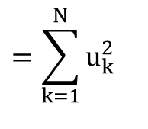


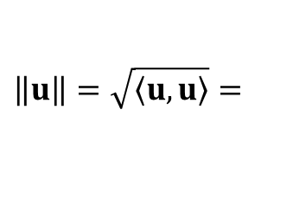
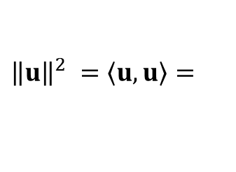
Euklidov norma, energia a metrika
$Euklidová norma:$
$$=\sqrt{\sum_{k=1}^{N}{u_{k}^{2}}}$$
$$\left\|u\right\|=\sqrt{\left\langle u\right.,\left.u\right\rangle }=$$
$$=\sqrt{u⋅u^{T}}$$
$$=\sqrt{u_{1}^{2}+...+u_{N}^{2}}$$
$Euklidová energia:$
$$=\sum_{k=1}^{N}{u_{k}^{2}}$$
$${\left\|u\right\|}^{2} =\left\langle u\right.,\left.u\right\rangle =$$
$$= u⋅u^{T}$$
$$=u_{1}^{2} + ...+ u_{N}^{2}$$
$Euklidová metrika:$
$$d(u,v)=\left\|u−v\right\|=\sqrt{\left\langle u−v,u−v\right\rangle }=\sqrt{\sum_{k=1}^{N}{{\left(u_{k}−v_{k}\right)}^{2}}}$$

Slide 3
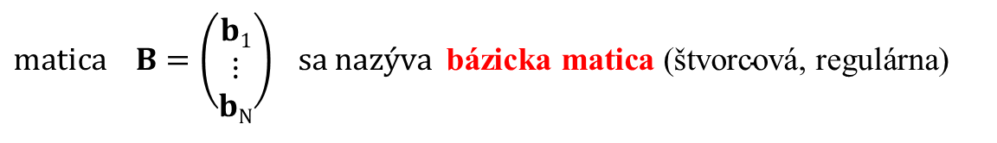
Báza a dimenzia V(F)
Báza vektorového priestoru V(F) je množina lineárne nezávislých vektorov
b₁, ... , b_{N} pomocou ktorých vieme vyjadriť každý vektor v ϵ V(F) ako ich lineárnu kombináciu:
∀$v \text{ϵ} \text{V}\text{(}\text{F}\text{)} ∃ c1,$..., $cN \text{ϵ} \text{F}$ ;$v= c1.b1+$ $c2.b2$+ ... + $cN.bN$
vektory b₁, ... , b_{N} nazývame bázické vektory V(F)
$$matica B=\left(\begin{matrix}b1 \\ ⋮ \\ bN\end{matrix}\right) sa nazýva \text{b}\text{á}\text{zicka} \text{matica} \text{(}\text{š}\text{tvorcov}\text{á, }\text{regul}\text{á}\text{rna}\text{)}$$
$\text{d}\text{imenzia} \text{V}\text{(}\text{F}\text{)} −hodnosť bázickej matice B, dim\left(V\right)=N, (počet prvkov bázy)$
Každá množina N lineárne nezávislých vektorov patriacich do N-rozmerného vektorového priestoru V(P) tvorí bázu tohto priestoru.

Slide 4
Priemet na priamku

Slide 5
Priemet na priamku

Slide 6



Gram-Schmidtova ortogonalizácia
Báza priestoru
$$B=\left(\begin{matrix}u \\ v\end{matrix}\right)$$
$$v$$
$$u$$

Slide 7
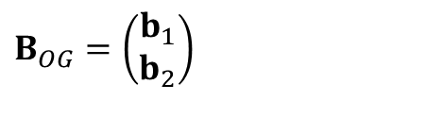

Gram-Schmidtova ortogonalizácia
Báza priestoru
$$B=\left(\begin{matrix}u \\ v\end{matrix}\right)$$
$$v$$
Ortogonálna báza priestoru
$$B_{OG}=\left(\begin{matrix}b_{1} \\ b_{2}\end{matrix}\right)$$
$$u$$

Slide 8





Gram-Schmidtova ortogonalizácia
Báza priestoru
$$B=\left(\begin{matrix}u \\ v\end{matrix}\right)$$
$$v$$
$$b_{2}=v−\tilde{v}$$
Ortogonálna báza priestoru
$$\tilde{v}$$
$$b_{1}=u$$
$$B_{OG}=\left(\begin{matrix}b_{1} \\ b_{2}\end{matrix}\right)$$
$$b_{1}=u$$
$$b_{2}=v−\tilde{v}$$

Slide 9



Gram-Schmidtova ortogonalizácia
Báza priestoru
$$B=\left(\begin{matrix}u \\ v\end{matrix}\right)$$
$$v$$
$$b_{2}=v−\tilde{v}$$
Ortogonálna báza priestoru
$$b_{1}=u$$
$$B_{OG}=\left(\begin{matrix}b_{1} \\ b_{2}\end{matrix}\right)$$
$$\tilde{v}=cb_{1}$$
$$b_{1}=u$$
$$b_{2}=v−\tilde{v}$$
$$c=\frac{\left\langle v,b_{1}\right\rangle }{\left\langle b_{1},b_{1}\right\rangle }$$
$$b_{2}=v−cb_{1}$$

Slide 10

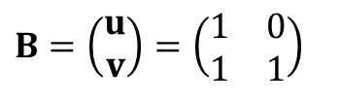

Gram-Schmidtova ortogonalizácia
$$B=\left(\begin{matrix}u \\ v\end{matrix}\right)=\left(\begin{matrix}1 & 0 \\ 1 & 1\end{matrix}\right)$$
$$v$$
$$u$$

Slide 11







Gram-Schmidtova ortogonalizácia
$$B=\left(\begin{matrix}u \\ v\end{matrix}\right)=\left(\begin{matrix}1 & 0 \\ 1 & 1\end{matrix}\right)$$
$$v$$
$$b_{1}=\left(1, 0\right)$$
$$b_{1}=u$$
$$c=\frac{\left\langle v,b_{1}\right\rangle }{\left\langle b_{1},b_{1}\right\rangle }=$$
$$=\frac{1⋅1+1⋅0}{1^{2}+0^{2}}$$
$$=\frac{1}{1}=1$$
$$b_{2}=v−cb_{1}=$$
$$=\left(1,1\right)−1.\left(1, 0\right)$$

Slide 12


Gram-Schmidtova ortogonalizácia
$$B=\left(\begin{matrix}u \\ v\end{matrix}\right)=\left(\begin{matrix}1 & 0 \\ 1 & 1\end{matrix}\right)$$
$$b_{2}$$
$$b_{1}=\left(1, 0\right)$$
$$b_{1}=u$$
$$c=\frac{\left\langle v,b_{1}\right\rangle }{\left\langle b_{1},b_{1}\right\rangle }=$$
$$=\frac{1⋅1+1⋅0}{1^{2}+0^{2}}$$
$$=\frac{1}{1}=1$$
$$b_{2}=v−cb_{1}=$$
$$=\left(1,1\right)−1.\left(1, 0\right)$$
$$⇒{ b}_{2}=\left(0, 1\right)$$

Slide 13

Gram-Schmidtova ortogonalizácia
$$B=\left(\begin{matrix}u \\ v\end{matrix}\right)=\left(\begin{matrix}1 & 0 \\ 1 & 1\end{matrix}\right)$$
$$b_{2}$$
$$b_{1}=\left(1, 0\right)$$
$$b_{1}=u$$
$$c=\frac{\left\langle v,b_{1}\right\rangle }{\left\langle b_{1},b_{1}\right\rangle }=$$
$$=\frac{1⋅1+1⋅0}{1^{2}+0^{2}}$$
$$=\frac{1}{1}=1$$
$$B_{OG}=\left(\begin{matrix}1 & 0 \\ 0 & 1\end{matrix}\right)$$
$$b_{2}=v−cb_{1}=$$
$$=\left(1,1\right)−1.\left(1, 0\right)$$
$$⇒{ b}_{2}=\left(0, 1\right)$$

Slide 14
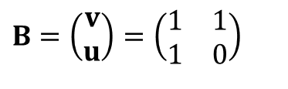


Gram-Schmidtova ortogonalizácia
$$B=\left(\begin{matrix}u \\ v\end{matrix}\right)=\left(\begin{matrix}1 & 0 \\ 1 & 1\end{matrix}\right)$$
$$b_{2}$$
$$b_{1}=\left(1, 0\right)$$
$$b_{1}=u$$
$$c=\frac{\left\langle v,b_{1}\right\rangle }{\left\langle b_{1},b_{1}\right\rangle }=$$
$$=\frac{1⋅1+1⋅0}{1^{2}+0^{2}}$$
$$=\frac{1}{1}=1$$
$$B_{OG}=\left(\begin{matrix}1 & 0 \\ 0 & 1\end{matrix}\right)$$
$$b_{2}=v−cb_{1}=$$
$$=\left(1,1\right)−1.\left(1, 0\right)$$
$$⇒{ b}_{2}=\left(0, 1\right)$$
$$B=\left(\begin{matrix}v \\ u\end{matrix}\right)=\left(\begin{matrix}1 & 1 \\ 1 & 0\end{matrix}\right)$$
$$v$$
$$u$$

Slide 15







Gram-Schmidtova ortogonalizácia
$$B=\left(\begin{matrix}u \\ v\end{matrix}\right)=\left(\begin{matrix}1 & 0 \\ 1 & 1\end{matrix}\right)$$
$$b_{2}$$
$$b_{1}=\left(1, 0\right)$$
$$b_{1}=u$$
$$c=\frac{\left\langle v,b_{1}\right\rangle }{\left\langle b_{1},b_{1}\right\rangle }=$$
$$=\frac{1⋅1+1⋅0}{1^{2}+0^{2}}$$
$$=\frac{1}{1}=1$$
$$B_{OG}=\left(\begin{matrix}1 & 0 \\ 0 & 1\end{matrix}\right)$$
$$b_{2}=v−cb_{1}=$$
$$=\left(1,1\right)−1.\left(1, 0\right)$$
$$⇒{ b}_{2}=\left(0, 1\right)$$
$$B=\left(\begin{matrix}v \\ u\end{matrix}\right)=\left(\begin{matrix}1 & 1 \\ 1 & 0\end{matrix}\right)$$
$$b_{1}=v$$
$$c=\frac{\left\langle u,b_{1}\right\rangle }{\left\langle b_{1},b_{1}\right\rangle }=$$
$$=\frac{1⋅1+0⋅1}{1^{2}+1^{2}}$$
$$=\frac{1}{2}$$
$$b_{1}=\left(1, 1\right)$$
$$u$$
$$b_{2}=u−cb_{1}=$$
$$=\left(1,0\right)−0.5.\left(1, 1\right)$$

Slide 16



Gram-Schmidtova ortogonalizácia
$$B=\left(\begin{matrix}u \\ v\end{matrix}\right)=\left(\begin{matrix}1 & 0 \\ 1 & 1\end{matrix}\right)$$
$$b_{2}$$
$$b_{1}=\left(1, 0\right)$$
$$b_{1}=u$$
$$c=\frac{\left\langle v,b_{1}\right\rangle }{\left\langle b_{1},b_{1}\right\rangle }=$$
$$=\frac{1⋅1+1⋅0}{1^{2}+0^{2}}$$
$$=\frac{1}{1}=1$$
$$B_{OG}=\left(\begin{matrix}1 & 0 \\ 0 & 1\end{matrix}\right)$$
$$b_{2}=v−cb_{1}=$$
$$=\left(1,1\right)−1.\left(1, 0\right)$$
$$⇒{ b}_{2}=\left(0, 1\right)$$
$$B=\left(\begin{matrix}v \\ u\end{matrix}\right)=\left(\begin{matrix}1 & 1 \\ 1 & 0\end{matrix}\right)$$
$$b_{1}=v$$
$$c=\frac{\left\langle u,b_{1}\right\rangle }{\left\langle b_{1},b_{1}\right\rangle }=$$
$$=\frac{1⋅1+0⋅1}{1^{2}+1^{2}}$$
$$=\frac{1}{2}$$
$$b_{1}=\left(1, 1\right)$$
$$b_{2}$$
$$b_{2}=u−cb_{1}=$$
$$=\left(1,0\right)−0,5.\left(1, 1\right)$$
$$⇒{ b}_{2}=\left(0.5, −0.5\right)$$

Slide 17
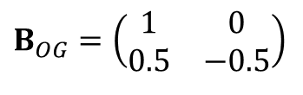
Gram-Schmidtova ortogonalizácia
$$B=\left(\begin{matrix}u \\ v\end{matrix}\right)=\left(\begin{matrix}1 & 0 \\ 1 & 1\end{matrix}\right)$$
$$b_{2}$$
$$b_{1}=\left(1, 0\right)$$
$$b_{1}=u$$
$$c=\frac{\left\langle v,b_{1}\right\rangle }{\left\langle b_{1},b_{1}\right\rangle }=$$
$$=\frac{1⋅1+1⋅0}{1^{2}+0^{2}}$$
$$=\frac{1}{1}=1$$
$$B_{OG}=\left(\begin{matrix}1 & 0 \\ 0 & 1\end{matrix}\right)$$
$$b_{2}=v−cb_{1}=$$
$$=\left(1,1\right)−1.\left(1, 0\right)$$
$$⇒{ b}_{2}=\left(0, 1\right)$$
$$B=\left(\begin{matrix}v \\ u\end{matrix}\right)=\left(\begin{matrix}1 & 1 \\ 1 & 0\end{matrix}\right)$$
$$b_{1}=v$$
$$c=\frac{\left\langle u,b_{1}\right\rangle }{\left\langle b_{1},b_{1}\right\rangle }=$$
$$=\frac{1⋅1+0⋅1}{1^{2}+1^{2}}$$
$$=\frac{1}{2}$$
$$b_{1}=\left(1, 1\right)$$
$$b_{2}$$
$$b_{2}=u−cb_{1}=$$
$$=\left(1,0\right)−0,5.\left(1, 1\right)$$
$$⇒{ b}_{2}=\left(0.5, −0.5\right)$$
$$B_{OG}=\left(\begin{matrix}1 & 0 \\ 0.5 & −0.5\end{matrix}\right)$$

Slide 18

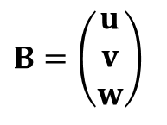
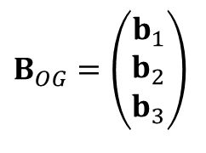


Gram-Schmidtova ortogonalizácia
Báza priestoru
$$B=\left(\begin{matrix}u \\ v \\ w\end{matrix}\right)$$
$$w$$
$$B_{OG}=\left(\begin{matrix}b_{1} \\ b_{2} \\ b_{3}\end{matrix}\right)$$
Ortogonálna báza
$$v$$
$$u$$

Slide 19




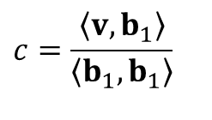



Gram-Schmidtova ortogonalizácia
Báza priestoru
$$B=\left(\begin{matrix}u \\ v \\ w\end{matrix}\right)$$
$$w$$
$$B_{OG}=\left(\begin{matrix}b_{1} \\ b_{2} \\ b_{3}\end{matrix}\right)$$
Ortogonálna báza
$$b_{1}=u$$
$$c=\frac{\left\langle v,b_{1}\right\rangle }{\left\langle b_{1},b_{1}\right\rangle }$$
$$b_{2}=v−cb_{1}$$
$$v$$
$$b_{2}=v−\tilde{v}$$
$$\tilde{v}=cb_{1}$$
$$b_{1}=u$$

Slide 20




Gram-Schmidtova ortogonalizácia
Báza priestoru
$$B=\left(\begin{matrix}u \\ v \\ w\end{matrix}\right)$$
$$w$$
$$B_{OG}=\left(\begin{matrix}b_{1} \\ b_{2} \\ b_{3}\end{matrix}\right)$$
Ortogonálna báza
$$b_{1}=u$$
$$c=\frac{\left\langle v,b_{1}\right\rangle }{\left\langle b_{1},b_{1}\right\rangle }$$
$$b_{2}=v−cb_{1}$$
$$b_{2}$$
$$b_{1}$$

Slide 21


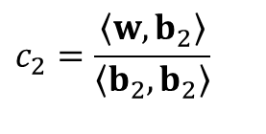
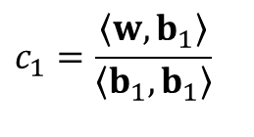





Gram-Schmidtova ortogonalizácia
Báza priestoru
$$B=\left(\begin{matrix}u \\ v \\ w\end{matrix}\right)$$
$$w$$
$$B_{OG}=\left(\begin{matrix}b_{1} \\ b_{2} \\ b_{3}\end{matrix}\right)$$
Ortogonálna báza
$$b_{3}=w−\tilde{w}$$
$$c_{2}b_{2}$$
$$b_{1}=u$$
$$c=\frac{\left\langle v,b_{1}\right\rangle }{\left\langle b_{1},b_{1}\right\rangle }$$
$$\tilde{w}=c_{1}b_{1}+c_{2}b_{2}$$
$$b_{2}=v−cb_{1}$$
$$b_{2}$$
$$b_{3}=w−\tilde{w}$$
$$=w−\left(c_{1}b_{1}+c_{2}b_{2}\right)$$
$$c_{1}b_{1}$$
$$c_{1}=\frac{\left\langle w,b_{1}\right\rangle }{\left\langle b_{1},b_{1}\right\rangle }$$
$$c_{2}=\frac{\left\langle w,b_{2}\right\rangle }{\left\langle b_{2},b_{2}\right\rangle }$$
$$b_{1}$$

Slide 22

Gram-Schmidtova ortogonalizácia
Báza priestoru
$$B=\left(\begin{matrix}u \\ v \\ w\end{matrix}\right)$$
$$B_{OG}=\left(\begin{matrix}b_{1} \\ b_{2} \\ b_{3}\end{matrix}\right)$$
$$b_{3}=w−\tilde{w}$$
Ortogonálna báza
$$c_{2}b_{2}$$
$$b_{1}=u$$
$$c=\frac{\left\langle v,b_{1}\right\rangle }{\left\langle b_{1},b_{1}\right\rangle }$$
$$\tilde{w}=c_{1}b_{1}+c_{2}b_{2}$$
$$b_{2}=v−cb_{1}$$
$$b_{2}$$
$$b_{3}=w−\tilde{w}$$
$$=w−\left(c_{1}b_{1}+c_{2}b_{2}\right)$$
$$c_{1}b_{1}$$
$$c_{1}=\frac{\left\langle w,b_{1}\right\rangle }{\left\langle b_{1},b_{1}\right\rangle }$$
$$c_{2}=\frac{\left\langle w,b_{2}\right\rangle }{\left\langle b_{2},b_{2}\right\rangle }$$
$$b_{1}$$

Slide 23

Gram-Schmidtova ortogonalizácia
Báza priestoru
$$B=\left(\begin{matrix}u \\ v \\ w\end{matrix}\right)$$
$$B_{OG}=\left(\begin{matrix}b_{1} \\ b_{2} \\ b_{3}\end{matrix}\right)$$
$$b_{3}$$
Ortogonálna báza
$$b_{1}=u$$
$$c=\frac{\left\langle v,b_{1}\right\rangle }{\left\langle b_{1},b_{1}\right\rangle }$$
$$b_{2}=v−cb_{1}$$
$$b_{2}$$
$$b_{3}=w−\tilde{w}$$
$$=w−\left(c_{1}b_{1}+c_{2}b_{2}\right)$$
$$c_{1}=\frac{\left\langle w,b_{1}\right\rangle }{\left\langle b_{1},b_{1}\right\rangle }$$
$$c_{2}=\frac{\left\langle w,b_{2}\right\rangle }{\left\langle b_{2},b_{2}\right\rangle }$$
$$b_{1}$$

Slide 24
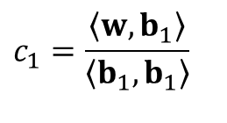
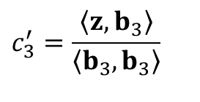


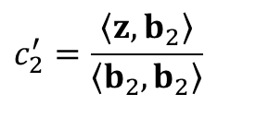

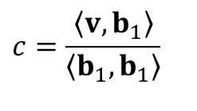
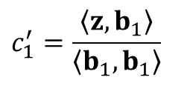



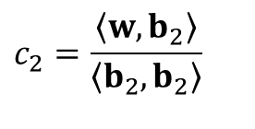
Gram-Schmidtova ortogonalizácia
Báza priestoru
$$B={\left(u,v,w,z\right)}^{T}$$
Ortogonálna báza
$$B_{OG}={\left(b_{1},b_{2},b_{3},b_{4}\right)}^{T}$$
$$b_{1}=u$$
$$c=\frac{\left\langle v,b_{1}\right\rangle }{\left\langle b_{1},b_{1}\right\rangle }$$
$$b_{2}=v−cb_{1}$$
$$c_{1}=\frac{\left\langle w,b_{1}\right\rangle }{\left\langle b_{1},b_{1}\right\rangle }$$
$$c_{2}=\frac{\left\langle w,b_{2}\right\rangle }{\left\langle b_{2},b_{2}\right\rangle }$$
$$b_{3}=w−c_{1}b_{1}+c_{2}b_{2}$$
$$b_{4}=z−\left(c_{1}^{′}b_{1}+c_{2}^{′}b_{2}+c_{3}^{′}b_{3}\right)$$
$$c_{1}^{′}=\frac{\left\langle z,b_{1}\right\rangle }{\left\langle b_{1},b_{1}\right\rangle }$$
$$c_{2}^{′}=\frac{\left\langle z,b_{2}\right\rangle }{\left\langle b_{2},b_{2}\right\rangle }$$
$$c_{3}^{′}=\frac{\left\langle z,b_{3}\right\rangle }{\left\langle b_{3},b_{3}\right\rangle }$$

Slide 25



Gram-Schmidtova ortogonalizácia
Báza priestoru
$$B={\left(u,v,w,z\right)}^{T}$$
Ortogonálna báza
$$B_{OG}={\left(b_{1},b_{2},b_{3},b_{4}\right)}^{T}$$
$$b_{1}=u$$
$$c=\frac{\left\langle v,b_{1}\right\rangle }{\left\langle b_{1},b_{1}\right\rangle }$$
$$b_{2}=v−cb_{1}$$
$$c_{1}=\frac{\left\langle w,b_{1}\right\rangle }{\left\langle b_{1},b_{1}\right\rangle }$$
$$c_{2}=\frac{\left\langle w,b_{2}\right\rangle }{\left\langle b_{2},b_{2}\right\rangle }$$
$$b_{3}=w−c_{1}b_{1}+c_{2}b_{2}$$
$$b_{4}=z−\left(c_{1}^{′}b_{1}+c_{2}^{′}b_{2}+c_{3}^{′}b_{3}\right)$$
$$c_{1}^{′}=\frac{\left\langle z,b_{1}\right\rangle }{\left\langle b_{1},b_{1}\right\rangle }$$
$$c_{2}^{′}=\frac{\left\langle z,b_{2}\right\rangle }{\left\langle b_{2},b_{2}\right\rangle }$$
$$c_{3}^{′}=\frac{\left\langle z,b_{3}\right\rangle }{\left\langle b_{3},b_{3}\right\rangle }$$

Slide 26
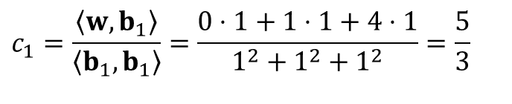

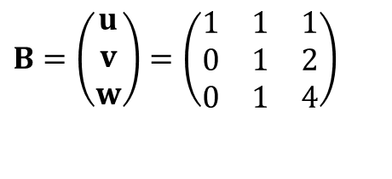

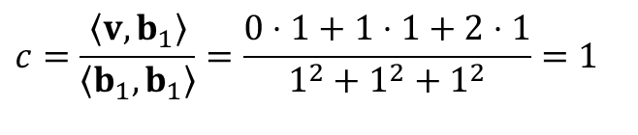

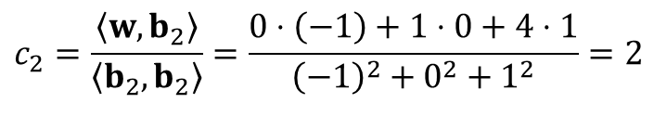
Gram-Schmidtova ortogonalizácia
$$B=\left(\begin{matrix}u \\ v \\ w\end{matrix}\right)=\left(\begin{matrix}1 & 1 & 1 \\ 0 & 1 & 2 \\ 0 & 1 & 4\end{matrix}\right)$$
$$b_{1}=u=\left(1,1,1\right)$$
$$c=\frac{\left\langle v,b_{1}\right\rangle }{\left\langle b_{1},b_{1}\right\rangle }=\frac{0⋅1+1⋅1+2⋅1}{1^{2}+1^{2}+1^{2}}=1$$
$$b_{2}=v−cb_{1}$$
$$b_{2}=\left(0,1,2\right)−1⋅\left(1,1,1\right)=\left(−1,0,1\right)$$
$$c_{1}=\frac{\left\langle w,b_{1}\right\rangle }{\left\langle b_{1},b_{1}\right\rangle }=\frac{0⋅1+1⋅1+4⋅1}{1^{2}+1^{2}+1^{2}}=\frac{5}{3}$$
$$b_{3}=w−\left(c_{1}b_{1}+c_{2}b_{2}\right)$$
$$c_{2}=\frac{\left\langle w,b_{2}\right\rangle }{\left\langle b_{2},b_{2}\right\rangle }=\frac{0⋅\left(−1\right)+1⋅0+4⋅1}{{\left(−1\right)}^{2}+0^{2}+1^{2}}=2$$

Slide 27
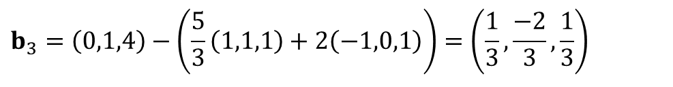
Gram-Schmidtova ortogonalizácia
$$B=\left(\begin{matrix}u \\ v \\ w\end{matrix}\right)=\left(\begin{matrix}1 & 1 & 1 \\ 0 & 1 & 2 \\ 0 & 1 & 4\end{matrix}\right)$$
$$b_{1}=u=\left(1,1,1\right)$$
$$c=\frac{\left\langle v,b_{1}\right\rangle }{\left\langle b_{1},b_{1}\right\rangle }=\frac{0⋅1+1⋅1+2⋅1}{1^{2}+1^{2}+1^{2}}=1$$
$$b_{2}=v−cb_{1}$$
$$b_{2}=\left(0,1,2\right)−1⋅\left(1,1,1\right)=\left(−1,0,1\right)$$
$$b_{3}=w−\left(c_{1}b_{1}+c_{2}b_{2}\right)$$
$$b_{3}=\left(0,1,4\right)−\left(\frac{5}{3}\left(1,1,1\right)+2\left(−1,0,1\right)\right)=\left(\frac{1}{3},\frac{−2}{3},\frac{1}{3}\right)$$

Slide 28
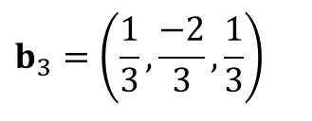

Gram-Schmidtova ortogonalizácia
$$B=\left(\begin{matrix}u \\ v \\ w\end{matrix}\right)=\left(\begin{matrix}1 & 1 & 1 \\ 0 & 1 & 2 \\ 0 & 1 & 4\end{matrix}\right)$$
$$b_{1}=u=\left(1,1,1\right)$$
$$c=\frac{\left\langle v,b_{1}\right\rangle }{\left\langle b_{1},b_{1}\right\rangle }=\frac{0⋅1+1⋅1+2⋅1}{1^{2}+1^{2}+1^{2}}=1$$
$$b_{2}=v−cb_{1}$$
$$b_{2}=\left(0,1,2\right)−1⋅\left(1,1,1\right)=\left(−1,0,1\right)$$
$$b_{3}=w−\left(c_{1}b_{1}+c_{2}b_{2}\right)$$
$$G=\left(\begin{matrix}1 & 1 & 1 \\ −1 & 0 & 1 \\ 1/3 & −2/3 & 1/3\end{matrix}\right)$$
$$b_{3}=\left(\frac{1}{3},\frac{−2}{3},\frac{1}{3}\right)$$

Slide 29

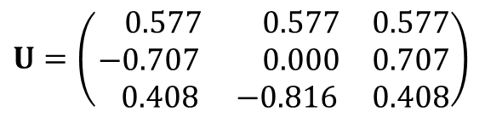




Gram-Schmidtova ortogonalizácia
$$B=\left(\begin{matrix}u \\ v \\ w\end{matrix}\right)=\left(\begin{matrix}1 & 1 & 1 \\ 0 & 1 & 2 \\ 0 & 1 & 4\end{matrix}\right)$$
$\left\|b_{1}\right\|=\sqrt{1^{2}+1^{2}+1^{2}}$ $=\sqrt{3}$
$$G=\left(\begin{matrix}1 & 1 & 1 \\ −1 & 0 & 1 \\ 1/3 & −2/3 & 1/3\end{matrix}\right)$$
$\left\|b_{2}\right\|=\sqrt{1^{2}+0^{2}+1^{2}}$ $=\sqrt{2}$
$\left\|b_{3}\right\|=\sqrt{1/9+4/9+1/9}$ $=\sqrt{6}/$3
$$U=\left(\begin{matrix} 0.577 & 0.577 & 0.577 \\ −0.707 & 0.000 & 0.707 \\ 0.408 & −0.816 & 0.408\end{matrix}\right)$$

Slide 30
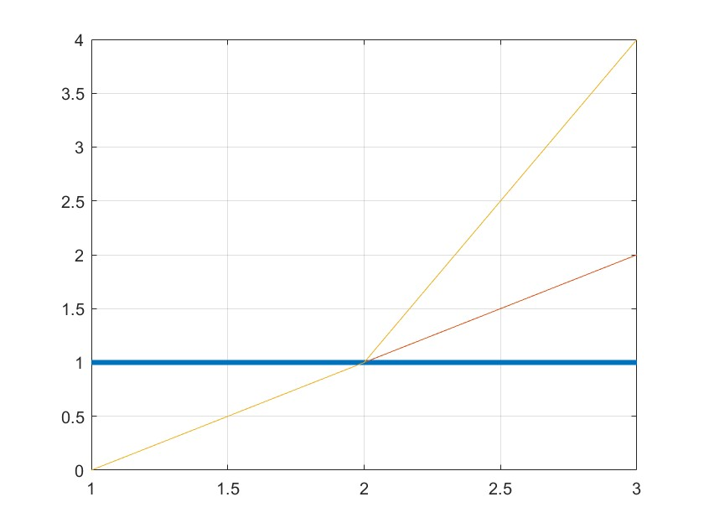
Gram-Schmidtova ortogonalizácia
$$B=\left(\begin{matrix}u \\ v \\ w\end{matrix}\right)=\left(\begin{matrix}1 & 1 & 1 \\ 0 & 1 & 2 \\ 0 & 1 & 4\end{matrix}\right)$$

Slide 31
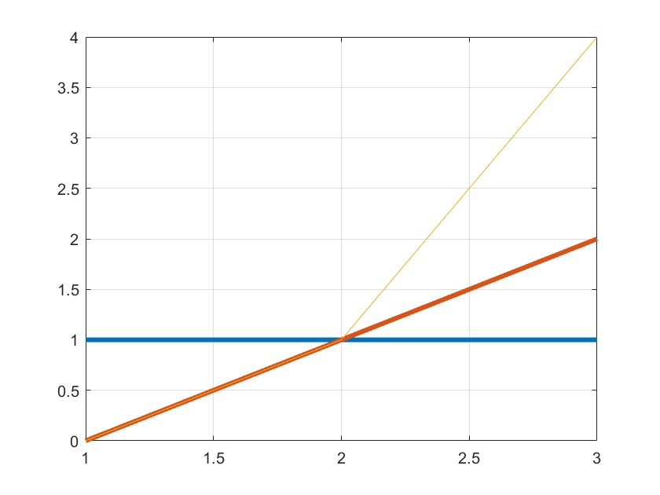
Gram-Schmidtova ortogonalizácia
$$B=\left(\begin{matrix}u \\ v \\ w\end{matrix}\right)=\left(\begin{matrix}1 & 1 & 1 \\ 0 & 1 & 2 \\ 0 & 1 & 4\end{matrix}\right)$$

Slide 32
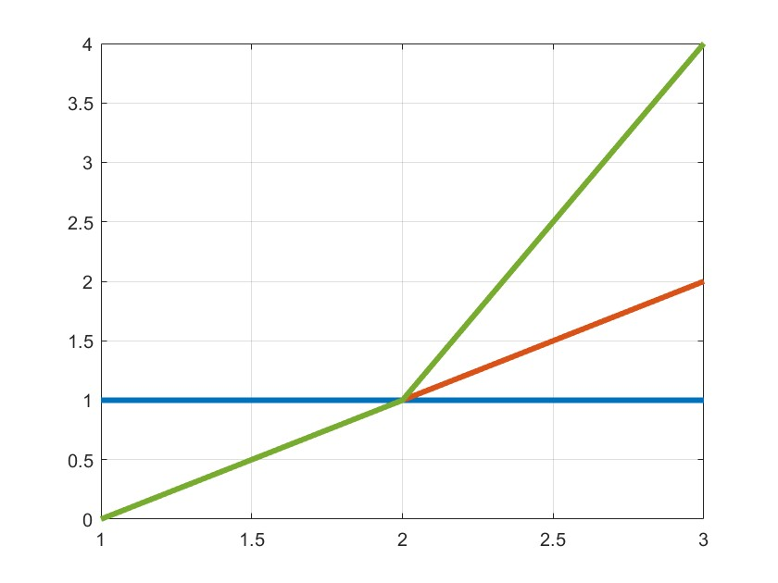
Gram-Schmidtova ortogonalizácia
$$B=\left(\begin{matrix}u \\ v \\ w\end{matrix}\right)=\left(\begin{matrix}1 & 1 & 1 \\ 0 & 1 & 2 \\ 0 & 1 & 4\end{matrix}\right)$$

Slide 33
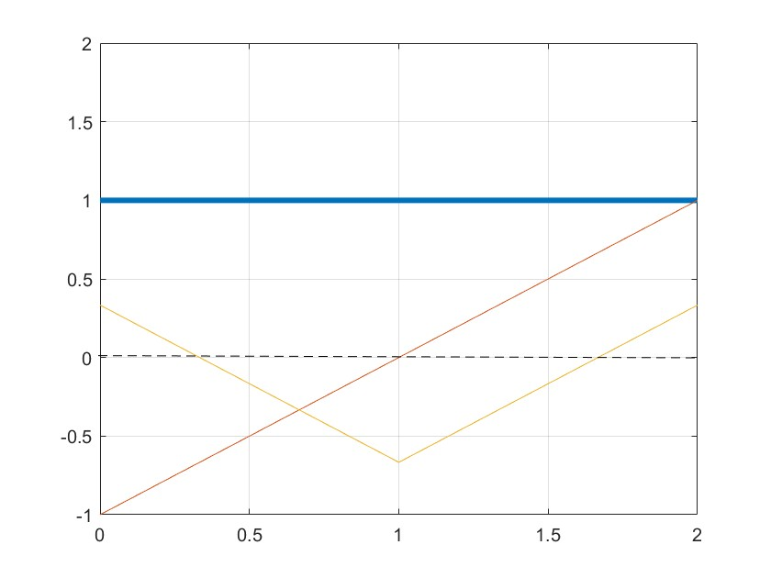
Gram-Schmidtova ortogonalizácia
$$B=\left(\begin{matrix}u \\ v \\ w\end{matrix}\right)=\left(\begin{matrix}1 & 1 & 1 \\ 0 & 1 & 2 \\ 0 & 1 & 4\end{matrix}\right)$$
$$G=\left(\begin{matrix}1 & 1 & 1 \\ −1 & 0 & 1 \\ 1/3 & −2/3 & 1/3\end{matrix}\right)$$

Slide 34
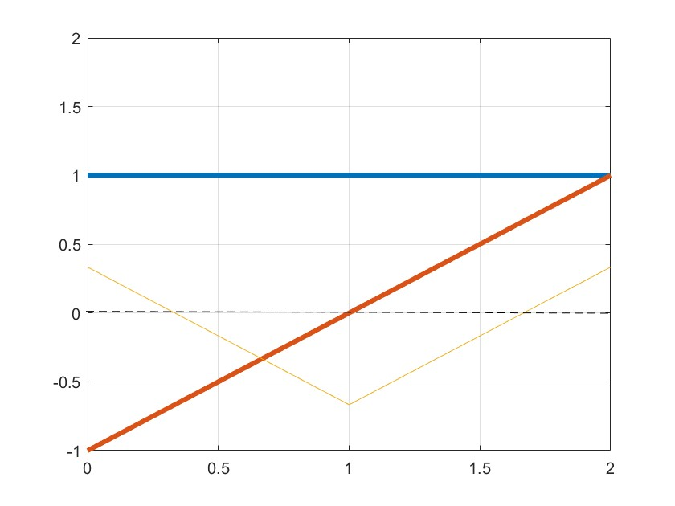
Gram-Schmidtova ortogonalizácia
$$B=\left(\begin{matrix}u \\ v \\ w\end{matrix}\right)=\left(\begin{matrix}1 & 1 & 1 \\ 0 & 1 & 2 \\ 0 & 1 & 4\end{matrix}\right)$$
$$G=\left(\begin{matrix}1 & 1 & 1 \\ −1 & 0 & 1 \\ 1/3 & −2/3 & 1/3\end{matrix}\right)$$

Slide 35
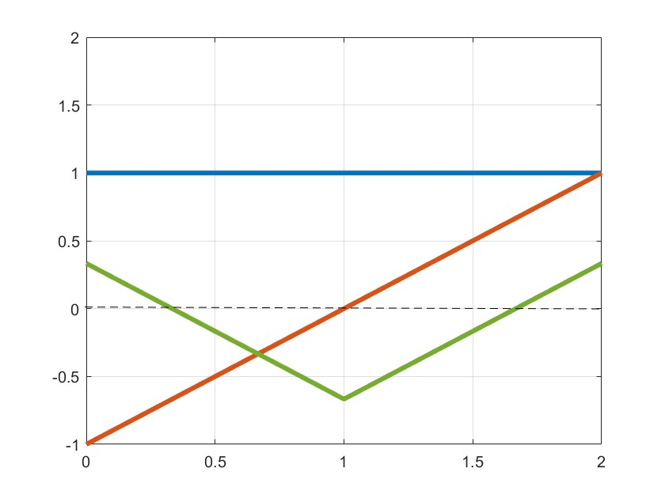
Gram-Schmidtova ortogonalizácia
$$B=\left(\begin{matrix}u \\ v \\ w\end{matrix}\right)=\left(\begin{matrix}1 & 1 & 1 \\ 0 & 1 & 2 \\ 0 & 1 & 4\end{matrix}\right)$$
$$G=\left(\begin{matrix}1 & 1 & 1 \\ −1 & 0 & 1 \\ 1/3 & −2/3 & 1/3\end{matrix}\right)$$

Slide 36
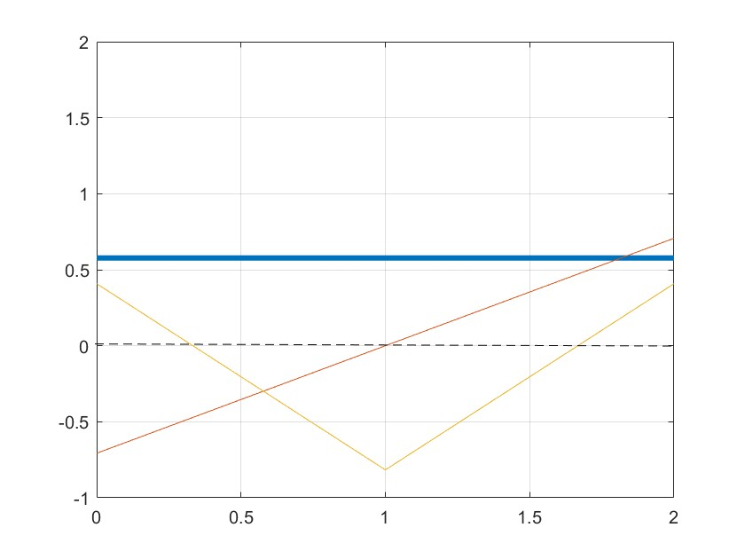
Gram-Schmidtova ortogonalizácia
0.5774 0.5774 0.5774
-0.7071 -0.0000 0.7071
0.4082 -0.8165 0.4082
$$B=\left(\begin{matrix}u \\ v \\ w\end{matrix}\right)=\left(\begin{matrix}1 & 1 & 1 \\ 0 & 1 & 2 \\ 0 & 1 & 4\end{matrix}\right)$$
$$G=\left(\begin{matrix}1 & 1 & 1 \\ −1 & 0 & 1 \\ 1/3 & −2/3 & 1/3\end{matrix}\right)$$
$$U=\left(\begin{matrix} 0.577 & 0.577 & 0.577 \\ −0.707 & 0.000 & 0.707 \\ 0.408 & −0.816 & 0.408\end{matrix}\right)$$

Slide 37
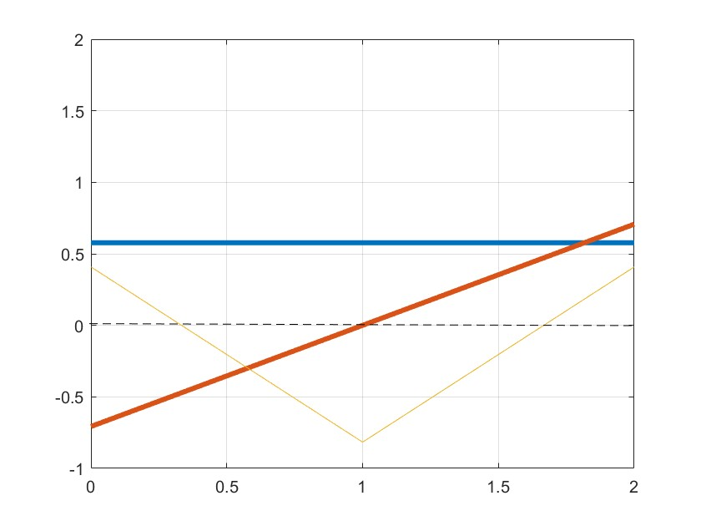
Gram-Schmidtova ortogonalizácia
$$B=\left(\begin{matrix}u \\ v \\ w\end{matrix}\right)=\left(\begin{matrix}1 & 1 & 1 \\ 0 & 1 & 2 \\ 0 & 1 & 4\end{matrix}\right)$$
$$G=\left(\begin{matrix}1 & 1 & 1 \\ −1 & 0 & 1 \\ 1/3 & −2/3 & 1/3\end{matrix}\right)$$
$$U=\left(\begin{matrix} 0.577 & 0.577 & 0.577 \\ −0.707 & 0.000 & 0.707 \\ 0.408 & −0.816 & 0.408\end{matrix}\right)$$

Slide 38

Gram-Schmidtova ortogonalizácia
$$B=\left(\begin{matrix}u \\ v \\ w\end{matrix}\right)=\left(\begin{matrix}1 & 1 & 1 \\ 0 & 1 & 2 \\ 0 & 1 & 4\end{matrix}\right)$$
$$G=\left(\begin{matrix}1 & 1 & 1 \\ −1 & 0 & 1 \\ 1/3 & −2/3 & 1/3\end{matrix}\right)$$
$$U=\left(\begin{matrix} 0.577 & 0.577 & 0.577 \\ −0.707 & 0.000 & 0.707 \\ 0.408 & −0.816 & 0.408\end{matrix}\right)$$

Slide 39

















Gram-Schmidtova ortogonalizácia
Dáta
$$f=\left(f_{1},f_{2},f_{3},...,f_{N}\right)$$
$$t=\left(t_{1},t_{2},t_{3},...,t_{N}\right)$$
Príklad 2.9.2 Nájdite konštantnú, lineárnu a kvadratickú zložku vektorov v = (3, 6, 2) a u = (0, 2, 7).
Príklad 2.9.2
Nájdite konštantnú, lineárnu a kvadratickú zložku: v = (3, 6, 3) a u = (0, 2, 7).
$$t=\left(0,1, 2\right)$$
$$v=\left(3, 6, 3\right)$$
$$c_{1}=\frac{\left\langle v,b_{1}\right\rangle }{\left\langle b_{1},b_{1}\right\rangle }$$
$$=\frac{3⋅1+6⋅1+3⋅1}{1^{2}+1^{2}+1^{2}}$$
$$=\frac{12 }{3}$$
$$=4$$
$$G=\left(\begin{matrix}1 & 1 & 1 \\ −1 & 0 & 1 \\ 1/3 & −2/3 & 1/3\end{matrix}\right)$$
$$c_{2}=\frac{\left\langle v,b_{2}\right\rangle }{\left\langle b_{2},b_{2}\right\rangle }$$
$$=\frac{3⋅(−1)+3⋅1}{1^{2}+0^{2}+1^{2}}$$
$$=\frac{0 }{2}$$
$$=0$$
$$c_{3}=\frac{\left\langle v,b_{3}\right\rangle }{\left\langle b_{3},b_{3}\right\rangle }$$
$$=\frac{1−4+1}{1/9+4/9+1/9}$$
$$=\frac{−2 }{6/9}$$
$$=−3$$

Slide 40

Gram-Schmidtova ortogonalizácia
Dáta
$$f=\left(f_{1},f_{2},f_{3},...,f_{N}\right)$$
$$t=\left(t_{1},t_{2},t_{3},...,t_{N}\right)$$
Príklad 2.9.2 Nájdite konštantnú, lineárnu a kvadratickú zložku vektorov v = (3, 6, 2) a u = (0, 2, 7).
Príklad 2.9.2
Nájdite konštantnú, lineárnu a kvadratickú zložku: v = (3, 6, 3) a u = (0, 2, 7).
$$t=\left(0,1, 2\right)$$
$$v=\left(3, 6, 3\right)$$
$$={\left(4, 0, −3\right)}_{G}$$
$$G=\left(\begin{matrix}1 & 1 & 1 \\ −1 & 0 & 1 \\ 1/3 & −2/3 & 1/3\end{matrix}\right)$$

Slide 41














Gram-Schmidtova ortogonalizácia
Dáta
$$f=\left(f_{1},f_{2},f_{3},...,f_{N}\right)$$
$$t=\left(t_{1},t_{2},t_{3},...,t_{N}\right)$$
Príklad 2.9.2 Nájdite konštantnú, lineárnu a kvadratickú zložku vektorov v = (3, 6, 2) a u = (0, 2, 7).
Príklad 2.9.2
Nájdite konštantnú, lineárnu a kvadratickú zložku: v = (3, 6, 3) a u = (0, 2, 7).
$$t=\left(0,1, 2\right)$$
$$v=\left(3, 6, 3\right)$$
$$={\left(4, 0, −3\right)}_{G}$$
$$u=\left(0, 2, 7\right)$$
$$c_{1}=\frac{\left\langle u,b_{1}\right\rangle }{\left\langle b_{1},b_{1}\right\rangle }$$
$$=\frac{0⋅1+2⋅1+7⋅1}{1^{2}+1^{2}+1^{2}}$$
$$=\frac{9 }{3}$$
$$=3$$
$$G=\left(\begin{matrix}1 & 1 & 1 \\ −1 & 0 & 1 \\ 1/3 & −2/3 & 1/3\end{matrix}\right)$$
$$c_{2}=\frac{\left\langle u,b_{2}\right\rangle }{\left\langle b_{2},b_{2}\right\rangle }$$
$$=\frac{0⋅(−1)+7⋅1}{1^{2}+0^{2}+1^{2}}$$
$$=\frac{7 }{2}$$
$$=3.5$$
$$c_{3}=\frac{\left\langle u,b_{3}\right\rangle }{\left\langle b_{3},b_{3}\right\rangle }$$
$$=\frac{−4/3+7/3}{1/9+4/9+1/9}$$
$$=\frac{3/3}{6/9}$$
$$=1.5$$

Slide 42

Gram-Schmidtova ortogonalizácia
Dáta
$$f=\left(f_{1},f_{2},f_{3},...,f_{N}\right)$$
$$t=\left(t_{1},t_{2},t_{3},...,t_{N}\right)$$
Príklad 2.9.2 Nájdite konštantnú, lineárnu a kvadratickú zložku vektorov v = (3, 6, 2) a u = (0, 2, 7).
Príklad 2.9.2
Nájdite konštantnú, lineárnu a kvadratickú zložku: v = (3, 6, 3) a u = (0, 2, 7).
$$t=\left(0,1, 2\right)$$
$$v=\left(3, 6, 3\right)$$
$$={\left(4, 0, −3\right)}_{G}$$
$$u=\left(0, 2, 7\right)$$
$$={\left(3, 3.5, 1.5\right)}_{G}$$
$$G=\left(\begin{matrix}1 & 1 & 1 \\ −1 & 0 & 1 \\ 1/3 & −2/3 & 1/3\end{matrix}\right)$$

Slide 43














Gram-Schmidtova ortogonalizácia
Dáta
$$f=\left(f_{1},f_{2},f_{3},...,f_{N}\right)$$
$$t=\left(t_{1},t_{2},t_{3},...,t_{N}\right)$$
Príklad 2.9.2 Nájdite konštantnú, lineárnu a kvadratickú zložku vektorov v = (3, 6, 2) a u = (0, 2, 7).
Príklad 2.9.2
Nájdite konštantnú, lineárnu a kvadratickú zložku: v = (3, 6, 3) a u = (0, 2, 7).
$$v=\left(3, 6, 3\right)$$
$$={\left(4, 0, −3\right)}_{G}$$
$$u=\left(0, 2, 7\right)$$
$$={\left(3, 3.5, 1.5\right)}_{G}$$
$$v$$
$$u$$
$$b_{1}$$
$$b_{1}$$
$$b_{2}$$
$$b_{3}$$
$$b_{2}$$
$$b_{3}$$

Slide 44








Gram-Schmidtova ortogonalizácia
Dáta
$$f=\left(f_{1},f_{2},f_{3},...,f_{N}\right)$$
$$t=\left(t_{1},t_{2},t_{3},...,t_{N}\right)$$
Príklad 2.9.2 Nájdite konštantnú, lineárnu a kvadratickú zložku vektorov v = (3, 6, 2) a u = (0, 2, 7).
Príklad 2.9.2
Nájdite konštantnú, lineárnu a kvadratickú zložku: v = (3, 6, 3) a u = (0, 2, 7).
$$v=\left(3, 6, 3\right)$$
$$={\left(4, 0, −3\right)}_{G}$$
$$u=\left(0, 2, 7\right)$$
$$={\left(3, 3.5, 1.5\right)}_{G}$$
$$v$$
$$u$$
$${4b}_{1}$$
$${3b}_{1}$$
$${−3b}_{3}$$
$${0b}_{2}$$
$${1.5b}_{3}$$
$${3.5b}_{2}$$

Slide 45


Gram-Schmidtova ortogonalizácia
Dáta
$$f=\left(f_{1},f_{2},f_{3},...,f_{N}\right)$$
$$t=\left(t_{1},t_{2},t_{3},...,t_{N}\right)$$
Príklad 2.9.2 Nájdite konštantnú, lineárnu a kvadratickú zložku vektorov v = (3, 6, 2) a u = (0, 2, 7).
Príklad 2.9.2
Nájdite konštantnú, lineárnu a kvadratickú zložku: v = (3, 6, 3) a u = (0, 2, 7).
$$v=\left(3, 6, 3\right)$$
$$={\left(4, 0, −3\right)}_{G}$$
$$u=\left(0, 2, 7\right)$$
$$={\left(3, 3.5, 1.5\right)}_{G}$$
$$v$$
$$u$$
$${4b}_{1}$$
$${3b}_{1}$$
$${−3b}_{3}$$
$${0b}_{2}$$
$${1.5b}_{3}$$
$${3.5b}_{2}$$

