Slide 1
Analýza procesov
Department of Information Networks
Faculty of Management Science and Informatics
University of Žilina
4. prednáška
Juraj Smieško

Slide 2


Priemet do M-rozmerného podpriestoru
$$\tilde{f}∈V_{M}$$
$$y∈V_{M}$$

Slide 3



Priemet do M-rozmerného podpriestoru
y$− \tilde{f}$
$$\tilde{f}$$
$$y$$

Slide 4


Priemet do M-rozmerného podpriestoru
f$− \tilde{f}$
y$− \tilde{f}$
$$\tilde{f}$$
$$y$$

Slide 5
Priemet do M-rozmerného podpriestoru
f$− \tilde{f}$
y$− \tilde{f}$
$$\tilde{f}$$
$$y$$

Slide 6

Priemet do M-rozmerného podpriestoru
$$\left(f−\tilde{f}\right)−\left(y−\tilde{f}\right)$$
f$− \tilde{f}$
y$− \tilde{f}$
$$\tilde{f}$$
$$y$$

Slide 7
Aproximácia vektora v podpriestore
Nech V_{N} je N-rozmerný vektorový priestor s Euklidovskou bázou E ,
a nech V_{M} je jeho M-rozmerný vektorový podpriestor s bázou B.
Nech f = (f₁, f₂,…, f_{N}) ∊ V_{N}. Spomedzi vektorov y ∊ V_{M} bude najbližší k vektoru f jeho kolmý priemet do podpriestoru U, vektor
je kolmý na každý vektor z U, preto aj na

Slide 8

Priemet do M-rozmerného podpriestoru
$$f−y$$
f$− \tilde{f}$
y$− \tilde{f}$
$$\tilde{f}$$
$$y$$

Slide 9
Aproximácia vektora v podpriestore
Nech V je N-rozmerný vektorový priestor s Euklidovskou bázou E ,
a nech U je jeho M-rozmerný vektorový podpriestor s bázou B.
Nech f = (f₁, f₂,…, f_{N}) ∊ V. Spomedzi vektorov y ∊ U bude najbližší k vektoru f jeho kolmý priemet do podpriestoru U, vektor
je kolmý na každý vektor z U, preto aj na

Slide 10
Metóda najmenších štvorcov MNŠ
Chyba aproximácie

Slide 11
Lineárna regresia
Jednorozmerná lineárna regresia
jednoparametrickými funkciami

Slide 12
Priemet do jedno-rozmerného podpriestoru

Slide 13


Regresia jednoparametrickou funkciou
Dáta
$$t=\left(t_{1},t_{2},t_{3},...,t_{N}\right)$$
$$f=\left(f_{1},f_{2},f_{3},...,f_{N}\right)$$
Regresná funkcia

Slide 14







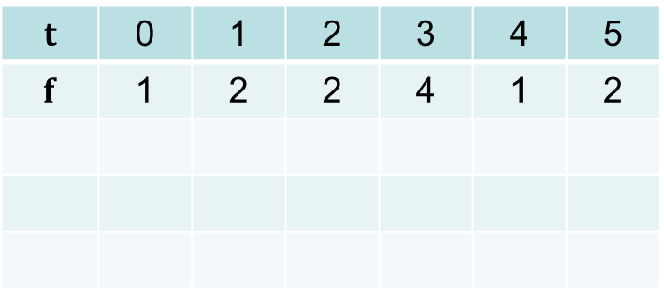

Regresia jednoparametrickou funkciou
Dáta
$$t=\left(t_{1},t_{2},t_{3},...,t_{N}\right)$$
$$f=\left(f_{1},f_{2},f_{3},...,f_{N}\right)$$
Regresná funkcia
$$t$$ | 0 | 1 | 2 | 3 | 4 | 5
$$f$$ | 1 | 2 | 2 | 4 | 1 | 2
$$\tilde{f}=\left(c,c,c,c,c,c\right)=$$
$$=cb$$
$$=c\left(1,1,1,1,1,1\right)=$$
$$c=\frac{\left\langle f,b\right\rangle }{\left\langle b,b\right\rangle }$$
$$=\frac{12}{6}=2$$
$$b=\left(1,1,1,1,1,1\right)$$
$$y(t)=2$$
$$\tilde{f}=cb=\left(2, 2,2, 2, 2, 2\right)$$

Slide 15
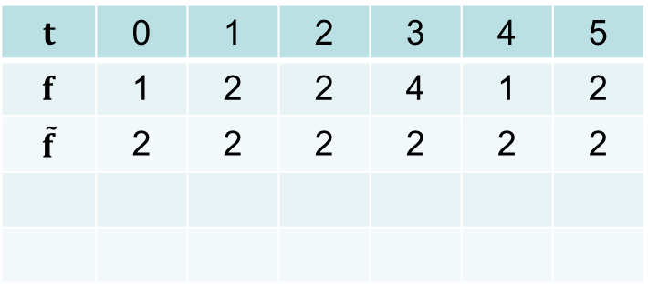
Regresia jednoparametrickou funkciou
Dáta
$$t=\left(t_{1},t_{2},t_{3},...,t_{N}\right)$$
$$f=\left(f_{1},f_{2},f_{3},...,f_{N}\right)$$
Regresná funkcia
$$t$$ | 0 | 1 | 2 | 3 | 4 | 5
$$f$$ | 1 | 2 | 2 | 4 | 1 | 2
$$\tilde{f}$$ | 2 | 2 | 2 | 2 | 2 | 2
$$\tilde{f}=\left(c,c,c,c,c,c\right)=$$
$$=cb$$
$$=c\left(1,1,1,1,1,1\right)=$$
$$c=\frac{\left\langle f,b\right\rangle }{\left\langle b,b\right\rangle }$$
$$=\frac{12}{6}=2$$
$$b=\left(1,1,1,1,1,1\right)$$
$$y(t)=2$$
$$\tilde{f}=cb=\left(2, 2,2, 2, 2, 2\right)$$

Slide 16
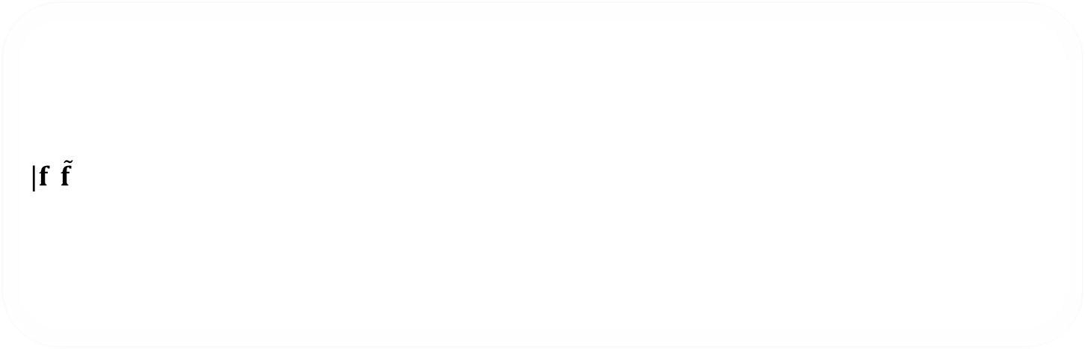
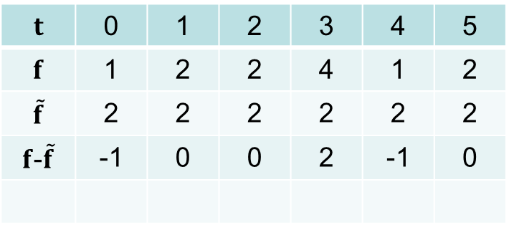
Regresia jednoparametrickou funkciou
Dáta
$$t=\left(t_{1},t_{2},t_{3},...,t_{N}\right)$$
$$f=\left(f_{1},f_{2},f_{3},...,f_{N}\right)$$
Regresná funkcia
$|f$-$\tilde{f}$|
$$t$$ | 0 | 1 | 2 | 3 | 4 | 5
$$f$$ | 1 | 2 | 2 | 4 | 1 | 2
$$\tilde{f}$$ | 2 | 2 | 2 | 2 | 2 | 2
$f$-$\tilde{f}$ | -1 | 0 | 0 | 2 | -1 | 0
$$\tilde{f}=\left(c,c,c,c,c,c\right)=$$
$$=cb$$
$$=c\left(1,1,1,1,1,1\right)=$$
$$c=\frac{\left\langle f,b\right\rangle }{\left\langle b,b\right\rangle }$$
$$=\frac{12}{6}=2$$
$$b=\left(1,1,1,1,1,1\right)$$
$$y(t)=2$$
$$\tilde{f}=cb=\left(2, 2,2, 2, 2, 2\right)$$

Slide 17

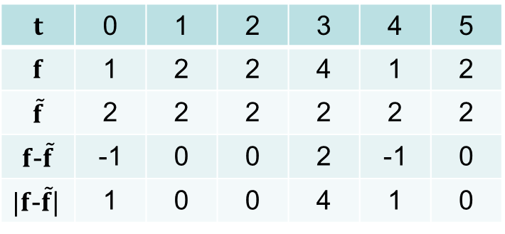
Regresia jednoparametrickou funkciou
Dáta
$$t=\left(t_{1},t_{2},t_{3},...,t_{N}\right)$$
$$f=\left(f_{1},f_{2},f_{3},...,f_{N}\right)$$
Regresná funkcia
$|f$-$\tilde{f}$|
$$t$$ | 0 | 1 | 2 | 3 | 4 | 5
$$f$$ | 1 | 2 | 2 | 4 | 1 | 2
$$\tilde{f}$$ | 2 | 2 | 2 | 2 | 2 | 2
$f$-$\tilde{f}$ | -1 | 0 | 0 | 2 | -1 | 0
$|f$-$\tilde{f}$| | 1 | 0 | 0 | 4 | 1 | 0
$$\tilde{f}=\left(c,c,c,c,c,c\right)=$$
$$=cb$$
$$=c\left(1,1,1,1,1,1\right)=$$
$$c=\frac{\left\langle f,b\right\rangle }{\left\langle b,b\right\rangle }$$
$$=\frac{12}{6}=2$$
$$b=\left(1,1,1,1,1,1\right)$$
$$y(t)=2$$
$$\tilde{f}=cb=\left(2, 2,2, 2, 2, 2\right)$$
$|f−\tilde{f}$| = $\sqrt{1+4+1}=\sqrt{6}$

Slide 18
Regresia jednoparametrickou funkciou
Dáta
$$t=\left(t_{1},t_{2},t_{3},...,t_{N}\right)$$
$$f=\left(f_{1},f_{2},f_{3},...,f_{N}\right)$$
Regresná funkcia

Slide 19
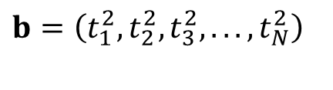
Regresia jednoparametrickou funkciou
Dáta
$$t=\left(t_{1},t_{2},t_{3},...,t_{N}\right)$$
$$f=\left(f_{1},f_{2},f_{3},...,f_{N}\right)$$
Regresná funkcia
$$b=\left(t_{1}^{2},t_{2}^{2},t_{3}^{2},...,t_{N}^{2}\right)$$

Slide 20
Lineárna regresia
Jednorozmerná lineárna regresia
dvojparametrickými funkciami

Slide 21
Regresia dvojparametrickou funkciou
Dáta
Regresná funkcia

Slide 22
Regresia dvojparametrickou funkciou
Dáta
Regresná funkcia

Slide 23


Regresia dvojparametrickou funkciou
Dáta
Regresná funkcia
$$f−\tilde{f}⊥b_{1}⇔ \left\langle f−\tilde{f},b_{1}\right\rangle =0$$
$$f−\tilde{f}⊥b_{2}⇔ \left\langle f−\tilde{f},b_{2}\right\rangle =0$$

Slide 24








Regresia dvojparametrickou funkciou
Dáta
Regresná funkcia
$$f−\tilde{f}⊥b_{1}⇔ \left\langle f−\tilde{f},b_{1}\right\rangle =0$$
$$f−\tilde{f}⊥b_{2}⇔ \left\langle f−\tilde{f},b_{2}\right\rangle =0$$
$$\left\langle f−\left(c_{1}b_{1}+c_{2}b_{2}\right),b_{1}\right\rangle =0$$
$$\left\langle f−\left(c_{1}b_{1}+c_{2}b_{2}\right),b_{2}\right\rangle =0$$
$$\left\langle f,b_{1}\right\rangle −\left\langle c_{1}b_{1},b_{1}\right\rangle −\left\langle c_{2}b_{2},b_{1}\right\rangle =0$$
$$\left\langle f,b_{2}\right\rangle −\left\langle c_{1}b_{1},b_{2}\right\rangle −\left\langle c_{2}b_{2},b_{2}\right\rangle =0$$
$$\left\langle c_{1}b_{1},b_{1}\right\rangle +\left\langle c_{2}b_{2},b_{1}\right\rangle =\left\langle f,b_{1}\right\rangle$$
$$\left\langle c_{1}b_{1},b_{2}\right\rangle +\left\langle c_{2}b_{2},b_{2}\right\rangle =\left\langle f,b_{2}\right\rangle$$

Slide 25










Regresia dvojparametrickou funkciou
$$t=\left(t_{1},t_{2},t_{3},...,t_{N}\right)$$
$$c_{1} \left\langle b_{1},b_{1}\right\rangle +c_{2}\left\langle b_{2},b_{1}\right\rangle =\left\langle f,b_{1}\right\rangle$$
$$f=\left(f_{1},f_{2},f_{3},...,f_{N}\right)$$
$$c_{1} \left\langle b_{1},b_{2}\right\rangle +c_{2}\left\langle b_{2},b_{2}\right\rangle =\left\langle f,b_{2}\right\rangle$$
Regresná priamka
$$y\left(t\right)=a+b.t$$
$\tilde{f}=\left(a+b.t_{1},a+b.t_{2},a+b.t_{3} ,...,a+b.t_{N}\right)$ =
$=\left(a,a,a,...,a \right)$ + $\left(b.t_{1},b.t_{2},b.t_{3} ,...,b.t_{N}\right)=$
$=a\left(1,1,1,...,1 \right)$ + $b\left(t_{1},t_{2},t_{3} ,...,t_{N}\right)$ =
$=ab_{1}$ + $bb_{2}$
$b_{1}$ = (1,1,1,...,1)
$b_{2}$ = ($t_{1},t_{2},t_{3} ,…,t_{N}$)

Slide 26




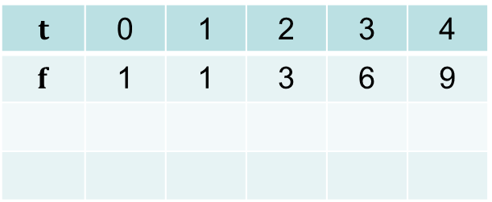










Regresia dvojparametrickou funkciou
$$t=\left(t_{1},t_{2},t_{3},...,t_{N}\right)$$
$$c_{1} \left\langle b_{1},b_{1}\right\rangle +c_{2}\left\langle b_{2},b_{1}\right\rangle =\left\langle f,b_{1}\right\rangle$$
$$f=\left(f_{1},f_{2},f_{3},...,f_{N}\right)$$
$$c_{1} \left\langle b_{1},b_{2}\right\rangle +c_{2}\left\langle b_{2},b_{2}\right\rangle =\left\langle f,b_{2}\right\rangle$$
Regresná priamka
$$t=\left(0,1,2,3,4 \right)$$
$$t$$ | 0 | 1 | 2 | 3 | 4
$$f$$ | 1 | 1 | 3 | 6 | 9
$$f=\left(1, 1, 3, 6, 9 \right)$$
$\tilde{f}=ab_{1}$ + $bb_{2}$
$$y\left(t\right)=a+b.t$$
$b_{1}$ = (1,1,1,1,1)
$$5a+10b=20$$
$$a+2b=4$$
$$a+2b=4$$
$b_{2}$ = (0,1,2,3,4)
$$10a+30b=61$$
$$a+3b=6.1$$
$b=2.1$
$a=−0.2$
$$y\left(t\right)=−0.2+2.1.t$$

Slide 27
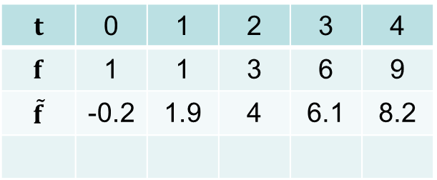
Regresia dvojparametrickou funkciou
$$t=\left(t_{1},t_{2},t_{3},...,t_{N}\right)$$
$$c_{1} \left\langle b_{1},b_{1}\right\rangle +c_{2}\left\langle b_{2},b_{1}\right\rangle =\left\langle f,b_{1}\right\rangle$$
$$f=\left(f_{1},f_{2},f_{3},...,f_{N}\right)$$
$$c_{1} \left\langle b_{1},b_{2}\right\rangle +c_{2}\left\langle b_{2},b_{2}\right\rangle =\left\langle f,b_{2}\right\rangle$$
Regresná priamka
$$t=\left(0,1,2,3,4 \right)$$
$$t$$ | 0 | 1 | 2 | 3 | 4
$$f$$ | 1 | 1 | 3 | 6 | 9
$$\tilde{f}$$ | -0.2 | 1.9 | 4 | 6.1 | 8.2
$$f=\left(1, 1, 3, 6, 9 \right)$$
$\tilde{f}=ab_{1}$ + $bb_{2}$
$$y\left(t\right)=a+b.t$$
$b_{1}$ = (1,1,1,1,1)
$$5a+10b=20$$
$$a+2b=4$$
$$a+2b=4$$
$b_{2}$ = (0,1,2,3,4)
$$10a+30b=61$$
$$a+3b=6.1$$
$b=2.1$
$a=−0.2$
$$y\left(t\right)=−0.2+2.1.t$$

Slide 28
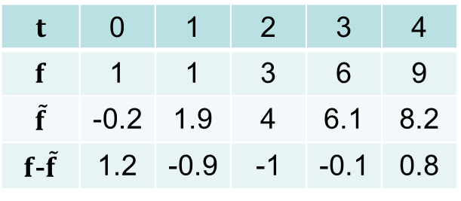
Regresia dvojparametrickou funkciou
$$t=\left(t_{1},t_{2},t_{3},...,t_{N}\right)$$
$$c_{1} \left\langle b_{1},b_{1}\right\rangle +c_{2}\left\langle b_{2},b_{1}\right\rangle =\left\langle f,b_{1}\right\rangle$$
$$f=\left(f_{1},f_{2},f_{3},...,f_{N}\right)$$
$$c_{1} \left\langle b_{1},b_{2}\right\rangle +c_{2}\left\langle b_{2},b_{2}\right\rangle =\left\langle f,b_{2}\right\rangle$$
Regresná priamka
$$t=\left(0,1,2,3,4 \right)$$
$$t$$ | 0 | 1 | 2 | 3 | 4
$$f$$ | 1 | 1 | 3 | 6 | 9
$$\tilde{f}$$ | -0.2 | 1.9 | 4 | 6.1 | 8.2
$f$-$\tilde{f}$ | 1.2 | -0.9 | -1 | -0.1 | 0.8
$$f=\left(1, 1, 3, 6, 9 \right)$$
$\tilde{f}=ab_{1}$ + $bb_{2}$
$$y\left(t\right)=a+b.t$$
$b_{1}$ = (1,1,1,1,1)
$$5a+10b=20$$
$$a+2b=4$$
$$a+2b=4$$
$b_{2}$ = (0,1,2,3,4)
$$10a+30b=61$$
$$a+3b=6.1$$
$b=2.1$
$a=−0.2$
$$y\left(t\right)=−0.2+2.1.t$$

Slide 29
Regresia dvojparametrickou funkciou
$$t=\left(t_{1},t_{2},t_{3},...,t_{N}\right)$$
$$c_{1} \left\langle b_{1},b_{1}\right\rangle +c_{2}\left\langle b_{2},b_{1}\right\rangle =\left\langle f,b_{1}\right\rangle$$
$$f=\left(f_{1},f_{2},f_{3},...,f_{N}\right)$$
$$c_{1} \left\langle b_{1},b_{2}\right\rangle +c_{2}\left\langle b_{2},b_{2}\right\rangle =\left\langle f,b_{2}\right\rangle$$
Regresná priamka
$$t=\left(0,1,2,3,4 \right)$$
$$t$$ | 0 | 1 | 2 | 3 | 4
$$f$$ | 1 | 1 | 3 | 6 | 9
$$\tilde{f}$$ | -0.2 | 1.9 | 4 | 6.1 | 8.2
$f$-$\tilde{f}$ | 1.2 | -0.9 | -1 | -0.1 | 0.8
$$f=\left(1, 1, 3, 6, 9 \right)$$
$\tilde{f}=ab_{1}$ + $bb_{2}$
$$y\left(t\right)=a+b.t$$
$b_{1}$ = (1,1,1,1,1)
$${\left\|e\right\|}^{2}=1.44+0.81+1+0.01+0.64=3.9$$
$b_{2}$ = (0,1,2,3,4)
$$y\left(t\right)=−0.2+2.1.t$$

Slide 30
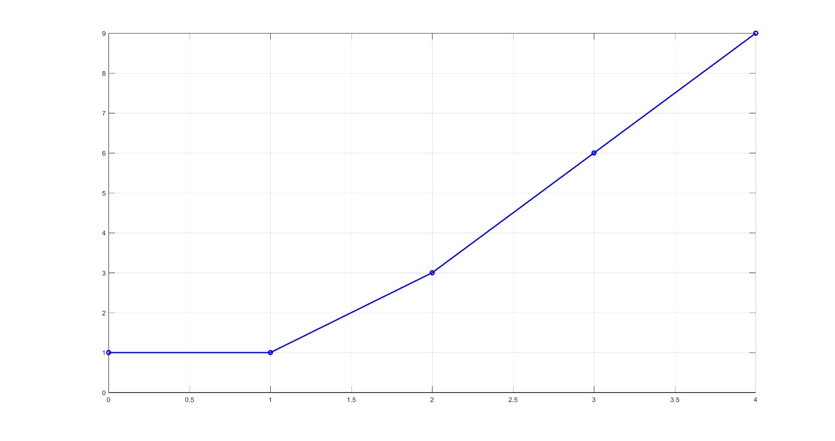

Regresia dvojparametrickou funkciou
$$t=\left(t_{1},t_{2},t_{3},...,t_{N}\right)$$
$$c_{1} \left\langle b_{1},b_{1}\right\rangle +c_{2}\left\langle b_{2},b_{1}\right\rangle =\left\langle f,b_{1}\right\rangle$$
$$f=\left(f_{1},f_{2},f_{3},...,f_{N}\right)$$
$$c_{1} \left\langle b_{1},b_{2}\right\rangle +c_{2}\left\langle b_{2},b_{2}\right\rangle =\left\langle f,b_{2}\right\rangle$$
Regresná priamka
$$t=\left(0,1,2,3,4 \right)$$
$$f=\left(1, 1, 3, 6, 9 \right)$$
$$f$$
$$y\left(t\right)=a+b.t$$
$b_{1}$ = (1,1,1,1,1)
$b_{2}$ = (0,1,2,3,4)

Slide 31
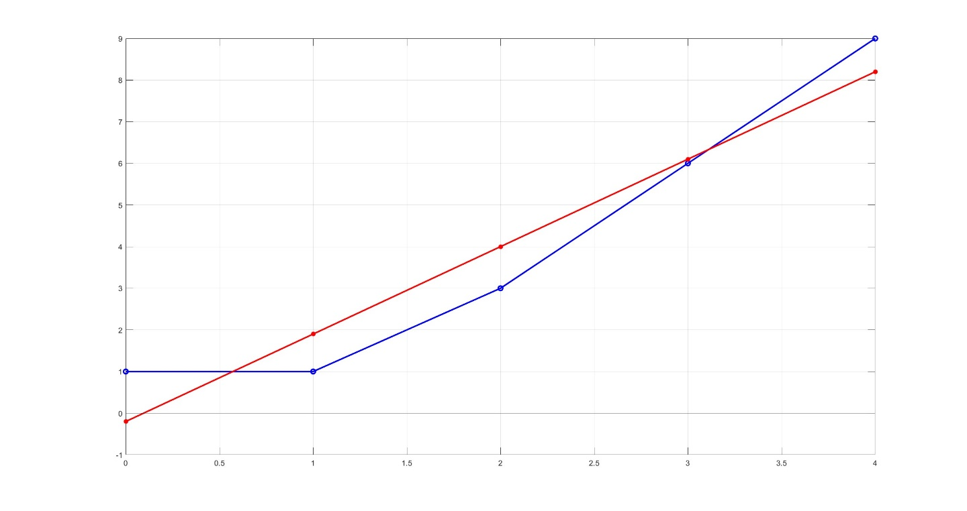

Regresia dvojparametrickou funkciou
$$t=\left(t_{1},t_{2},t_{3},...,t_{N}\right)$$
$$c_{1} \left\langle b_{1},b_{1}\right\rangle +c_{2}\left\langle b_{2},b_{1}\right\rangle =\left\langle f,b_{1}\right\rangle$$
$$f=\left(f_{1},f_{2},f_{3},...,f_{N}\right)$$
$$c_{1} \left\langle b_{1},b_{2}\right\rangle +c_{2}\left\langle b_{2},b_{2}\right\rangle =\left\langle f,b_{2}\right\rangle$$
Regresná priamka
$$t=\left(0,1,2,3,4 \right)$$
$$f=\left(1, 1, 3, 6, 9 \right)$$
$$f$$
$$y\left(t\right)=a+b.t$$
$b_{1}$ = (1,1,1,1,1)
$$\tilde{f}$$
$b_{2}$ = (0,1,2,3,4)

Slide 32
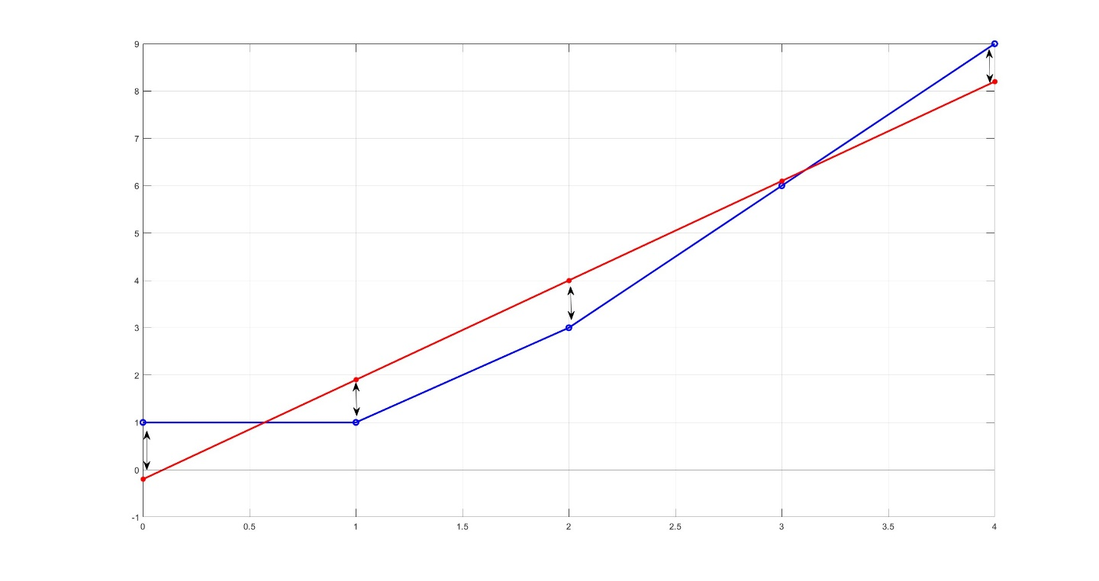

Regresia dvojparametrickou funkciou
$$t=\left(t_{1},t_{2},t_{3},...,t_{N}\right)$$
$$c_{1} \left\langle b_{1},b_{1}\right\rangle +c_{2}\left\langle b_{2},b_{1}\right\rangle =\left\langle f,b_{1}\right\rangle$$
$$f=\left(f_{1},f_{2},f_{3},...,f_{N}\right)$$
$$c_{1} \left\langle b_{1},b_{2}\right\rangle +c_{2}\left\langle b_{2},b_{2}\right\rangle =\left\langle f,b_{2}\right\rangle$$
Regresná priamka
$$t=\left(0,1,2,3,4 \right)$$
$$f\tilde{ − f}=(1.2, −0.9, −1,−0.1,0.8)$$
$$f=\left(1, 1, 3, 6, 9 \right)$$
$$f$$
$$y\left(t\right)=a+b.t$$
$b_{1}$ = (1,1,1,1,1)
$$\tilde{f}$$
$b_{2}$ = (0,1,2,3,4)

Slide 33
Lineárna regresia
Jednorozmerná lineárna regresia
viacparametrickými funkciami

Slide 34
Lineárna viacparametrická regresia
Regresná funkcia:

Slide 35
Lineárna viacparametrická regresia
Regresná funkcia:

Slide 36
Lineárna viacparametrická regresia
Regresná funkcia:

Slide 37
End

