Slide 1
Analýza procesov
Department of Information Networks
Faculty of Management Science and Informatics
University of Žilina
1. prednáška
Juraj Smieško

Slide 2











Vektorový priestor
A $=(3,2)$
$R$²
B $=(7,3)$
$$u=B −A$$
$$B$$
$=\left(7,3\right)−(3,2)$
$$A$$
$$u$$
$$=(4,1)$$
$$u$$
$$(0,0)$$

Slide 3







Vektorový priestor
$R$²
$$u=(4,1)$$
$$u$$
$$(6,5)$$
$$v=(2,4)$$
$$v$$
$$v+u=(6,5)$$
$$u$$
$$(0,0)$$

Slide 4






Vektorový priestor
$R$²
$$u=(4,1)$$
$$v=(2,4)$$
$$v$$
$$u−v=(2,−3)$$
$$u$$
$$(0,0)$$
-$v$
$$(2,−3)$$

Slide 5




Vektorový priestor
$R$²
$$u=(4,1)$$
$$v=(2,4)$$
$$−u$$
$$v$$
$$(−2,3)$$
$$u−v=(2,−3)$$
$$u$$
$$v−u=(−2,3)$$
$$(0,0)$$
-$v$
$$(2,−3)$$

Slide 6







Vektorový priestor
$R$²
$$u=(4,1)$$
$$z$$
$$v=(2,4)$$
$$1.5u$$
$$z=2u+1.5v$$
$$v$$
$$2u$$
$$u$$
$$(0,0)$$

Slide 7




Vektorový priestor
$R$²
$$u=(4,1)$$
$z$ = (11,8)
$$v=(2,4)$$
$$1.5u$$
$$z=2u+1.5v$$
$$=2∙(4,1)+1.5∙(2,4)$$
$$v$$
$$=(8,2)+(3,6)$$
$$=(11,8)$$
$$2u$$
$$u$$
$$(0,0)$$

Slide 8




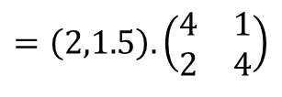
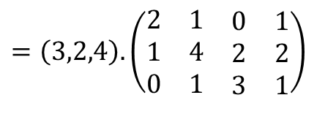




Vektorový priestor
$$u=(4,1)$$
$$v=(2,4)$$
$$z=2u+1.5v$$
$$=2∙(4,1)+1.5∙(2,4)$$
$$=\left(2,1.5\right).\left(\begin{matrix}4 & 1 \\ 2 & 4\end{matrix}\right)$$
$=\left(2∙4 +1.5∙2 ,2∙1 +1.5∙4\right)$ =
$$=\left( 11 ,8\right)$$
$$u=(2,1,0,1)$$
$$v=(1,4,2,2)$$
$$w=(0,1,3,1)$$
$$=\left(3,2,4\right). \left(\begin{matrix}2 & 1 & \begin{matrix}0 & 1\end{matrix} \\ 1 & 4 & \begin{matrix}2 & 2\end{matrix} \\ 0 & 1 & \begin{matrix}3 & 1\end{matrix}\end{matrix}\right)$$
$$z=3.u+2.v+4.w$$
$=3.(2,1,0,1)+2.(1,4,2,2)$ + 4.(0,1,3,1)

Slide 9



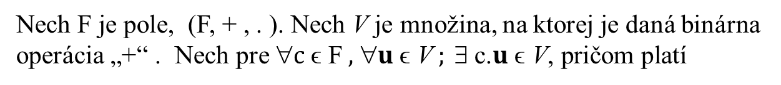





Vektorový priestor
Nech F je pole, (F, + , . ). Nech V je množina, na ktorej je daná binárna operácia „+“ . Nech pre ∀$c \text{ϵ} \text{F} \text{, }\text{∀}u \text{ϵ} \text{V} ; ∃ \text{c}\text{.} u \text{ϵ} \text{V}\text{, }\text{pri}\text{č}\text{om} \text{plat}\text{í}$
1. $\text{}u,v,\text{z} \text{ϵ} \text{V} ; u+(v+z)=u+(v+z)$
2. $ 0 \text{ϵ} \text{V}\text{ , }\text{∀}u \text{ϵ} \text{V} ; u+0=0$ + $u$ = $u$
3. $\text{}u \text{ϵ} \text{V} , ∃ v \text{ϵ} \text{V}\text{ ,} u+v=0$ = $v+u$
(V, „+“) je grupa
4. $\text{}u\text{, }v \text{ϵ} \text{V}\text{ ,} u+v$= $v+u$
(V, „+“) je komutatívna grupa
5.$\text{} c \text{ϵ} F ,\text{∀} u\text{, }v \text{ϵ} \text{V}\text{ ,} c.(u+v)$= $c.v+c.u$
6.$\text{} c, d \text{ϵ} F ,\text{∀} u \text{ϵ} \text{V}\text{ ,} (c.d).u$= $c.(d.u$)
7.$\text{} c, d \text{ϵ} F ,\text{∀} u \text{ϵ} \text{V}\text{ ,} (c+d).u$= $c.u+d.u$
8. $ 1 \text{ϵ} \text{F}\text{ , }\text{∀} u \text{ϵ} \text{V} ; 1.u=u$
Potom V je vektorovým priestorom na poľom F, značíme V(F)

Slide 10
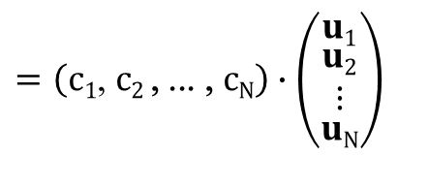


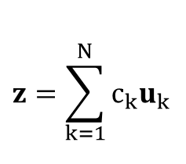

Lineárna nezávislosť
$$z=\sum_{k=1}^{N}{c_{k}u_{k}}$$
$$=\left(c1\text{, }c2 \text{, ... , }cN\right)∙\left(\begin{matrix}u1 \\ \begin{matrix}u2 \\ ⋮\end{matrix} \\ uN\end{matrix}\right)$$
$=c1.u1+$ $c2.u2$+ ... + $cN.uN$
$$=c∙U$$
vektor z je lineárnou kombináciou vektorov u_{k}
vektori z a u_{k} sú navzájom lineárne závislé
Vektori v_{k} sú lineárne nezávislé (LNZ), ak existuje iba triviálne (nulové) riešenia nasledujúcej rovnice:
$c1.v1+$ $c2.v2$+ ... + $cN.vN$ = 0
$c1.v1+$ $c2.v2$+ ... + $cN.vN$ = 0 ⇔ ∀ k; $ck$ = 0

Slide 11








Lineárna nezávislosť
$c1.v1+$ $c2.v2$ = 0
$R$²
$$v1=(4,1)$$
$$v2$$
$$v2=(8,2)$$
lineárne závislé
$$2.v1−v2=0$$
$$v1$$
$(c1 ,c2$) = (2,-1)
$$(0,0)$$
$$v2=2.v1$$

Slide 12




Lineárna nezávislosť
$c1.v1+$ $c2.v2$ = 0
$R$²
$$v1=(4,1)$$
$$v2$$
$$v2=(3,3)$$
lineárne nezávislé
$$0.v1+0.v2=0$$
$$v1$$
$(c1 ,c2$) = (0,0)
$$(0,0)$$

Slide 13










Lineárna nezávislosť
$c1.v1+$ $c2.v2 +$ $c3.v3$= 0
$R$²
$$v2$$
$$v1=(4,2)$$
$$v2=(3,3)$$
$$v3$$
$$v3=(8,7)$$
$c1.v1+$ $c2.v2 +$ $c3.v3$= 0
$$v1$$
$c1(4,2)+$ $c2(3,3)+$ $c3(8,7)=(0,0)$
$$(0,0)$$
$4c1+$ 3$c2+$ 8$c3=0$
$2c1+$ 3$c2+$ 7$c3=0$

Slide 14


Lineárna nezávislosť
$c1.v1+$ $c2.v2 +$ $c3.v3$= 0
$R$²
$$v2$$
$$v1=(4,2)$$
$$v2=(3,3)$$
$$v3$$
$$v3=(8,7)$$
$c1.v1+$ $c2.v2 +$ $c3.v3$= 0
$$v1$$
$c1(4,2)+$ $c2(3,3)+$ $c3(8,7)=(0,0)$
$$(0,0)$$
$4c1+$ 3$c2+$ 8$c3=0 /4$
$2c1+$ 3$c2+$ 7$c3=0 /2$

Slide 15

Lineárna nezávislosť
$c1.v1+$ $c2.v2 +$ $c3.v3$= 0
$R$²
$$v2$$
$$v1=(4,2)$$
$$v2=(3,3)$$
$$v3$$
$$v3=(8,7)$$
$c1.v1+$ $c2.v2 +$ $c3.v3$= 0
$$v1$$
$c1(4,2)+$ $c2(3,3)+$ $c3(8,7)=(0,0)$
$$(0,0)$$
$c1+$ 0.75$c2+$ 2$c3=0$
$2c1+$ 3$c2+$ 7$c3=0 /2$

Slide 16

Lineárna nezávislosť
$c1.v1+$ $c2.v2 +$ $c3.v3$= 0
$R$²
$$v2$$
$$v1=(4,2)$$
$$v2=(3,3)$$
$$v3$$
$$v3=(8,7)$$
$c1.v1+$ $c2.v2 +$ $c3.v3$= 0
$$v1$$
$c1(4,2)+$ $c2(3,3)+$ $c3(8,7)=(0,0)$
$$(0,0)$$
$c1+$ 0.75$c2+$ 2$c3=0$
$c1+$ 1.5$c2+$ 3.5$c3=0$

Slide 17
Lineárna nezávislosť
$c1.v1+$ $c2.v2 +$ $c3.v3$= 0
$R$²
$$v2$$
$$v1=(4,2)$$
$$v2=(3,3)$$
$$v3$$
$$v3=(8,7)$$
$c1.v1+$ $c2.v2 +$ $c3.v3$= 0
$$v1$$
$c1(4,2)+$ $c2(3,3)+$ $c3(8,7)=(0,0)$
$$(0,0)$$
$c1+$ 0.75$c2+$ 2$c3=0$
$c1+$ 1.5$c2+$ 3.5$c3=0$

Slide 18

Lineárna nezávislosť
$c1.v1+$ $c2.v2 +$ $c3.v3$= 0
$R$²
$$v2$$
$$v1=(4,2)$$
$$v2=(3,3)$$
$$v3$$
$$v3=(8,7)$$
$c1.v1+$ $c2.v2 +$ $c3.v3$= 0
$$v1$$
$c1(4,2)+$ $c2(3,3)+$ $c3(8,7)=(0,0)$
$$(0,0)$$
$c1+$ 0.75$c2+$ 2$c3=0$
0.75$c2+$ 1.5$c3=0$

Slide 19

Lineárna nezávislosť
$c1.v1+$ $c2.v2 +$ $c3.v3$= 0
$R$²
$$v2$$
$$v1=(4,2)$$
$$v2=(3,3)$$
$$v3$$
$$v3=(8,7)$$
$c1.v1+$ $c2.v2 +$ $c3.v3$= 0
$$v1$$
$c1(4,2)+$ $c2(3,3)+$ $c3(8,7)=(0,0)$
$$(0,0)$$
$c1+$ 0.75$c2+$ 2$c3=0$
0.75$c2+$ 1.5$c3=0 /0.75$

Slide 20





Lineárna nezávislosť
$c1.v1+$ $c2.v2 +$ $c3.v3$= 0
$R$²
$$v2$$
$$v1=(4,2)$$
$$v2=(3,3)$$
$$v3$$
$$v3=(8,7)$$
$c1.v1+$ $c2.v2 +$ $c3.v3$= 0
$$v1$$
$c1(4,2)+$ $c2(3,3)+$ $c3(8,7)=(0,0)$
$$(0,0)$$
$c1+$ 0.75$c2+$ 2$c3=0$
$c2+$ 2$c3=0$
$$c3=1,$$
$$c2=−2,$$
$$c1=−0,5$$

Slide 21




Lineárna nezávislosť
$c1.v1+$ $c2.v2 +$ $c3.v3$= 0
$R$²
$$v2$$
$$v1=(4,2)$$
$$v2=(3,3)$$
$$v3$$
$$v3=(8,7)$$
$c1.v1+$ $c2.v2 +$ $c3.v3$= 0
$$v1$$
$$0.5v1$$
$(c1 ,c2 ,c3$) = (-0.5 , -2, 1)
$$(0,0)$$
$−0.5v1−$ $2v2 +$ $1v3$= 0
$v3$= $0.5v1$+ $2v2$

Slide 22


Lineárna nezávislosť
$c1.v1+$ $c2.v2 +$ $c3.v3$= 0
$R$²
$$2v2$$
$$v1=(4,2)$$
$$v2=(3,3)$$
$$v3$$
$$v2$$
$$v3=(8,7)$$
$c1.v1+$ $c2.v2 +$ $c3.v3$= 0
$$v1$$
$$0.5v1$$
$(c1 ,c2 ,c3$) = (-0.5 , -2, 1)
$$(0,0)$$
$−0.5v1−$ $2v2 +$ $1v3$= 0
$v3$= $0.5v1$+ $2v2$

Slide 23

Lineárna nezávislosť
$c1.v1+$ $c2.v2 +$ $c3.v3$= 0
$$v3$$
$R$²
$$2v2$$
$$v1=(4,2)$$
$$v2=(3,3)$$
$$v2$$
$$v3=(8,7)$$
$c1.v1+$ $c2.v2 +$ $c3.v3$= 0
$$v1$$
$$0.5v1$$
$(c1 ,c2 ,c3$) = (-0.5 , -2, 1)
$$(0,0)$$
$−0.5v1−$ $2v2 +$ $1v3$= 0
$v3$= $0.5v1$+ $2v2$

Slide 24


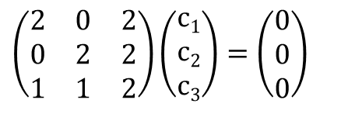

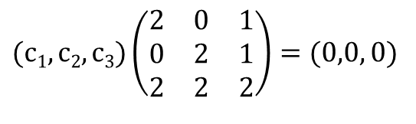



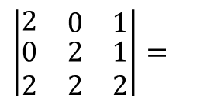

Lineárna nezávislosť
$c1.v1+$ $c2.v2 +$ $c3.v3$= 0
$$v1=(2, 0, 1)$$
$$\left|\begin{matrix}2 & \begin{matrix}0 & 1\end{matrix} \\ \begin{matrix}0 \\ 2\end{matrix} & \begin{matrix}\begin{matrix}2 & 1\end{matrix} \\ \begin{matrix}2 & 2\end{matrix}\end{matrix}\end{matrix}\right|=$$
$8+$ $0+$ $0 −4 −4 −0=0$
lineárne závislé
$$v2=(0, 2, 1)$$
$$v3=(2, 2, 2)$$
$$(c1,c2,c3)\left(\begin{matrix}2 & 0 & 1 \\ 0 & 2 & 1 \\ 2 & 2 & 2\end{matrix}\right)=(0,0, 0)$$
$c1(2, 0, 1)+$ $c2(0, 2, 1)+$ $c3(2, 2, 2)=(0,0, 0)$
$$\left(\begin{matrix}2 & 0 & 2 \\ 0 & 2 & 2 \\ 1 & 1 & 2\end{matrix}\right)\left(\begin{matrix}c1 \\ c2 \\ c3\end{matrix}\right)=\left(\begin{matrix}0 \\ 0 \\ 0\end{matrix}\right)$$
$2c1+$ 0$c2+$ 2$c3=0$
$0c1+$ 2$c2+$ 2$c3=0$
$c1+$ $c2+$ 2$c3=0$

Slide 25

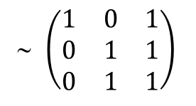



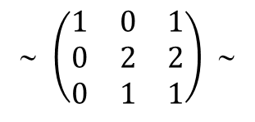

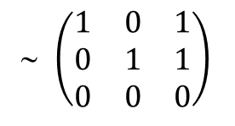

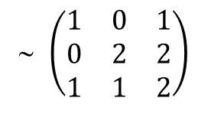

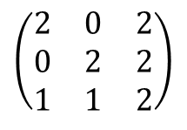



Lineárna nezávislosť
$c1.v1+$ $c2.v2 +$ $c3.v3$= 0
$$v1=(2, 0, 1)$$
$$\left|\begin{matrix}2 & \begin{matrix}0 & 1\end{matrix} \\ \begin{matrix}0 \\ 2\end{matrix} & \begin{matrix}\begin{matrix}2 & 1\end{matrix} \\ \begin{matrix}2 & 2\end{matrix}\end{matrix}\end{matrix}\right|=$$
$8+$ $0+$ $0 −4 −4 −0=0$
lineárne závislé
$$v2=(0, 2, 1)$$
$$v3=(2, 2, 2)$$
$c1(2, 0, 1)+$ $c2(0, 2, 1)+$ $c3(2, 2, 2)=(0,0, 0)$
$2c1+$ 0$c2+$ 2$c3=0$
$$\left(\begin{matrix}2 & 0 & 2 \\ 0 & 2 & 2 \\ 1 & 1 & 2\end{matrix}\right)$$
∼ $\left(\begin{matrix}1 & 0 & 1 \\ 0 & 2 & 2 \\ 1 & 1 & 2\end{matrix}\right)$
∼ $\left(\begin{matrix}1 & 0 & 1 \\ 0 & 2 & 2 \\ 0 & 1 & 1\end{matrix}\right)$ ∼
$0c1+$ 2$c2+$ 2$c3=0$
$c1+$ $c2+$ 2$c3=0$
∼ $\left(\begin{matrix}1 & 0 & 1 \\ 0 & 1 & 1 \\ 0 & 1 & 1\end{matrix}\right)$
∼ $\left(\begin{matrix}1 & 0 & 1 \\ 0 & 1 & 1 \\ 0 & 0 & 0\end{matrix}\right)$
$c1+$ $c3=0$
$c2+$ $c3=0$
$v3$= $v1+v2 ⇐$
$−v1−v2 +$ $v3$= 0 $⇐$
$$c3=1,$$
$$c1=−1,$$
$$c2=−1$$

Slide 26
to be continued

