Slide 1
An Introduction
Database systems

Slide 2
Information Engineering
Application modeling using information
Objects and relationships modeling
Data modeling with an independence of using it
Process modeling
Data analysis
Design of physical data implementation
Design of prototypes
Creation of tools for searching, generating,
…

Slide 3
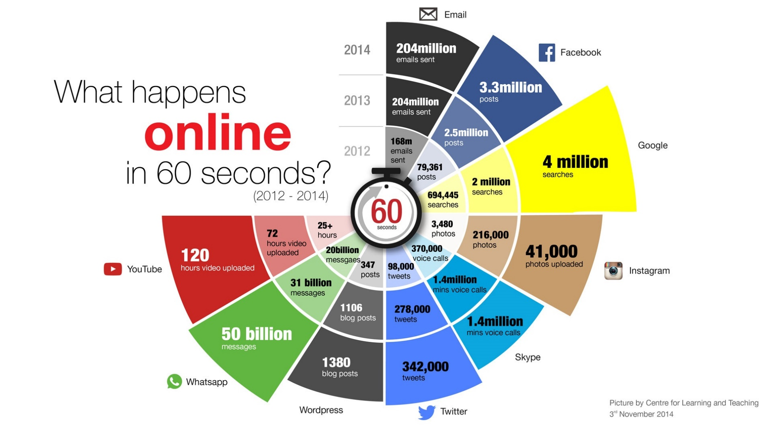
1 minute on the internet
http://edge.alluremedia.com.au/uploads/businessinsider

Slide 4
The Moore's Law of Big Data
It’s not simply computers generating terabytes of data, it’s all sorts of hardware, instruments, and sensors generating and collecting data.
One estimate finds a single Boeing jet engine generates 10 terabytes of information for each 30 minutes it operates. That means a single trans-Atlantic flight of a conventional passenger jet creates 640 terabytes of data.
In test and measurement applications, engineers and scientists can collect vast amounts of data every second of every day. For every second that the Large Hadron Collider at CERN runs an experiment, the instrument can generate 40 terabytes of data

Slide 5
Database technology
Database technology is the set of terms, means and techniques used mainly for the creation of information systems.
The essential feature of database technology is that it provides an INTERNAL representation (model) of the EXTERNAL world of interest.

Slide 6
Database systems – Evolution of Database systems
File systems
Navigational DBS
      Hierarchical DBS
      Network DBS
Relation DBS
Object oriented DBS
Object relation DBS
Retrieval information system – Textual Database System
Knowledge base systems
Expert systems
Real Time DBS
Temporal DBS
Spatial DBS
NoSQL DBS

Slide 7
DBS
Smaller and Smaller Systems
Bigger and Bigger Systems
Information Integration

Slide 8
Database system (DBS)
DBS is the set of related data with software for data processing.

Slide 9
Database system (DBS)
DBS is computerized record-keeping system with the following main functions:
  Adding new (empty) files to database;
  Inserting new data into existing files;
  Retrieving data from existing files;
  Updating data in existing files;
  Deleting data from existing files;
  Removing existing files permanently from database;

Slide 10
Example of data
rod_cislo | meno | priezvisko | ulica | obec | PSC | okres | st_ prisl
801106/3456 | Peter | Novák | Kamenná 27 | Banská Bystrica | 97401 | Banská Bystrica | SR
800312/7845 | Stanislav | Steinmüller | Zelená 9 | Nové Mesto nad Váhom | 91501 | Trenčín | SR
… | … | …. | … | … | . | . | .
755022/8569 | Erika | Lipovská | Priečna ulica 35 | Bytča | 01401 | Bytča | SR
831215/7539 | Peter | Malík | Tulská 56 | Banská Bystrica | 97401 | Banská Bystrica | SR

Slide 11
Example of data
rod_cislo | meno | priezvisko | ulica | obec | PSC | okres | st_ prisl
801106/3456 | Peter | Novák | Kamenná 27 | Banská Bystrica | 97401 | Banská Bystrica | SR
800312/7845 | Stanislav | Steinmüller | Zelená 9 | Nové Mesto nad Váhom | 91501 | Trenčín | SR
… | … | …. | … | … | . | . | .
755022/8569 | Erika | Lipovská | Priečna ulica 35 | Bytča | 01401 | Bytča | SR
831215/7539 | Peter | Malík | Tulská 56 | Banská Bystrica | 97401 | Banská Bystrica | SR
Name
Sreet
ZIP
Nationality
ID
Surname
Town
District

Slide 12
Inserting data about new person into table OS_udaje (about person)
INSERT INTO
os_udaje(rod_cislo, meno, priezvisko, ulica, obec, psc, okres, st_prisl)
VALUES (‘755806/7598’,’Ján’,’Mrkvička’,
‘Nábrežná12’,’Prievidza’,’97101’,’Prievidza’, ‘SR’);

Slide 13
Deleting data from the table with identification number 791229/5431
DELETE FROM os_udaje
WHERE rod_cislo = ‘ 791229/5431’;

Slide 14
Updating first name to ‘Karol’ of the man with identification number 831215/7539
UPDATE os_udaje
SET meno = ‘Karol’
WHERE rod_cislo = ‘831215/7539’;

Slide 15
List of identification numbers, names and surnames of the people from Žilina
SELECT rod_cislo, meno, priezvisko
FROM os_udaje
WHERE psc =‘01001’;

Slide 16
Example in Pseudocode (3GL)
program ou;
-- define object structure (Class, Record, …)
type tOs_udaje Object
rod_cislo : str[11];
meno: str[15];
priezvisko: str[15];
ulica: str[20];
mesto: str[20];
psc: str[5];
okres: str[20];
st_prisl: str[2];
end;
-- define file like the object stream
tfOs_udaje = FILE OF tOs_udaje;
var fOs_udaje: tfOs_udaje;

Slide 17
Example in Pseudocode (cont.)
-- Method for the insertion of object (record) into the stream (file)
procedure Insert_Ou(File:ftOs_udaje;Object :tOs_udaje);
New pom: tOs_udaje;
begin
FEXISTS(File);
if IOResult<>0 then CREATE(FILE);
while not eof(FILE) do begin
read(FILE,pom);
end;
write(FILE,pom);
close(FILE);
end;
--- Follow exceptions always and everywhere where is it possible

Slide 18
Example in Pseudocode (cont.2)
-- prepare data into the instance of the object
procedure Prepare_Object_Ou(FILE:ftOs_udaje);
new pom: tOs_udaje;
begin
with pom do begin
write('Rodne cislo: '); readln(rod_cislo);
write('Meno: '); readln(meno);
write('Priezvisko: '); readln(priezvisko);
write('Ulica: '); readln(ulica);
write('Obec: '); readln(obec);
write('PSC: '); readln(psc);
write('Statna prislusnost:');readln(st_prisl);
write('Okres: '); readln(okres);
end;
-- put data into the file
CALL Insert_Ou(FILE,pom);
end;
begin
– call procedures
end.

Slide 19
Database system (DBS)
Definition – (Engel)
Database system is the couple involving Database (DB) and Data Management System (DBMS)
We can write:
DBS = DB + DBMS

Slide 20
Database system (DBS)
Definition – (Date)
Database system is the quaternion (composed from four main components) :
    Data
    Hardware
    Software
    Users

Slide 21
Data, information, knowledge
Physically representation:
Numbers or Strings (Jozef, 65, 180)
Knowledge
Information
Data

Slide 22
Data, information, knowledge
Presented data:
Jozef is 180 cm high and he has 65 kg.
Physically representation:
Numbers or Strings (Jozef, 65, 180)
Knowledge
Information
Data

Slide 23
Data, information, knowledge
Patterns, rules, relationships, …:
Jozef is slim. (Man is slim if he has 180 cm and his weight is 65 kg).
Presented data:
Jozef is 180 cm high and he has 65 kg.
Physically representation:
Numbers or Strings (Jozef, 65, 180)
Knowledge
Information
Data

Slide 24
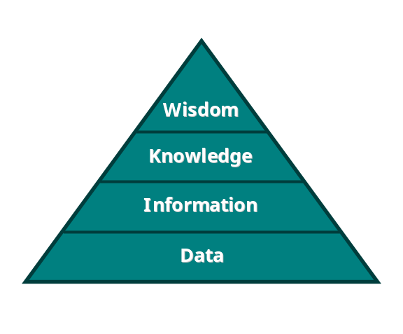
Hierarchy of information levels
Data - facts without simple relation to the meaning and other relations
Information – is developed from data by adding some semantics and relationships
Knowledge - what is known in a particular field or in total; facts and information through experience or education;
Wisdom is the ability to effectively and efficiently apply perceptions and knowledge and so to produce the desired results.

Slide 25
Data
Definition - Data
Data are values physically recorded in databases representing some facts, messages etc. (technical, economics, administrative, financial, statistic, …)which are able proceeded by technical means.
♦

Slide 26
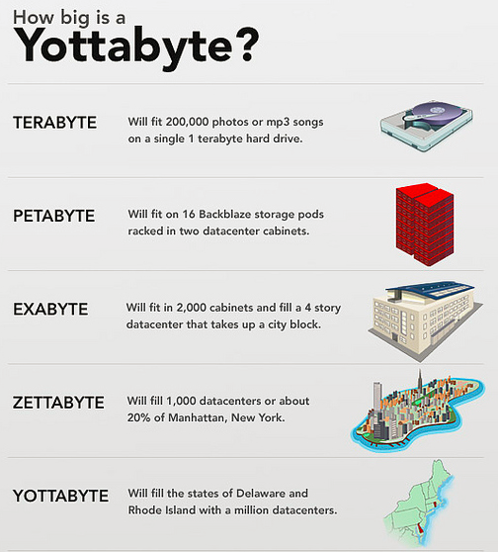
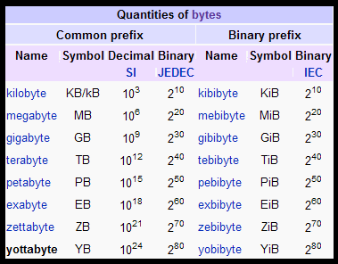
How and where to store information?

Slide 27
How Big is Big Data?
Byte of data: one grain of rice
Kilobyte: cup of rice
Megabyte: 8 bags of rice
Gigabyte: 3 container lorries
Terabyte: 2 container ships
Petabyte: covers Manhattan
Exabyte: covers the UK (3 times)
Zettabyte: fills the Pacific ocean

Slide 28
Information object | How many bytes
Binary information | 1 bit
Simple character | 1 byte
Typical word | 10 bytes
Typical page of the text | 2 kilobyte s ( KB s)
Simple photo | 100 kilobytes
Short novel | 1 megabyte ( MB )
Photo with great resolution | 2 megabytes
All from Shakespeara | 5 megabytes
One minute HIFI music | 10 megabytes
One Meter books | 100 megabytes
Full car of books | 1 gigabyte GB )
Everything from Beethoven | 20 gigabytes
One floor full of journals | 100 gigabytes
50,000 trees proceeded into paper | 1 terabyte ( TB )
Academic library | 2 terabytes
U.S. Library of Congress | 10 terabytes
Database of National Climactic Data Center | 400 terabytes
All academic libraries in USA | 2 petabytes
Everything printed in the world | 200 petabytes
All words using by people | 5 exabytes

Slide 29
Mobile Data Traffic, Worlwide 2013-2016
Year | 2013 | 2014 | 2015 | 2016
Total Terabytes | 19,049,158 | 32,512,824 | 51,820,492 | 79,527,408
Growth (%) | 80 | 71 | 59 | 53
Source: Gartner ()

Slide 30
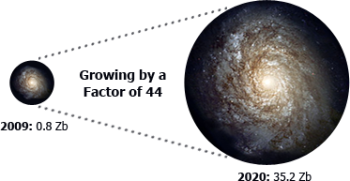
Data Growth is exponential

Slide 31
Persistent data
Definition –
Persistent data exists after finishing program.
♦

Slide 32
Input data
Definition-
Input data represents information entry into to the system.
♦

Slide 33
Output data
Definition
Output data represents information issued from system.
♦

Slide 34
Database
Definition
Database is the set of persistent data using in an application system for enterprice, factory, …
♦

Slide 35
Characteristic of data
        Sharable
        Integrable

Slide 36
Representation of data
Numerical types
Strings
Code lists
BLOB
Be careful with :
Derived data
- Units

Slide 37
Hardware
Most important parts of hardware influencing database system
  Storage media
  Procesor
  Internal memory
  Communication subsystem

Slide 38
Software
Software for data processing in Database is Database Management System-(DBMS, SRBD(in Slovak)).
All requests from users for access to the database are handled by DBMS:
  Creating files
  Inserting data
  Retrieving data
One of general function of DBMS is shielding of database from hardware level details
Basic functions :
    Data definition
    Data manipulation
    Data integrity
    Data security

Slide 39
Users
Classification of users in database systems:
  End users
  Application programmers
  DBA – database administrator

Slide 40
Objectives of DBS
Separate data definition from statements for manipulation with data
Data independence (logical, physical)
Procedural and nonprocedural interface
Redundancy can be reduced
Inconsistency can be avoided
The data can be shared
Security restrictions can be applied
Integrity can be maintained

Slide 41
Advantages of DBS
Compactness
No need paper documents
Speed, Less drudgery
Retrieving and storing data are very quickly
Availability (Currency)
Accurate, up-to-date information are available on demand at any time

Slide 42


UNIVERSITY OF ZILINA
FACULTY OF MANAGEMENT SCIENCE AND INFORMATICS
DEPARTMENT OF INFORMATICS
Univerzitna 8215/1SK-01026, Zilina, Slovak Republic
Phone: +421-41-513 4040
Fax: +421-41-513 4055
Homepage: http://www.fri.uniza.sk
Introduction
The Department of Informatics comprises around 20 academics and research fellows who form research community in Computer Science. Its complement of people directly involved in research is close to 50. The Department is strongly involved in many practical collaborative industry projects and research projects on national and international level.
Research
Research addresses the fundamentals of computer systems, architectures, database systems and information analysis. The key research topics cover distributed and parallel systems and advanced database systems.
doc. Ing. Michal Kvet, PhD.
Michal.Kvet@fri.uniza.sk
Department of Informatics
Faculty of Management Science and Informatics
University of Zilina

