Slide 1
An Architecture for the DBS

Slide 2
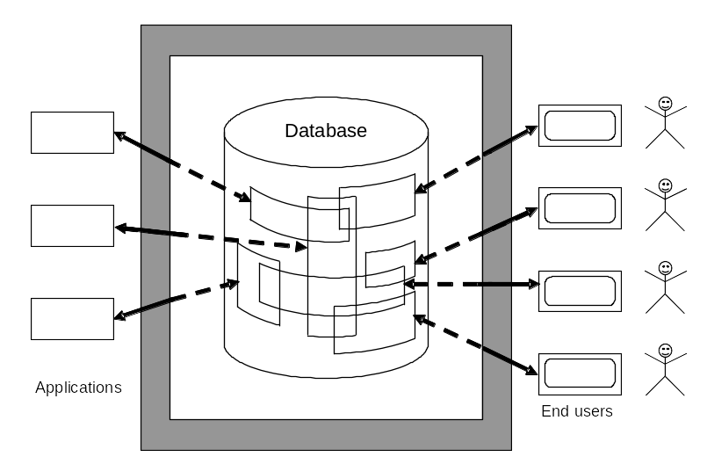

Slide 3
Architectural levels
ANSI/SPARC architecture is divided to three levels:
  External
  Conceptual
  Internal

Slide 4
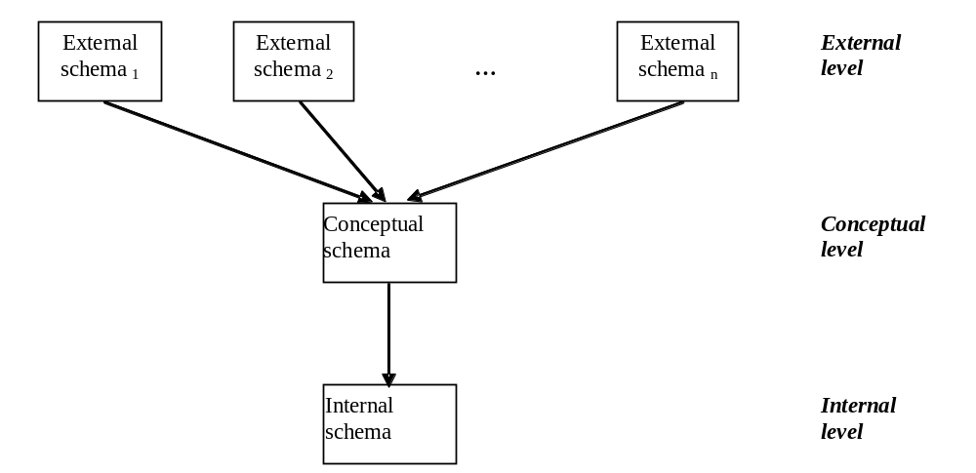
Architecture of the DBS

Slide 5
Definition - Schema
The Schema is specific set of data describing application data model or its part.
♦

Slide 6
Definition - Subschema
Subschema is subset of the schema.
♦

Slide 7
Definition - External schema
The External schema is the implementation independent set of data describing users views in the application.
♦

Slide 8
Definícia -
Conceptual schema is the implementation independent set of data describing data model of the application.
♦

Slide 9
Definition - Internal schema
The Internal schema is the implementation dependent set of data describing data structures and access methods to the stored data in external memory of DBS.
♦

Slide 10
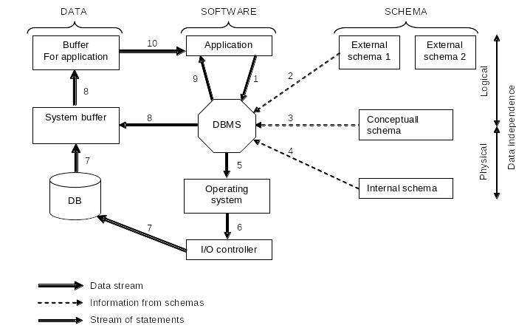
Example request for READ operation

Slide 11


UNIVERSITY OF ZILINA
FACULTY OF MANAGEMENT SCIENCE AND INFORMATICS
DEPARTMENT OF INFORMATICS
Univerzitna 8215/1SK-01026, Zilina, Slovak Republic
Phone: +421-41-513 4040
Fax: +421-41-513 4055
Homepage: http://www.fri.uniza.sk
Introduction
The Department of Informatics comprises around 20 academics and research fellows who form research community in Computer Science. Its complement of people directly involved in research is close to 50. The Department is strongly involved in many practical collaborative industry projects and research projects on national and international level.
Research
Research addresses the fundamentals of computer systems, architectures, database systems and information analysis. The key research topics cover distributed and parallel systems and advanced database systems.
doc. Ing. Michal Kvet, PhD.
Michal.Kvet@fri.uniza.sk
Department of Informatics
Faculty of Management Science and Informatics
University of Zilina
Strana <number>

