Slide 1
DBMS – Database Management System

Slide 2
Definition-
Database Management System
DBMS is the set of programs satisfying manipulation of data, security of data, parallel processing of data, etc.
♦

Slide 3
Basic tasks of the DBMS
Definition of data
Manipulation with data

Slide 4
Additional functions of DBMS
Access control
Integrity control
Recovery of database
Parallel access to data
Security of data
Catalog control

Slide 5
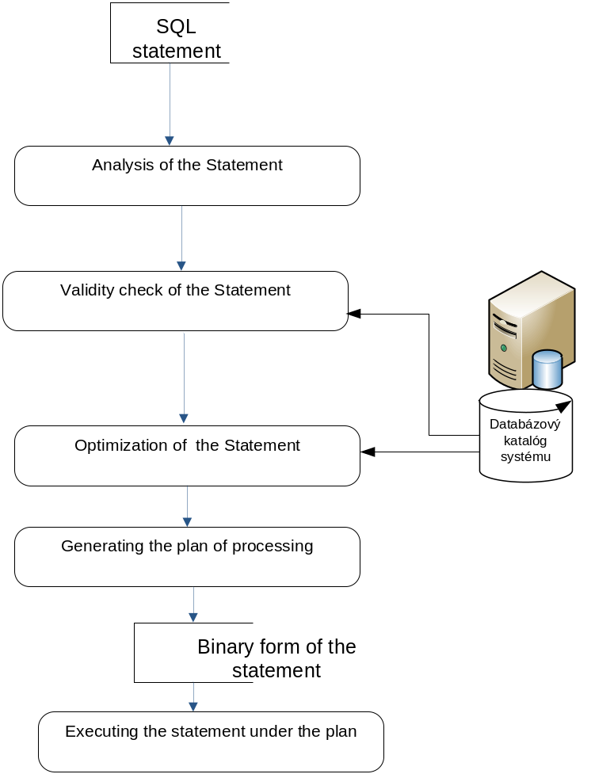
Processing SQL request

Slide 6
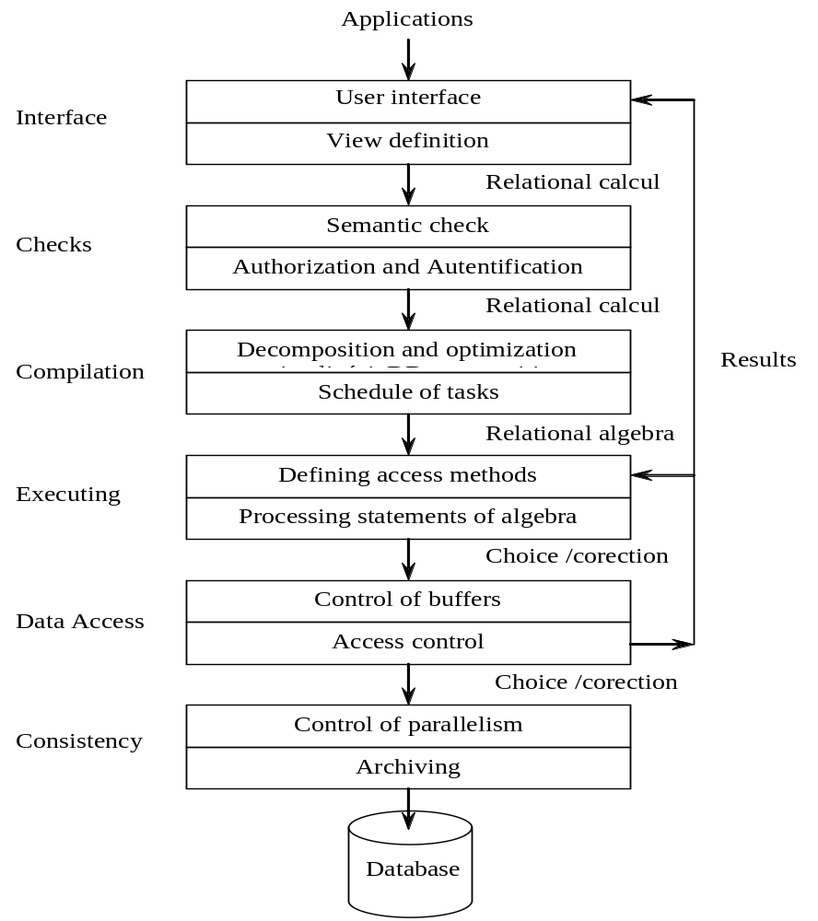

Slide 7
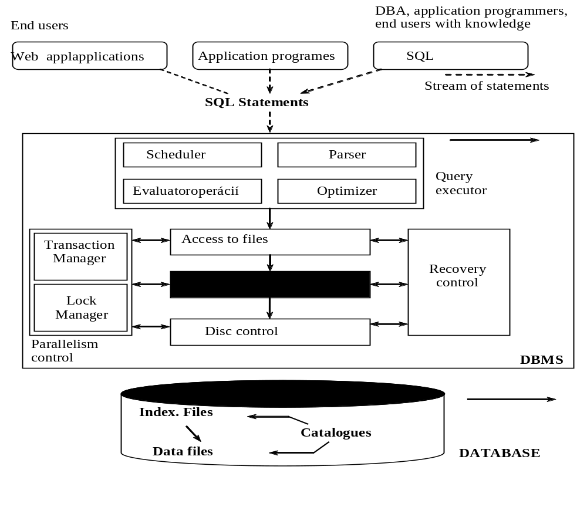

Slide 8
Architectures of DBMS
Computer systems with DBS can be divided into following architectures:
  Filed oriented
  Centralized
  Multilevel (for example. client/server)
  Distributed

Slide 9
Kind of services
Presentation services
Presentation logic
Logic of application
Logic of data
Data services
File services

Slide 10
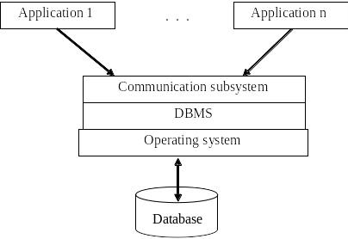
Centralized architecture

Slide 11
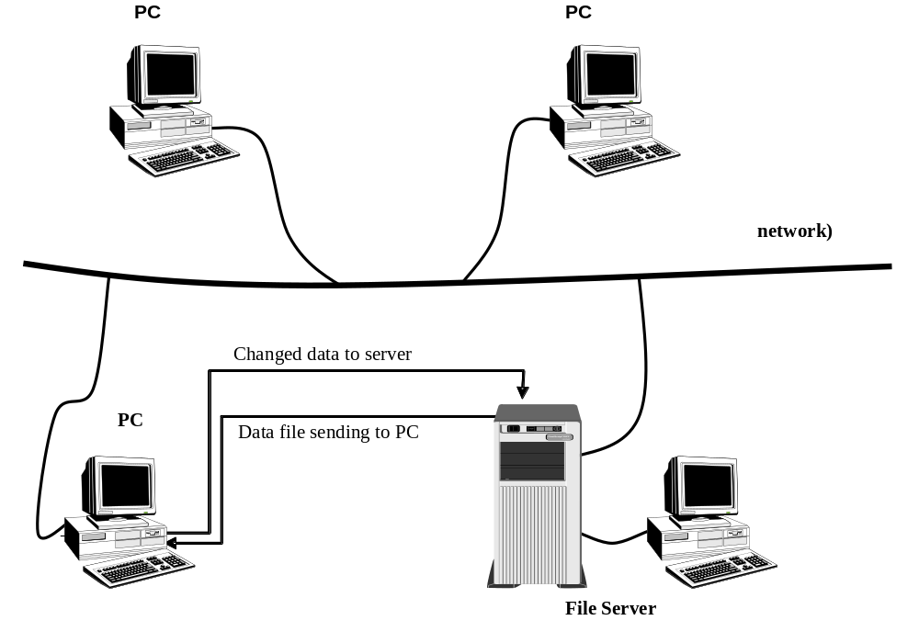
File systems

Slide 12
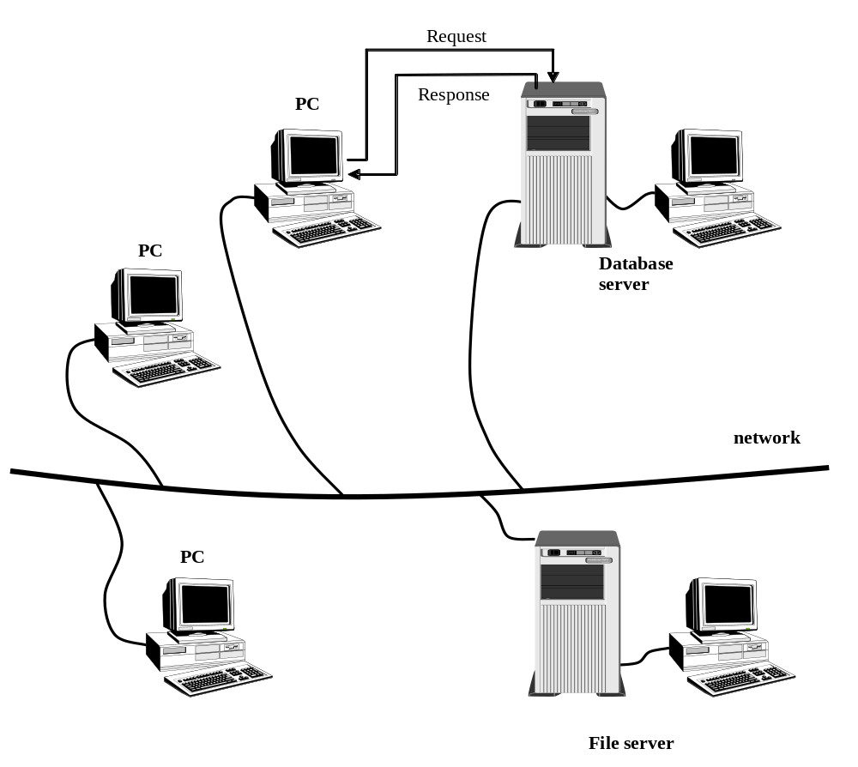
Client / server architecture

Slide 13
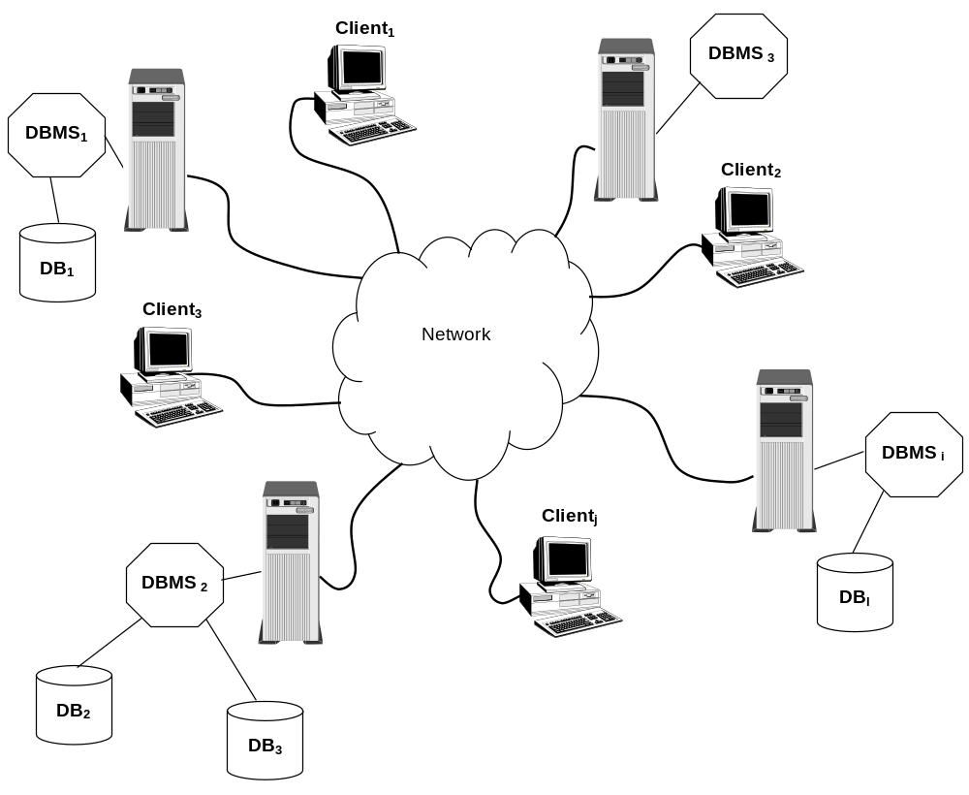
Distributed database system

Slide 14


UNIVERSITY OF ZILINA
FACULTY OF MANAGEMENT SCIENCE AND INFORMATICS
DEPARTMENT OF INFORMATICS
Univerzitna 8215/1SK-01026, Zilina, Slovak Republic
Phone: +421-41-513 4040
Fax: +421-41-513 4055
Homepage: http://www.fri.uniza.sk
Introduction
The Department of Informatics comprises around 20 academics and research fellows who form research community in Computer Science. Its complement of people directly involved in research is close to 50. The Department is strongly involved in many practical collaborative industry projects and research projects on national and international level.
Research
Research addresses the fundamentals of computer systems, architectures, database systems and information analysis. The key research topics cover distributed and parallel systems and advanced database systems.
doc. Ing. Michal Kvet, PhD.
Michal.Kvet@fri.uniza.sk
Department of Informatics
Faculty of Management Science and Informatics
University of Zilina
Strana <number>

