Slide 1
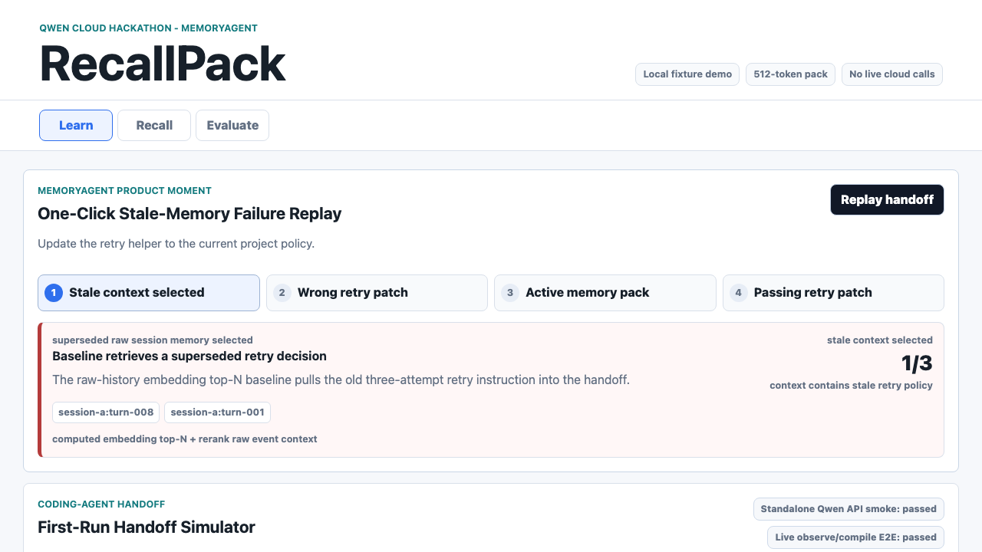
QWEN CLOUD GLOBAL AI HACKATHON | MEMORYAGENT
RecallPack
Stale-aware memory lifecycle
for coding-agent handoffs
When a project reverses a decision, a fresh agent must not keep treating the old decision as active.
Local deterministic replay; source-backed synthetic scenario
remember -> supersede -> recall under a fixed budget
RecallPack: stale-decision exclusion before a handoff is compiled
1

Slide 2
THE PROBLEM
The stale decision can win before the agent reasons
The source-backed ProjectOdyssey fixture contains an older workaround and a later reversal. Under a fixed handoff budget, retrieval can surface the older policy before the fresh agent sees the correction.
ONE HANDOFF, TWO POLICIES
fixed handoff budget
1 Earlier policy
Retry with old workaround
Superseded
2 Later reversal
Use current retry policy
Active
3 Naive retrieval
selects the old policy
Wrong patch risk
The agent reasons after retrieval; it may never see the later reversal.
Failure class: the stale policy is selected before reasoning begins.
Scenario boundary: source-backed synthetic fixture, not a production trace
2

Slide 3
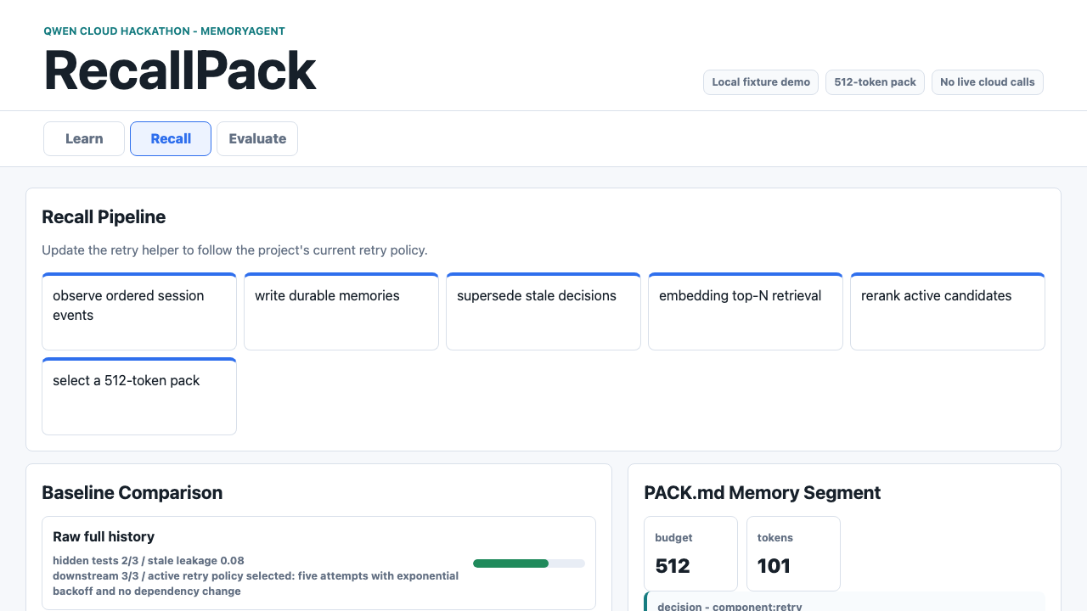
THE PRODUCT
Lifecycle status is set before the handoff is packed
/observe
When old and new decisions co-occur, the provider path proposes memory decisions and the runtime persists active versus superseded state.
/compile
text-embedding-v4 retrieves candidates, qwen3-rerank improves precision, and the deterministic selector packs only active task-relevant memory.
Public demo: credential-free deterministic providers. Stored Qwen traces are separate integration evidence.
Lifecycle is a write-time fact; relevance is resolved at recall time
3

Slide 4
THE EVIDENCE
The replay shows a failure class, not a benchmark result
The downstream check is a real temp-repo patch plus hidden fixture tests. The comparison is deliberately bounded: it shows what happens when stale context enters a constrained handoff, not a live failure rate or universal retrieval claim.
1/3
3/3
8
Baseline fixture tests when stale context drives the patch
RecallPack fixture tests when active memory drives the patch
Curated lifecycle fixtures; mechanism coverage, not a broad benchmark
Stored live raw-history baseline traces selected the active policy on a small fixture. That adverse result is disclosed rather than hidden.
Authored deterministic replay + source-backed fixture provenance + stored live integration traces
4

Slide 5
QWEN CLOUD BOUNDARY
Qwen decides semantics; code enforces contracts
Qwen model work
MODEL WORK
DETERMINISTIC RUNTIME
Memory decision and supersession judgment
text-embedding-v4 candidate retrieval
qwen3-rerank precision improvement
Qwen text model
Memory decision
Supersession judgment
text-embedding-v4
qwen3-rerank
Retrieve and rank
candidates
Normal code
Order events
Filter lifecycle
Select 512-token budget
Assemble pack
Deterministic runtime work
Event ordering, lifecycle filtering, token accounting, budget selection, pack assembly, and test execution stay reviewable in normal code.
Sanitized provider traces make the model boundary reviewable; normal code remains deterministic.
Stored live provider-path traces are integration evidence, not a statistical benchmark
5

Slide 6
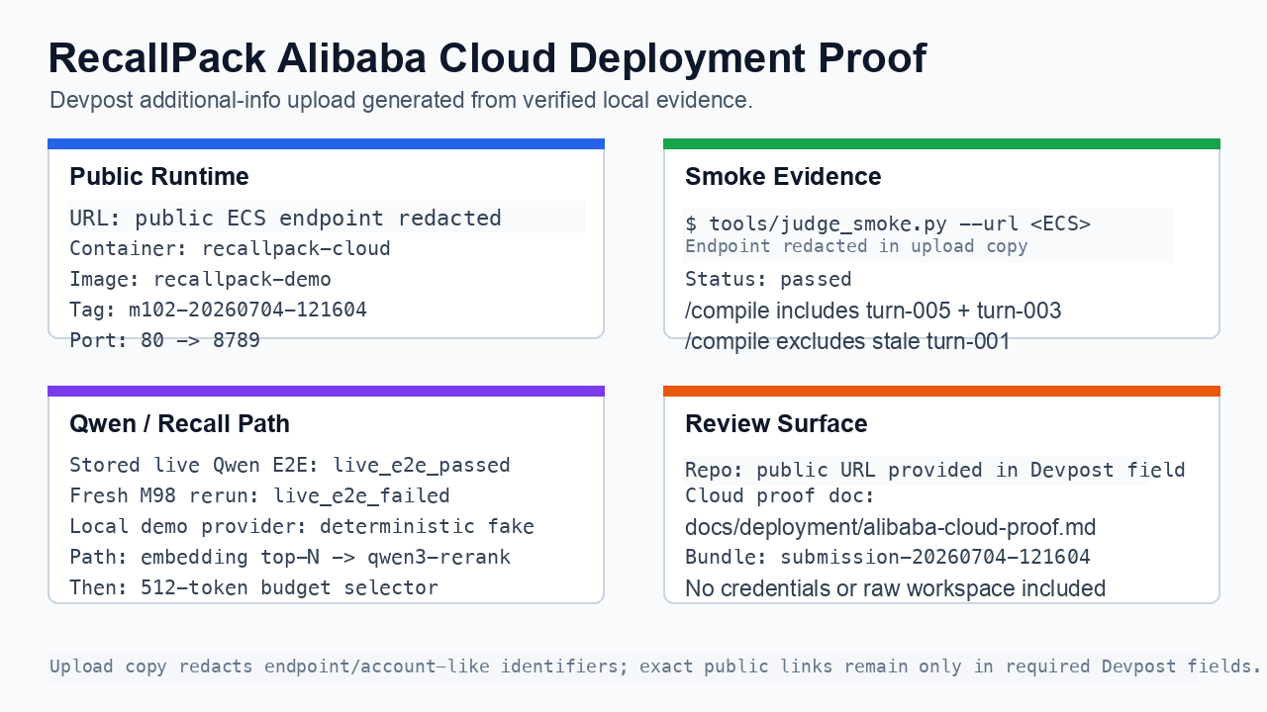
JUDGE PATH
A judge can replay the product and inspect its limits
What is ready to inspect
Sanitized source bundle
Fresh-clone smoke, local demo, and judge smoke
585 local tests in final verification
Credential-free public replay surface
Bounded claims: no universal retrieval superiority, no guaranteed live downstream success, and no claim that the source-backed fixture is production-trace evidence.
RecallPack makes stale-decision exclusion structural before a fresh coding agent starts reasoning.
Deployment visual is redacted; no credentials, private paths, or personal account data included
6

