Slide 1

Mini-Projet
C++
DEMINGEON Cyril
Campus-Booster ID : 125827
Notes:
[Title of the course]
Copyright © 2004-2005 NameOfTheOrganization. All rights reserved.

Slide 2
Introduction
Mini-Projet C++
Notes:
[Title of the course]
Copyright © 2004-2005 NameOfTheOrganization. All rights reserved.

Slide 3

Sujet
Introduction
Jeu multijoueur
Jeu d’encadrement
Programme en console
Notes:
[Title of the course]
Copyright © 2004-2005 NameOfTheOrganization. All rights reserved.

Slide 4
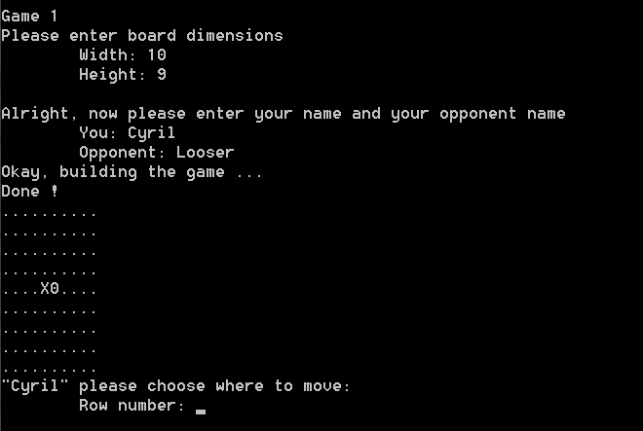
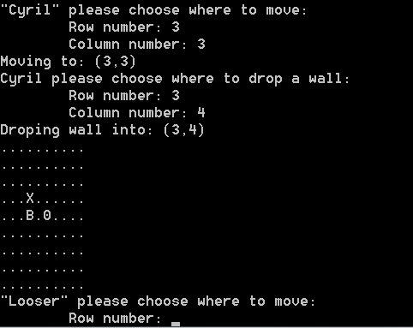
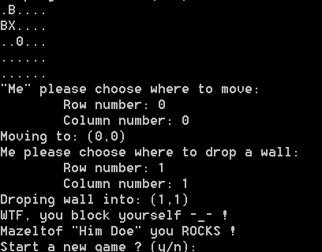
Réalisation
Introduction
Notes:
[Title of the course]
Copyright © 2004-2005 NameOfTheOrganization. All rights reserved.

Slide 5
Code
Mini-Projet C++
Notes:
[Title of the course]
Copyright © 2004-2005 NameOfTheOrganization. All rights reserved.

Slide 6
Classes
Code
Les différentes classes du programme:
game
Regroupe et initialiase les autres classes
piece
Représente une piece de l’un des joueurs
board
Gère le plateau de jeu
people
Entitée possédant un nom et un prénom
player
People jouant au jeu
Notes:
[Title of the course]
Copyright © 2004-2005 NameOfTheOrganization. All rights reserved.

Slide 7
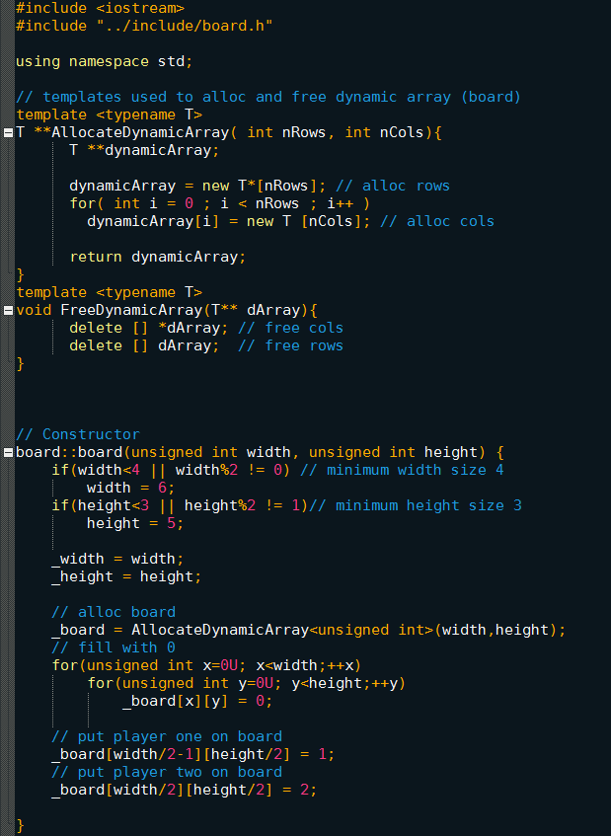
Détails
Code
Board.cpp
Constructor
Notes:
[Title of the course]
Copyright © 2004-2005 NameOfTheOrganization. All rights reserved.

Slide 8
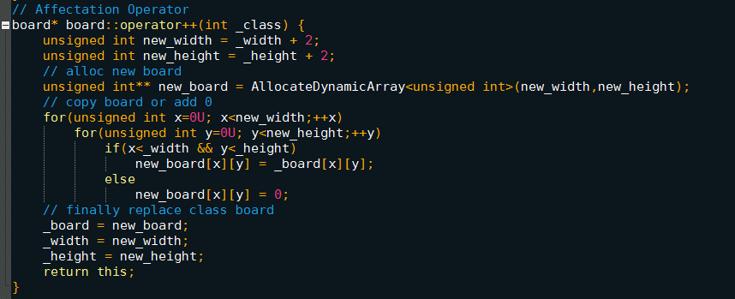
Détails
Code
Opérateur ++ sur une class board
Notes:
[Title of the course]
Copyright © 2004-2005 NameOfTheOrganization. All rights reserved.

Slide 9
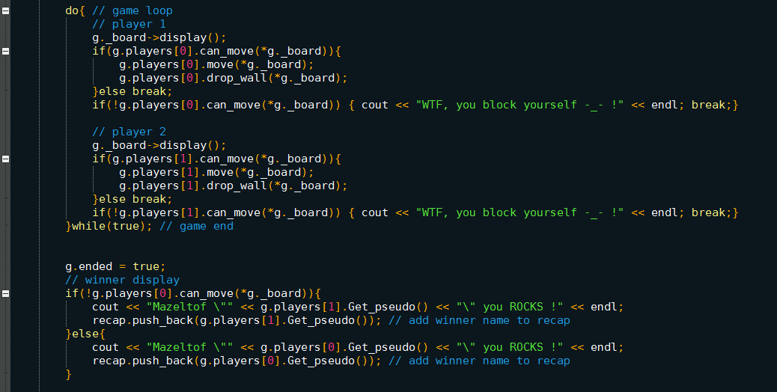
Détails
Code
Boucle de jeu principale
Notes:
[Title of the course]
Copyright © 2004-2005 NameOfTheOrganization. All rights reserved.

Slide 10
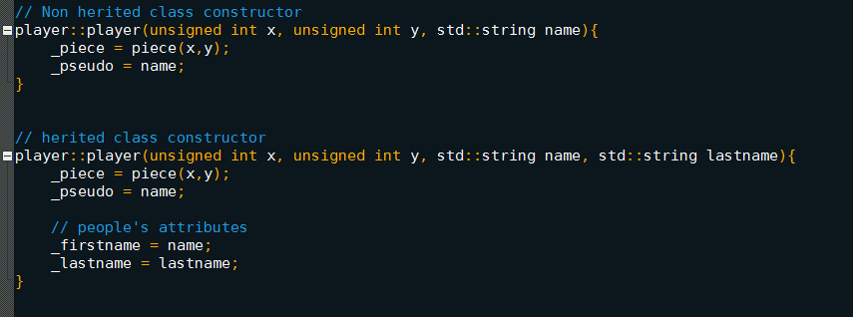
Détails
Code
Players.cpp
Herité VS non herité
Notes:
[Title of the course]
Copyright © 2004-2005 NameOfTheOrganization. All rights reserved.

Slide 11


The end
Mini-Projet C++
Notes:
[Title of the course]
Copyright © 2004-2005 NameOfTheOrganization. All rights reserved.

