Slide 1
Implementation and Evaluation of asynchronous MAC protocols for
2.4 GHz lora
Progress presentation
Louka Grignard
Notes:
The goal of this thesis is to implement an RDC layer into contiki-ng and evaluate the performance of several RDC protocols for the SX1280 radio which is a 2.4 GHz LoRa radio.

Slide 2
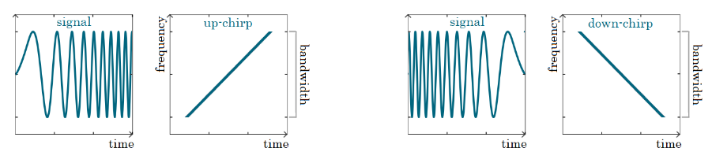
LoRa
Long Range, Wireless modulation technique based on CSS technology
Sweep between 2 frequencies
High SF:
  Slow signal
  Low data rate
  high power consumption
  more reliable, less influenced by noise
Taken from: https://blog.ttulka.com/lora-spreading-factor-explained/
Notes:
Lets start off by taking a look at LoRa. LoRa, which stand for Long Range, is a wireless modulation technique based on the Chirp Spread Spectrum(CSS) technology.
It works by sweeping the signal between a lower and an upper frequency over a certain time period. On the left we see an up chirp which increases the frequency and on the right a down chirp which decreases the frequency.
An important parameter of LoRa is the Spreading Factor. This is the speed at which the signal frequency changes. A higher spreading factor means a slower sweep and thus a lower data rate.
A signal with a higher SF is easier to receive and distinguish from noise. On the other hand, a slower signal means a longer time on air which uses more power.

Slide 3
Lora vs lora 2.4 GHz
 | Sub GHz LoRa(Europe) | LoRa 2.4 GHz
Free license ISM band | 433 MHz and 868 MHz | 2.4 GHz
Bandwidth | 125 kHz or 250 kHz | Also 1625 kHz
Duty cycle per day | Max 1% = 36s/h | Unlimited
Max datarate | ~10 kbps | ~250 kbps
Notes:
Every region of the world has several free ISM(Industrial, Scientific and Medical) bands. These bands do not require a license but sometimes have restrictions. In europe there are 2 sub GHz bands, 433 MHz and 868 MHz. There is also the 2.4 GHz band which is available over the entire world, unlike the sub GHz bands which differ per region. This means the 2.4 GHz LoRa radio requires 1 chip which can be used globally while the sub GHz LoRa chip is different for every region and can only be used inside that region.
The next difference is the bandwidth you can use. For sub GHz LoRa you can choose 125 kHz or 250 kHz (in europe) and for 2.4 GHz LoRa we can also choose 1625 kHz.
Another big difference is that sub GHz LoRa has a maximum allowed duty cycle of 1%. This means it cannot send for more the 1% of the time which is equal to 36s per hour. The 2.4 GHz band does not have this restriction.
Finally, there is also a big difference in max possible data rate. While sub GHz LoRa cannot go higher the 10 kbps under ideal curcomstances, 2.4 GHz LoRa is able to go up to 250 kbps.

Slide 4
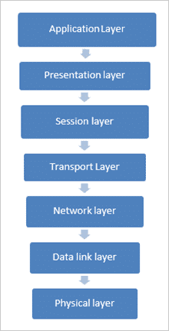
RDC protocols
Radio Duty Cycling = turn radio on/off
Reduce power consumption => great for battery powered devices
Example: ContikiMAC
RDC Layer
Notes:
Next lets take a look at what an RDC protocol is and how it can help us. RDC stands for Radio Duty Cycling protocol which means it is a protocol responsible for turning the radio on and off. In theory a radio should only be on while it is sending or receiving a packet but in practice we do not known when a packet should be received. This is where a good RDC protocol comes in to balance the power usage and latency.
The RDC layer lies between the data link layer and the physical layer.
An example of a good RDC protocol is contikiMAC. This is the working of a unicast message in contikiMAC

Slide 5
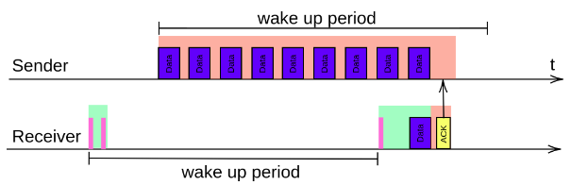
contikiMAC
Unicast
Sender sleep until it has to send
Receiver wakes up once a period, default = 125 ms
Receiver does double CCA
Sender sends for 1 whole period + 1 packet or until ACK is received
Broadcast => same but always send for whole period and no ACK send
Notes:
Next lets take a look at what an RDC protocol is and how it can help us. RDC stands for Radio Duty Cycling protocol which means it is a protocol responsible for turning the radio on and off. In theory a radio should only be on while it is sending or receiving a packet but in practice we do not known when a packet should be received. This is where a good RDC protocol comes in to balance the power usage and latency.
An example of a good RDC protocol is contikiMAC. This is the working of a unicast message in contikiMAC

Slide 6
contikiMAC
Timing requirements:
  Time to send smallest packet > Time of 2 CCA + time between 2 CCA
  Time between 2 CCA > time between 2 packets
  Time between 2 packets > time between receiving packet and sending ACK + time to detect ACK
Several techniques used to improve the protocol
  Packet detection and fast sleep
  Transmission phase lock
ContikiMAC for LoRa:
  No CCA but CAD
Notes:
ContikiMAC is one of the more complex RDC protocols. It has some very strict timing requirements. You can also implement more advanced techniques like packet detection and fast sleep. This technique uses the knowledge of the strict timing requirements to determine wether there is actually a packet being received. If 1 of the timing rules is being broken that means there was a false positive by the CCA and the receiver will go back to sleep.

Slide 7
State of the project
Driver for 2.4 GHz LoRa radio for contiki-ng
rdc.h defines RDC protocol structure
  Init
  Send
  Send_list
  Input
  On
  Off
Configuring MAKE file to allow commands like MAKE_RDC = MAKE_RDC_CONTIKIMAC
Setup log module for RDC to allow for easier debugging
Implement first RDC protocol: NULLRDC => does nothing, radio always on
Next steps:
  Fix 2.4 GHz LoRa driver: not automatically handling incoming packets
  Implement more advanced RDC protocol and analyse it
Notes:
Now we will look at the current state of the project. The radio I will be using is the sx1280 which is a 2.4 GHz LoRa radio. It is not officially supported by contiki so I need a custom driver to make it work. Luckily this part was done by 2 previous students.
The next step is to implement the basic structure of the RDC layer. For this part I made use of the previous version of contiki-ng which is called contiki-os. This version still had an RDC layer. When they created contiki-ng they removed the RDC layer but they hardcoded nullRDC into CSMA. This meant I could use contiki-os to understand how the RDC layer should be implemented why
This is done by creating a RDC.h file. This file defines the general structure for an RDC protocol.

Slide 8
Thank you

