Slide 1
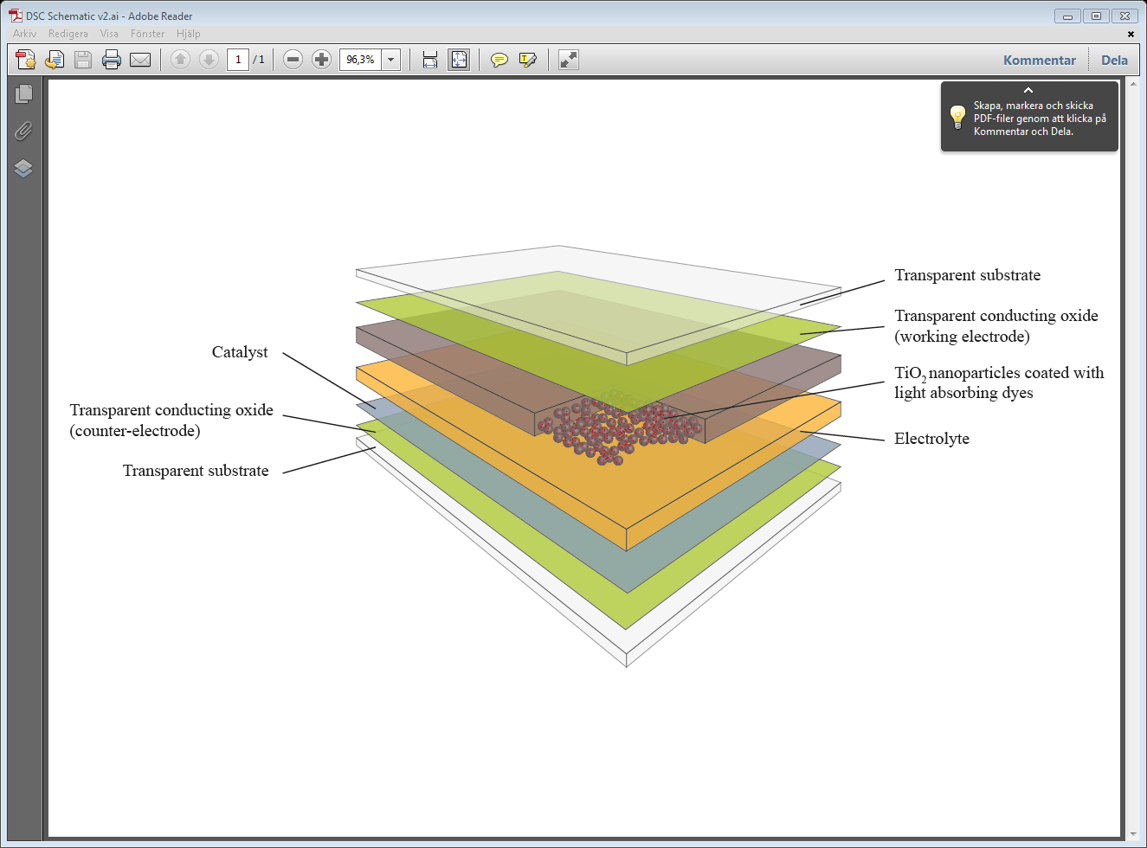
Transparent substrate
Catalyst
Transparent conducting oxide (Working Electrode)
Transparent conducting oxide (Counter Electrode)
TIO₂ nanoparticles coated with light absorbing dyes
Electrolyte
Transparent substrate

Slide 2
Working Electrode
Light (Natural / Artificial)
Counter Electrode
e
TiO₂
3I⁻
LUMO
e
e
e
I₃⁻
e
Electrolyte
e
e
e
HOMO
e
e
DYE
e
e
e
e
e

Slide 3
Performance
World
record
efficiency
Module
efficiency
Sensitivity to light
angle and condition
Sensitivity to
temperature
fluctuations
1st generation PV
Mono-
crystalline
silicon
30.0%
19.5%
High
- 0.53% / ᵒC
Multi-
crystalline
silicon
18.0%
13.0-15.0%
13.0-15.0%
High
High
- 0.44% / ᵒC
- 0.44% / ᵒC
17.3%
13.5%
Medium
- 0.27% / ᵒC
2nd generation PV
Cadmium
telluride
- 0.27% / ᵒC
CIGS
20.3%
15.1%
Medium
- 0.42% / ᵒC
Amorphous
silicon
13.0%
5.0-7.0%
Medium
- 0.20% / ᵒC
3rd gen.
DSCs
14.14%
(15%)
10.3%
Low
+ 0.1% / ᵒC

Slide 4
Heat-sink
LED Lamps
White Light
Enclosure
Solar Cell
LUX Meter
0.0A 0.0V
0.0A 0.0V
Test Equipment
Brightness Control (Power Supply)

Slide 5
LED array
Adjustable intensity
DSC array
PC Running LAB View to automate data collection
Test Equipment
0.0A 0.0V
0.0A 0.0V

Slide 6
f(x)
y
a
max
p₁
p₂
b
x
α
β
β
α
a
p₁
p₂
b
a
p₁
p₂
b
a
p₁
p₂
b
a
p₁
p₂
b

Slide 7
a
max
p₁
p₂
b
a
p₁
p₂
b
a
p₁
p₂
b
a
p₁
p₂
b
a
p₁
p₂
b

