Slide 1
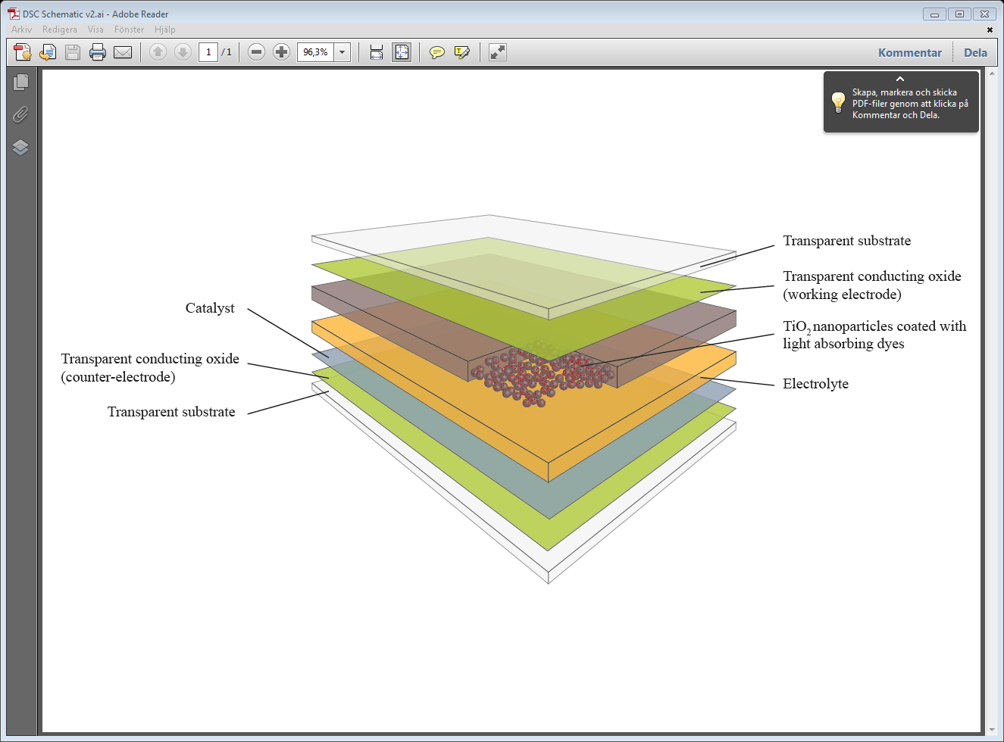
Transparent substrate
Catalyst
Transparent conducting oxide (Working Electrode)
Transparent conducting oxide (Counter Electrode)
TIO₂ nanoparticles coated with light absorbing dyes
Electrolyte
Transparent substrate

Slide 2
Working Electrode
Light (Natural / Artificial)
Counter Electrode
e
TiO₂
3I⁻
LUMO
e
e
e
I₃⁻
e
Electrolyte
e
e
e
HOMO
e
e
DYE
e
e
e
e
e

Slide 3
Working Electrode
Light (Natural / Artificial)
Counter Electrode
e
TiO₂
3I⁻
LUMO
e
e
e
I₃⁻
e
Electrolyte
e
e
e
HOMO
e
e
DYE
e
e
e
e
e

Slide 4
Performance
World
record
efficiency
Module
efficiency
Sensitivity to light
angle and condition
Sensitivity to
temperature
fluctuations
1st generation PV
Mono-
crystalline
silicon
30.0%
19.5%
High
- 0.53% / ᵒC
Multi-
crystalline
silicon
18.0%
13.0-15.0%
13.0-15.0%
High
High
- 0.44% / ᵒC
- 0.44% / ᵒC
17.3%
13.5%
Medium
- 0.27% / ᵒC
2nd generation PV
Cadmium
telluride
- 0.27% / ᵒC
CIGS
20.3%
15.1%
Medium
- 0.42% / ᵒC
Amorphous
silicon
13.0%
5.0-7.0%
Medium
- 0.20% / ᵒC
3rd gen.
DSCs
14.14%
(15%)
10.3%
Low
+ 0.1% / ᵒC

Slide 5
Heat-sink
LED Lamps
White Light
Enclosure
Solar Cell
LUX Meter
0.0A 0.0V
0.0A 0.0V
Test Equipment
Brightness Control (Power Supply)

Slide 6
LED array
Adjustable intensity
DSC array
PC Running LAB View to automate data collection
Test Equipment
0.0A 0.0V
0.0A 0.0V

Slide 7
f(x)
y
a
max
p₁
p₂
b
x
α
β
β
α
a
p₁
p₂
b
a
p₁
p₂
b
a
p₁
p₂
b
a
p₁
p₂
b

Slide 8
a
max
p₁
p₂
b
a
p₁
p₂
b
a
p₁
p₂
b
a
p₁
p₂
b
a
p₁
p₂
b

Slide 9
Background and Problem Definition
Dye-sensitized solar cells
Dye-sensitized solar cells (also known as Grätzel cells) ooriginated from research done by Professor Michael Grätzel in Switzerland in the early 1990s
Porous layer of interconnected TiO₂ nanoparticles is electrically attached to a front contact
Light absorbing dye-molecules are coated onto the surface of the TiO₂ particles
An electrolyte solution permeates the porous TiO₂ and contacts the front- and back contact between the two sandwiched electrodes
Transparent substrate
Catalyst
Transparent conducting oxide (front contact)
Transparent conducting oxide (back contact)
TIO₂ nanoparticles coated with light absorbing dyes
Electrolyte
Transparent substrate
Operation
Sunlight enters the cell through the transparent substrate, striking the dye on the surface of the TiO2
The dye-molecules absorb photons with enough energy and inject electrons into the TiO₂ particles
The electrons diffuse through the TiO2 particle network and via an external circuit they reach the catalyst
The electrolyte solution captures the electrons at the catalyst and then transfers the electrons back to the dye molecules in order to complete the electrical circuit
3
Picture Source : i. Exeger

