Slide 1
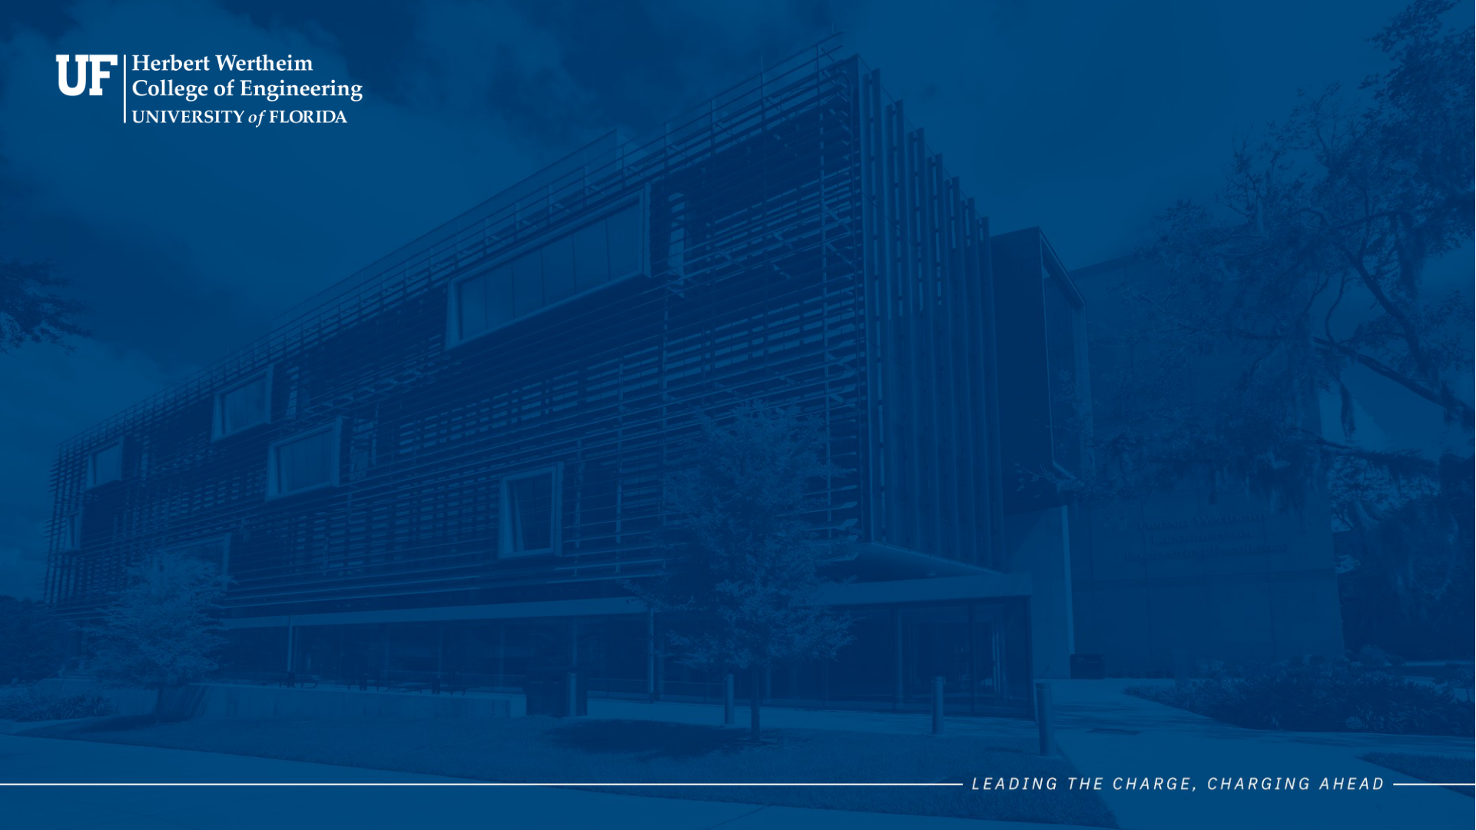
2026 | THREE MINUTE THESIS
Giving Robots Room to Move
Obstacle-Centric FPGA Acceleration for
Deterministic Map Inflation in Robotic Navigation
Audrey Cyrielle Moguem Souop
Department of Electrical and Computer Engineering

