Slide 1
Agenda
1. For Team:
Winning and Score predictor (WASP) using predictive analysis to predict the result
of the match based upon various factors like team record against opposition,
venue where match is being played etc.
2. For Individual Players:
Predicting final Innings score of respective team based upon average statistics
of respective players impact in average conditions.

Slide 2
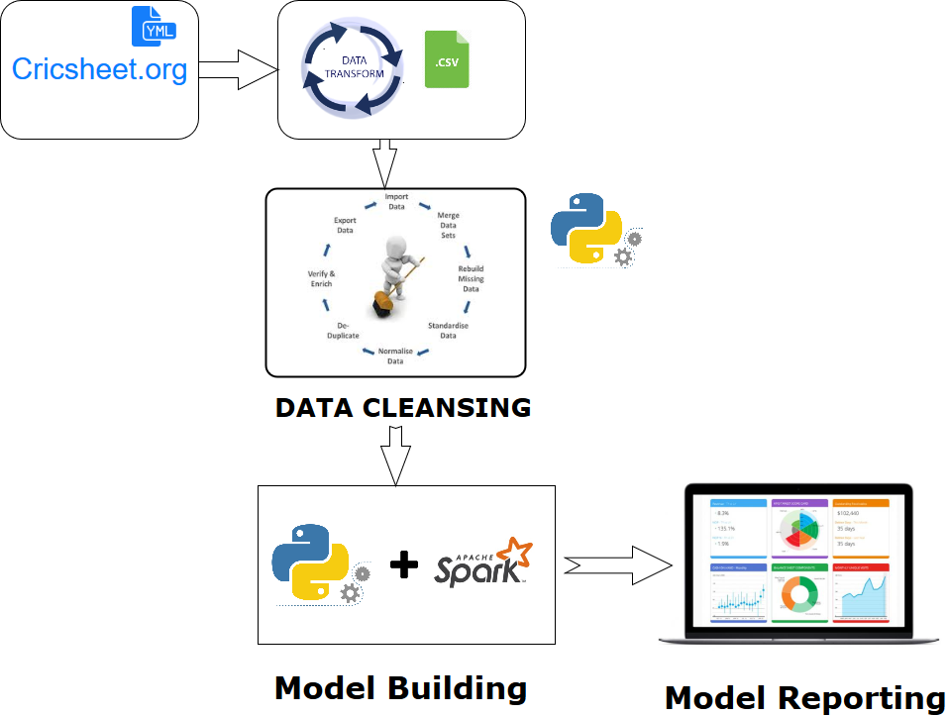

Slide 3
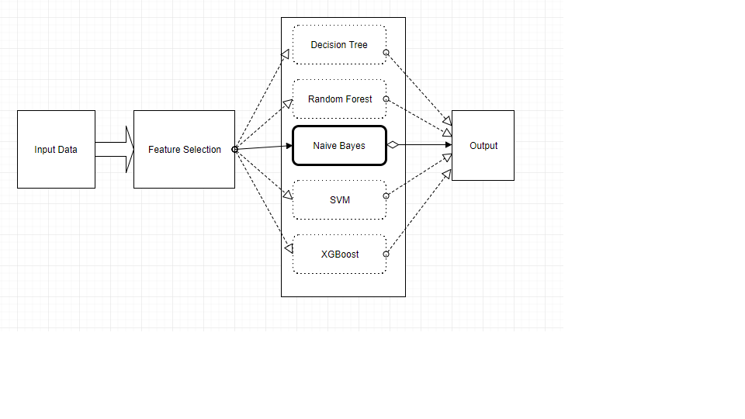
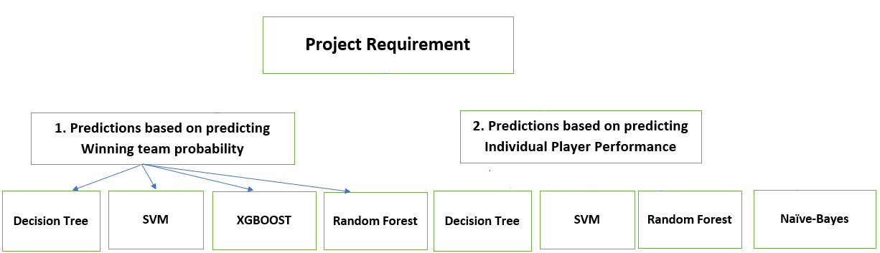

Slide 4
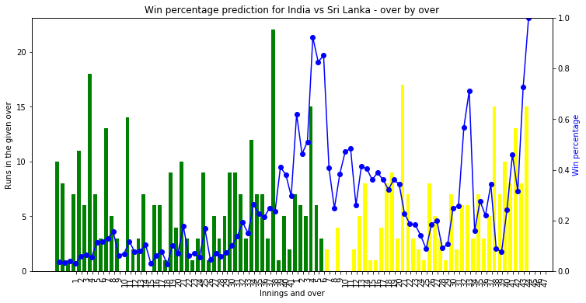
1. Predictions based on predicting Winning team probability.
Features Used:
1. Team batting First
2. Home ground Conditions
3. Runs chased/scored in the matches.
Toss Winner
1. 1st Innings Score
2. Number of Wickets Fallen
3. Past History of Matches played between 2 teams
4. Over by Over comparison between number of wickets and run scored by each team. 5.Current Run Rate and Required Run Rate
Notes:
Batting 1st Team sri Lanka, India won by 7 Wickets.

Slide 5
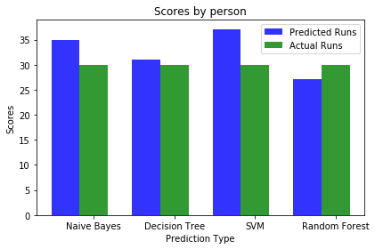
2.1 Predictions based on predicting how much runs player will score.
Actual Scored | Predicted Score
25 | 31
31 | 29
2 | 0
1. Balls Faced
2. Team
3. Home or Away Ground

Slide 6
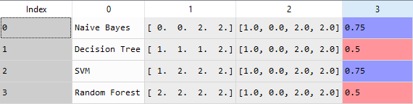
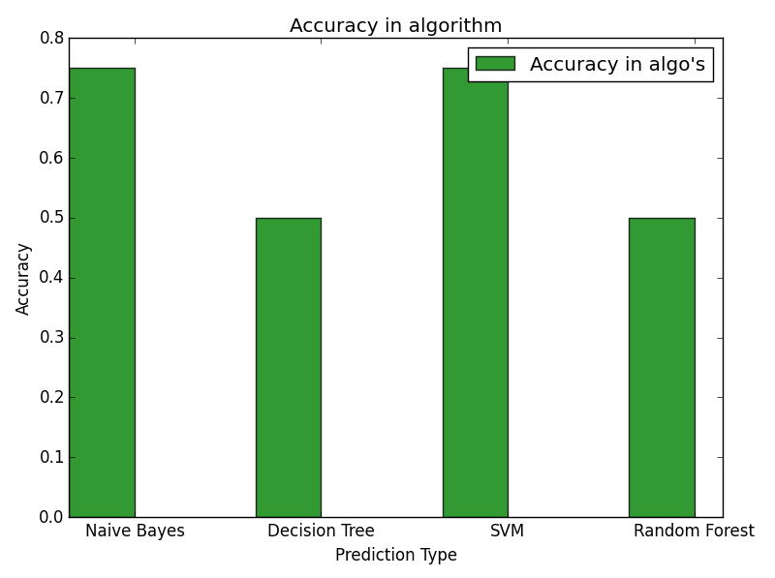
2.2 Predictions based on predicting how much wickets a bowler will score.
Feature Selection Criteria:
Runs Conceded
Overs

Slide 7
WHAT IS THE MARKET NEED OF PROJECT
1.Our project can be produce effective value for money in Betting Institutions and Fantasy leagues like Dream11, IPL fantasy leagues etc.
2.It can even assist IPL franchises for comparative analysis to determine which Player should they invest upon and who will be better will be better value for money.

