Slide 1


Slide 2
Introduction
Wal-Mart Stores, Inc is an American Multinational retail corporation that operates a chain of discount department stores and Warehouse Stores.

Slide 3
Objective
The aim of this project is to enable category managers of Wal-Mart to check weekly sales and monthly sales of departments. Analysis includes the effect of the markdown on sales , and also the extent of effect on sales by fuel prices , temperature unemployment , CPI etc has been analyzed using simple and multiple linear regression models .

Slide 4
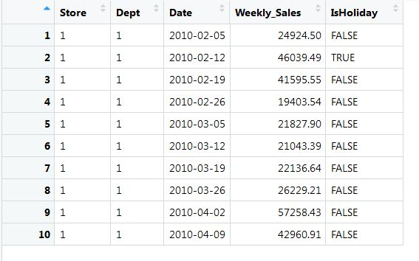
Datasets Utilised
Train.csv

Slide 5
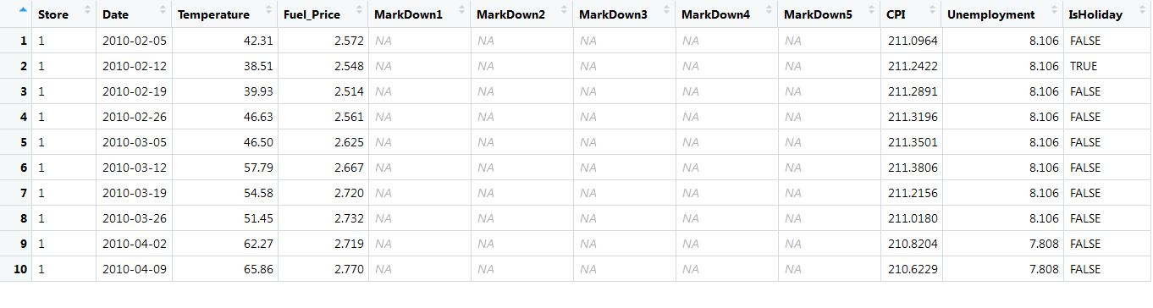
Features

Slide 6
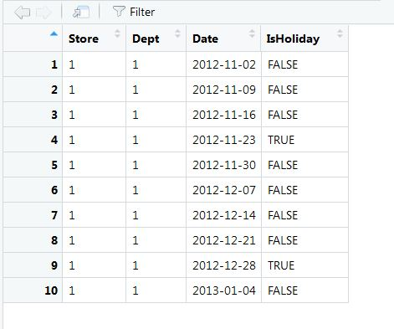
Test

Slide 7
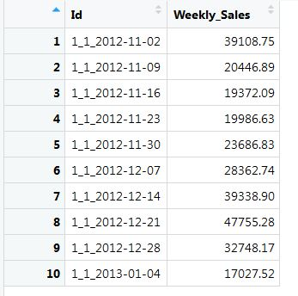
Result

Slide 8
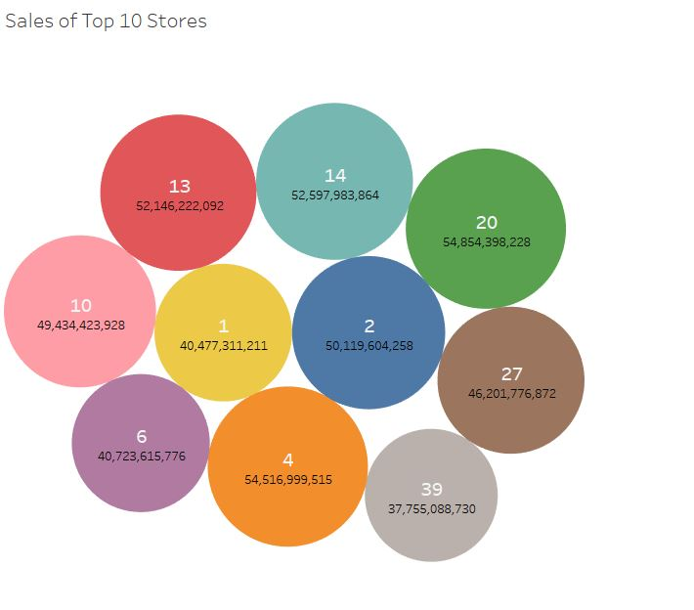

Slide 9
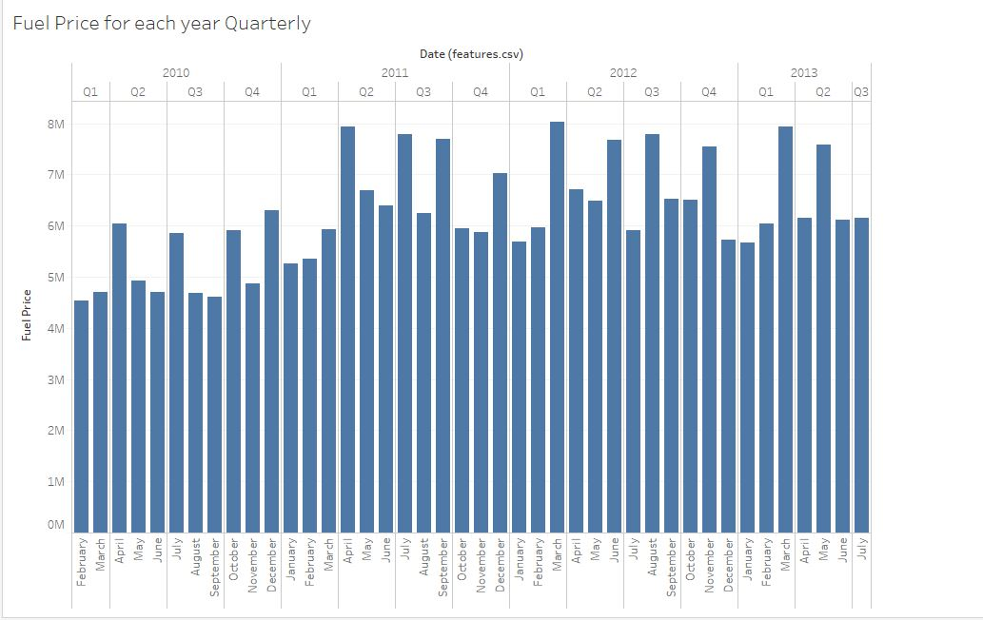

Slide 10
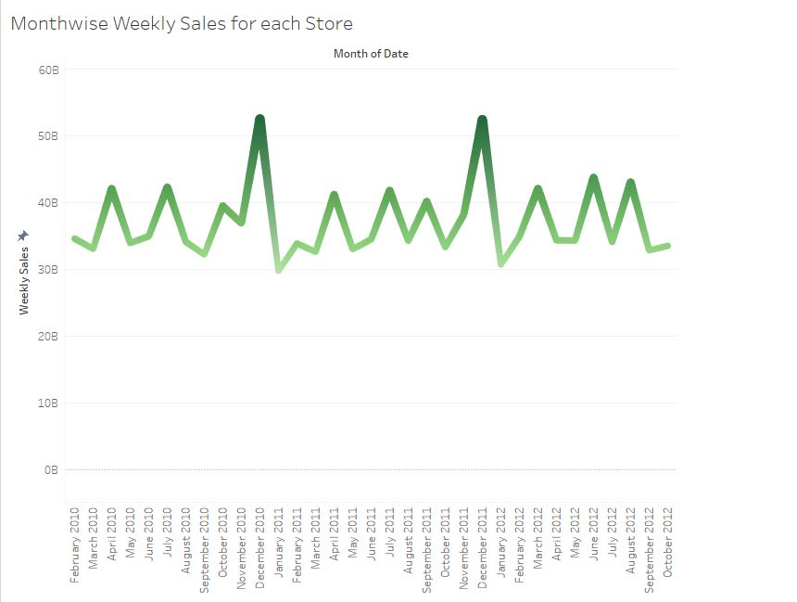

Slide 11
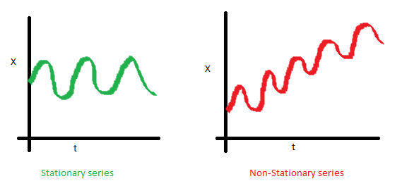
How to check time series is stationary or Not?
Is the Mean constant ?

Slide 12
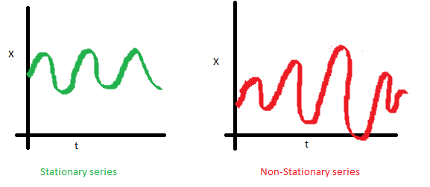
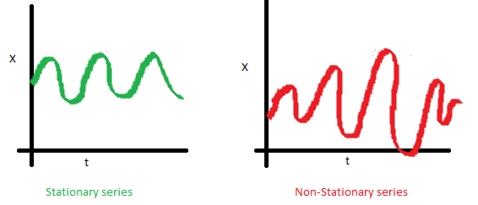
Is the Variance constant?
Is the covariance constant?

Slide 13
The two most common ways to make a non-stationary time series curve stationary are
Differencing
In order to make your series stationary, you take a difference between the data points. So let us say, your original time series was:
X1, X2, X3,...........Xn
You series with difference of degree 1 becomes:
(X2 - X1, X3 - X2, X4 - X3,.......Xn - X(n-1)
Transformation
If you can not make a time series stationary, you can try out transforming the variables. Log transform is probably the most commonly used transformation

Slide 14
Time series components
Trend
A trend exists when there is a long-term increase or decrease in the data. It does not have to be linear. Sometimes we will refer to a trend “changing direction” when it might go from an increasing trend to a decreasing trend.
Seasonal
A seasonal pattern exists when a series is influenced by seasonal factors (e.g., the quarter of the year, the month, or day of the week). Seasonality is always of a fixed and known period.
Cyclic
A cyclic pattern exists when data exhibit rises and falls that are not of fixed period. The duration of these fluctuations is usually of at least 2 years.

Slide 15
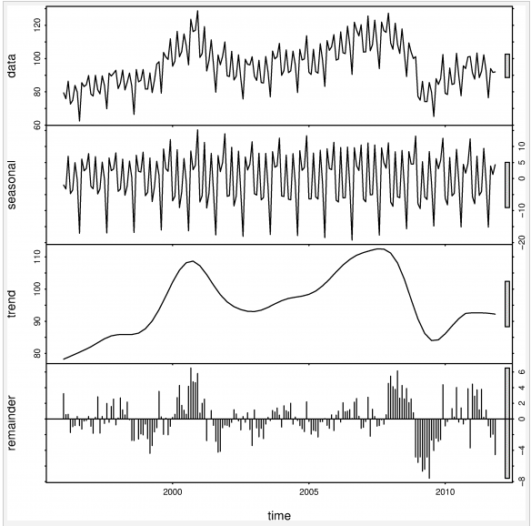

Slide 16
STL decomposition
Seasonal and Trend decomposition using Loess
Loess is a method for estimating nonlinear relationships
STL has several advantages over the classical decomposition method and X-12-ARIMA:
Unlike X-12-ARIMA, STL will handle any type of seasonality, not only monthly and quarterly data.
The seasonal component is allowed to change over time, and the rate of change can be controlled by the user.
The smoothness of the trend-cycle can also be controlled by the user.
It can be robust to outliers (i.e., the user can specify a robust decomposition). So occasional unusual observations will not affect the estimates of the trend-cycle and seasonal components. They will, however, affect the remainder component.

Slide 17


Forecasting with decomposition
While decomposition is primarily useful for studying time series data, and exploring the historical changes over time, it can also be used in forecasting.
Additive decomposition
Where is the seasonally adjusted component

Slide 18


Multiplicative decomposition
Where
To Forecast decomposed Time series ,we separately forecast the seasonal component and seasonally adjusted component.
To forecast the seasonally adjusted component, any non-seasonal forecasting method may be used. For example, a random walk with drift model, or Holt’s method or a non-seasonal ARIMA model

Slide 19
Approach
Time Series Model
ARIMA model (Auto Regression Integrated Moving Averages)

Slide 20
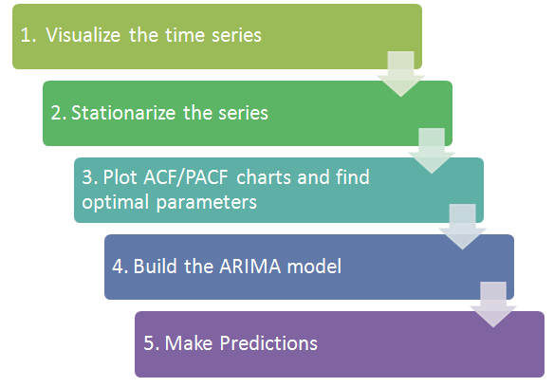
Time Series Model

Slide 21
Time series models are very useful models when we have serially correlated data.
Model can be:
Stationary
Random walks
Rho Coefficient

Slide 22
ets() function:
Can handle any combination of trend and seasonality.
Produces prediction intervals for every model.
Produces an object of class ets.
Methods: coef(), plot(), summary(), residuals(), fitted() and forecast()

Slide 23
stlf: Forecasting using stl object
Forecasts of STL objects are obtained by applying a non-seasonal forecasting method to the seasonally adjusted data and re-seasonalizing using the last year of the seasonal component.
STL decomposition method is used for estimating nonlinear relationships.
It can handle any type of seasonality, not only monthly and quarterly data.

Slide 24
How to seasonally adjust the data
Select key features from test dataset that is unique dates, number of dates, unique store numbers, number of store numbers and department numbers.
Construct a data frame df1 with dates corresponding to store number and all stores corresponding to all dates.
Create a variable with all data set of test plus a column weekly sales initialized to zero.
Similarly perform some operation with train data.
Select date, number of dates

Slide 25
How we process data primarily
Create data frame df2, containing dates corresponding to number of stores, store numbers corresponding to dates
Now for each department of test data, add store, date, weekly sales column to df1. Cast date and store. Make weekly sales to 0 for df2 after adding weekly sales column. Again cast date and store.
Add df1 and df2.
Melt the result.

