Slide 1
Fundamentals of Neural Networks
The Perceptron
Cyril Akafia

Slide 2
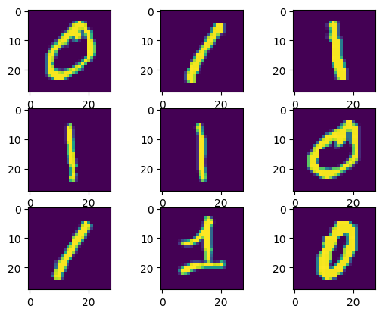
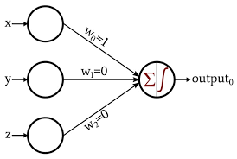
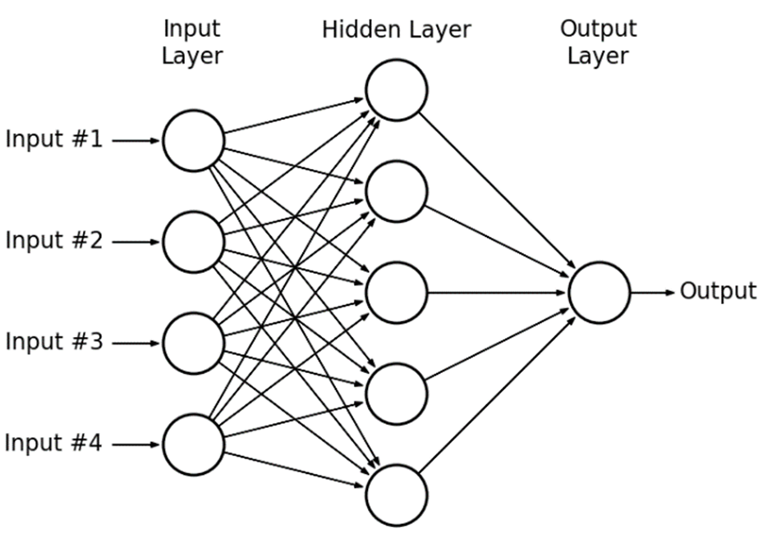
Solving an image classification task with a Perceptron
Ultimately, my goal was to learn how perceptron’s learn

Slide 3
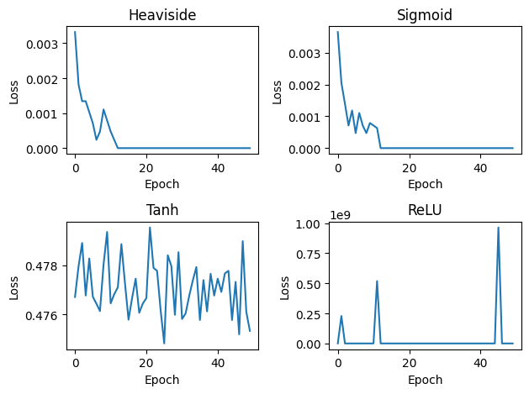
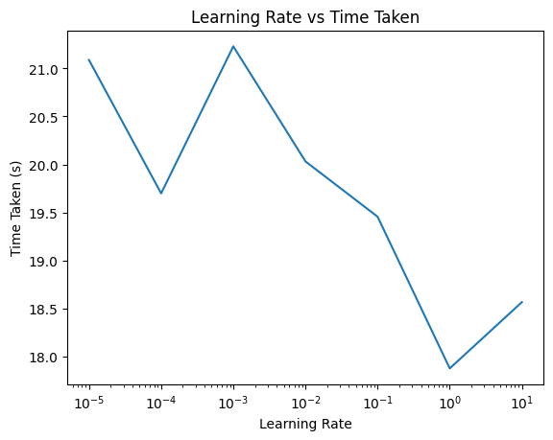
The Perceptron

Slide 4
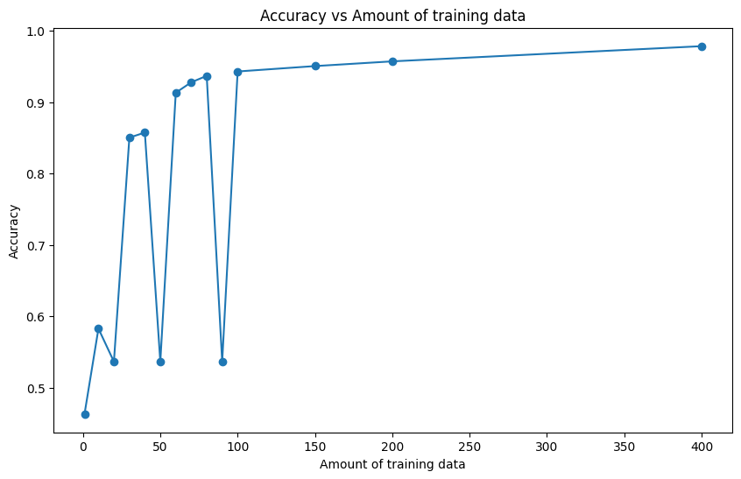
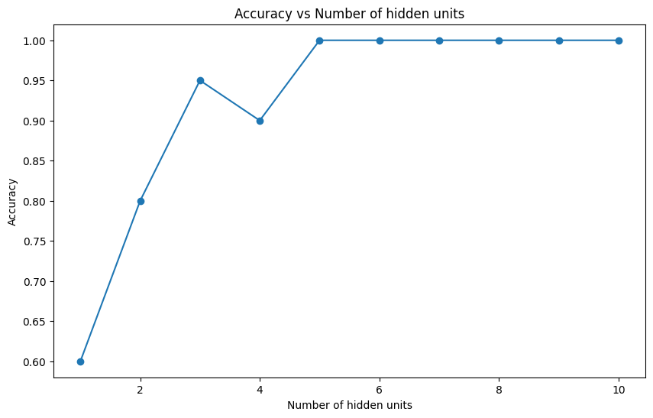
The MLP
Amount of training data ∝ Performance
No. of hidden layer units ∝ Performance

Slide 5
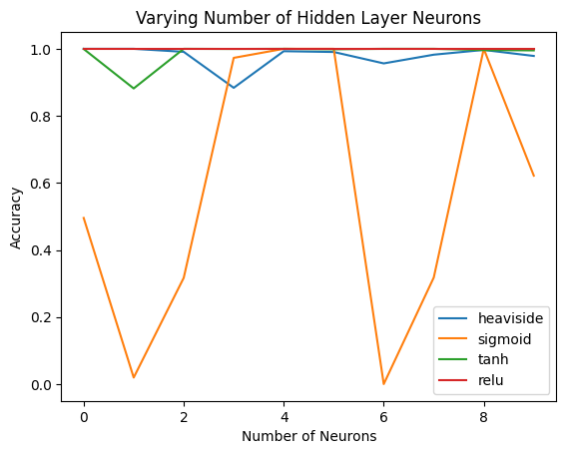
The MLP

Slide 6
Conclusion
Perceptron (MLPs) are capable of performing ‘complex’ tasks.
The chain rule is great!

