Slide 1


Project KAYAK
CDSD block 1
Cyril Braguy

Slide 2
Goal of the project
Pitch
Goal
Design a travel application, a search engine to recommend the best trip destinations within a list of 35 cities to visit in France, from reliable informations on :
Best weather forecast,
hotel rooms availability in these destinations
Get info on cities : GPS coordinates
Get weather data of cities at 5 days
- order cities by weather results
- select best 5 cities
Get hotels info about each destination
Store all the information above in a data lake : one file .csv
Extract, transform and load cleaned data from your datalake to a data warehouse
Display these informations on a nice frontend

Slide 3
Detailed pipeline :
1. Cities + weather
35 cities list → get lat & lon from nominatim.org → dataFrame
Get weather data of cities at 5 days in 3 hrs slots from openweathermap.org [ D to D+4 ]
Average weather data on each time window eg : [ D+1 – D+4] & [ D+3 – D+4 ]
  groupby data on each day (average, sum, max)
  Compute a weather comfort score
  order cities by weather comfort score
  select best 5 cities : weather_avg[‘selected’] =1
Store in a .csv file on S3

Slide 4
Detailed pipeline :
2. Hotels
boking_scraper.py : A special tool developed to scrape booking.com :
using playwright
  [city, checkin, checkout, nb_adults, nb_children, nb_rooms]
  → 5 hotels w/ several informations :
  [ hotel_name,url_hotel,address_hotel,hotel_description,lat_hotel,lon_hotel,score_hotel,price_hotel,currency_hotel,room_description,hotel_city,combined_score_hotel ]
Combined_score = score_hotel - p * (price_hotel - max_price).clip(lower=0)
Store all the information above in a data lake : hotels_top20_cities.csv

Slide 5
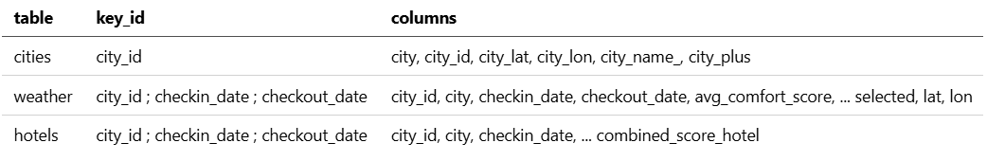
Detailed pipeline
3. ETL & SQL database
Load last hotels_top20_cities.csv
Save information in 3 sql tables to respect unicity principle :
cities weather hotels

Slide 6
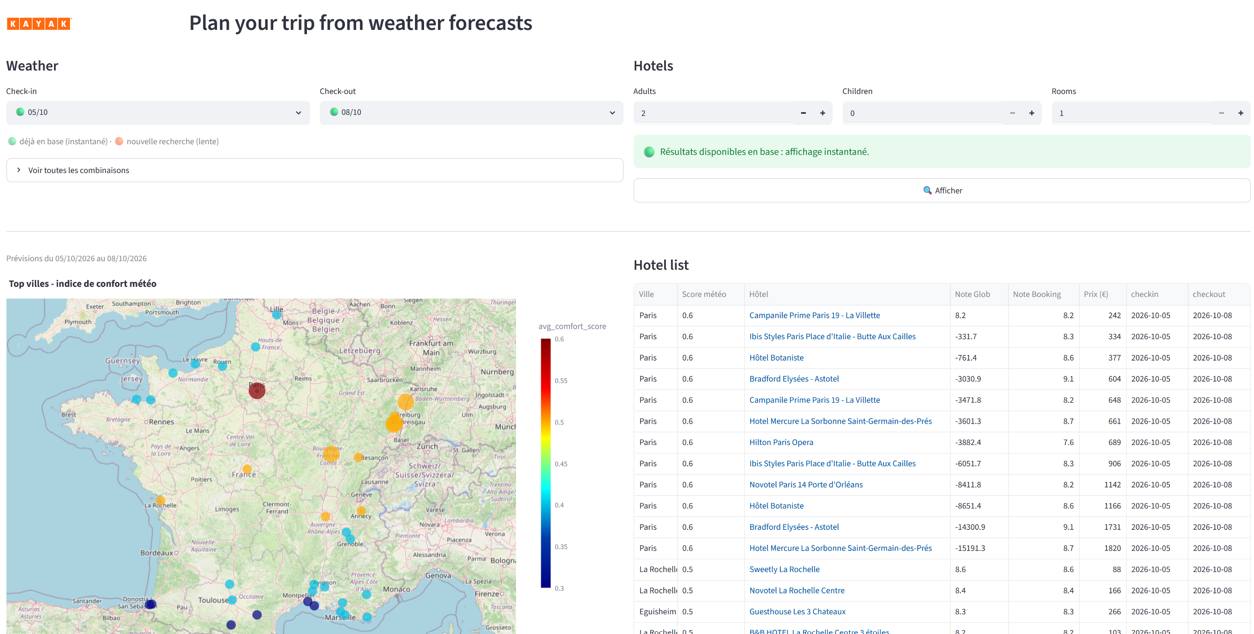
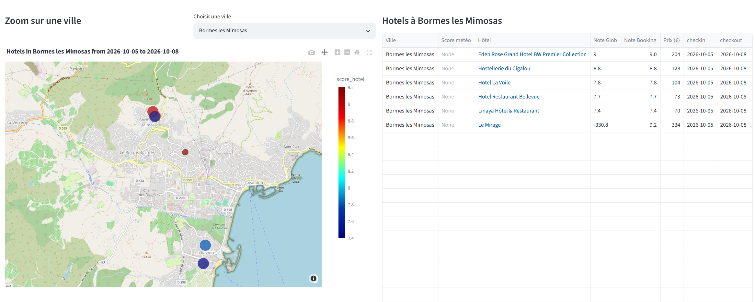
Detailed pipeline
4. Frontend
A streamlit frontend is used
Reads sql database and displays filtered and ordered data
1 : weather & best cities
displays best cities w/ color map & bigger marker size
& hotels list by order of
2 : select one cities ; view hotels list
order by combined_score

Slide 7
Complete solution
An application in a Docker container in huggingface space
1 : pipeline linear get weather hotels ;
ETL : cron 6h & 18 h ; store in S3 & neon SQL dB
2 : Streamlit frontend to print results for customer
Git repo for code store & version
Github_action to deploy in HuggingFace space at push
S3 bucket Sql database on NeondB

