Slide 1


Conversion rate challenge
CDSD certification Bloc 3
Cyril Braguy · Date 07/11/2026

Slide 2
Introduction et objectif
Introduction
This is a machine learning competition.
www.datascienceweekly.org is a famous newsletter on which anyone can register to receive weekly news about data science.
The data scientists creators of the newsletter would like to understand better the behaviour of the visitors regarding conversion to newsletter by building a predicting model from a few information.
They organised a competition by sharing datasets, and decided to evaluate results with f1 score..
Goal of the project
1. EDA ; preprocessing and train the baseline with the file data_train.csv
2. improve your model's f1-score on your test set: (feature engineering, feature selection, regularization, non-linear models, hyperparameter optimization by grid search, etc...)
3. make some predictions with data_test.csv (and dump it to your teacher/TA 🤓). several submissions are made with different models !
4. Analyze your best model's parameters.
Propose actions that would help to improve the newsletter's conversion rate, Make recommendations to the team

Slide 3
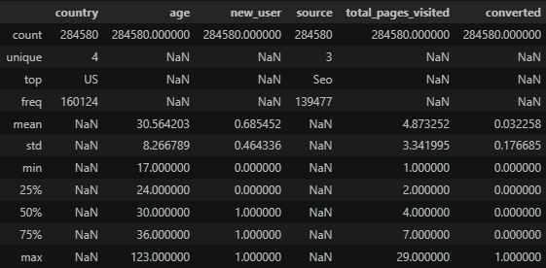
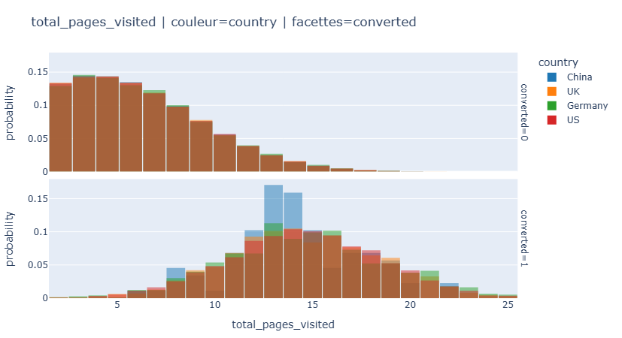
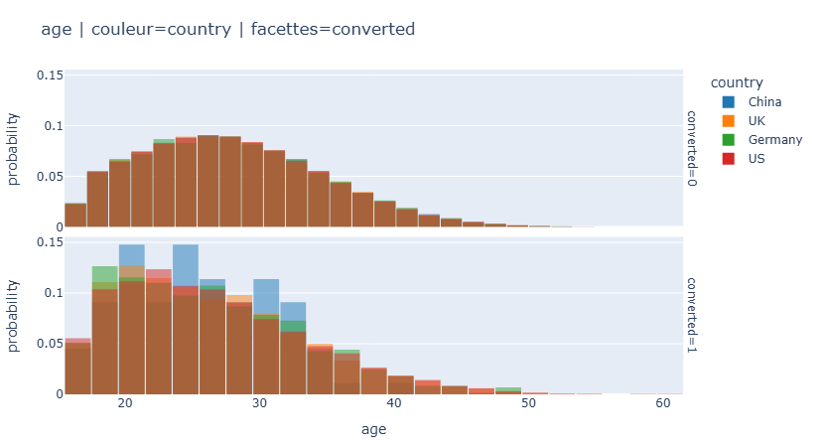
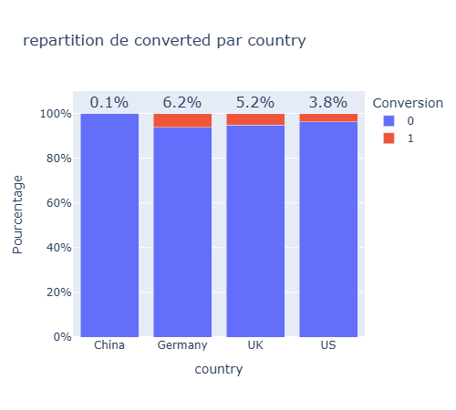
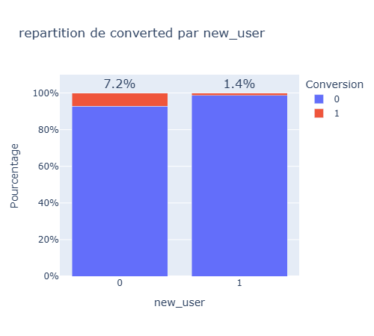
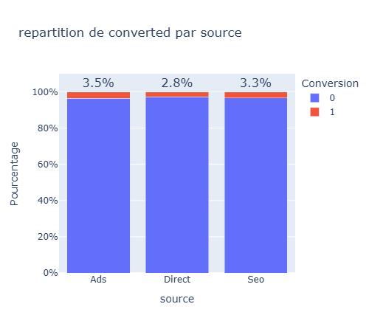
1 - EDA Exploratory Data Analysis
Quite big Dataset: 280 k lines
5 features & 1 target label (converted)
Average conversion rate : 3.22%
Clean data from outliers : keep age <= 75
total_pages_visited <= 25
Age and pages_visited look to have an impact
on conversion
China repartition curves looks different and strange compared to other countries
=> main impacting feature is
total_pages_visited
Then age and new_user
Slight impact from country (especially China) and source

Slide 4
1 - train baseline and first level of optimisation
Nr | Model | Remove outliers | Features | F1 train | F1 test
0 | Logistic | 0 | total_pages_visited | 0.69
1 | Logistic |  | all | 0.76 | 0.757
2 | Logistic |  | All - age | 0.74
3 | Logistic + gridsearch |  | All | 0.7649 | 0.7568
4 | Random Forest+gs |  | All | 0.778 | 0.7563
5 | Random Forest+gs |  | All | 0.7727 | 0.7609
8 | Bagging +logreg |  |  | 0.7411 | 0.7426
11 | Adaboost + logistic |  |  | 0.6326 | 0.6372
12.2a | XGBoost |  | All | 0.7666 | 0.7608
First model baseline is using a logistic regression with one feature : total_pages_visited
then with all features
Then gridsearch is tested with several features and others models
Best result at this simple stage is given by
Random Forest with with gridsearch with all features gives a pretty good result

Slide 5
2- Improve model : Feature engineering & feature selection
improve the model's f1-score on our test set:
A specific pipeline is built to allow automatic searching : FeatureEngineer → Preprocessor → Classifier
Several tests are launched to evaluate effect of:
feature engineering : no significant effect
regularization : small effect
non-linear models: random forest, XGBoost,
hyperparameter optimization by grid search :
sensible effect
XGBoost is identified as the best performer model
Feature importance is also used to best locate most efficient features and re-run the model fit
Example on model 16a XGBoost:
Nr | Model | params | Features | F1 train | F1 test
12.2a | XGBoost |  | All | 0.7666 | 0.7608
12.2b | XGBoost | Threshold on Xfull | All | 0.7722
13 | XGBoost |  | pages, country & new_user | 0.7504 | 0.7404
14a | XGBoost |  | country, new_user, total_pages_visited, age | 0.767167 | 0.759203
14b | XGBoost | Threshold on Xfull |  | 0.77047
15 |  | + stacking & bootstrap |  | 0.7718 | 0.7608
16 | XGBoost | rmoutl | country, new_user, total_pages_visited, age + pages*new_user | 0.7671 | 0. 75920
num__total_pages_visited | 0.650471
cat__country_China | 0.163329
num__new_user | 0.13485
num__age | 0.025033
cat__country_US | 0.016332
cat__country_UK | 0.006276
cat__country_Germany | 0.003708

Slide 6
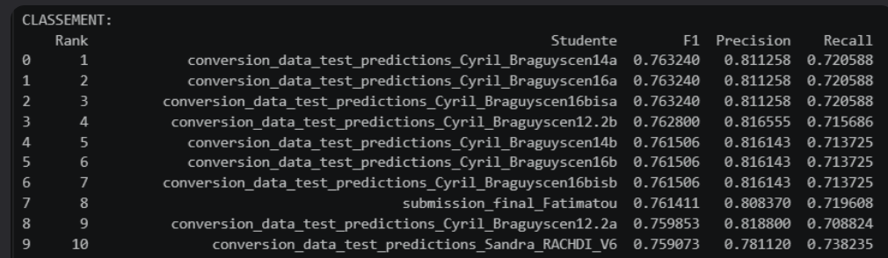
3 - make some predictions with data_test.csv and submit
Several models and parameters are tested
Predictions are computed with data_test.csv (and dump to our teacher/TA 🤓 Pietro Scalisi).
Some small variations are also tested :
Train model on X_train -> f1-score
Test model on X_test -> f1-score
Re-train model on X_full = [X_train, X_test]
Possible to recompute best threshold on X_full
Models 14a & 16a give equivalent results
with my best f1-score at a pretty good level
But just 1% margin better than model N°1 logistic regression

Slide 7
4. Analyze best model's parameters.
Best model is version 14a / 16a :
Model : XGBoost
Features : country, new_user, total_pages_visited, age + rmoutl
Feature engineering : pages*new_user
Hyperparameters : 'clf__colsample_bytree': 0.85, learning_rate': 0.05,
max_depth': 4,
n_estimators': 200,
subsample': 0.85
F1-train : 0.7671 ; f1-test : 0.75920
best_threshold: 0.41 ; f1_test_opt : 0.76833
F1 data_test : 0.763240 ;
Feature importance:
num__total_pages_visited | 0.650471
cat__country_China | 0.163329
num__new_user | 0.13485
num__age | 0.025033
cat__country_US | 0.016332
cat__country_UK | 0.006276
cat__country_Germany | 0.003708
Conclusion :
Conversion rate is highly linked on number of pages visited, then on second order if user is from China or not, and if user is new.
Then on a third order : age (young people convert more)
Actions Proposal to help to improve the newsletter's conversion rate :
Implement a different navigation experience on website in function of conversion ML prediction to propose some conversion messages differently from ML prediction.
improve the website / information for low converting people : those from China ; not new users, older people,

