Slide 1
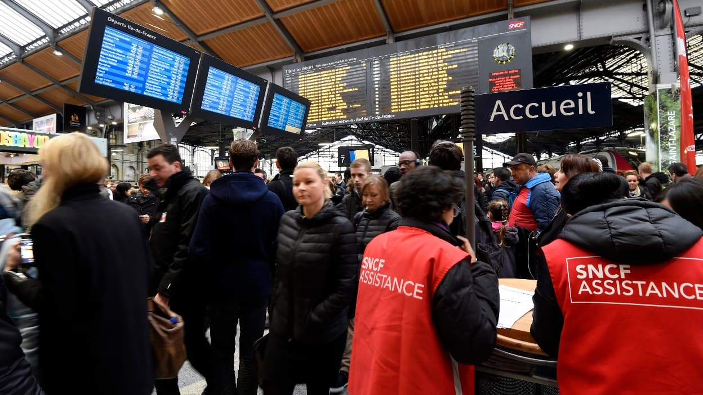
TRANSILIEN SNCF
SNCF Delay Prediction
Machine Learning for Finance
Monestier – Ferlus - Muhammad

Slide 2
The Problem
Concrete Scenario
ML Formulation
Train T1 stops at station G1 at stop #3, on March 15, 2023.
How many minutes will this train actually wait compared to its scheduled time?
1
Target
p0q0 = actual wait - scheduled wait
2
Inputs
Past delays of same train & same stations
3
Metric
MAE (Mean Absolute Error) in minutes

Slide 3
The Data
667,264
11
training
observations
available
features
Key Variables
train / station / date / stop
Contextual identifiers of the trip
p2q0, p3q0, p4q0
Delays of trains T-2, T-3, T-4 at the same station
p0q2, p0q3, p0q4
Delays of train T1 at previous stops (-2, -3, -4)
p0q0
TARGET - actual vs scheduled wait time (in minutes)

Slide 4
Feature Cleaning
1
Exploratory Analysis
2
Outlier Detection via PCA + K-Means
Heavily left-skewed distribution for p3q0 / p4q0
-> Presence of extreme outliers
PC1 : 30% variance explained
Cluster 1 = 807 outlier points -> removed
3
Tested & Rejected Hypothesis
4
Linear relationship historical delay <-> current delay?
Result: highly scattered data, weak R-squared

Slide 5
Models & Results (MAE)
Best Model
XGBoost + Optuna
MAE = 0.764 min
Hierarchical Strategy
Global base model -> Refinement per station (>1000 pts) -> Refinement per (station, stop) (>1000 pts) -> Fallback to best previous model if worse

Slide 6
Conclusion
V
667K observations processed, 807 outliers removed via PCA + K-Means
V
XGBoost (Optuna): MAE 0.764 vs 0.866 for linear regression baseline
V
Hierarchical approach: global model -> station -> (station, stop)

